Slide 1

YouTube Transcript Summarizer Using Machine Learning and Natural Language Processing
Amrutvahini College of Engineering, Sangamner
Department of Computer Engineering
Presented by: Pratiksha Hase Shreya S Gumaste
SUYash gunjal sanket Ahire
College name :Amrutvahini college of engineering

Slide 2
Contents :
Abstract
Introduction
Literature survey
Architecture
Proposed Approach
Methodology
Performance metrics
Validation & Testing
Conclusion
References

Slide 3
Abstract :
The project involves developing a system that summarizes YouTube videos using Machine Learning (ML) and Natural Language Processing (NLP).
The goal is to condense the transcribed text from videos into a summary without missing key points.
The system takes a video's identifier as input and generates a concise summary of the transcript.
The research found that this method of summarization is more efficient than other approaches.

Slide 4
Introduction :
An automatic YouTube transcript summarizer is a tool that generates a summary of the content in a YouTube.
The method involves extracting transcripts from the user-provided video ID.
Utilization of the Latent Semantic Analysis (LSA) Natural Language Computing (NLC) algorithm.
Efficiently extract the key points for the transcript.
Our results show concise and accurate summaries of YouTube videos.

Slide 5
Literature Survey :
Sr. No. | Paper Title | Year | Methods Used | Limitations
1 | Video Transcript Summarizer | 2022 | NLP and Machine Learning | Unable to accurately capture context
2 | Automated Youtube Video Transcription To Summarized Text Using Natural Language Processing | 2023 | NLP and Speech Recognition | It produces errors in noisy environments or with accents, resulting in accurate transcriptions and summaries
3 | Youtube Transcript Summarizer using FLASK and NLP | 2022 | NLP and CNN | The model may require significant computational resources, potentially leading to slower response times and scalability issues
4 | Survey on Abstractive Transcript Summarization | 2021 | Text Summarization and NLP | Generate summaries that are less coherent or accurate due to the complexity of understanding and rephrasing nuanced content.
5 | Text Summarization Using Latent Semantic Analysis | 2021 | NLP and LSA | LSA may over simplify text representations
6 | Natural Language Processing | 2022 | Techniques and NLP | It struggles with understanding and interpreting context-specific nuances, idiomatic expressions and cultural references, leading to potential inaccuracies in the analysis.

Slide 6
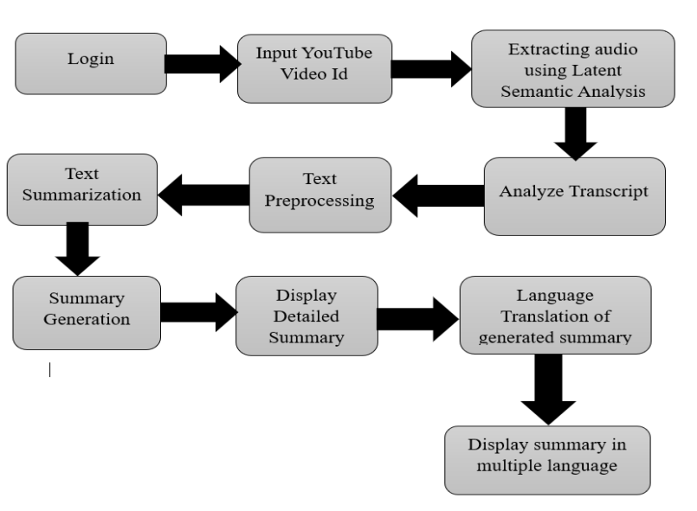
Proposed Approach :

Slide 7
Methodology :
1. User Login: Secure registration and login functionality.
2. User Authentication: Verify login credentials for authorized access.
3. Input Processing: Accept YouTube video IDs.
4. Data Classification: Extract audio and generate transcripts.
5. Training Process: Enhance system performance through transcript training.
6. NLP Algorithm Application: Apply LSA for key sentence extraction.
7. Transcript Analysis: Preprocess and analyze transcripts.
8. Summary Generation: Tokenize and lowercase for summary creation.
9. Summary Display: Showcase generated summaries.
10. Multilingual Translation: Translate summaries for accessibility.

Slide 8
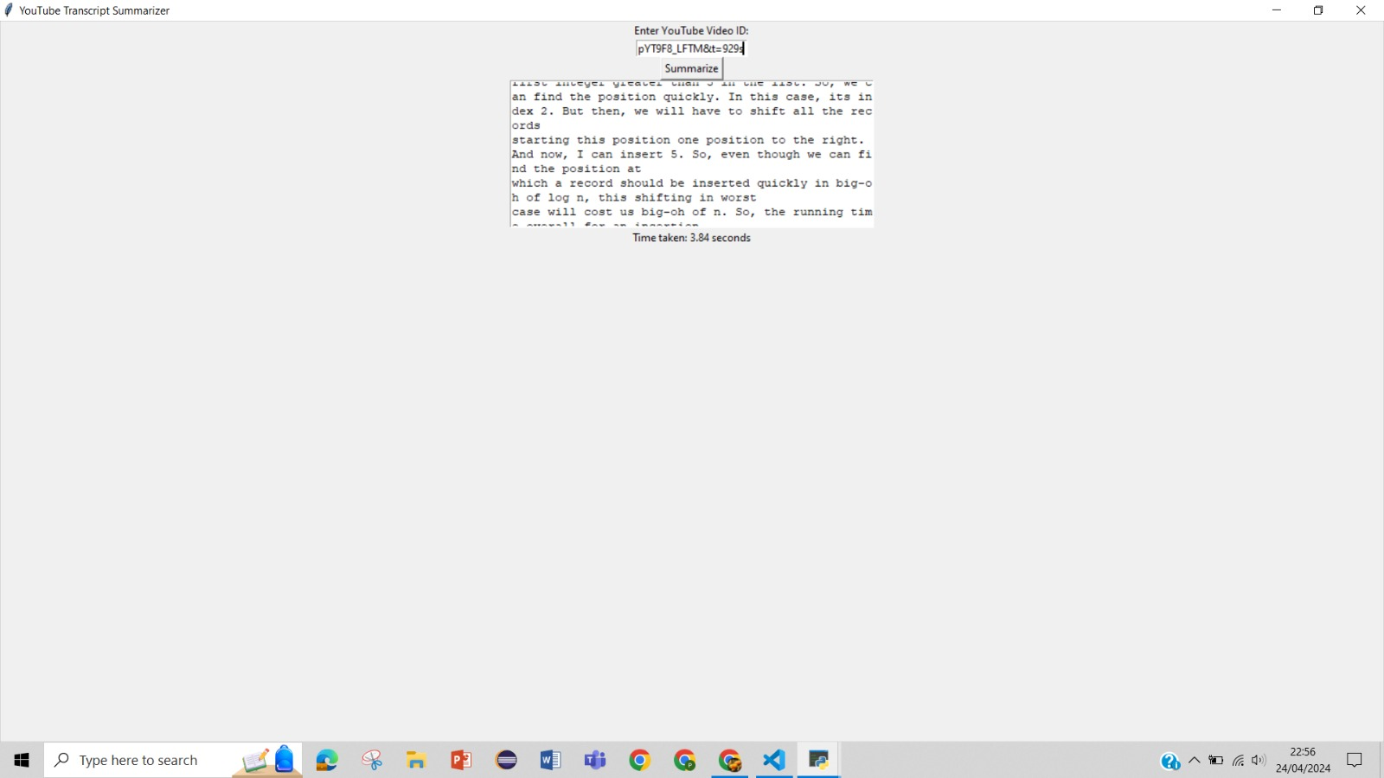
Performance Metrics :

Slide 9
Validation & Testing :
Sr No | Video Name | Video ID | Video Language | Generated Summary Status
1 | Blockchain And Cryptocurrency | MFw8Ax0p7dA | English | Pass
2 | Binary Search Tree | pYT9F8_LFTM&t=928s | English | Pass
3 | SELENA GOMEZ: Mental Health Awareness | QwSGn8A-nd0 | English | Pass
4 | Detailed Roadmap for Machine Learning | 1vsmaEfbnoE | Hindi | Fail
5 | What is Electronics and Communication Engineering | o5UOL65xKZc | Marathi | Fail

Slide 10
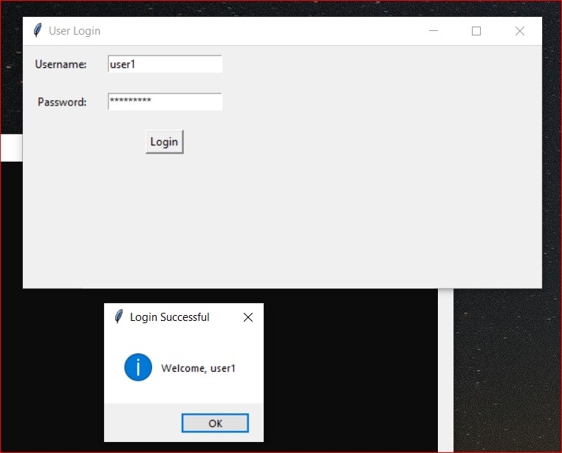
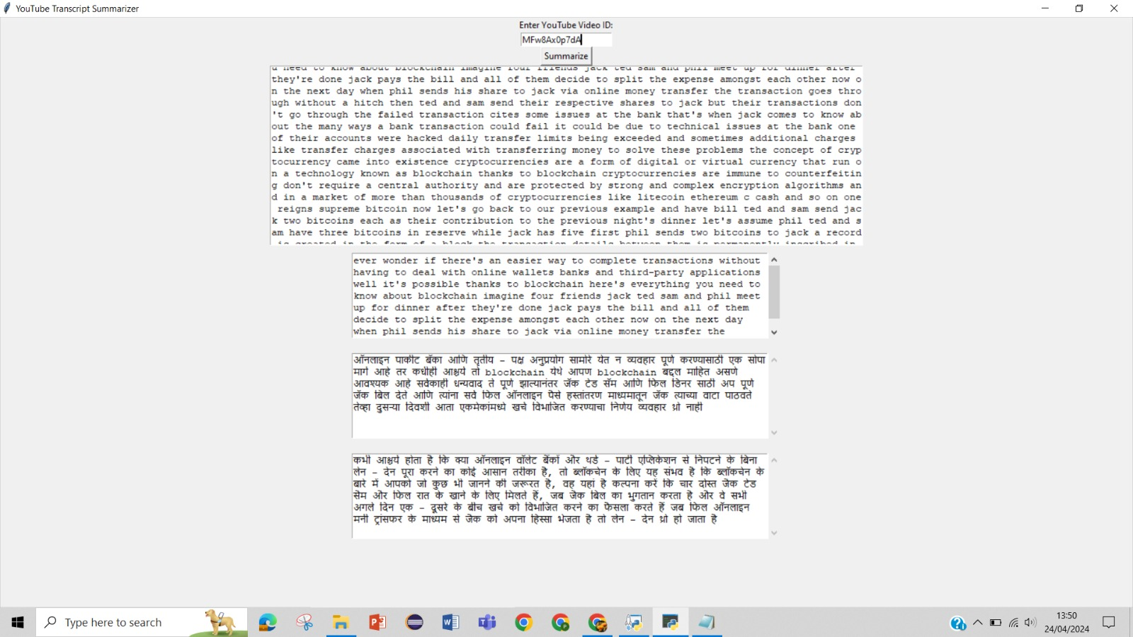
Validation & Testing
Login
Blockchain And Cryptocurrency

Slide 11
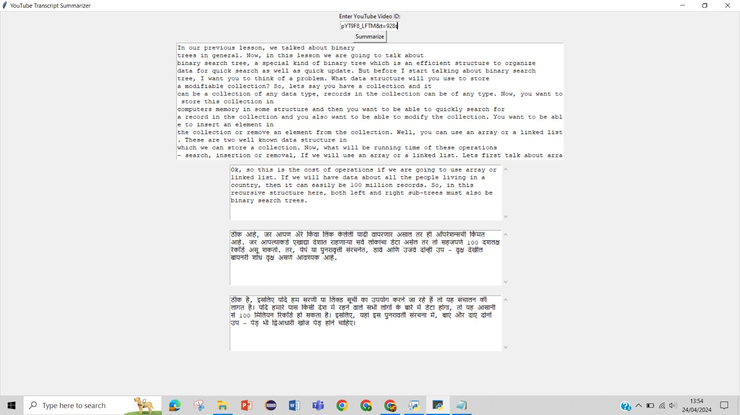
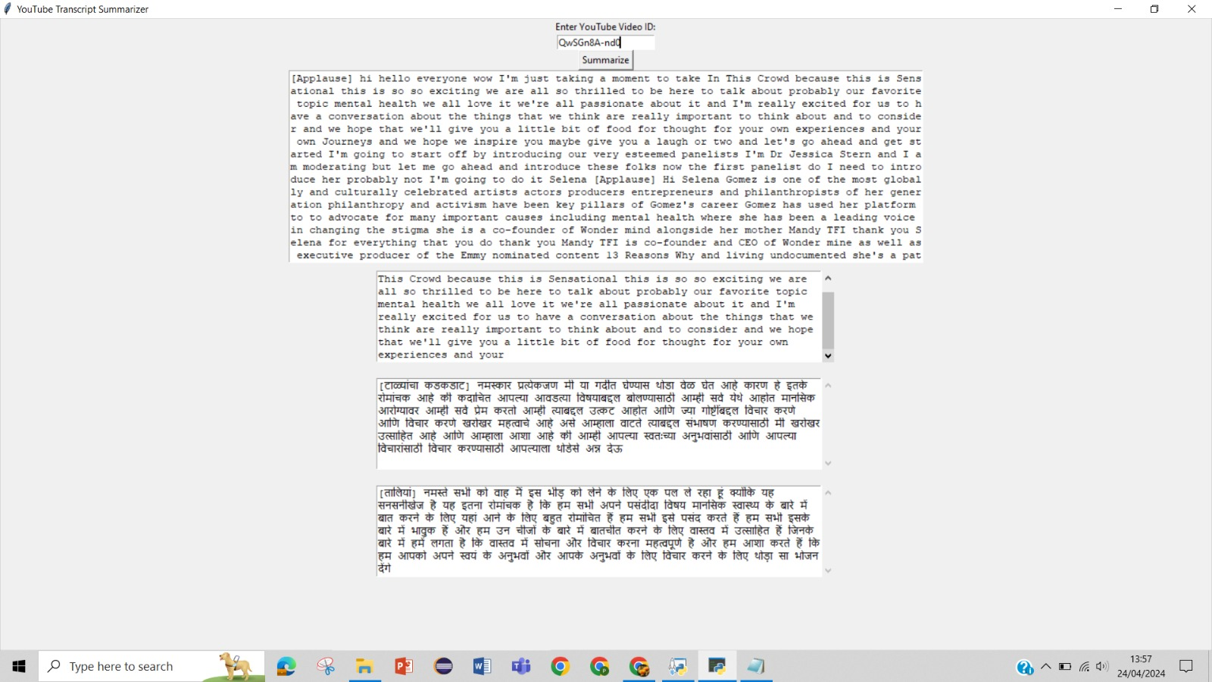
Validation & Testing
Binary Search Tree
SELENA GOMEZ: Mental Health Awareness

Slide 12
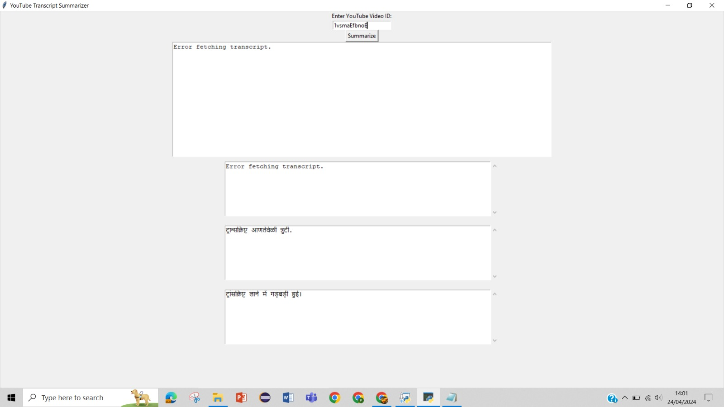

Validation & Testing :
Binary SeaDetailed Roadmap for Machine Learning
What is Electronics and Communication Engineering

Slide 13
Performance Result Analysis and Observations :
Summarization Length : Capture the essence of the video without being too lengthy or too short.
Accuracy : Evaluate how accurately the summarizer captures the main points and themes of the video.
Performance Speed : Evaluate how quickly the summarizer processes the video transcript and generates the summary.
Customization Option: The adjustment of the summary or filtering out certain types of content
Coverage : The summarizer covers all relevant topics and subtopics discussed in the video
Handling Of Multimodal Content : Assess how well the summarizer handles videos with diverse content types, such as interviews, presentations, or tutorials.

Slide 14
Conclusions and Future Work :
The "YouTube Transcript Summarizer" project marks a notable advancement in online video content interaction.
It promises improved accessibility, efficiency, and informativeness for users.
Key sentences are extracted from video transcripts using Latent Semantic Analysis (LSA), enabling concise summaries.
Users can swiftly grasp the essence of video content without watching the entire video, saving time and enhancing the viewing experience.
Future enhancements may include sentiment analysis, topic modeling, and advanced NLP techniques for deeper insights.
Integration of multilingual support and real-time summarization features could expand its global impact.
By addressing current digital media needs and evolving to meet future demands, the project shapes video content consumption and creation dynamics.

Slide 15
References :
A.N. S. S. Vybhavi, L. V. Saroja, J. Duvvuru and J. Bayana, "Video Transcript Summarizer," 2022 International Mobile and Embedded Technology Conference (MECON), Noida, India, 2022, pp. 461-465, doi: 10.1109/MECON53876.2022.9751991.
Foong, O.-M., Yong, S.-P., & Jaid, F.-A. (2015). Text Summarization Using Latent Semantic Analysis Model in Mobile Android Platform. 2015 9th Asia Modelling Symposium (AMS). doi:10.1109/ams.2015.15
Sulochana Devi, Rahul Nadar, Tejas Nichat, and Alfredprem Lucas. Abstrac tive summarizer for youtube videos. In International Conference on Appli cations of Machine Intelligence and Data Analytics (ICAMIDA 2022), pages 431–438. Atlantis Press, 2023.
Eesha Inamdar, Varada Kalaskar, and Vaidehi Zade. Survey paper on youtube transcript summarizer.
Dan Jurafsky. Speech & language processing. Pearson Education India, 2000. [6] Yue Kang, Zhao Cai, Chee-Wee Tan, Qian Huang, and Hefu Liu. Natural language processing (nlp)

