Slide 1
SOMAIYA VIDYAVIHAR UNIVERSITY
K J Somaiya School of Engineering
Somaiya TRUST
CareCompanion
Assistive Companion Mobile Application for Elderly and Disabled Users

Slide 2
SOMAIYA VIDYAVIHAR UNIVERSITY
K J Somaiya School of Engineering
Somaiya TRUST
Group ID - 6
Devanshi Pandey 16014023016 EXCP
Suyash Humne 16014223085 AIDS
Deon Menezes 16014223030 AIDS
Project Guide: Sonali Wankhede (IT/AIDS)
Project Co-Guide: Balwant Kumar Singh (EXCP)

Slide 3
SOMAIYA VIDYAVIHAR UNIVERSITY
K J Somaiya School of Engineering
Introduction / Background
Somaiya TRUST
Elderly and disabled individuals face difficulty:
• Remembering daily medicines
• Maintaining regular activity and hydration
• Accessing help during emergencies
• Finding wheelchair-friendly locations
Caregivers cannot monitor continuously
Hence there is a need for a simple, accessible, integrated solution

Slide 4
SOMAIYA VIDYAVIHAR UNIVERSITY
K J Somaiya School of Engineering
Problem Statement
Somaiya TRUST
• Elderly and disabled users face difficulty managing daily healthcare tasks such as medicines and activities
• Challenges include remembering medicines, maintaining hydration, and accessing emergency help
• Existing mobile applications solve these problems individually, not in an integrated manner
• Most apps are not designed with accessibility as a priority
• Users struggle with small text, complex navigation, and lack of voice/visual assistance
• Hence, there is a need for a simple, accessible, and unified assistive mobile solution

Slide 5
SOMAIYA VIDYAVIHAR UNIVERSITY
K J Somaiya School of Engineering
Objectives of the Project
Somaiya TRUST
• Develop assistive Android application
• Provide medicine & activity reminders
• Enable caregiver monitoring
• Implement emergency SOS
• Maintain health vitals records
• Ensure accessibility-first UI

Slide 6
SOMAIYA VIDYAVIHAR UNIVERSITY
K J Somaiya School of Engineering
Objectives of the Project
Somaiya TRUST
CareCompanion is an Android-based assistive application that:
1.
Integrates multiple assistive features into one app.
2.
Uses visual cues, voice assistance, reminders, and safety mechanisms.
3.
Is designed with elderly and disabled users as the primary focus.
4.
Follows a modular architecture for scalability and maintainability.

Slide 7
SOMAIYA VIDYAVIHAR UNIVERSITY
K J Somaiya School of Engineering
Literature Review
Somaiya TRUST
Author(s) | Title | Proposed Solution | Research Gap Identified
E. Amouzadeh et al. (2025) | Optimizing Mobile App Design for Older Adults | Identified age-friendly UI principles such as large icons, simplified navigation | Lacks a unified, real-world mobile app combining reminders, emergency support, and caregiver control in one system.
M. Awan et al. (2021) | Usability Barriers for Elderly Users in Smartphone App Usage | Prioritized major usability barriers — small text, complex interfaces, lack of intuitive navigation. | Does not propose a complete assistive mobile solution or caregiver-controlled system.
J. Abascal and C. Nicolle (2021) | Moving Towards Inclusive Design Guidelines for Mobile Apps for Older Adults | Inclusive design guidelines: accessibility, simplified interactions, adaptive interfaces. | Guidelines are theoretical and lack validation through a practical healthcare-oriented mobile application.
A. Holzinger et al. (2021) | On Improving Mobile Applications for the Elderly | Adaptive interfaces, reduced interaction steps, context-aware assistance. | Does not address healthcare tasks such as medicine adherence, emergency alerts, or caregiver monitoring.
L. Chen et al. (2022) | Design and Evaluation of an Elderly-Friendly Mobile Health Application | Mobile health app focusing on health monitoring and basic reminders for elderly users. | Limited caregiver involvement; lacks features like SOS emergency support, wheelchair assistance, and configurable shortcuts.
S. Wickramathilaka et al. (2025) | Adaptive and Accessible UIs for Senior Citizens via Model-Driven Engineering | Adaptive UI generation techniques that adjust interfaces based on elderly user needs. | Focuses mainly on UI adaptation; doesn't integrate full elderly-care workflows such as medicine tracking, caregiver dashboards, and emergency response.

Slide 8
SOMAIYA VIDYAVIHAR UNIVERSITY
K J Somaiya School of Engineering
Existing Solutions
Somaiya TRUST
Feature | Medisafe | MyTherapy | SOS Apps | Google Assistant
Caregiver Configuration | X | X | X | X
Emergency SOS | X | X | ✓ | Partial
Activity & Water Reminders | X | ✓ | X | Partial
Shortcuts for Elderly | X | X | X | X
Wheelchair Assistance | X | X | X | X
Health Vitals Records | X | Partial | X | X
Single Integrated Platform | X | X | X | X

Slide 9
SOMAIYA VIDYAVIHAR UNIVERSITY
K J Somaiya School of Engineering
Existing Solutions
Somaiya TRUST
No single app provides integrated healthcare + accessibility + caregiver control

Slide 10
SOMAIYA VIDYAVIHAR UNIVERSITY
K J Somaiya School of Engineering
Methodology / Approach
Somaiya TRUST
📱
Platform:
</>
Programming Language:
Android (Android Studio)
Kotlin (Jetpack Compose)
✉
Notifications:
🗄
Database:
Firebase Cloud Messaging + Notification Manager
Supabase / PostgreSQL with row-level security
📍
Maps & Location:
⚙
Background Tasks:
Google Maps SDK, Location Services
WorkManager & AlarmManager

Slide 11
SOMAIYA VIDYAVIHAR UNIVERSITY
K J Somaiya School of Engineering
Technologies Used
Somaiya TRUST
1
2
Language & UI
Kotlin · Jetpack Compose · Material 3
Architecture
MVVM · Hilt · Navigation Compose
3
4
Backend
Supabase (PostgreSQL) · Row-level security
Authentication & Push
Firebase Auth · Google Sign-In · Cloud Messaging
5
6
Scheduling
AlarmManager · WorkManager · Boot receiver
Testing & Build
JUnit · Robolectric · Gradle · Target API 36

Slide 12
SOMAIYA VIDYAVIHAR UNIVERSITY
K J Somaiya School of Engineering
Scope – Functional Requirements
Somaiya TRUST
1
2
Visual medicine reminders with pill images
Daily activity and hydration reminders
3
4
Emergency SOS with calling and alerts
Wheelchair-friendly navigation (basic)
5
6
Quick access shortcuts (contacts, videos)
Health vitals recording (manual entry)

Slide 13
SOMAIYA VIDYAVIHAR UNIVERSITY
K J Somaiya School of Engineering
Scope – Non-Functional Requirements
Somaiya TRUST
1
2
High usability with minimal interaction
Accessibility-first UI (large buttons, contrast)
3
4
Offline-first operation
Secure and privacy-focused data handling
5
6
Modular and scalable design
Timely reminders and emergency response

Slide 14
SOMAIYA VIDYAVIHAR UNIVERSITY
K J Somaiya School of Engineering
Overview of Implementation
Somaiya TRUST
Input to the System
Output of the System:
• Medicine details (name, dosage, image, timing)
• Shortcut & Activity Module
• Emergency contact details
• User location for navigation
• Activity preferences (water, walk reminders)
• Visual and voice-based reminders
• Emergency calls and alerts
• Activity completion summaries
• Navigation routes to accessible locations
• Logs and summaries for daily usage

Slide 15
SOMAIYA VIDYAVIHAR UNIVERSITY
K J Somaiya School of Engineering
Module Diagram / Workflow
Somaiya TRUST
Major Modules:
Medicine Reminder Module
Shortcut & Activity Module
Emergency SOS Module
Daily Activity & Hydration Module
Wheelchair-Friendly Navigation Module
Workflow:
User Input
Core Assistive Platform
Module Processing
Notification Output
Diagram 1.1

Slide 16
SOMAIYA VIDYAVIHAR UNIVERSITY
K J Somaiya School of Engineering
Data Set Description
Somaiya TRUST
Data used includes:
• User-entered medicine schedules
• Reminder logs (taken / skipped)
• Emergency contact information
• Location data for wheelchair-friendly navigation
• No large external datasets are required
All data is:
• Stored locally on the device
• Used only for application functionality
• Not shared without user permission

Slide 17
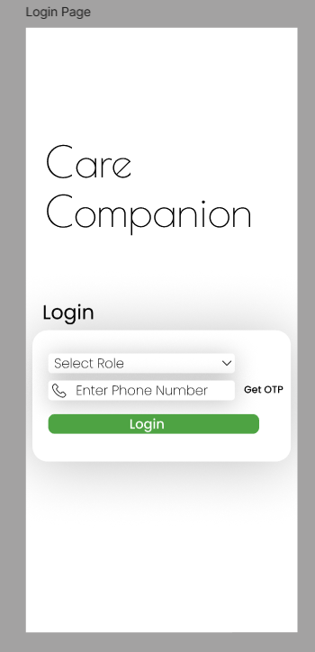
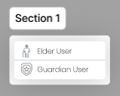
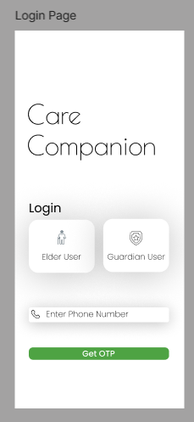
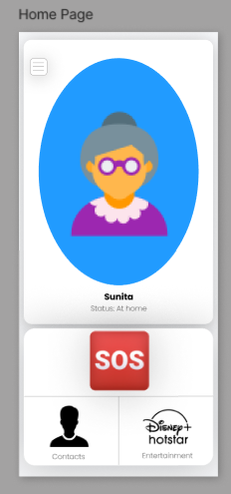
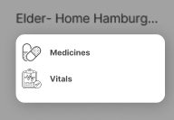
SOMAIYA VIDYAVIHAR UNIVERSITY
K J Somaiya School of Engineering
Work Implemented Previously
Somaiya TRUST
Elder App:

Slide 18
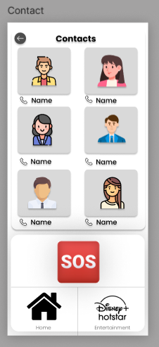
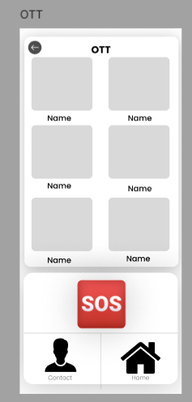
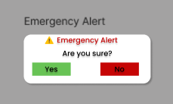
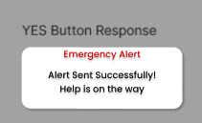
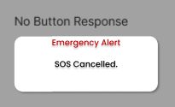
SOMAIYA VIDYAVIHAR UNIVERSITY
K J Somaiya School of Engineering
Work Implemented Previously
Somaiya TRUST
Elder App:

Slide 19
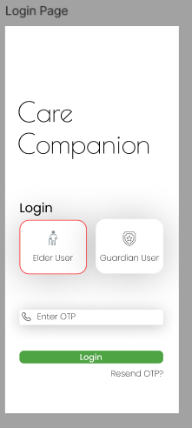
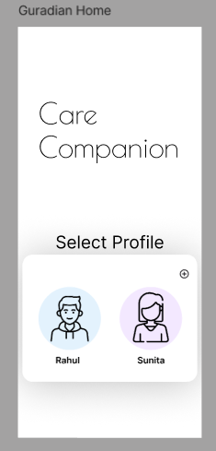
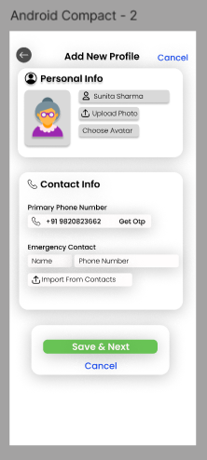
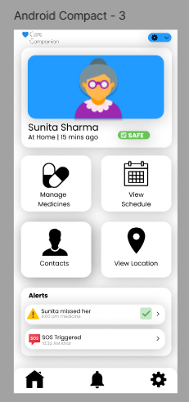
SOMAIYA VIDYAVIHAR UNIVERSITY
K J Somaiya School of Engineering
Work Implemented Previously
Somaiya TRUST
Guardian App:

Slide 20
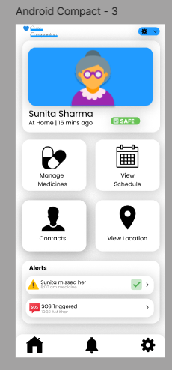
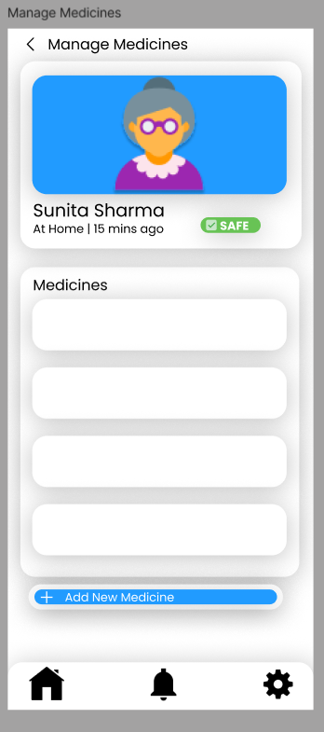
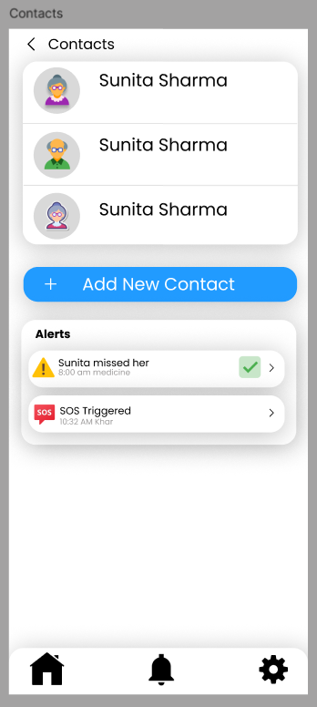
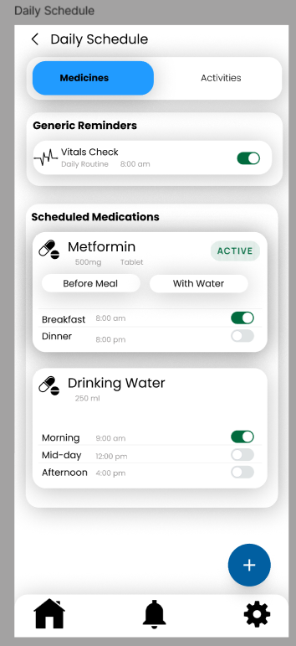
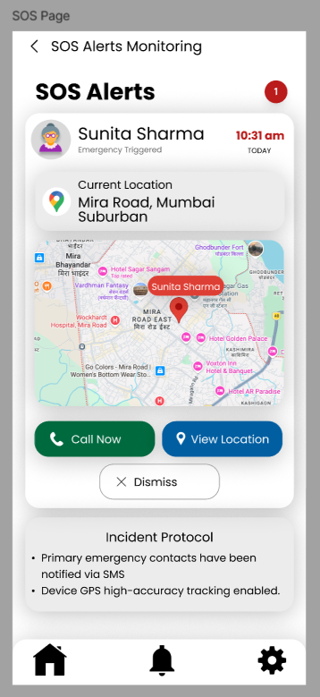
SOMAIYA VIDYAVIHAR UNIVERSITY
K J Somaiya School of Engineering
Work Implemented Previously
Somaiya TRUST
Guardian App:

Slide 21
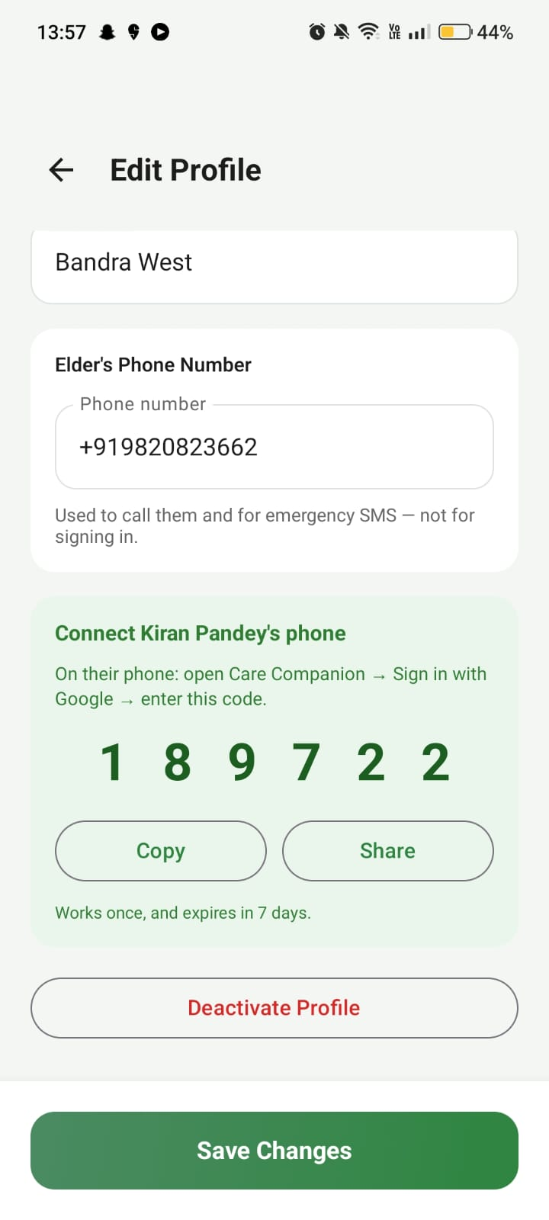
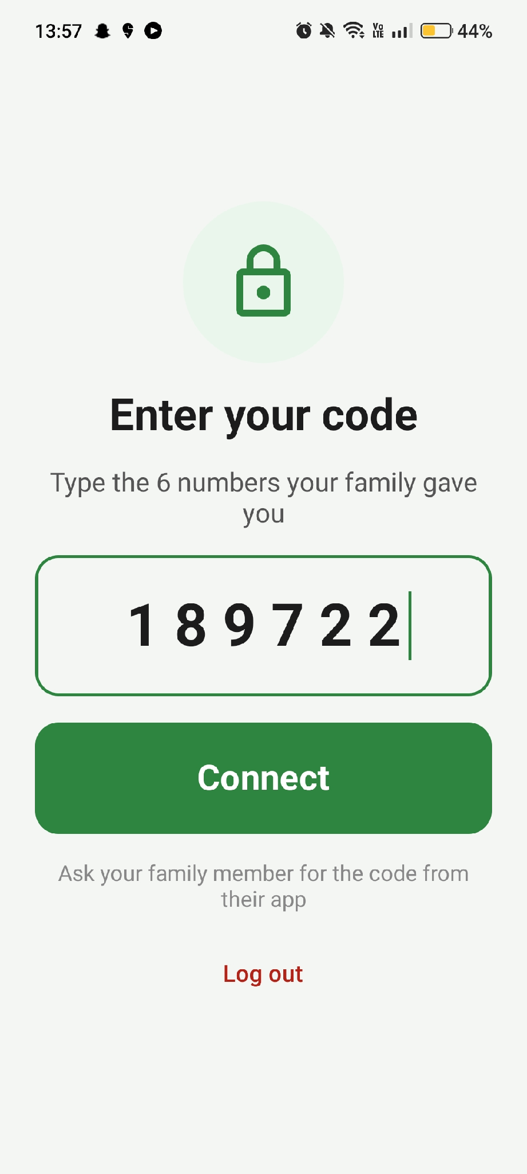
SOMAIYA VIDYAVIHAR UNIVERSITY
K J Somaiya School of Engineering
Work Implemented
Somaiya TRUST
Google Sign-In with a one-time connect code
• Both users sign in with any Google account - no OTP, no hard-coded test numbers.
• The guardian creates the elder's profile and gets a six-digit code.
• Entering that code once on the elder's phone links the two accounts.
• Each code works only once and expires after seven days.

Slide 22
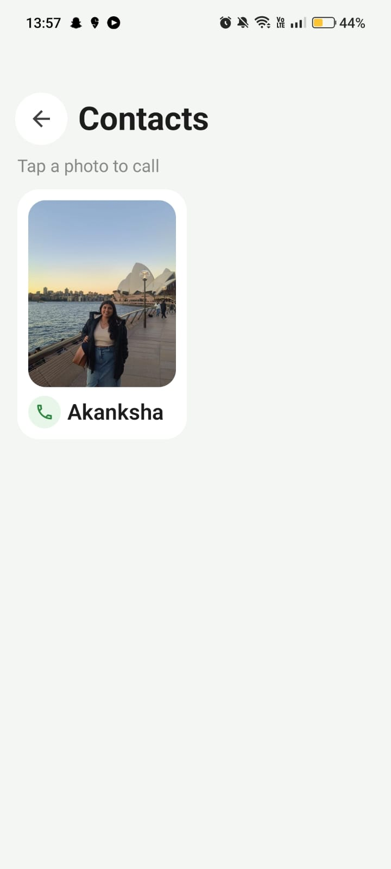
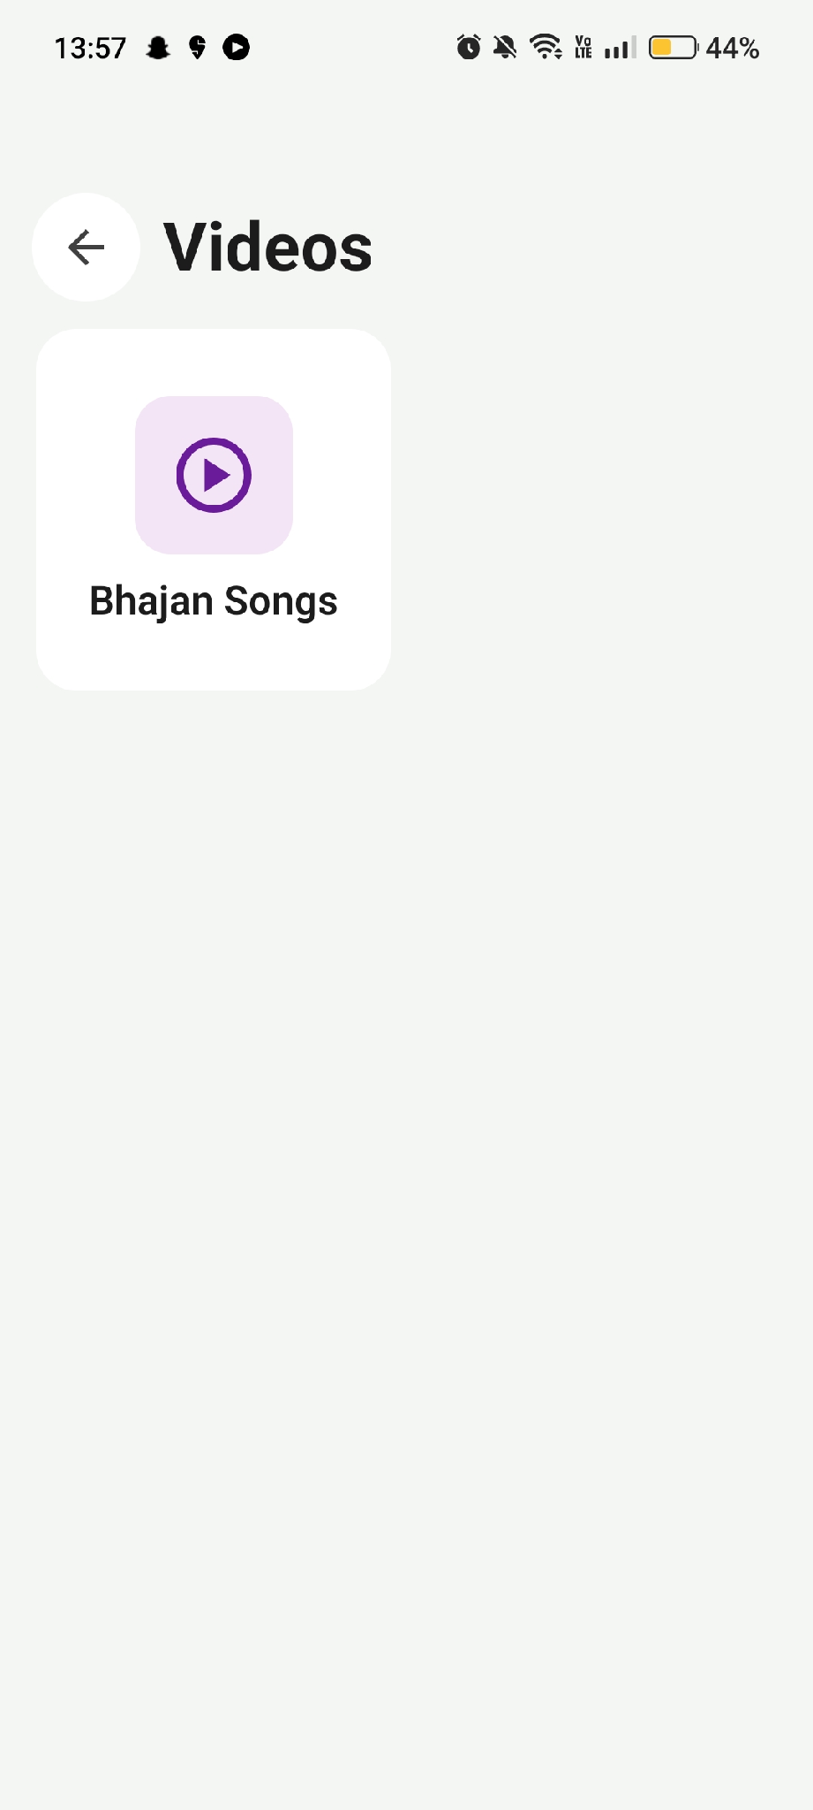
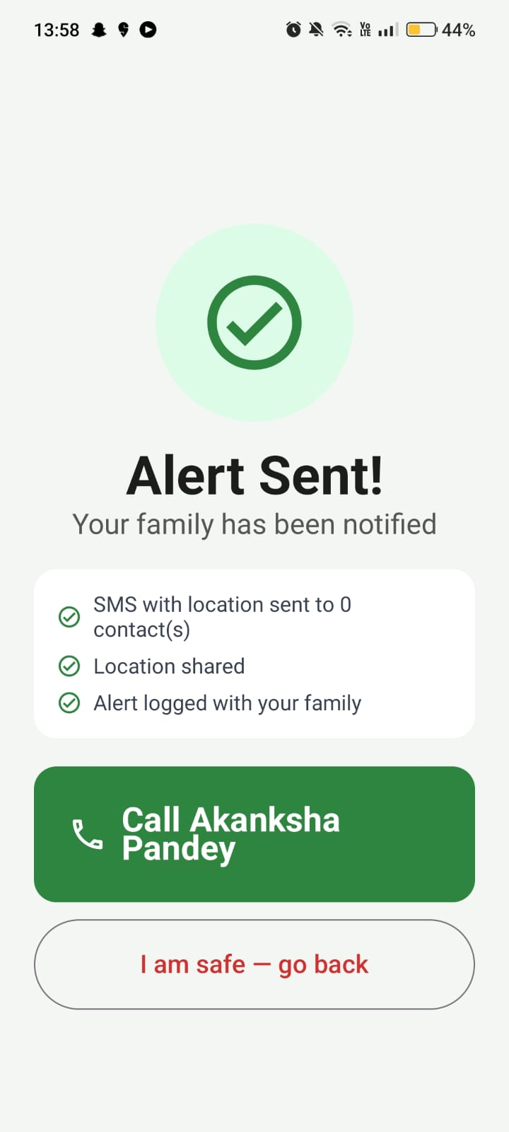
SOMAIYA VIDYAVIHAR UNIVERSITY
K J Somaiya School of Engineering
Work Implemented
Somaiya TRUST
Elder App:

Slide 23
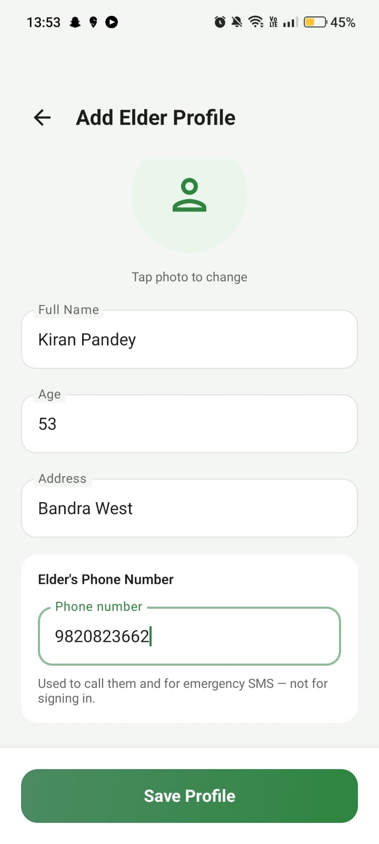
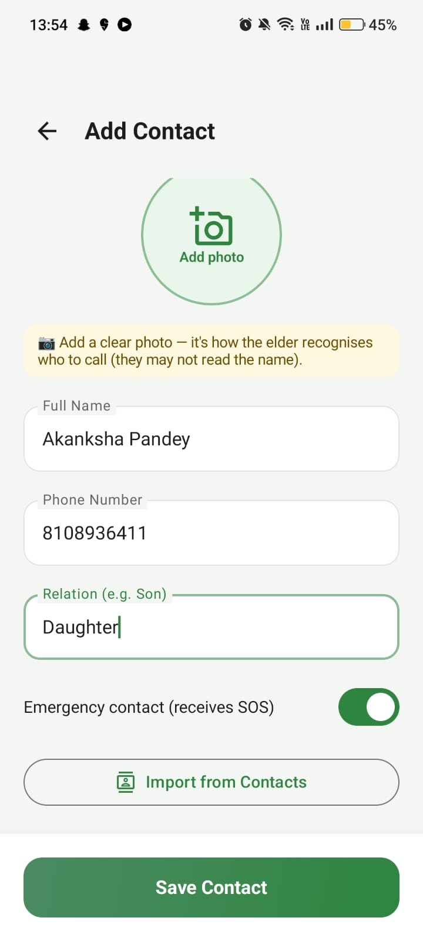
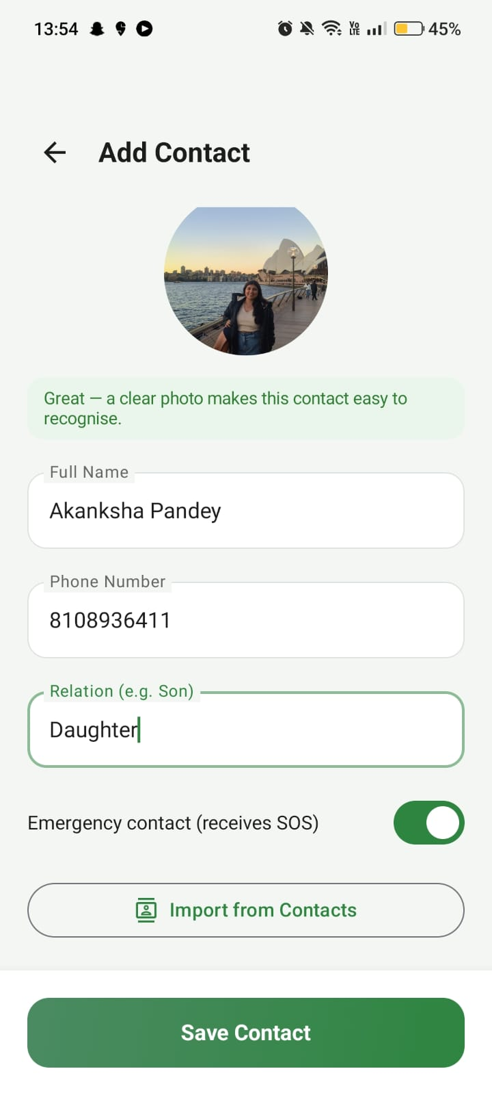
SOMAIYA VIDYAVIHAR UNIVERSITY
K J Somaiya School of Engineering
Work Implemented
Somaiya TRUST
Guardian App:

Slide 24
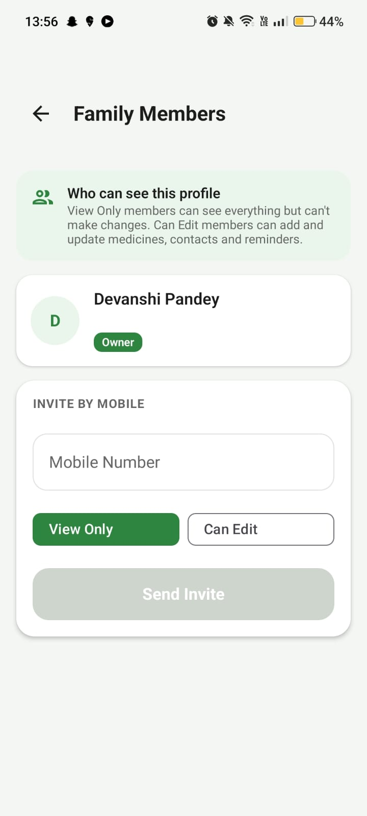
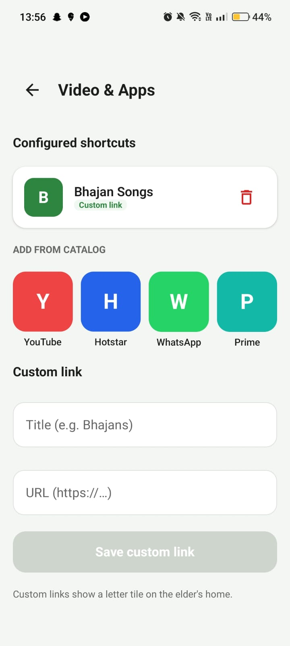
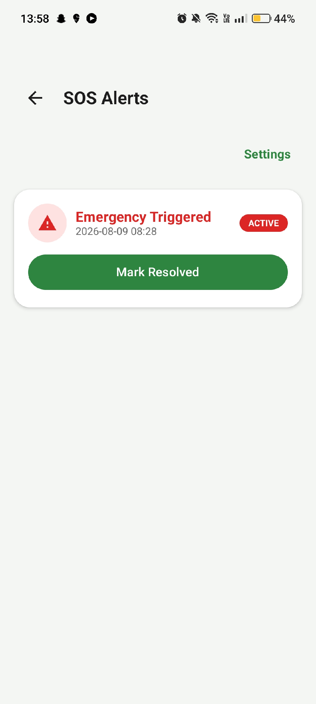
SOMAIYA VIDYAVIHAR UNIVERSITY
K J Somaiya School of Engineering
Work Implemented
Somaiya TRUST
Guardian App:

Slide 25
SOMAIYA VIDYAVIHAR UNIVERSITY
K J Somaiya School of Engineering
Status of Work Completed
Somaiya TRUST
Features Delivered
Engineering & Quality
• Google Sign-In replacing phone OTP, for both roles
• Single-use invite codes binding an elder's device
• Guardian: medicines, schedules, reminders, vitals,
adherence, contacts, family access, SOS monitor
• Elder: home, medicines, contacts, vitals, videos
• Four languages, three text sizes, high contrast
• Backend live: 17 tables, 33 access policies
• Three-path reminder arming (app, worker, boot)
• Offline adherence queue with later sync
• Fail-honest SOS with user-mediated fallback
• 142 automated tests · Lint clean
• Play-ready: API 36, signed build, no restricted
permissions

Slide 26
SOMAIYA VIDYAVIHAR UNIVERSITY
K J Somaiya School of Engineering
Implementation Results and Discussion
Somaiya TRUST
20 sp vs 13 sp
Median text size: elder vs guardian interface
64 dp minimum
Every primary control, against a 48 dp standard
1 tap
To raise an emergency alarm
3 taps
To confirm a dose from its reminder
142 / 142
Automated tests passing · Lint clean
13 defects, 8 silent
Found by audit (62%) — all corrected

Slide 27
SOMAIYA VIDYAVIHAR UNIVERSITY
K J Somaiya School of Engineering
Software Test Cases
Somaiya TRUST
Reminders & Adherence
Emergency, Access & UI
TC-01 Reminder fires at the scheduled time — Pass
TC-02 Dose taken early cancels its alarm — Pass
TC-03 Alarms restored after restart — Pass
TC-04 Offline dose queued, synced later — Pass
TC-09 Water / walk reminders delivered — Pass
TC-05 SOS reaches guardian; failure stated — Pass
TC-06 Invite code single-use, 7-day expiry — Pass
TC-07 Elder UI correct in all four languages — Pass
TC-08 Save errors shown on network failure — Pass
TC-10 SOS not silenced by notification toggle — Pass
142 automated tests
JVM + Robolectric
No emulator required
Lint: 0 errors

Slide 28
SOMAIYA VIDYAVIHAR UNIVERSITY
K J Somaiya School of Engineering
Status of Research Paper
Somaiya TRUST
The Paper
Submission
Title: CareCompanion: Assistive Companion Mobile
Application for Elderly and Disabled Users
• IEEE format · 7 pages · 6 figures · 21 references
• Contributions: dual-surface design, secure device
binding, fail-honest alerting, defect taxonomy
• Figures generated from the application source
Submitted to ICISS 2027
www.iciss2027.in
• Peer review managed through Microsoft CMT
• Status: under review
• All references verified against Crossref

Slide 29
SOMAIYA VIDYAVIHAR UNIVERSITY
K J Somaiya School of Engineering
Future Scope
Somaiya TRUST
1
2
Medicine Stock Database
Track quantity in hand; stock falls as doses are taken and the guardian is alerted before a medicine runs out
AI Voice Assistant
Speech recognition and a language model let elders confirm doses by speaking in Hindi, Marathi or Gujarati, and the app replies in their language
3
4
Conversational Insights
Guardians ask questions of the care data and receive spoken adherence summaries
iOS Application
Extend CareCompanion to iPhone users
5
6
Google Play Release
Publish for public distribution and real-world use
User Study
Evaluate with elderly participants and their caregivers

Slide 30
SOMAIYA VIDYAVIHAR UNIVERSITY
K J Somaiya School of Engineering
Conclusion
Somaiya TRUST
• The CareCompanion project not only addresses significant societal needs but also stands as a robust demonstration of modern mobile application development.
• Tackles a crucial social issue by enhancing the independence and safety of elderly and disabled users.
• Prioritizes accessibility, safety, and intuitive ease of use, ensuring a positive user experience.
• Showcases practical application of advanced Android development concepts and best practices.
• Built with a modular architecture for future expansion, making it a suitable and impactful final-year engineering project.

Slide 31
SOMAIYA VIDYAVIHAR UNIVERSITY
K J Somaiya School of Engineering
References
Somaiya TRUST
[1] E. Amouzadeh, M. N. A. Rashid, and R. Mohd, "Optimizing mobile app design for older adults: A systematic review of age-friendly design principles," Aging Clinical and Experimental Research, vol. 37, no. 1, pp. 1–18, 2025, doi: 10.1007/s40520-025-03157-7.
[2] M. Awan, A. M. Raza, and S. U. Khan, "Usability barriers for elderly users in smartphone app usage: An analytical hierarchical process-based prioritization," Scientific Programming, vol. 2021, pp. 1–14, 2021, doi: 10.1155/2021/5598523.
[3] S. Wickramathilaka, P. Gamage, and S. Perera, "Adaptive and accessible user interfaces for senior citizens using model-driven engineering," Automated Software Engineering, vol. 32, no. 1, pp. 1–25, 2025, doi: 10.1007/s10515-025-00547-z.
[4] J. Abascal and C. Nicolle, "Moving towards inclusive design guidelines for mobile applications for older adults," IEEE Computer, vol. 54, no. 3, pp. 62–70, Mar. 2021, doi: 10.1109/MC.2021.3051519.
[5] R. Pak and A. McLaughlin, "Designing displays and interfaces for older adults," IEEE Reviews in Biomedical Engineering, vol. 14, pp. 289–302, 2021, doi: 10.1109/RBME.2020.3042376.
[6] J. Zhou, M. Rau, and G. Salvendy, "Age-related differences in mobile phone usage and usability," IEEE Transactions on Human-Machine Systems, vol. 51, no. 4, pp. 364–375, Aug. 2021, doi: 10.1109/THMS.2021.3079275.
[7] A. Holzinger, G. Searle, and A. Nischelwitzer, "On some aspects of improving mobile applications for the elderly," IEEE Access, vol. 9, pp. 101734–101746, 2021, doi: 10.1109/ACCESS.2021.3097654.

Slide 32
SOMAIYA VIDYAVIHAR UNIVERSITY
K J Somaiya School of Engineering
References
Somaiya TRUST
[8] L. Chen, Y. Zhang, and X. Wang, "Design and evaluation of an elderly-friendly mobile health application," IEEE Journal of Biomedical and Health Informatics, vol. 26, no. 6, pp. 2875–2884, Jun. 2022, doi: 10.1109/JBHI.2022.3147652.
[9] S. Park and J. Kim, "Factors affecting smartphone adoption and continued use among older adults," IEEE Access, vol. 10, pp. 21456–21467, 2022, doi: 10.1109/ACCESS.2022.3156784.
[10] M. Al-Mahmud, M. H. Mahmud, and S. M. S. Islam, "Assistive mobile applications for elderly healthcare: A systematic review," IEEE Access, vol. 11, pp. 10945–10960, 2023, doi: 10.1109/ACCESS.2023.3241987.

Slide 33
SOMAIYA VIDYAVIHAR UNIVERSITY
K J Somaiya School of Engineering
Existing Applications
Somaiya TRUST
Medisafe – Medication Reminder App
Platform: Android / iOS
Purpose: Medicine reminders
Features:
• Time-based medicine reminders
• Basic adherence tracking
• Notification alerts
Limitations:
• Text-based reminders only
• No visual medicine identification (pill images)
• No caregiver-controlled configuration
• No emergency SOS integration
• No activity or hydration reminders
Inference: Focuses only on medicine reminders, not holistic elderly care.

Slide 34
SOMAIYA VIDYAVIHAR UNIVERSITY
K J Somaiya School of Engineering
Existing Applications
Somaiya TRUST
MyTherapy – Pill Reminder & Health Tracker
Platform: Android / iOS
Purpose: Medication and habit tracking
Features:
• Pill reminders
• Basic health tracking
• Simple activity reminders
Limitations:
• Complex UI for elderly users
• No caregiver–elder role separation
• No visual shortcuts
• Emergency features are missing
• No wheelchair navigation support
Inference: Multi-feature app but not accessibility-first or caregiver-driven.

Slide 35
SOMAIYA VIDYAVIHAR UNIVERSITY
K J Somaiya School of Engineering
Existing Applications
Somaiya TRUST
Google Assistant
Platform: Android
Purpose: Voice-based digital assistant
Features:
• Voice commands
• Calling and app opening
• General reminders
Limitations:
• Not designed specifically for elderly users
• Requires learning voice commands
• No caregiver monitoring
• No medicine visual confirmation
• No emergency-focused design
Inference: Generic assistant, not an assistive care solution.

Slide 36
SOMAIYA VIDYAVIHAR UNIVERSITY
K J Somaiya School of Engineering
Existing Applications
Somaiya TRUST
Red Panic Button / SOS Emergency Apps
Platform: Android
Purpose: Emergency support
Features:
• One-touch SOS
• Emergency calling and SMS
Limitations:
• Standalone emergency functionality
• No routine tracking
• No medicine or health reminders
• No caregiver dashboard
• No accessibility customization
Inference: Effective for emergencies but isolated from daily care routines.

Slide 37
SOMAIYA VIDYAVIHAR UNIVERSITY
K J Somaiya School of Engineering
Existing Applications
Somaiya TRUST
Google Maps
Platform: Android
Purpose: Navigation
Features:
• Location-based navigation
• Route planning
Limitations:
• Does not reliably indicate wheelchair accessibility
• No accessibility tagging by caregivers
• Not integrated with elderly assistive workflows
• Requires multiple steps and user interaction
Inference: General navigation app, not designed for disabled accessibility support.

Slide 38
SOMAIYA VIDYAVIHAR UNIVERSITY
K J Somaiya School of Engineering
Supporting Documents and Links
Somaiya TRUST
1
2
Source Code
github.com/Suyash2205/Care-Companion-
Release APK
github.com/Suyash2205/Care-Companion-/releases
3
4
Research Paper
IEEE format — submitted with this presentation
User Manual
PDF — submitted with this presentation
5
6
Conference Submission
www.iciss2027.in
Demo Video
To be added before the demonstration

Slide 39
SOMAIYA VIDYAVIHAR UNIVERSITY
K J Somaiya School of Engineering
Somaiya TRUST
Thank You!

