Slide 1

SMART INDIA HACKATHON 2026
TITLE PAGE
Problem Statement ID – SIH26021
Problem Statement Title- Honey Chain: A block chain-based system for honey traceability and smart beekeeping management.
Theme- Agriculture, FoodTech & Rural Development
PS Category- Software
Team ID- 133847
Team Name (Registered on portal)- CodeVerse

Slide 2
HONEY CHAIN: Blockchain Honey Traceability + AI-IoT Smart Beekeeping
CodeVerse
❖ Proposed Solution (Describe your Idea/Solution/Prototype)
• How it addresses the problem
Honey Chain gives every hive, harvest batch and jar a tamper-proof digital identity on a permissioned blockchain. Consumers verify authenticity by scanning a QR code; IoT + AI keep colonies healthy and productive.
Problem (PS SIH26021) | Honey Chain answer
Counterfeit honey | Lab results incl. NMR/SMR sealed per batch; failures are permanent; QR verifies each jar
Low consumer trust | Scan-to-verify trust score, origin and journey read from the ledger, not from the seller
Weak market linkage | Verified batches + custody trail support premium pricing and direct/retail buyers
No traceability or hive-management support | Hive → harvest → jar trail; IoT-AI alerts, advice and yield forecast
• Detailed explanation of the proposed solution
1. Register – each KVIC bee box gets a Hive ID (owner, village, GPS, cluster, flora) written to the ledger.
2. Sense – ESP32 hive node streams weight, brood temperature, humidity, colony sound, CO₂ and entrance activity; edge AI diagnoses varroa, foulbrood, queenless, pre-swarm and starvation and forecasts 30-day yield.
3. Anchor – 14-day telemetry is hashed into a Merkle root and sealed on-chain; raw data stays local, so a 2G link is enough.
4. Harvest – beekeeper picks hives, enters kg + flora → batch ID + printable QR; yield-per-hive plausibility is checked automatically.
5. Certify – NABL lab records moisture, HMF, sucrose, reducing sugars, ash, C4 sugar, NMR profile and rice-syrup marker (SMR); pass/fail is computed from limits and cannot be edited.
6. Move – processor / distributor / retailer handovers and retail packing are logged; every write prints a signed receipt.
7. Verify – consumer scans the QR → trust score 0-100, origin, lab table, journey and validator signatures; forged codes return "no such batch".
• Expected solution coverage (per problem statement)
✔ Blockchain prototype + QR consumer authentication – built and live
✔ IoT hive monitoring + AI analytics – built (simulated sensors, explainable model)
✔ Scalable KVIC deployment framework – phased plan, costs, risks (slide 4)
• Innovation and uniqueness of the solution
Lab-agnostic trust layer: anchors NMR, SMR, C4 and HMF results, so syrups engineered to pass basic tests are still rejected (CSE 2020)
Yield plausibility: claimed kg vs hive-weight telemetry exposes blending ("95 kg from 1 hive" is flagged)
Telemetry anchored by Merkle root: auditable claims with minimal bandwidth and cost
Permissioned PoA (KVIC / FSSAI / lab validators): no mining, no gas, accountable writers
Explainable AI with advice in English + Hindi; offline-first installable PWA built for villages
• Trust score shown to the buyer (0-100)
+25 hives registered · +15 harvest logged · +40 lab PASS · +10 telemetry anchored · +10 custody / retail trail · −20 implausible yield per hive
Lab FAIL or score < 50 → REJECT. Unknown / forged QR → "no such batch". Ledger integrity is re-checked on every load.

Slide 3
TECHNICAL APPROACH
CodeVerse
❖ Technologies to be used (e.g. programming languages, frameworks, hardware)
How we use AI (beyond the blockchain)
Layer | Technologies | Role
Frontend | React 18, Vite, JavaScript; installable offline-first PWA (service worker); html5-qrcode; EN / हिन्दी | Consumer, beekeeper, lab, supply-chain and officer portals
Ledger | SHA-256 hash-chain (Web Crypto); Proof-of-Authority round-robin validators; Merkle trees | Tamper-evidence; integrity check on every load
Smart contract | Solidity 0.8 (roles, batch, certify, custody) → Hyperledger Besu / Fabric-class network | Production ledger; a lab FAIL is final
IoT hardware | ESP32, HX711 + load cell, DS18B20, DHT22, MEMS mic (I²S), CO₂ sensor, LoRa, solar + Li-ion | 15-min readings; 1 gateway per 20-40 hives
AI / analytics | Feature model: brood-temp variance, sound shift, weight slope, activity drop, CO₂ → softmax; CNN (TFLite Micro) | 5 conditions + healthy; 30-day yield forecast (80% range)
Data | On-chain: hashes only. Off-chain: time-series store; IPFS for lab PDFs | Privacy, low cost
DevOps / security | GitHub Actions CI; Pages / Vercel / Docker + nginx; HTTPS; role-based keys (Ed25519 planned) | Repeatable, secure deployment
[Built] Hive-health model: sensor features → varroa, foulbrood, queenless, pre-swarm, starvation (24/24 on simulated tests)
[Built] 30-day yield forecast (80% range) + fraud flag when claimed kg per hive exceeds what hive data supports
[Plan] CNN on hive audio via TFLite Micro, trained on open datasets (refs 8, 9); advice shown with confidence
[Plan] Comb-photo disease check on the phone; Hindi voice entry and advice for low-literacy users
How we use Cloud
[Today] PWA served from a CDN (GitHub Pages / Vercel); CI/CD with GitHub Actions
[Plan] LoRaWAN → MQTT broker → time-series DB; Merkle root anchored on-chain
[Plan] Validator nodes + indexer as containers on MeitY-empanelled / GI Cloud; KMS/HSM keys
[Plan] Cloud GPU training, OTA model updates, drift monitoring; object storage + IPFS; retailer API; SMS / WhatsApp alerts
❖ Methodology and process for implementation (Flow Charts/Images/ working prototype)
1 Register
2 Sense
3 Harvest
4 Certify
5 Move
6 Verify
Hive ID: owner, GPS, cluster, flora
Block HIVE_REGISTERED
Node reads sensors every 15 min
Edge AI diagnosis + advice
Merkle root → SENSOR_ATTESTATION
Pick hives, kg, flora
Batch ID HC-YYYY-NNNN + QR
Yield/hive check (> 45 kg flagged)
NABL lab enters 8 tests
Auto PASS / FAIL vs limits
LAB_CERTIFIED – immutable
CUSTODY_TRANSFER, RETAIL_PACKED
Who → whom, bottles, outlet
Signed receipt per write
Scan QR or enter batch ID
Hash + signature re-check
Trust score, journey, verdict
Design rule: only hashes and attestations go on-chain; raw sensor data stays local and is proven later via the Merkle root. AI: softmax over 6 states, 24 / 24 injected conditions identified in tests. Data: synthetic records modelled on real districts, flora and public parameters (slide 6).

Slide 4
FEASIBILITY AND VIABILITY
CodeVerse
Analysis of the feasibility of the idea
Potential challenges and risks
Strategies for overcoming these challenges
Technical: working prototype live (ledger, QR verify, lab portal with NMR/SMR, hive AI, receipts, PWA); mature open-source stack
Hardware: ESP32 node ≈ ₹1.5-2.5k per hive*; one LoRa gateway serves 20-40 hives within ~5 km
Economic: near-zero ledger cost (PoA, no gas); QR label ≈ ₹0.1-0.3 per jar*
Operational: fits NBHM / KVIC clusters, NABL labs and FSSAI oversight; no new institution needed
Regulatory: minimal personal data (name, village); limits FSSAI/BIS-style, final limits set by the notified lab
Scalable: validator nodes per KVIC region; hashes on-chain, raw data off-chain
Garbage-in: a dishonest lab or beekeeper can enter false data
Adulteration that beats basic tests: engineered syrups pass C4/HMF (CSE 2020)
Connectivity and literacy: patchy 2G/4G, low digital skills
QR cloning: copying a genuine label onto fake jars, refilling
Field hardware: sensor drift, theft, power, weather
Adoption and governance: cluster buy-in, cost sharing, who runs validators and keys
Trust in inputs: accredited-lab keys, random re-tests, IoT weight cross-check vs claimed yield
Lab-agnostic: anchor NMR + SMR alongside C4/HMF; new tests plug in
Village-ready: offline-first PWA, EN/HI, QR-first flows, assisted entry via KVIC field officers
Anti-cloning: per-jar serials + single-use claim codes, tamper seals (roadmap)
Hardware: calibration, solar, IP-rated enclosure, sensor-anomaly flags
Governance: multi-stakeholder validators (KVIC, FSSAI, labs); hardware key storage; pilot via SHG trainers
Unit economics – planning estimates* (to be validated in the pilot)
Phased rollout and validation plan
Item | Estimate | Note
Hive node (ESP32 + sensors) | ₹1.5-2.5k / hive | solar + LoRa
LoRa gateway (per cluster) | ₹15-25k | 20-40 hives each
QR label per jar | ₹0.1-0.3 | printed by beekeeper
Pilot: 100 hives, 3-5 gateways | ≈ ₹2-3.8 lakh | hardware only
Pilot · 0-3 mo
State · 4-9 mo
Regional · 10-18 mo
National · Yr 2+
2 clusters · 50 beekeepers · 100 hives · 1 lab
10 clusters · 3 states · QR at Khadi outlets
all Honey Mission states · FSSAI dashboard
open API · export certificates · trained CNN
Validation first: 10-minute interviews with 5 beekeepers, 2 NABL labs, 1 KVIC field officer (script prepared)
Pilot KPIs: % batches with QR + lab certificate, scans/month, price realisation, colony-loss rate
*Planning estimates, not quotes.

Slide 5
IMPACT AND BENEFITS
CodeVerse
❖ Potential impact on the target audience
WHY NOW – public evidence
Audience | Today | With Honey Chain
Rural beekeepers (KVIC Honey Mission) | Cannot prove purity; sell to middlemen at commodity prices; late disease detection | Verifiable quality → direct buyers and premium price; early alerts and yield forecast reduce colony loss
Consumers | Cannot tell real honey from syrup blends; labels are easy to copy | Scan-to-verify in seconds: origin, lab report, journey, trust score; fake batches flagged before purchase
KVIC / FSSAI / regulators | No live view of production or adulteration; manual audits | Cluster dashboards, tamper-evident audit trail, adulteration flags, hotspot targeting for extension
Processors, retailers, e-commerce | Brand and recall risk from unverifiable supply | Trusted supply chain with custody trail; verified, premium-ready listings
Labs and exporters | Reports on paper, easy to dispute or re-use | Signed, immutable certificates (NMR/SMR/C4/HMF) reusable as export evidence
17 of 22
honey samples tested were adulterated with sugar syrup (77%)
CSE investigation, Dec 2020
46%
of imported honey in the EU was suspected of adulteration in 2022 (EU coordinated action)
via Frontiers Sust. Food Syst., 2025
1.4 lakh MT
natural honey produced in India in 2024; ~1.07 lakh MT exported in FY 2023-24
PIB - National Beekeeping & Honey Mission
❖ Benefits of the solution (social, economic, environmental, etc.)
₹500 crore
NBHM outlay, FY 2020-21 to 2025-26: production is growing, trust must keep pace
PIB
Social
Economic
Environmental
Governance
Trust in rural produce
Livelihood security incl. SHGs / women beekeepers
Bilingual, low-literacy design
Higher realisation per kg
Less fraud loss for buyers
Export-ready traceability
Lower colony-loss cost
Healthier colonies → pollination
Targeted treatment, less chemical
Low-energy ledger (no mining)
Paperless certificates
Tamper-evident audit trail
Data-driven KVIC planning
Aligned to SDG 1, 2, 8, 12, 15
Pilot KPIs (baseline measured at pilot start)
100% of pilot batches with QR + lab certificate
Scans / month; adulterated batches flagged per 1,000
Price realisation vs unlabelled honey; colony-loss rate

Slide 6
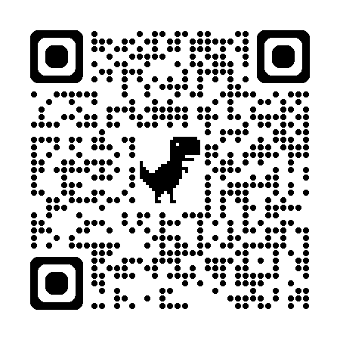
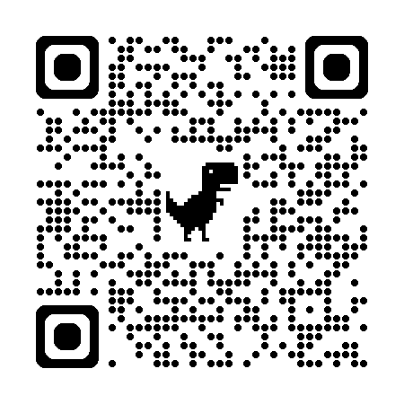
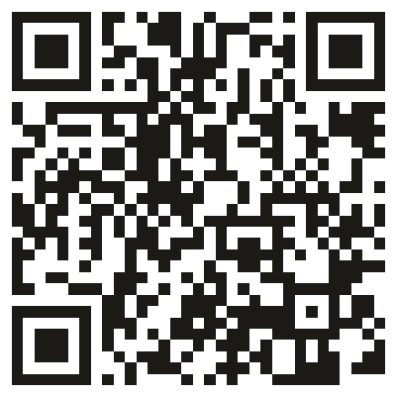
RESEARCH AND REFERENCES
CodeVerse
❖ Details / Links of the reference and research work
Market, regulatory and standards evidence
1. CSE – "Laboratory results of honey testing" (Dec 2020): NMR tests on branded honey
cdn.downtoearth.org.in/report_laboratory_results_of_honey_testing_20201201.pdf
2. FSSAI press release reviewing the CSE honey-sample issue (3 Dec 2020)
fssai.gov.in/upload/press_release/2020/12/5fc8eb6d70965Press_Release_Honey_Sample_03_12_2020.pdf
3. PIB – National Beekeeping & Honey Mission: outlay, production, exports
pib.gov.in/PressReleasePage.aspx?PRID=2185400 | National Bee Board: nbb.gov.in
4. The Tribune – "Honeytrap": syrups designed to bypass purity tests
tribuneindia.com/news/nation/honeytrap-cse-investigations-claim-nefarious-adulteration-business-of-honey-designed-to-bypass-purity-tests-178930
5. Business Standard – FSSAI on the SMR (rice-syrup marker) test
business-standard.com/article/companies/fssai-questions-cse-for-not-conducting-smr-test-on-honey-brands-120120301199_1.html
6. Codex Alimentarius – Standard for Honey, CXS 12-1981 (rev. 2001; amended 2019, 2022)
fao.org/input/download/standards/310/cxs_012e.pdf | Indian standard: BIS IS 4941 (honey)
Technology and research
7. Ramsey et al. – "The prediction of swarming in honeybee colonies using vibrational spectra", Sci. Rep. 10, 9798 (2020)
nature.com/articles/s41598-020-66115-5
8. Kulyukin – "Audio, image, video, and weather datasets for continuous electronic beehive monitoring", Applied Sciences 11(10), 4632 (2021)
Open datasets for training the production CNN
9. Machine Learning and Computer Vision Techniques in Continuous Beehive Monitoring Applications: A survey
arxiv.org/pdf/2208.00085
10. "Fujairah Honey Chain (FHC): A Blockchain Framework for Monitoring Honey Production", Information 16(8), 626 (2025)
mdpi.com/2078-2489/16/8/626
11. "Analysing blockchain adoption in beekeeping: application of theoretical models", Frontiers in Sustainable Food Systems (2025)
frontiersin.org/journals/sustainable-food-systems/articles/10.3389/fsufs.2025.1566341/full
Data used in the prototype (transparency)
Real public data: CSE 2020 test findings, PIB / NBHM production and outlay figures, FSSAI / BIS / Codex honey parameters (refs 1-6) - used for the problem evidence, lab limits and impact statistics.
Prototype dataset: 15 hives, 10 batches and 51 ledger blocks across 8 real districts in 6 states (Bharatpur, Muzaffarpur, Ludhiana, South 24 Parganas, Saharanpur, Nashik, Nagpur, Sawai Madhopur) using real flowering regions. Beekeeper names, hive IDs, lab reports and sensor streams are synthetic (no real individuals); real pilot data replaces them in Phase 0.
AI data path: prototype model runs on simulated telemetry; production CNN to be trained on open beehive datasets (refs 8, 9) plus KVIC apiary recordings.
Research takeaways applied in the design
TRY THE PROTOTYPE
Engineered syrups can pass C4/HMF but fail NMR → ledger is lab-agnostic and anchors NMR + SMR results (refs 1, 4, 5)
Hive vibration/acoustics can forewarn swarming (ref 7) → colony-sound feature in the model; CNN trained on open datasets (refs 8, 9) is the production path
Blockchain honey frameworks exist (refs 10, 11); Honey Chain focuses on NMR/SMR-aware labs, Merkle-anchored telemetry and an offline bilingual PWA for Indian clusters
Prototype lab limits are indicative (FSSAI / BIS / Codex style); final limits come from the notified lab
Live app
honey-chain-rust.vercel.app
Source code
github.com/Suyash2527/HoneyChain
Verify a sample batch
live app, batch HC-2026-0001

