Slide 1


SMART INDIA HACKATHON 2026
TITLE PAGE
Problem Statement ID – SIH26250
Problem Statement Title- Planning and dynamically retasking air operations in a contested, rapidly changing environment
Theme- Transportation & Logistics
PS Category- Software
Team ID- 133847
Team Name (Registered on portal)- CodeVerse
GitHub- Suyash2527/airpower-ops-optimiser

Slide 2
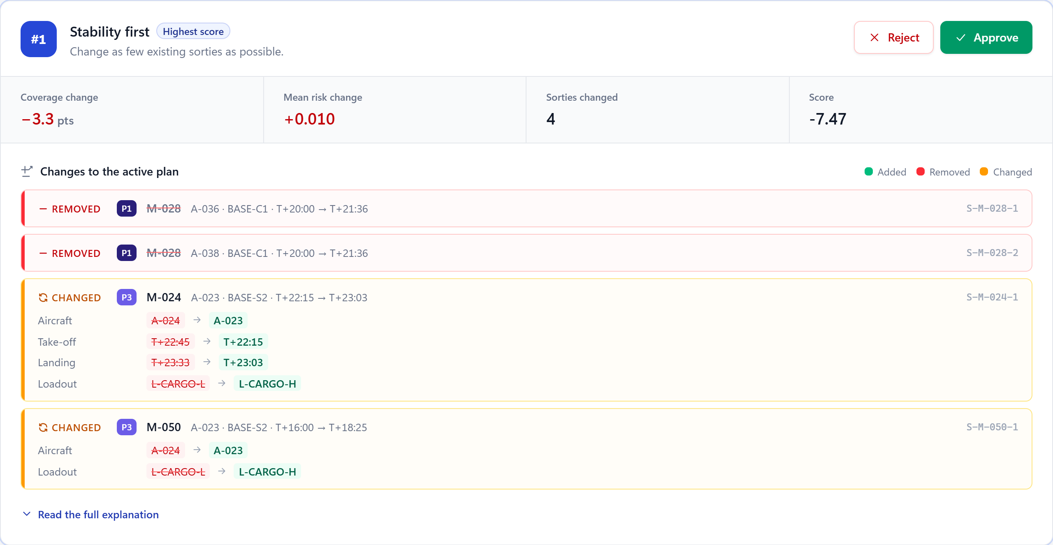
AIRPOWER: AI Decision Support for Air Operations
CodeVerse
❖ Proposed Solution (Describe your Idea/Solution/Prototype)
AirPower fuses scattered air-operations data into one live picture, builds an optimised plan with a reason for every assignment, and proposes ranked re-plans the moment anything changes. A human approves every change.
• Detailed explanation of the proposed solution
1
2
3
4
5
Fuse
sources, age, conflicts
Check
every constraint per sortie
Optimise
CP-SAT + baselines
Approve
human decision, audited
Retask
ranked options + diff
• How it addresses the problem
Data in silos
→
One fused picture with source and age
Slow, sub-optimal allocation
→
Optimised draft plan, every choice explained
Retasking option as the planner sees it: trade-offs and a sortie-level diff (prototype screenshot)
Painful re-planning
→
Ranked options with a plan diff
+8.0%
+29.9%
0
• Innovation and uniqueness of the solution
priority-weighted coverage vs the greedy baseline (mean of 20 scenarios)
vs first-in first-out planning
validator violations in 60 plans; 385 tests pass
Explainable by construction: reason code + sentence + next-best option
Stability-aware retasking: airborne sorties frozen, minimal-change variants
Independent validator: 0 violations across 60 benchmark plans
Measured by benchmarks/run_benchmarks.py on synthetic scenarios; see benchmarks/RESULTS.md

Slide 3
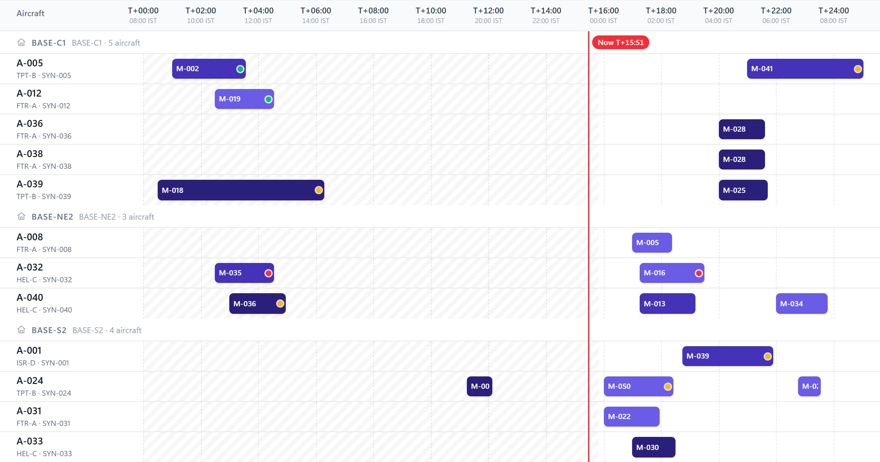
TECHNICAL APPROACH
CodeVerse
❖ Technologies to be used (e.g. programming languages, frameworks, hardware)
Frontend
API and data
Next.js · React · TypeScript · Tailwind. India map drawn in SVG from open data (no tile server).
Python · FastAPI · Pydantic · SQLModel. SQLite for development, PostgreSQL when deployed.
Optimisation
Assurance and hardware
Google OR-Tools CP-SAT, with greedy and FIFO baselines; shapely + pyproj for routes and zones.
pytest (385 tests) and an independent plan validator. No special hardware: a standard CPU.
Plan timeline: sorties by aircraft, locked = airborne
❖ Methodology and process for implementation (Flow Charts/Images/ working prototype)
1 Ingest
2 Fuse
3 Check
4 Optimise
5 Approve
6 Retask
Adapter per source, provenance on every record
Scored on trust, confidence and freshness; conflicts kept, stale flagged
Range, stock, crew, duty, airspace, weather, threat
CP-SAT within 20 s; greedy plan as warm start
Draft until a person approves; audit entry written
Event → affected sorties → ranked options and diff
Advisory only
no auto-execution, no targeting logic
Every decision explained
reason code + plain sentence
Seeded and reproducible
same seed, same scenario, same result

Slide 4
FEASIBILITY AND VIABILITY
CodeVerse
Analysis of the feasibility of the idea
Potential challenges and risks
Strategies for overcoming these challenges
Technical: working end-to-end prototype and test suite
Compute: laptop CPU; plans bounded at 20 s; no GPU
Data: adapter layer; real feeds replace synthetic ones by configuration
Operational: advisory, so command authority is unchanged
Security: runs offline and air-gapped; open-source stack
Data access: operational feeds are classified and fragmented
Data quality: late or conflicting reports can mislead a plan
Trust: planners will not act on a black box
Model fidelity: performance and risk figures are placeholders today
Adoption: doctrine, training, change management
Accreditation first: on-premise, read-only adapters, role-based access
Freshness rules: stale and conflict flags; a human can pin a value
Explain and approve: reason codes, plan diff, audit trail
Real data: replace placeholders with service-approved figures
Shadow mode: run beside today's process before any reliance
Measured on the prototype (benchmark, not claimed)
Phased rollout and validation plan
20
17 of 20
11 of 20
0
Pilot · 0-3 mo
Trial · 4-9 mo
Expand · 10-18 mo
Scale · Yr 2+
seeded scenarios, 3 planners each
scenarios where CP-SAT beat greedy; worse in 0
plans proven optimal within the 20 s limit
violations in 60 validated plans
1 planning cell, shadow mode, historical data
live read-only feeds, 2 cells, KPIs tracked
command-wide; ML models on real data
joint and HADR operations
Where the optimiser times out it returns the best plan found; a fallback is always labelled as such. Source: benchmarks/RESULTS.md
Pilot KPIs: time to first approved plan, re-plan latency, priority-weighted coverage, share of proposals accepted

Slide 5
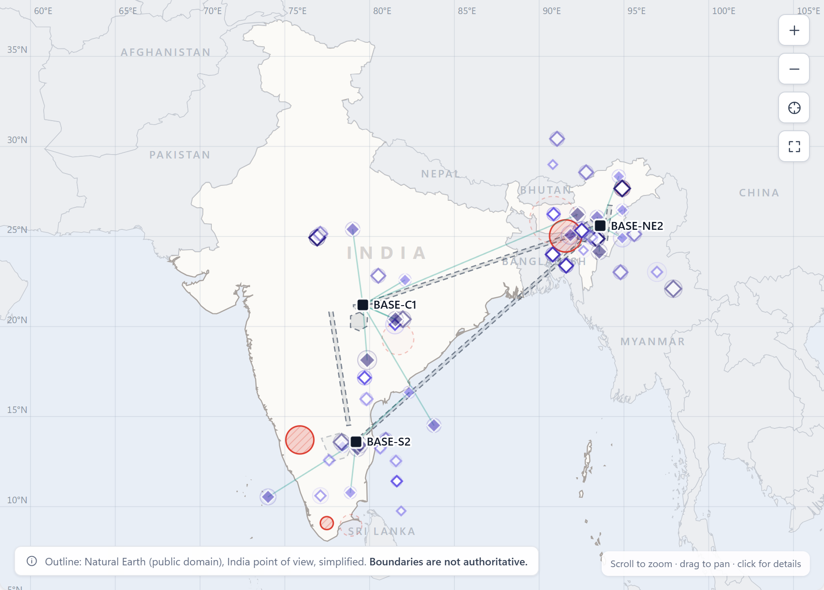
IMPACT AND BENEFITS
CodeVerse
❖ Potential impact on the target audience
P
Air-ops planners One fused picture and an explained draft plan instead of manual collation
C
Duty controllers A disruption becomes affected sorties and ranked options, not a scramble
K
Commanders Coverage by priority, risk and a full audit trail at a glance
H
HADR / NDMA relief Relief airlift allocated by priority and weather with the same engine
M
Crew and maintenance Duty, rest and maintenance limits enforced at plan time, with the reason
❖ Benefits of the solution (social, economic, environmental, etc.)
Social
Economic
Environmental
Governance
Faster relief airlift in floods and cyclones
Less decision stress on planners
Fewer wasted sorties and flying hours
Open-source stack, no licence cost
Less unnecessary flying, so less fuel burned
Targeted re-plans, not full re-flights
Human approval on every change
Append-only audit trail
Operating picture: bases, mission areas by priority, threat zones, airspace, sorties. Outline: Natural Earth, not authoritative.
Pilot KPIs (baseline measured in shadow mode)
Time to first approved plan vs the current process
Re-plan latency after a disruption
Priority-weighted coverage; sorties lost to late changes

Slide 6

RESEARCH AND REFERENCES
CodeVerse
❖ Details / Links of the reference and research work
Problem and doctrine
SEE THE CODE · CHECK THE NUMBERS
SIH 2026, Problem Statement SIH26250 (Ministry of Defence) · sih.gov.in
US Joint Chiefs of Staff, JP 3-30 Joint Air Operations (joint air tasking cycle) · jcs.mil
NDMA, National Disaster Management Plan: air support for HADR · ndma.gov.in
Human factors and automation
Endsley (1995). Toward a theory of situation awareness in dynamic systems. Human Factors 37(1) · doi.org/10.1518/001872095779049543
Parasuraman, Sheridan, Wickens (2000). A model for types and levels of human interaction with automation. IEEE Trans. SMC-A 30(3) · doi.org/10.1109/3468.844354
Optimisation and open data
Google OR-Tools, CP-SAT solver (Apache-2.0) · developers.google.com/optimization
Gopalan and Talluri (1998). Mathematical models in airline schedule planning: a survey. Annals of Operations Research 76
Barnhart et al. (2003). Airline crew scheduling. Handbook of Transportation Science
Natural Earth admin-0, India point of view · OurAirports · Open-Meteo elevation API (open data)
Source code
github.com/Suyash2527/airpower-ops-optimiser
Data used in the prototype (transparency)
Real open data: map outline (Natural Earth), alternate civil airfields (OurAirports), base elevations (Open-Meteo).
Synthetic data: all bases, units, aircraft, crews, missions, threats, weather and events are generated from a seed and labelled SYNTHETIC in the app; performance figures are illustrative.
Measured results: 20 seeded scenarios, 3 planners each; the script and CSV are in the repository, so no figure is typed in by hand.

