Slide 1

“A Decentralized IoT-Blockchain Framework with Customized Smart Contracts for Transparent and Traceable Agricultural Supply Chains”
Presented By
Kerkar Suyash Satish (TU8S2425003)
Esaf Shanum Shakil (TU8S2425004)
Patil Rutuja Sanjeev (TU8S2425006)
Doctor Umerkhan Junaidkhan (TU8S2425008)
Under the Guidance of
Prof. Shraddha Rokade

Slide 2
Agenda
Introduction
Problem Statement
Objectives
Literature Survey
Methodology & Flow Chart of Project Work
Software & Hardware Requirement Specification
Use Case Diagram
Design and Implementation
Results
Conclusion
Future Scope
References

Slide 3
Introduction
Agricultural supply chains involve multiple stakeholders, making product origin, produce quality, custody handoffs, and farmer payments difficult to track transparently.
While IoT sensor feeds and blockchain provide real-time telemetry and immutable records, blockchain alone cannot verify whether the incoming sensor data is authentic or physically tampered with.
Our proposed system introduces an AI Trust Layer to evaluate and validate IoT telemetry before recording it on the blockchain, while customized smart contracts autonomously govern provenance, custody transitions, and payment settlements.
The system delivers trustworthy, end-to-end agricultural traceability from farm to fork while guaranteeing transparent pricing and economic fairness for farmers.

Slide 4
Problem Statement
Traditional agricultural supply chains rely on fragmented, siloed record-keeping, leaving farmers, logistics operators, retailers, and consumers without real-time visibility or verifiable trust in produce origin and quality. This opacity facilitates food fraud, delayed contamination recalls, and severe economic exploitation where intermediaries capture inflated margins while farmers receive unfair compensation. Furthermore, existing blockchain implementations blindly record incoming IoT telemetry without verification failing to solve the critical "Garbage-In, Garbage-Out" off-chain data trust problem while suffering from smart contract vulnerabilities and unoptimized state models. Consequently, there is an urgent need for an intelligent, tamper-proof architecture combining pre-chain data validation with secure, modular smart contracts to deliver transparent, equitable, and end-to-end agricultural traceability.

Slide 5
Objectives
AI-Powered IoT Validation: Validate simulated sensor data and detect anomalies using physical checks and Isolation Forest.
Tamper-Proof Custody Tracking: Maintain secure, sequential agricultural batch records using blockchain smart contracts.
Cold-Chain SLA Monitoring: Simulate temperature and humidity conditions to identify environmental violations.
Fair & Transparent Farmer Payments: Demonstrate smart contract-based escrow settlements and direct farmer payment calculations.
Consumer Verification & Auditability: Enable QR-based product traceability and maintain auditable records of quarantined telemetry.

Slide 6
Scope
End-to-End Custody Lifecycle: Strict, forward-only tracking of harvest batches from farm gate to consumer doorstep.
AI-Driven Data Integrity: Machine learning-based pre-chain validation to intercept drifted, noisy, or spoofed IoT sensor telemetry.
Modular Smart Contract Automation: EVM-based rules governing custody handoffs, thermal SLA breach penalties, and emergency circuit breakers.
Fair Farmer Remuneration: Transparent, direct-to-farmer payouts via automated escrow in integer paise, eliminating hidden middleman deductions.
Consumer Provenance & Verification: Mobile QR-code scanning for instant access to farm origin, IPFS lab certificates, and true unit rate price breakdowns.

Slide 7
Literature Survey

Slide 8
RefNo | Paper Title | Author(s) & Year | Focus | Key Contribution | Limitation
1 | Blockchain Technology for Global Supply Chain Management: A Survey of Applications, Challenges, Opportunities and Implications | Dudczyk, Dunston & Crosby (2024) | Blockchain in Global Supply Chains | Reviews blockchain applications and benefits for global supply-chain transparency and traceability. | Lacks agriculture-specific evaluation.
2 | Revolutionizing Agri-Food Supply Chain Management with Blockchain-Based Traceability and Navigation Integration | Aggarwal, Rani, Rani & Sharma (2024) | Blockchain in Agri-food | Provides blockchain-based traceability and navigation for food provenance and consumer trust. | Scalability concerns in large-scale deployment.
3 | High-Efficiency Blockchain-Based Supply Chain Traceability | Wu, Jiang & Cao (2023) | Blockchain Traceability | Improves efficiency of blockchain-based supply-chain traceability by reducing search latency and storage overhead. | Limited real-world/large-scale validation.
4 | Integrating Blockchain Technology for Enhanced Transparency and Security in Supply Chains | Chaker & Damak (2024) | Blockchain for Supply Chain | Discusses blockchain integration for supply-chain transparency and security. | Mostly conceptual; limited quantitative evidence.
5 | Demystifying the Impact of Blockchain on Trust in Emerging and Established Relationships: A Case of Organic Food Supply Chains | Yavaprabhas, Kurnia, Seyedghorban & Samson (2024) | Blockchain in Organic Food | Examines how blockchain can improve trust in organic food supply-chain relationships. | Findings are context-specific to organic food.

Slide 9
RefNo | Paper Title | Author(s) & Year | Focus | Key Contribution | Limitation
1 | Optimizing Supply Chain Management With IoE and AI | Agrawal, Aronkar, Palav, Badre, Karumuri & Bagale (2025) | IoE & AI in SCM | Explores AI and Internet of Everything for supply-chain optimization and decision-making. | Lacks empirical validation in agricultural contexts.
2 | Zero-Day Exploits Detection with Adaptive WavePCA-Autoencoder (AWPA) Adaptive Hybrid Exploit Detection Network (AHEDNet) | Mohamed, Al-Saleh, Sharma & Tejani (2025) | ML-Based Security | Uses a hybrid ML approach for proactive zero-day exploit detection. | Requires high-quality, large training datasets.
3 | A Novel Malware Detection Model in the Software Supply Chain Based on LSTM and SVMs | Zhou, Li, Fu & Jiao (2024) | ML Malware Detection | Uses LSTM and SVM-based models for malware detection. | Higher model complexity increases deployment cost.
4 | Harnessing Advanced Hybrid Deep Learning Model for Real-Time Detection and Prevention of Man-in-the-Middle Cyber Attacks | Kandasamy & Roseline (2025) | Deep Learning Security | Applies hybrid deep learning for real-time MITM attack detection and prevention. | Computationally intensive for constrained devices.

Slide 10
RefNo. | Paper Title | Author(s) & Year | Focus | Key Contribution | Limitation
1 | Secure Pharmaceutical Supply Chain Using Blockchain in IoT Cloud Systems | Mangala, Naveen, Reddy, Buyya, Venugopal, Iyengar & Patnaik (2024) | Blockchain + IoT | Integrates blockchain with IoT-cloud systems for secure authentication and anti-counterfeiting. | High system complexity limits adoption.
2 | Enhancing Supply Chain Resilience and Efficiency Through Internet of Things Integration: Challenges and Opportunities | Shoomal, Jahanbakht, Componation & Ozay (2024) | IoT-Enabled SCM | Shows how IoT improves supply-chain resilience, efficiency and coordination. | Data privacy risks remain unresolved.
3 | Supply Chain Management Growth With the Adoption of Blockchain Technology (BoT) and Internet of Things (IoT) | Singh & Dadhich (2023) | Blockchain + IoT | Presents a model showing improved supply-chain coordination and visibility through Blockchain + IoT. | Lacks real implementation and empirical testing.
4 | Blockchain-Driven Security for IoT Networks: State-of-the-Art, Challenges and Future Directions | Maurya, Rishiwal, Yadav, Shiblee, Yadav, Agarwal & Chaudhry (2025) | IoT Security | Reviews blockchain-based approaches for improving IoT security and data protection. | Introduces computational overhead.
5 | Enhancing IoT Data Security: Using the Blockchain to Boost Data Integrity and Privacy | Eghmazi, Ataei, Landry & Chevrette (2024) | IoT Data Security | Uses blockchain to improve IoT data integrity, privacy and security. | Scalability with high sensor-data volume is not fully addressed.

Slide 11
RefNo. | Paper Title | Author(s) & Year | Focus | Key Contribution | Limitation
1 | Revolutionizing Agri-Food Supply Chain Management with Blockchain-Based Traceability and Navigation Integration | Aggarwal, Rani, Rani & Sharma (2024) | Agri-food Traceability | Improves end-to-end food provenance, traceability and consumer trust. | Scalability concerns in large-scale deployment.
2 | Demystifying the Impact of Blockchain on Trust in Emerging and Established Relationships: A Case of Organic Food Supply Chains | Yavaprabhas, Kurnia, Seyedghorban & Samson (2024) | Organic Food Supply Chain | Demonstrates blockchain's role in strengthening trust within organic food supply chains. | Findings are specific to organic food case studies.
3 | Optimizing Supply Chain Management With IoE and AI | Agrawal, Aronkar, Palav, Badre, Karumuri & Bagale (2025) | AI in Supply Chain | Explores AI and IoE for supply-chain optimization. | Lacks empirical validation in agricultural contexts.
4 | Enhancing Supply Chain Resilience and Efficiency Through Internet of Things Integration: Challenges and Opportunities | Shoomal, Jahanbakht, Componation & Ozay (2024) | IoT Supply Chain | Highlights IoT applications for real-time tracking and improved supply-chain resilience, including agri-food chains. | Privacy, interoperability and scalability challenges.
5 | Blockchain Technology for Global Supply Chain Management: A Survey of Applications, Challenges, Opportunities and Implications | Dudczyk, Dunston & Crosby (2024) | Global Supply Chain | Identifies blockchain's benefits for transparency and traceability across supply chains. | Does not specifically evaluate agricultural applications.

Slide 12
Proposed Methodology
IoT Telemetry Simulation: Generate realistic cold-chain metrics using a IoT telemetry simulator with multi-class fault injection.
AI Trust Validation: Deploy the AI Trust Layer to detect, score, and quarantine anomalous or spoofed telemetry before blockchain entry.
Blockchain Anchoring: Anchor cryptographic SHA-256 audit hashes, AI trust scores, and verified batch states onto an immutable EVM distributed ledger.
Smart Contract Automation: Execute customized Solidity smart contracts to calculate automated cold-chain SLA breach penalties, enforce custody rules, and manage escrow locks.
Lifecycle Traceability: Enforce strict forward-only custody state transitions across participants: Farmer to Consumer.
Farmer Payment: Execute automated, rule-based escrow payouts in deterministic integer currency to guarantee fair, prompt compensation without middleman cuts.
Monitoring & Verification: Provide enterprise portals with live quarantine audit feeds and empower consumers with instant QR-code mobile provenance scanning.

Slide 13
How It Is Better Than Existing Systems
Existing Systems | Our Proposed System (AgriChain)
• Blindly trusts IoT data (Garbage-In, Garbage-Out). | • AI Trust Layer filters and quarantines faulty or spoofed telemetry.
• Centralized records can be altered, delayed, or lost. | • Blockchain immutability guarantees tamper-proof custody history.
• Manual quality checks cause disputes and unfair deductions. | • Smart contracts automatically calculate cold-chain SLA penalties.
• Delayed farmer payments controlled by intermediaries. | • Automated escrow guarantees prompt, direct-to-farmer payouts.
• Consumers have no way to verify product journey or freshness. | • QR-code verification gives consumers full provenance transparency.
• Private logs offer no real-time auditability. | • Live quarantine audit feed provides transparent system oversight.

Slide 14
Flowchart

Slide 15
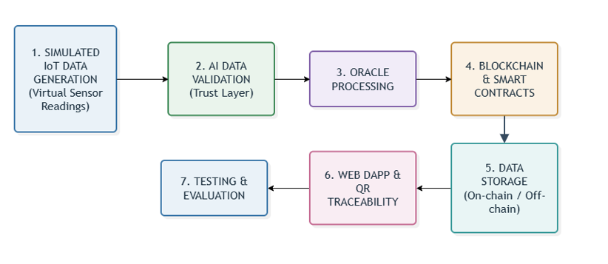

Slide 16
System Architecture

Slide 17
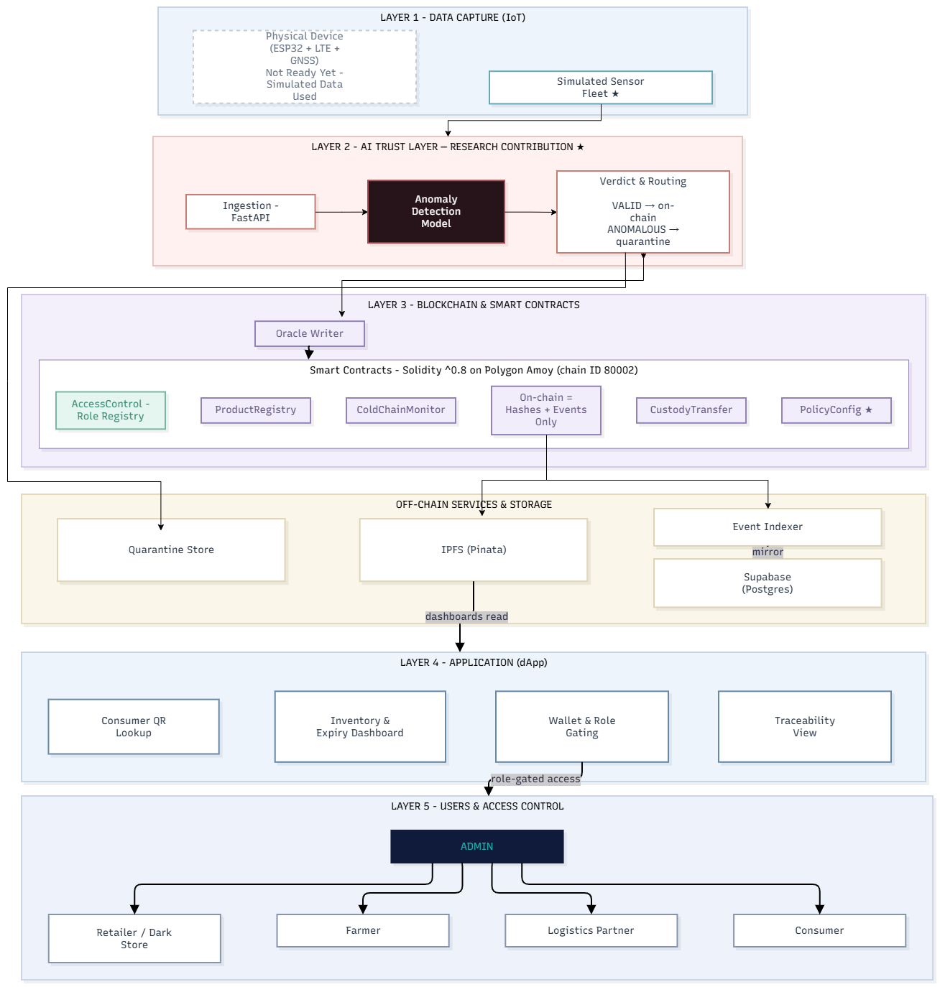

Slide 18
Software & Hardware Requirements Specification

Slide 19
Category | Component / Specification | Purpose in Architecture
Operating System | Windows 11 / Linux Ubuntu 22.04 LTS | Host environment for local nodes, backend, and development servers
Programming Languages | Python 3.11+, Solidity 0.8.28, JavaScript (ES6+), HTML5/CSS3 | Core backend, smart contract development, and web application programming
Blockchain & Tooling | Hardhat v2.22, Polygon Amoy Testnet (Chain ID 80002) | EVM execution environment, compilation, testing, and deployment
Smart Contract Library | OpenZeppelin Contracts v5.0 (AccessControl, Pausable) | Audited role-based access control and emergency circuit breaker patterns
AI & Machine Learning | Scikit-Learn (Isolation Forest), NumPy, SciPy | Unsupervised anomaly detection, multi-dimensional feature engineering
Backend Web Framework | FastAPI, Uvicorn (ASGI), Web3.py v6.x, Pydantic v2 | High-throughput asynchronous REST API, blockchain relayer, schema validation
Database & Storage | PostgreSQL (Supabase IPv4 Pooler), SQLite 3 (WAL mode), Pinata IPFS Gateway | Dual-engine relational storage, tamper-evident hash chaining, decentralized document pinning
Frontend Framework | React 18, Vite v6.0, Tailwind CSS v3.4, Lucide React | Responsive multi-role UI dashboards (Farmer, Logistics, Dark Store, Consumer, Admin)
IoT Simulation Engine | Python CLI Telemetry Simulator, Virtual Sensor Fleet, Synthetic Telematics Engine | Multi-vector environmental telemetry streaming, transit route generation, and simulated cold-chain monitoring.

Slide 20
Use Case Diagram

Slide 21
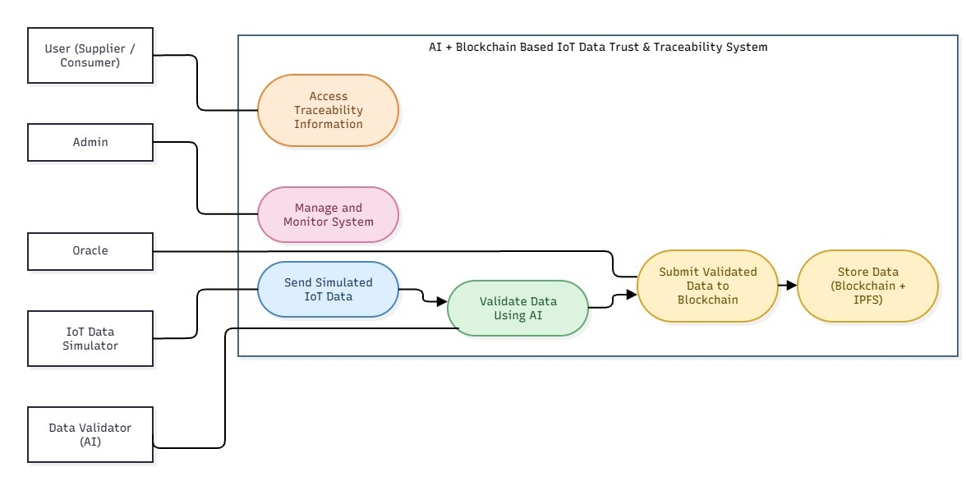

Slide 22
Key Features
IoT Cold-Chain Simulation: Generates continuous environmental streams with multi-class fault injection to stress-test perishable crop monitoring.
Pre-Chain AI Trust Layer: Acts as an intelligent gatekeeper using thermodynamic plausibility rules and an Isolation Forest model to filter spoofed or faulty data before blockchain write.
Immutable Blockchain Traceability: Anchors cryptographic SHA-256 audit hashes and verified batch events on a decentralized ledger to eliminate retroactive record tampering.
Custom Solidity Smart Contracts: Enforces strict forward-only custody transitions and automatically calculates carrier penalties for cold-chain SLA violations.
Intermediary-Free Farmer Escrow: Locks buyer funds in decentralized escrow and triggers direct payouts in integer currency (paise), eliminating predatory middleman deductions.
End-to-End Visibility & Consumer QR: Delivers role-based enterprise dashboards with live quarantine logs and empowers consumers with instant QR-code origin and ₹/kg price breakdown.

Slide 23
Design & Implementation

Slide 24
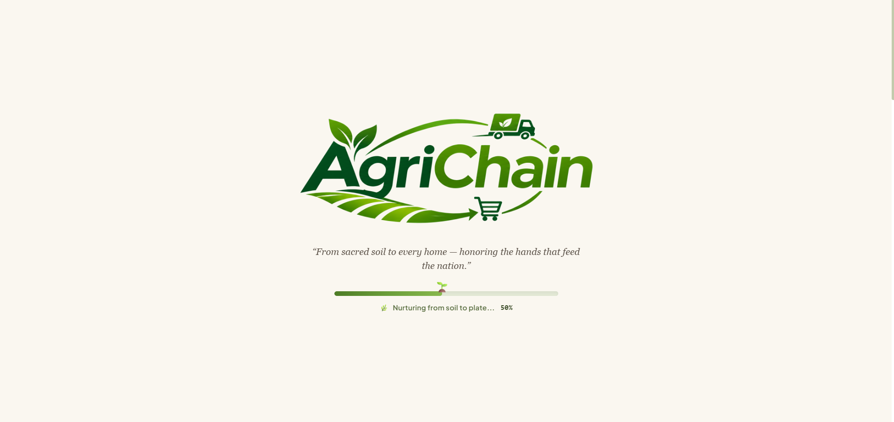

Slide 25
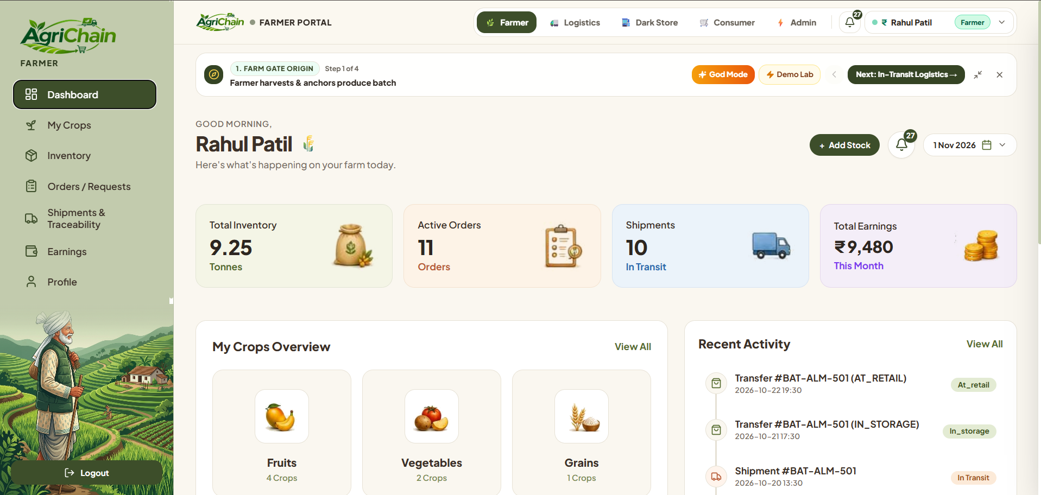
Farmer Dashboard for Agricultural Product and Batch Registration

Slide 26
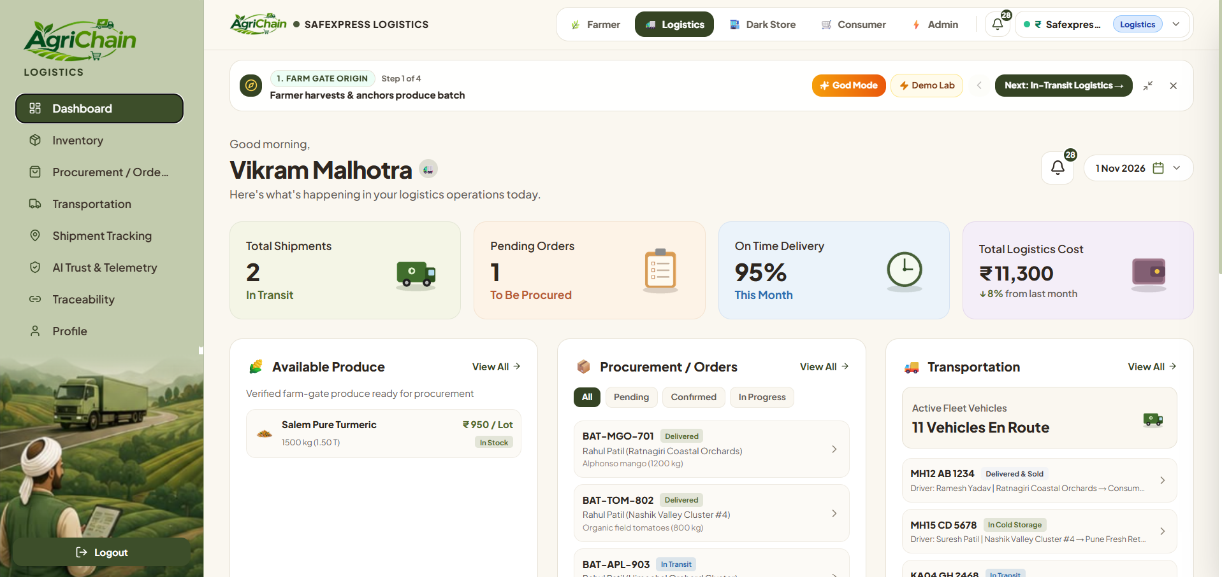
Logistics Dashboard for Product Dispatch and Tracking

Slide 27
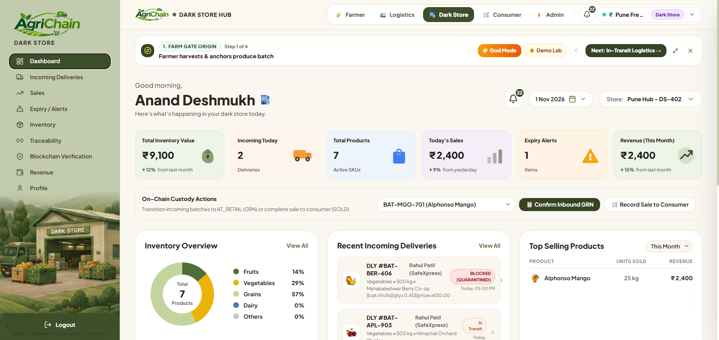
Dark-Store Dashboard for Product Receiving and Inventory Management

Slide 28
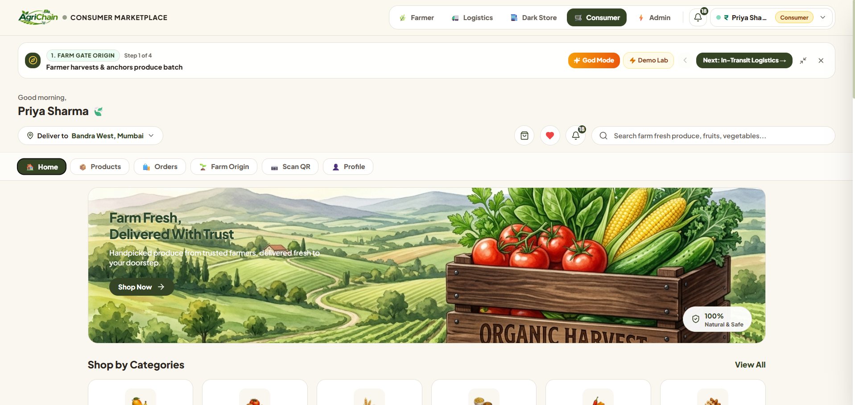
Consumer Interface for QR-Based Product Traceability

Slide 29
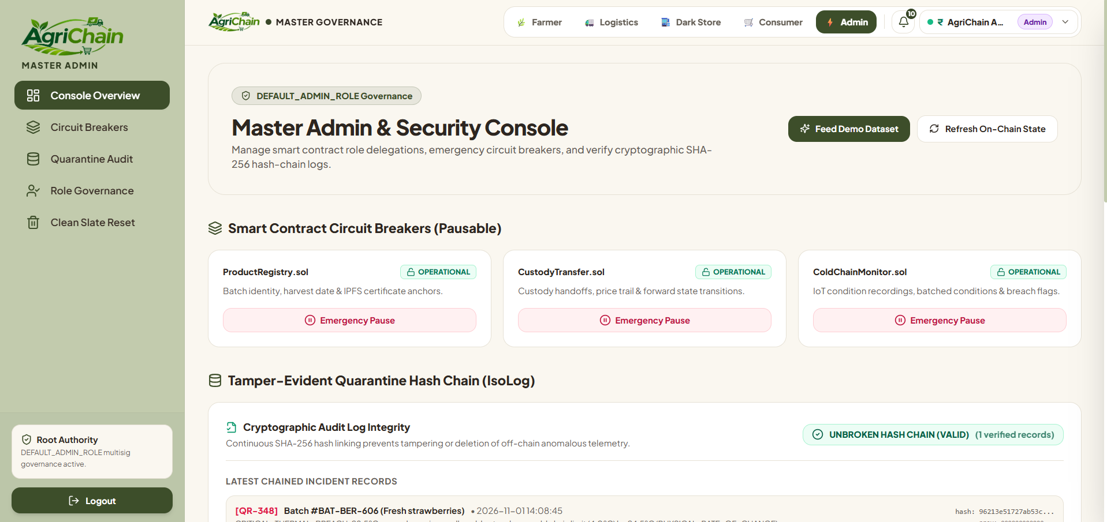
Administrative Dashboard for Supply Chain Governance and Circuit Breakers

Slide 30
Results

Slide 31
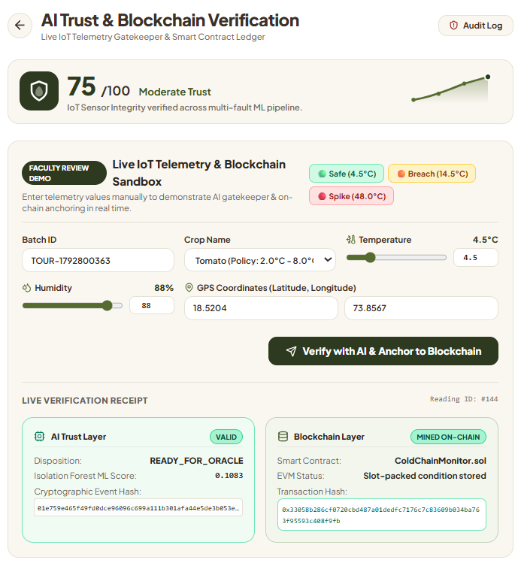
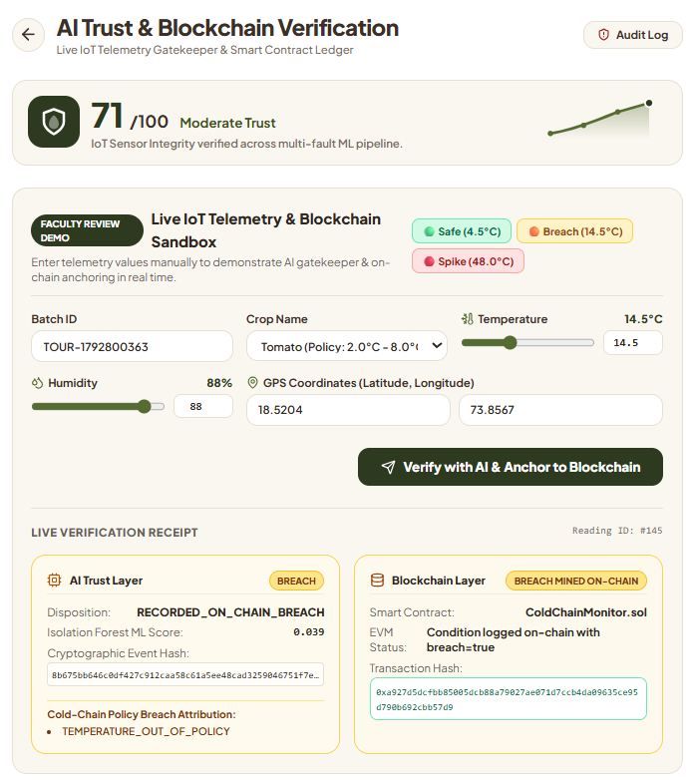
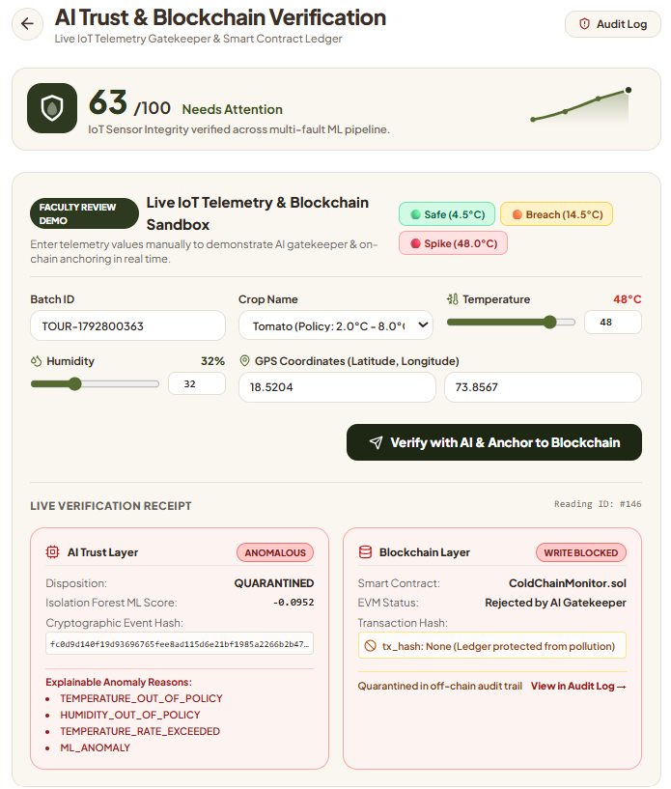
AI Trust Layer for IoT Telemetry Validation and Checkpoints

Slide 32
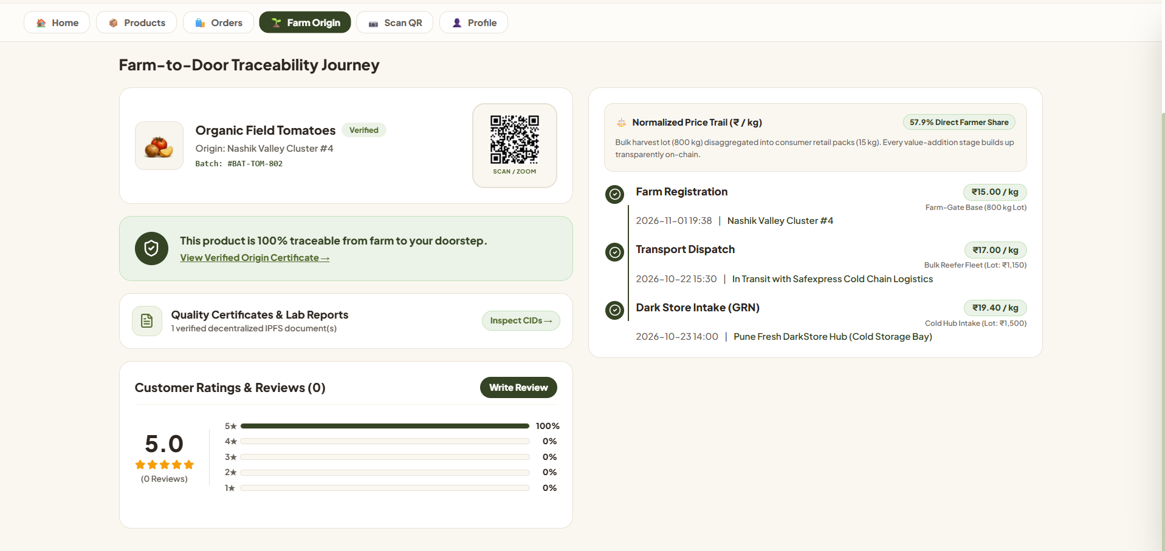
Farm-to-Fork Product Journey with Cumulative Price Breakdown

Slide 33
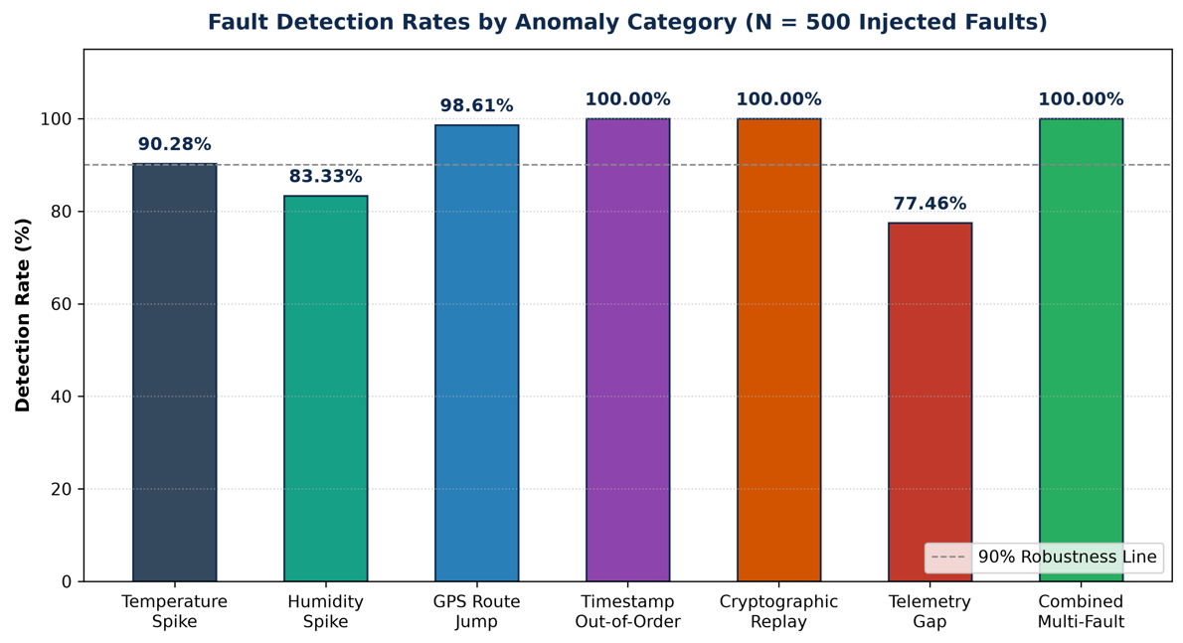
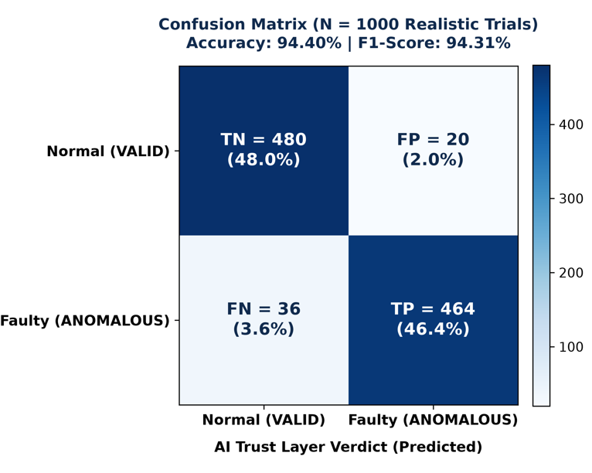
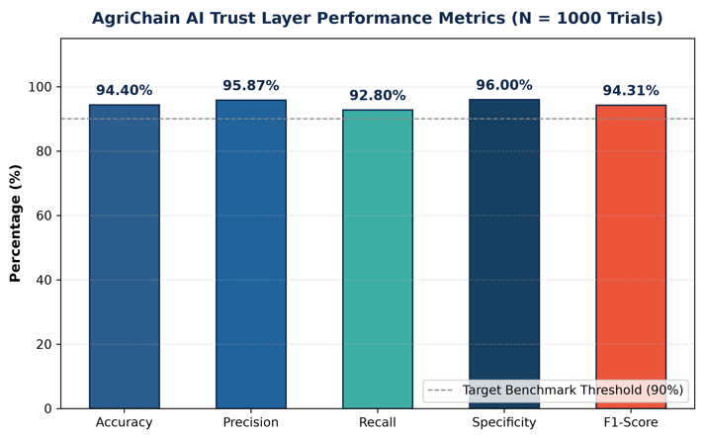
AI-Based Telemetry Anomaly Detection and Quarantine Isolation
Confusion Matrix of the AI-Based Anomaly Detection Model

Slide 34
Future Scopes
1. Physical IoT Hardware Deployment: Integrate real-time IoT sensors into refrigerated trucks for live temperature, humidity, and location monitoring.
2. Advanced AI Anomaly Detection: Implement LSTM and Temporal Autoencoders to detect gradual temperature changes and predict potential spoilage.
3. Automated Escrow and Digital Payments: Integrate smart contract-based payments with UPI or CBDC for faster and transparent farmer payments.
4. Offline-First Mobile Application: Develop a multilingual mobile app with offline support and Marathi/Hindi language options for rural farmers.
5. Dynamic Quality-Adjusted Pricing: Introduce automated price adjustments based on product quality and temperature exposure to reduce food waste and protect consumers.

Slide 35
Conclusion
The system resolves the blockchain-IoT Oracle dilemma by validating sensor telemetry through an AI Trust Layer before committing data on-chain.
Immutable smart contracts provide verifiable, end-to-end produce traceability across strict forward-only custody stages from farm to retail.
Automated cold-chain SLA monitoring replaces subjective manual inspections with objective, real-time penalty deductions for thermal breaches.
Direct smart contract escrow settlements ensure prompt, transparent, and fair compensation for farmers without intermediary cuts.
Consumers gain verifiable trust in crop origin and freshness through instant QR-code inspection backed by real-time audit logs.

Slide 36
References
[1] A. Agrawal et al., "Optimizing Supply Chain Management With IoE and AI," 2025.
[2] M. Mohamed, A. Al-Saleh, A. Sharma, and M. Tejani, "Zero-Day Exploits Detection with Adaptive WavePCA-Autoencoder (AWPA) Adaptive Hybrid Exploit Detection Network (AHEDNet)," Scientific Reports, 2025.
[3] A. Maurya et al., "Blockchain-Driven Security for IoT Networks: State-of-the-Art, Challenges and Future Directions," Peer-to-Peer Networking and Applications, 2025.
[4] D. Dudczyk, M. Dunston, and M. Crosby, "Blockchain Technology for Global Supply Chain Management: A Survey of Applications, Challenges, Opportunities and Implications," IEEE Access, 2024.
[5] S. Yavaprabhas, R. Kurnia, M. Seyedghorban, and D. Samson, "Demystifying the Impact of Blockchain on Trust in Emerging and Established Relationships: A Case of Organic Food Supply Chains," 2024.

Slide 37
Thank You

