Slide 1

“A Decentralized IoT-Blockchain Framework with Customized Smart Contracts for Transparent and Traceable Agricultural Supply Chains”
Presented By
Kerkar Suyash Satish (TU8S2425003)
Esaf Shanum Shakil (TU8S2425004)
Patil Rutuja Sanjeev (TU8S2425006)
Doctor Umerkhan Junaidkhan (TU8S2425008)
Under the Guidance of
Prof. Shraddha Rokade

Slide 2
Agenda
Introduction
Problem Statement
Objectives
Scope
Literature Survey
Methodology & Flow Chart of Project Work
Software & Hardware Requirement Specification
Use Case Diagram
Design and Implementation
Results
Conclusion
Future Scope
References

Slide 3
Introduction
Agricultural supply chains involve multiple stakeholders, making product origin, quality, transactions, and farmer payments difficult to track transparently.
IoT sensors and blockchain can provide real-time data and immutable records, but blockchain alone cannot verify whether the incoming sensor data is trustworthy.
Our proposed system introduces an AI Trust Layer to validate IoT data before recording it on the blockchain, while customized smart contracts manage traceability, custody, quality, and payment-related transactions.
The system aims to achieve transparent, trustworthy, end-to-end agricultural traceability while improving payment transparency and fairness for farmers.

Slide 4
Problem Statement
Traditional agricultural supply chains rely on fragmented, siloed record-keeping that leaves farmers, processors, distributors, retailers and consumers without real-time visibility or trust in product origin and quality. This lack of transparency enables food fraud, delayed recalls and poor accountability, while existing blockchain-based solutions remain proof-of-concept, still facing scalability, interoperability, smart-contract security and off-chain data-trust challenges. There is a need to design and implement a scalable, secure blockchain system with customized smart contracts that delivers real, end-to-end traceability across the agricultural supply chain.

Slide 5
Objectives
AI-Powered IoT Validation: Filter anomalous, drifted, or spoofed sensor telemetry before on-chain entry using physical plausibility bounds and an Isolation Forest ML model.
Tamper-Proof Custody Tracking: Enforce strict forward-only batch lifecycle transitions (REGISTERED → IN_TRANSIT → IN_STORAGE → AT_RETAIL → SOLD) using EVM smart contracts.
Automated Cold-Chain SLA Enforcement: Continuously monitor ambient conditions (temperature, humidity) and automatically compute dynamic penalties for environmental SLA breaches.
Fair & Transparent Farmer Payments: Guarantee secure, intermediary-free escrow settlements with direct-to-farmer payouts in integer currency units (paise).
Consumer Verification & Auditability: Enable instant QR-code provenance inspection for consumers and real-time quarantine audit trails for all supply chain participants.

Slide 6
Scope
• Farmer-Centric Supply Chain: Direct market access with fair grower pricing. | • Product & Custody Tracking: Strict sequential transitions (REGISTERED to SOLD).
• AI Sensor Validation: Pre-chain filtering of faulty/spoofed IoT telemetry via ML. | • Transparent Records: Tamper-evident ledger of all events and hashes.
• Blockchain Traceability: Immutable batch provenance and cryptographic audit logs. | • Farmer Payment Transparency: Automated escrow releases with zero unfair deductions.
• Custom Smart Contracts: Enforces SLA penalty rules and custody handoffs in Solidity. | • QR Farm-to-Consumer: Instant consumer mobile scan for origin and trust score

Slide 7
Literature Survey

Slide 8
RefNo | Paper Title | Author(s) & Year | Focus | Key Contribution | Limitation
1 | Blockchain Technology for Global Supply Chain Management: A Survey of Applications, Challenges, Opportunities and Implications | Dudczyk, Dunston & Crosby (2024) | Blockchain in Global Supply Chains | Reviews blockchain applications and benefits for global supply-chain transparency and traceability. | Lacks agriculture-specific evaluation.
2 | Revolutionizing Agri-Food Supply Chain Management with Blockchain-Based Traceability and Navigation Integration | Aggarwal, Rani, Rani & Sharma (2024) | Blockchain in Agri-food | Provides blockchain-based traceability and navigation for food provenance and consumer trust. | Scalability concerns in large-scale deployment.
3 | High-Efficiency Blockchain-Based Supply Chain Traceability | Wu, Jiang & Cao (2023) | Blockchain Traceability | Improves efficiency of blockchain-based supply-chain traceability by reducing search latency and storage overhead. | Limited real-world/large-scale validation.
4 | Integrating Blockchain Technology for Enhanced Transparency and Security in Supply Chains | Chaker & Damak (2024) | Blockchain for Supply Chain | Discusses blockchain integration for supply-chain transparency and security. | Mostly conceptual; limited quantitative evidence.
5 | Demystifying the Impact of Blockchain on Trust in Emerging and Established Relationships: A Case of Organic Food Supply Chains | Yavaprabhas, Kurnia, Seyedghorban & Samson (2024) | Blockchain in Organic Food | Examines how blockchain can improve trust in organic food supply-chain relationships. | Findings are context-specific to organic food.

Slide 9
RefNo | Paper Title | Author(s) & Year | Focus | Key Contribution | Limitation
1 | Optimizing Supply Chain Management With IoE and AI | Agrawal, Aronkar, Palav, Badre, Karumuri & Bagale (2025) | IoE & AI in SCM | Explores AI and Internet of Everything for supply-chain optimization and decision-making. | Lacks empirical validation in agricultural contexts.
2 | Zero-Day Exploits Detection with Adaptive WavePCA-Autoencoder (AWPA) Adaptive Hybrid Exploit Detection Network (AHEDNet) | Mohamed, Al-Saleh, Sharma & Tejani (2025) | ML-Based Security | Uses a hybrid ML approach for proactive zero-day exploit detection. | Requires high-quality, large training datasets.
3 | A Novel Malware Detection Model in the Software Supply Chain Based on LSTM and SVMs | Zhou, Li, Fu & Jiao (2024) | ML Malware Detection | Uses LSTM and SVM-based models for malware detection. | Higher model complexity increases deployment cost.
4 | Harnessing Advanced Hybrid Deep Learning Model for Real-Time Detection and Prevention of Man-in-the-Middle Cyber Attacks | Kandasamy & Roseline (2025) | Deep Learning Security | Applies hybrid deep learning for real-time MITM attack detection and prevention. | Computationally intensive for constrained devices.

Slide 10
RefNo. | Paper Title | Author(s) & Year | Focus | Key Contribution | Limitation
1 | Secure Pharmaceutical Supply Chain Using Blockchain in IoT Cloud Systems | Mangala, Naveen, Reddy, Buyya, Venugopal, Iyengar & Patnaik (2024) | Blockchain + IoT | Integrates blockchain with IoT-cloud systems for secure authentication and anti-counterfeiting. | High system complexity limits adoption.
2 | Enhancing Supply Chain Resilience and Efficiency Through Internet of Things Integration: Challenges and Opportunities | Shoomal, Jahanbakht, Componation & Ozay (2024) | IoT-Enabled SCM | Shows how IoT improves supply-chain resilience, efficiency and coordination. | Data privacy risks remain unresolved.
3 | Supply Chain Management Growth With the Adoption of Blockchain Technology (BoT) and Internet of Things (IoT) | Singh & Dadhich (2023) | Blockchain + IoT | Presents a model showing improved supply-chain coordination and visibility through Blockchain + IoT. | Lacks real implementation and empirical testing.
4 | Blockchain-Driven Security for IoT Networks: State-of-the-Art, Challenges and Future Directions | Maurya, Rishiwal, Yadav, Shiblee, Yadav, Agarwal & Chaudhry (2025) | IoT Security | Reviews blockchain-based approaches for improving IoT security and data protection. | Introduces computational overhead.
5 | Enhancing IoT Data Security: Using the Blockchain to Boost Data Integrity and Privacy | Eghmazi, Ataei, Landry & Chevrette (2024) | IoT Data Security | Uses blockchain to improve IoT data integrity, privacy and security. | Scalability with high sensor-data volume is not fully addressed.

Slide 11
RefNo. | Paper Title | Author(s) & Year | Focus | Key Contribution | Limitation
1 | Revolutionizing Agri-Food Supply Chain Management with Blockchain-Based Traceability and Navigation Integration | Aggarwal, Rani, Rani & Sharma (2024) | Agri-food Traceability | Improves end-to-end food provenance, traceability and consumer trust. | Scalability concerns in large-scale deployment.
2 | Demystifying the Impact of Blockchain on Trust in Emerging and Established Relationships: A Case of Organic Food Supply Chains | Yavaprabhas, Kurnia, Seyedghorban & Samson (2024) | Organic Food Supply Chain | Demonstrates blockchain's role in strengthening trust within organic food supply chains. | Findings are specific to organic food case studies.
3 | Optimizing Supply Chain Management With IoE and AI | Agrawal, Aronkar, Palav, Badre, Karumuri & Bagale (2025) | AI in Supply Chain | Explores AI and IoE for supply-chain optimization. | Lacks empirical validation in agricultural contexts.
4 | Enhancing Supply Chain Resilience and Efficiency Through Internet of Things Integration: Challenges and Opportunities | Shoomal, Jahanbakht, Componation & Ozay (2024) | IoT Supply Chain | Highlights IoT applications for real-time tracking and improved supply-chain resilience, including agri-food chains. | Privacy, interoperability and scalability challenges.
5 | Blockchain Technology for Global Supply Chain Management: A Survey of Applications, Challenges, Opportunities and Implications | Dudczyk, Dunston & Crosby (2024) | Global Supply Chain | Identifies blockchain's benefits for transparency and traceability across supply chains. | Does not specifically evaluate agricultural applications.

Slide 12
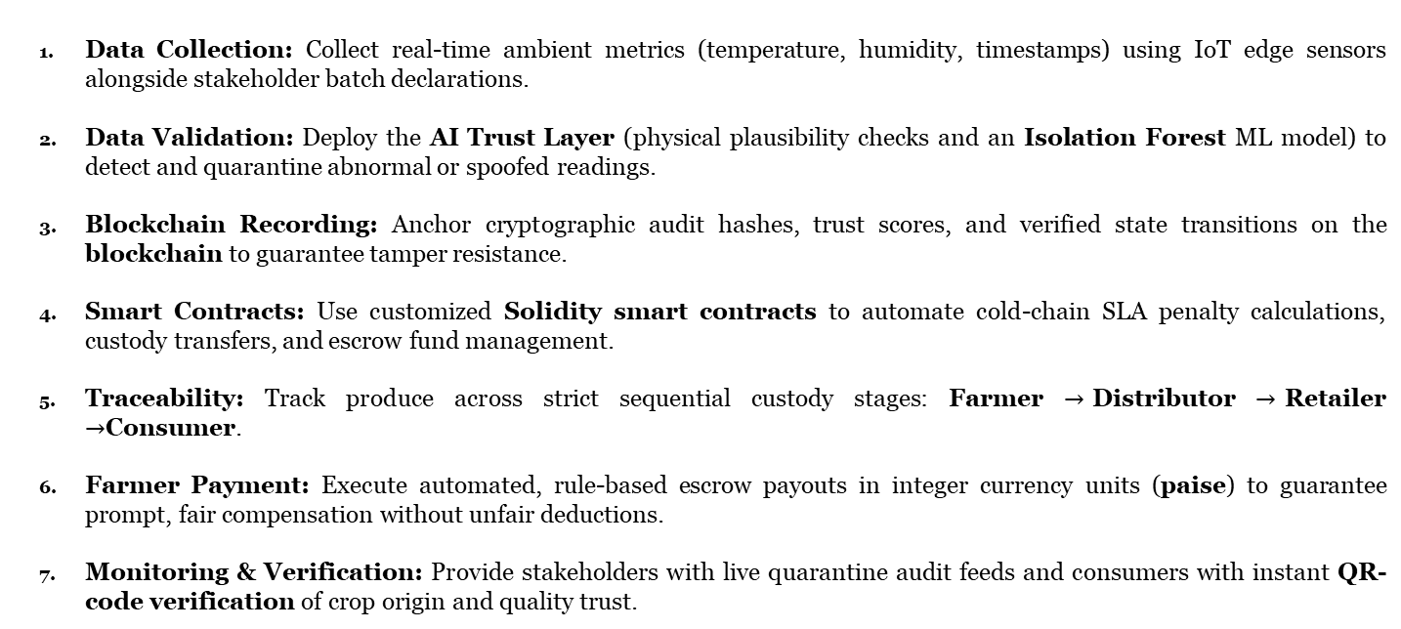
Proposed Methodology
Data Collection: Collect real-time ambient metrics (temperature, humidity, timestamps) using IoT edge sensors alongside stakeholder batch declarations.
Data Validation: Deploy the AI Trust Layer (physical plausibility checks and an Isolation Forest ML model) to detect and quarantine abnormal or spoofed readings.
Blockchain Recording: Anchor cryptographic audit hashes, trust scores, and verified state transitions on the blockchain to guarantee tamper resistance.
Smart Contracts: Use customized Solidity smart contracts to automate cold-chain SLA penalty calculations, custody transfers, and escrow fund management.
Traceability: Track produce across strict sequential custody stages: Farmer $→$Distributor $→$Retailer $→$Consumer.
Farmer Payment: Execute automated, rule-based escrow payouts in integer currency units (paise) to guarantee prompt, fair compensation without unfair deductions.
Monitoring & Verification: Provide stakeholders with live quarantine audit feeds and consumers with instant QR-code verification of crop origin and quality trust.

Slide 13
How It Is Better Than Existing Systems
Existing Systems | Our Proposed System (AgriChain)
• Blindly trusts IoT data (Garbage-In, Garbage-Out). | • AI Trust Layer filters and quarantines faulty or spoofed telemetry.
• Centralized records can be altered, delayed, or lost. | • Blockchain immutability guarantees tamper-proof custody history.
• Manual quality checks cause disputes and unfair deductions. | • Smart contracts automatically calculate cold-chain SLA penalties.
• Delayed farmer payments controlled by intermediaries. | • Automated escrow guarantees prompt, direct-to-farmer payouts.
• Consumers have no way to verify product journey or freshness. | • QR-code verification gives consumers full provenance transparency.
• Private logs offer no real-time auditability. | • Live quarantine audit feed provides transparent system oversight.

Slide 14
Flowchart

Slide 15
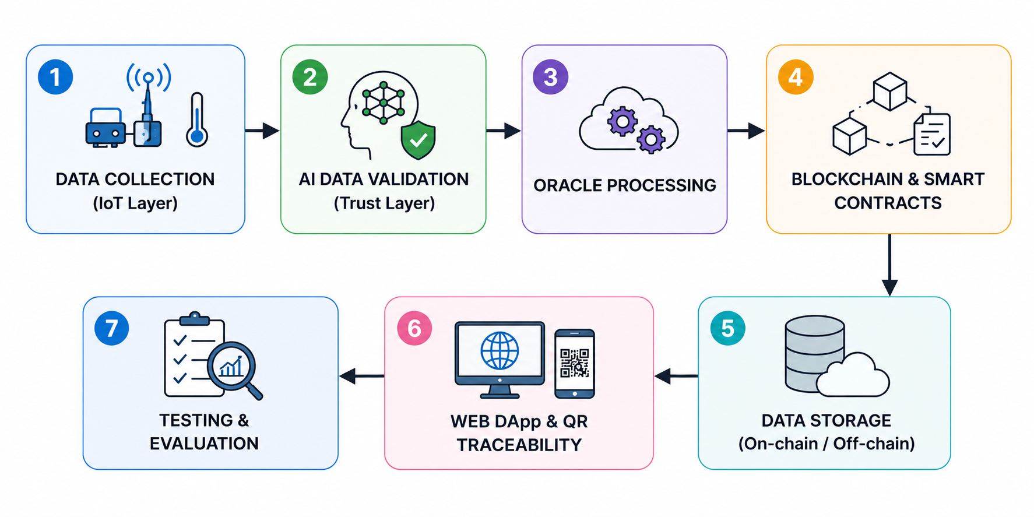

Slide 16
System Architecture

Slide 17
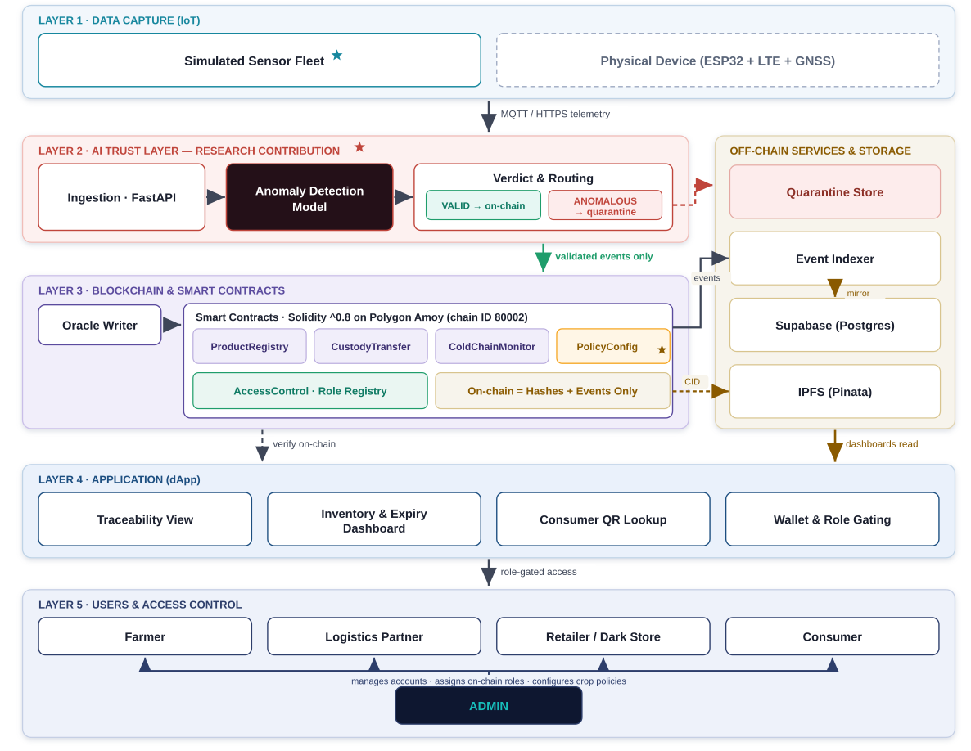

Slide 18
Software & Hardware Requirements Specification

Slide 19
Category | Component / Specification | Purpose in Architecture
Operating System | Windows 11 / Linux Ubuntu 22.04 LTS | Host environment for local nodes, backend, and development servers
Programming Languages | Python 3.11+, Solidity 0.8.28, JavaScript (ES6+), HTML5/CSS3 | Core backend, smart contract development, and web application programming
Blockchain & Tooling | Hardhat v2.22, Polygon Amoy Testnet (Chain ID 80002) | EVM execution environment, compilation, testing, and deployment
Smart Contract Library | OpenZeppelin Contracts v5.0 (AccessControl, Pausable) | Audited role-based access control and emergency circuit breaker patterns
AI & Machine Learning | Scikit-Learn (Isolation Forest), NumPy, SciPy | Unsupervised anomaly detection, multi-dimensional feature engineering
Backend Web Framework | FastAPI, Uvicorn (ASGI), Web3.py v6.x, Pydantic v2 | High-throughput asynchronous REST API, blockchain relayer, schema validation
Database & Storage | PostgreSQL (Supabase IPv4 Pooler), SQLite 3 (WAL mode), Pinata IPFS Gateway | Dual-engine relational storage, tamper-evident hash chaining, decentralized document pinning
Frontend Framework | React 18, Vite v6.0, Tailwind CSS v3.4, Lucide React | Responsive multi-role UI dashboards (Farmer, Logistics, Dark Store, Consumer, Admin)
IoT Hardware / Sim | ESP32 DevKit v1, DHT22 Sensor, NEO-6M GPS, Python CLI Simulator | Physical and synthetic multi-fault environmental telemetry streaming

Slide 20
Use Case Diagram

Slide 21
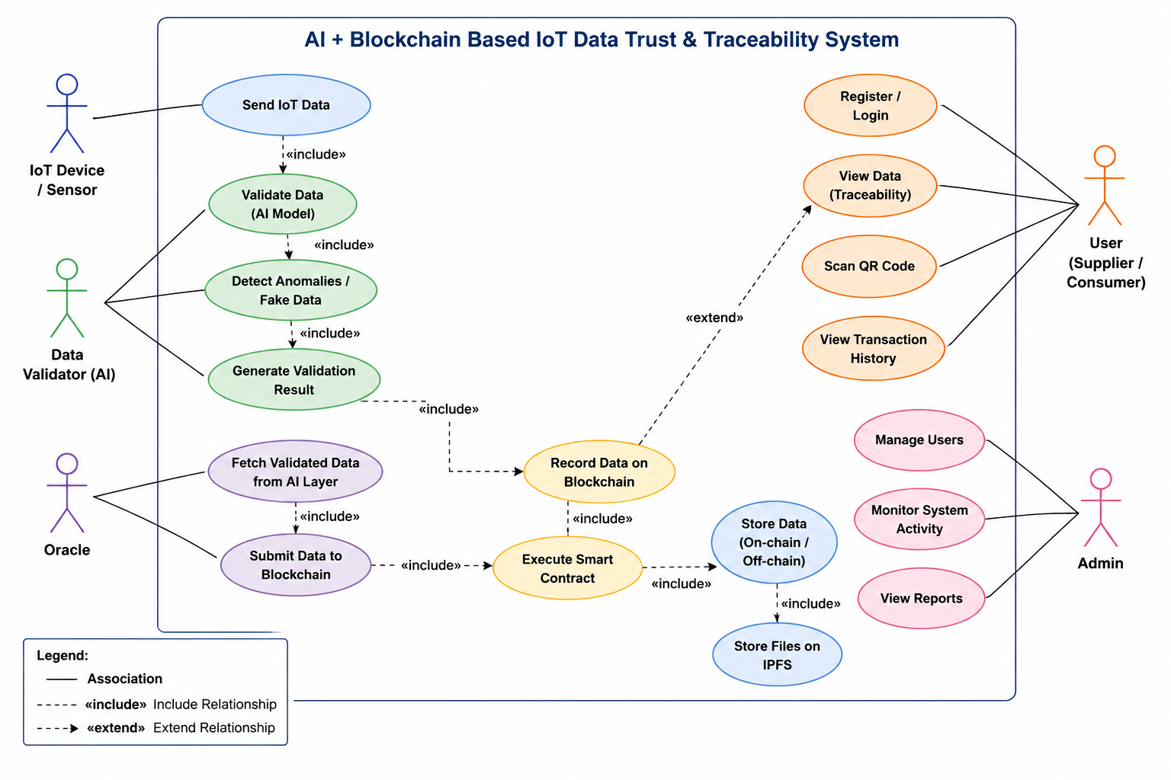

Slide 22
Key Features
IoT-Based Real-Time Monitoring (Simulator) – Simulates real-time cold-chain environmental streams (temperature, humidity, and location) to monitor perishable crop health continuously during storage and transit.
AI Trust Layer – Serves as an intelligent gatekeeper using physical plausibility rules and an Isolation Forest model to detect and quarantine faulty, drifted, or tampered sensor readings before blockchain entry.
Blockchain-Based Traceability – Immutably logs every verified batch lifecycle event and cryptographic audit hash on a decentralized ledger, preventing retrospective record tampering.
Customized Smart Contracts – Governs strict sequential custody transfers (REGISTERED → IN_TRANSIT → IN_STORAGE → AT_RETAIL → SOLD) and automatically calculates penalties for cold-chain SLA breaches.
Transparent Farmer Payments – Locks buyer deposits in automated smart contract escrow, releasing prompt, direct payouts to farmers without intermediary delays or arbitrary quality cuts.
End-to-End Supply Chain Visibility – Provides role-based dashboards with real-time quarantine audit feeds for stakeholders, and instant QR-code verification for consumers to check crop origin and freshness.

Slide 23
Design & Implementation

Slide 24
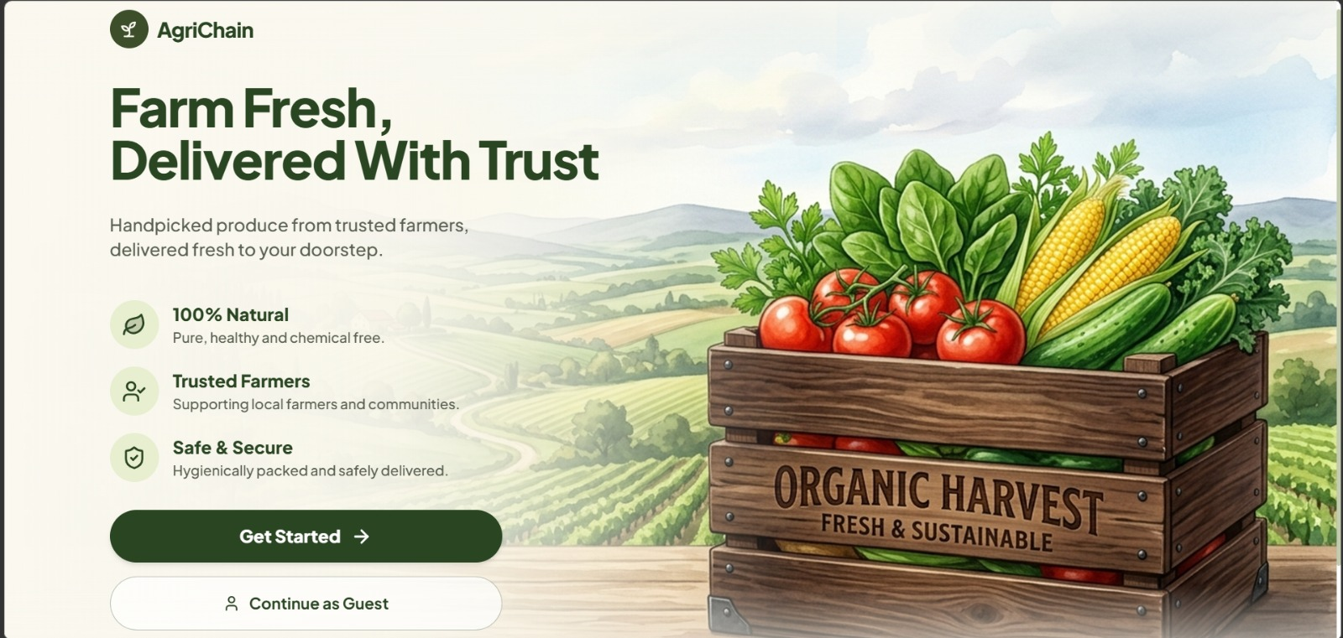

Slide 25
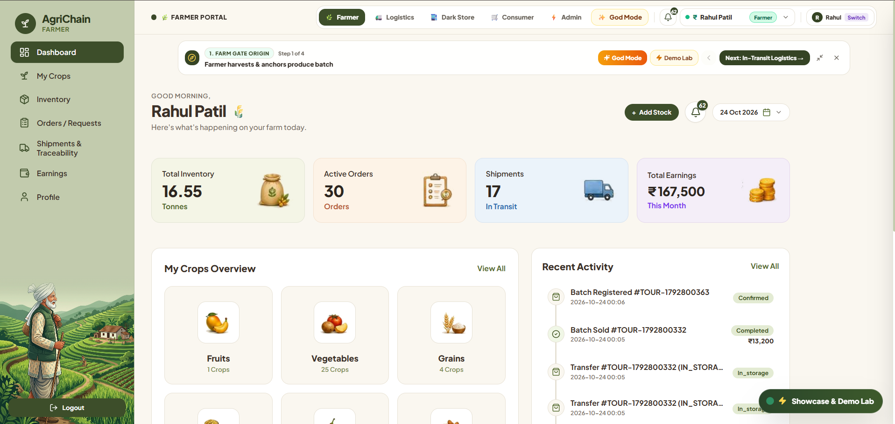
Farmer Dashboard for Agricultural Product and Batch Registration

Slide 26
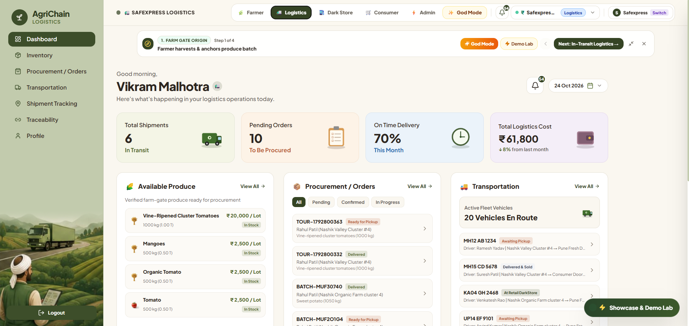
Logistics Dashboard for Product Dispatch and Tracking

Slide 27
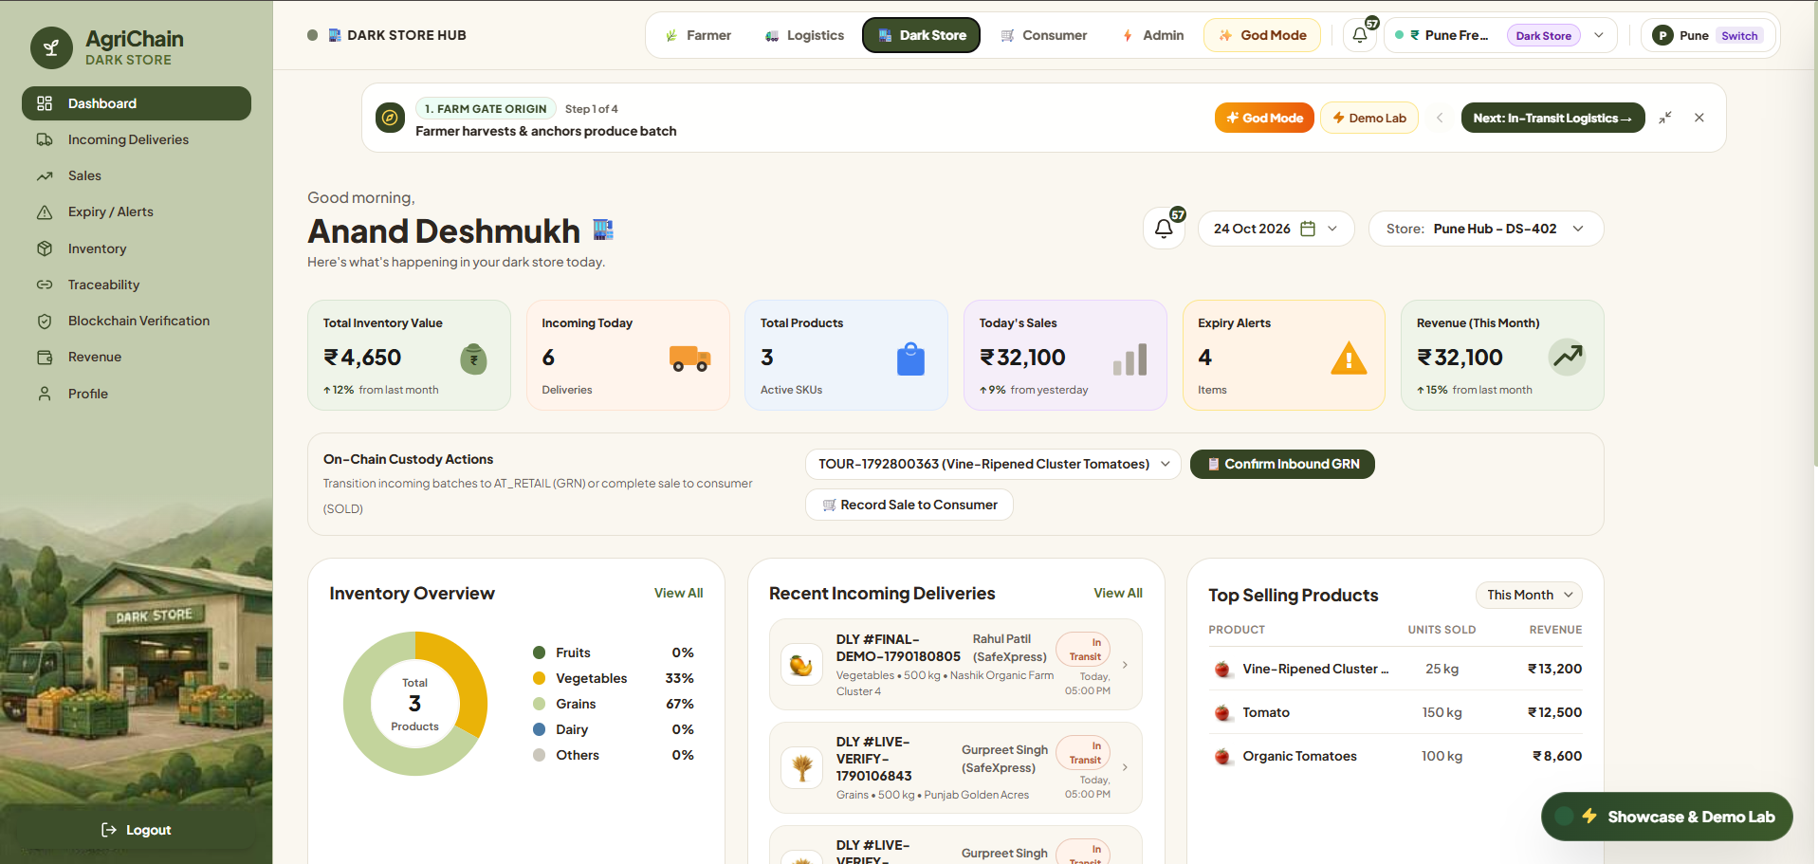
Dark-Store Dashboard for Product Receiving and Inventory Management

Slide 28
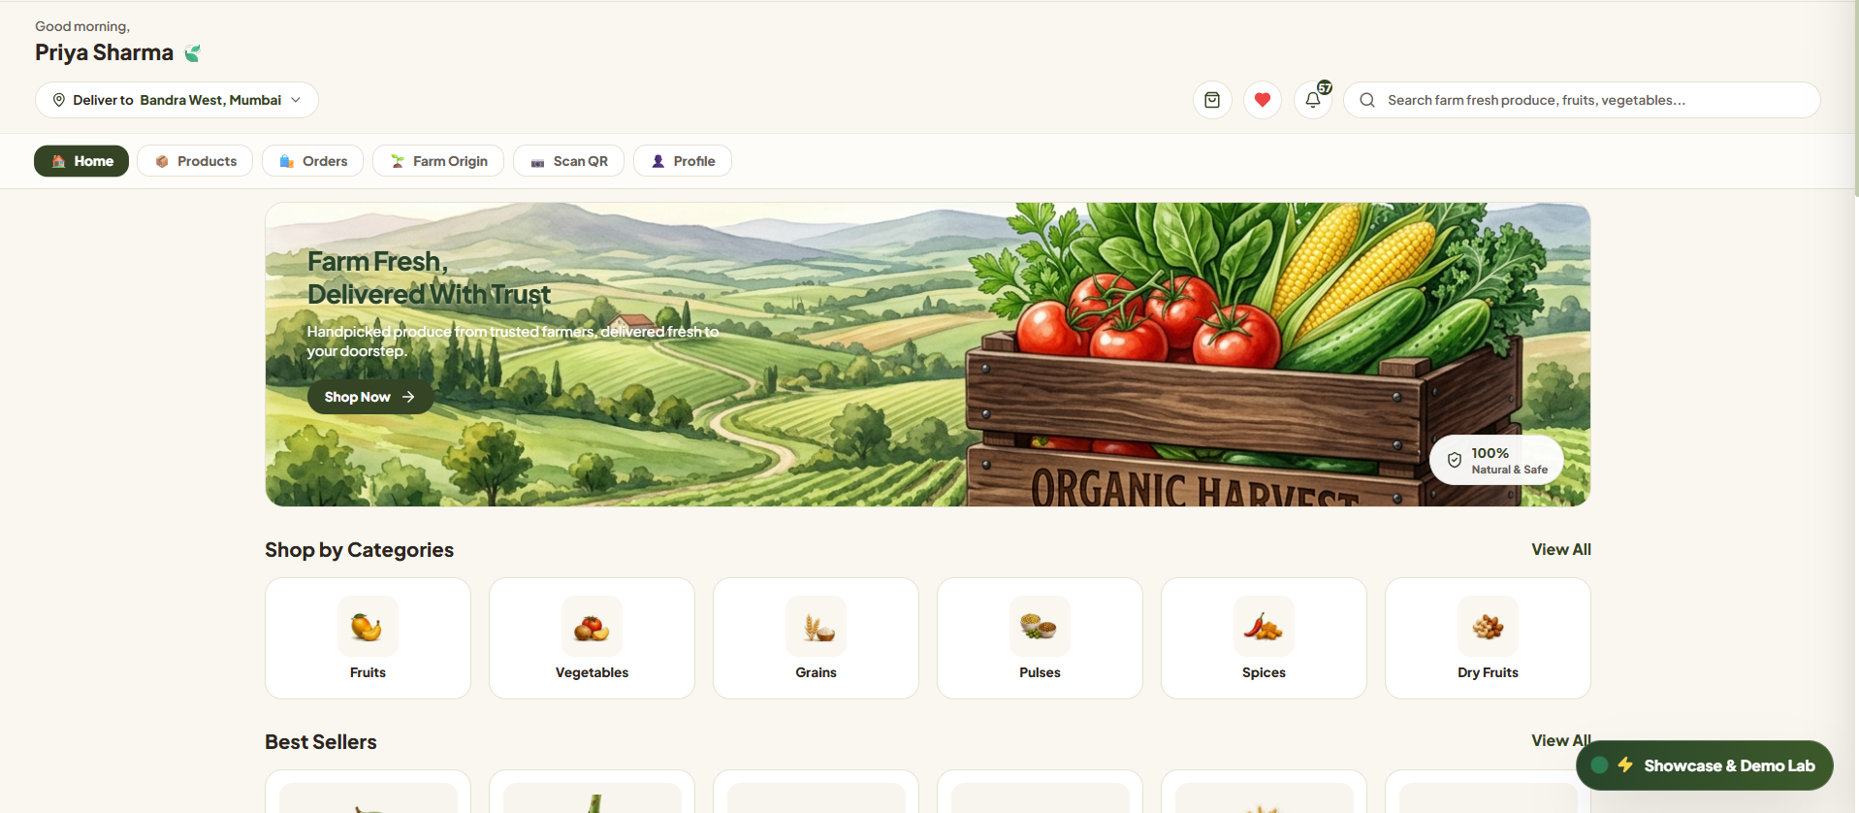
Consumer Interface for QR-Based Product Traceability

Slide 29
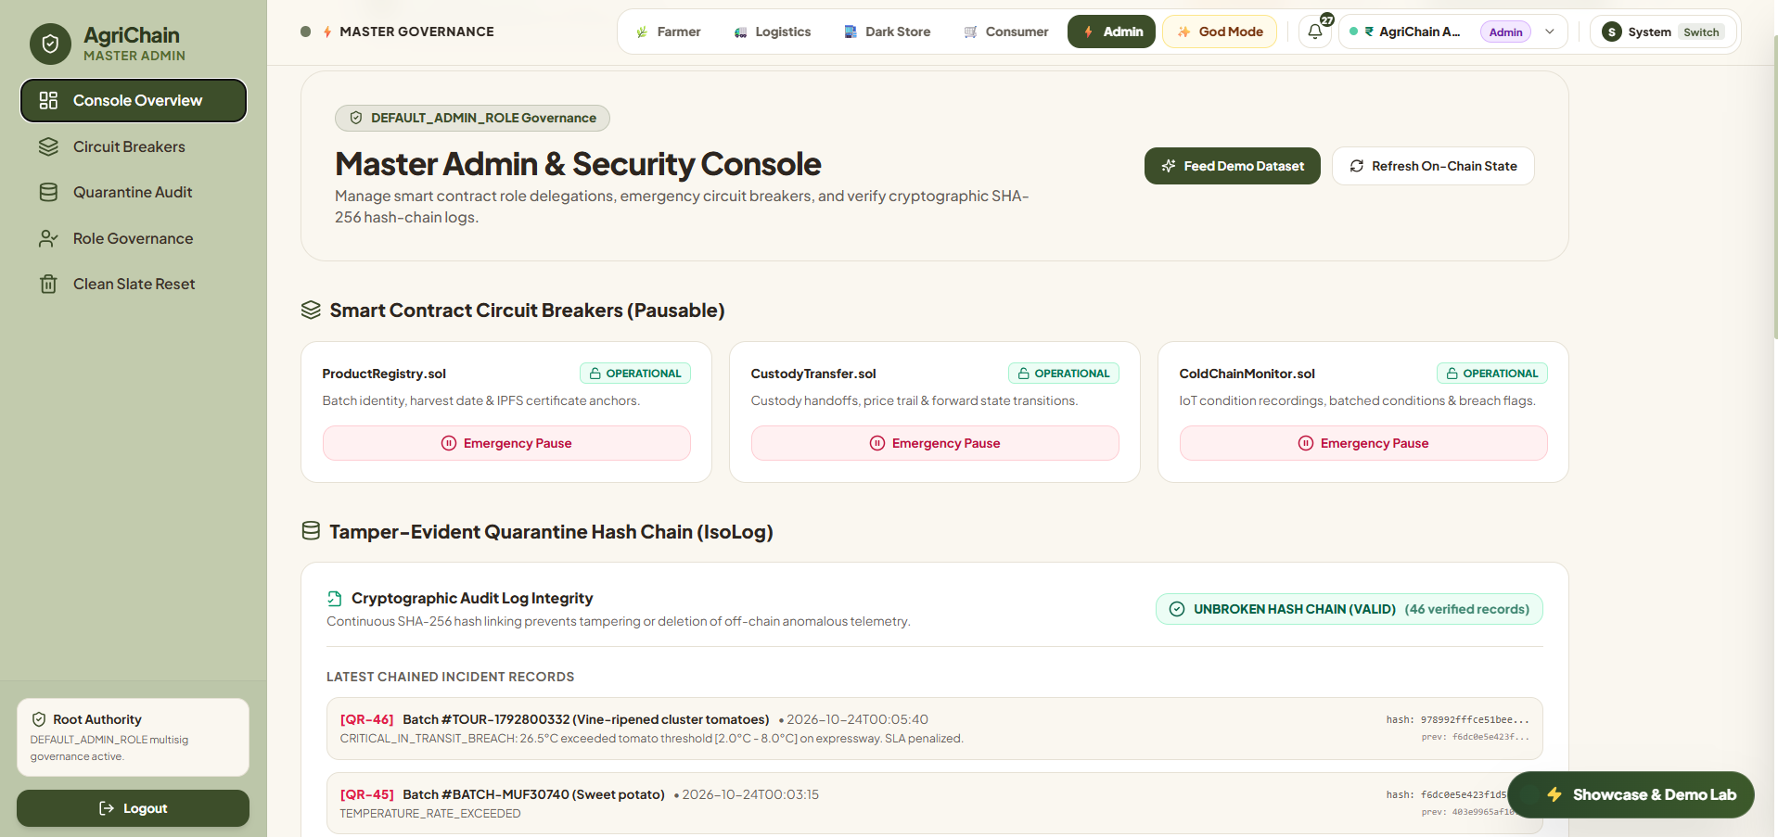
Administrative Dashboard for Supply Chain Governance and Circuit Breakers

Slide 30
Results

Slide 31
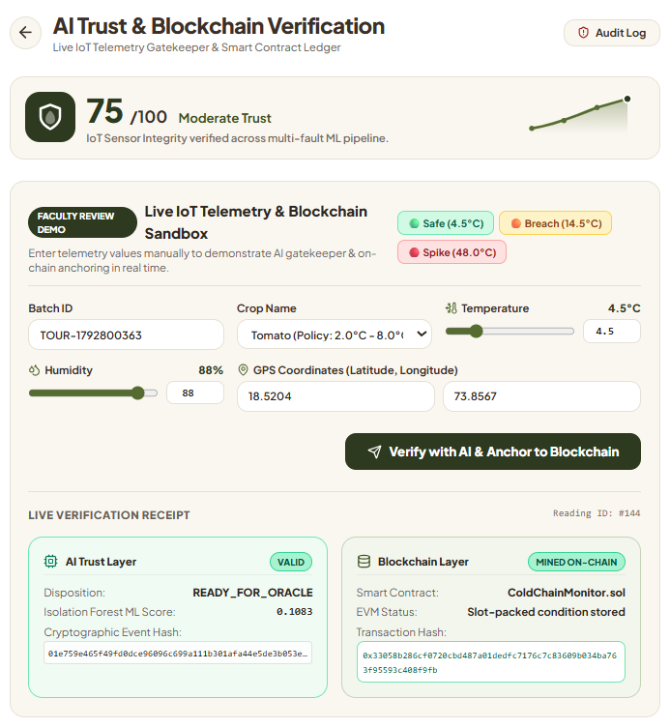
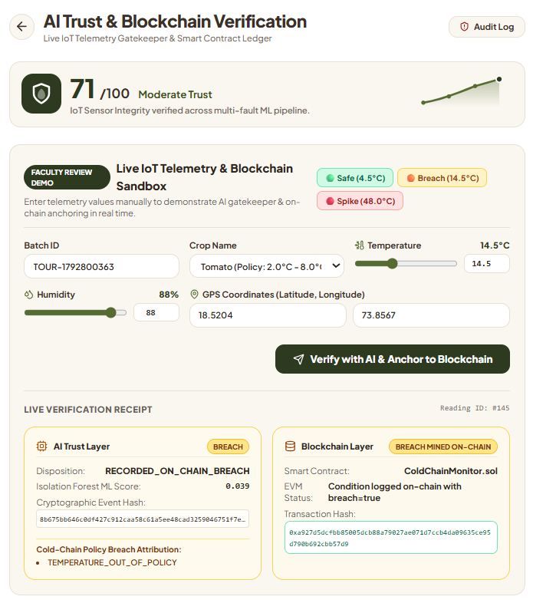
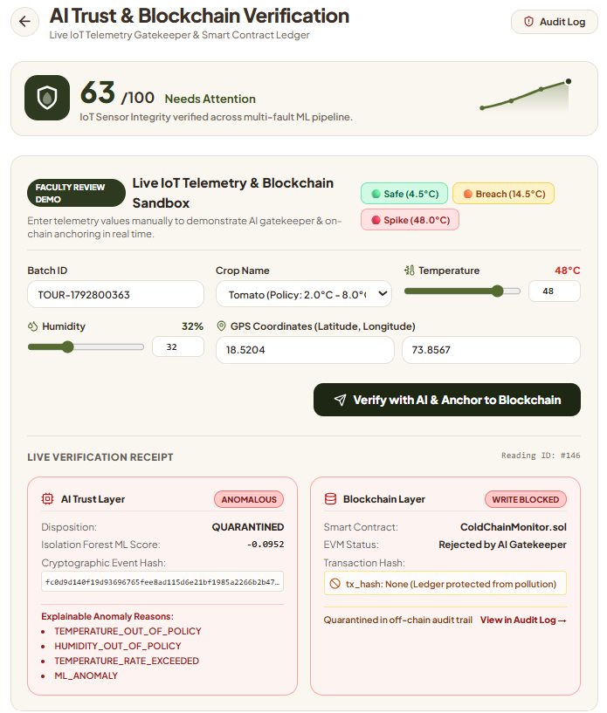
AI Trust Layer for IoT Telemetry Validation and Checkpoints

Slide 32
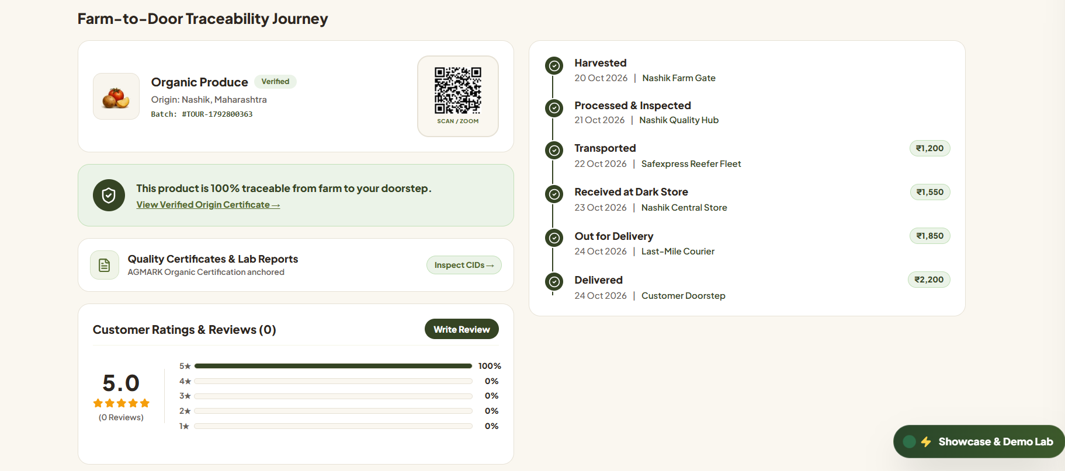
Farm-to-Fork Product Journey with Cumulative Price Breakdown

Slide 33
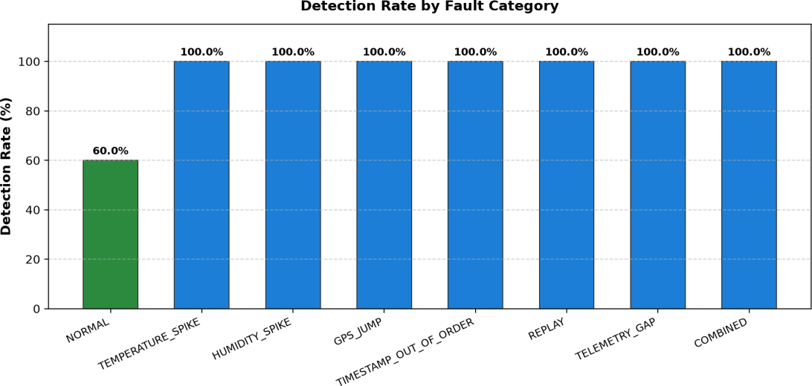
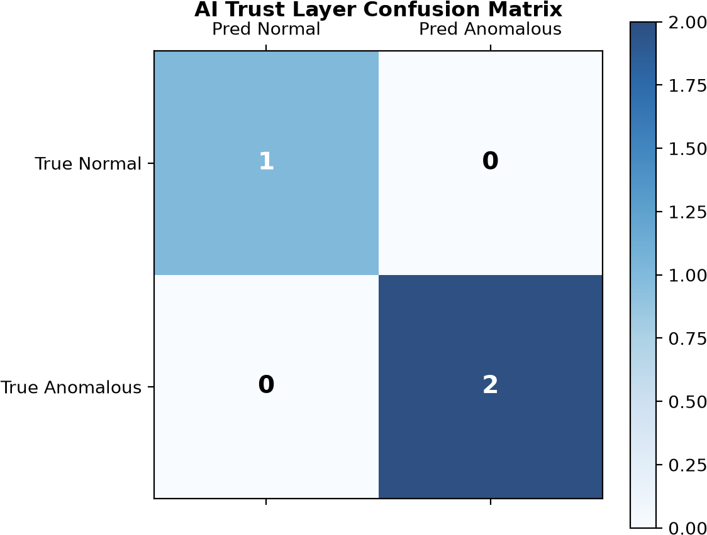
AI-Based Telemetry Anomaly Detection and Quarantine Isolation
Confusion Matrix of the AI-Based Anomaly Detection Model

Slide 34
Recorded End-to-End System Verification Outcomes (PRD Section 6 Suite)
Verification Area / Sub-System | Recorded Outcome | Scope of Automated Validation
Modular Smart-Contract RBAC Checks | PASS | Gating of registerBatch, transferCustody, recordCondition to assigned roles
Batched Condition Oracle Writes | PASS | EVM transaction execution of recordConditionsBatch fitting single gas slot
AI Trust Multi-Fault Evaluation | PASS | Detection of all 7 fault profiles (temp spikes, GPS teleportation, replay attacks)
Multi-Role Supply Chain Journey | PASS | State progression: REGISTERED -> IN_TRANSIT -> IN_STORAGE -> AT_RETAIL -> SOLD
IoT Hardware Breach & Push-Button Quarantine | PASS | Interception of 48 C thermal breaches and routing to quarantine hash-chain
Decentralized IPFS Quality Certificates | PASS | Pinata upload, CID generation (ipfs://Qm...), and on-chain hash anchoring
Dark Store Inbound Receiving & Checkout | PASS | GRN bay allocation, micro-inventory update, and retail checkout execution
Consumer Reviews & Rating Aggregation | PASS | Verified review submission strictly for SOLD batches with 5-star scoring
Multi-Stage Fair Price Distribution | PASS | Cumulative paise calculation verifying farmer price share transparency (50.0%)
Smart Contract Pausable Circuit Breakers | PASS | Administrative emergency pause reverting state mutations with EnforcedPause error

Slide 35
Future Scopes
• Advanced AI Validation: Deep learning for temporal trend analysis and predictive anomaly scoring. | • Automated Payments: Smart contract integration with real-world banking rails and UPI/CBDC.
• Real-Time IoT Hardware: Deploying physical edge sensors (temperature, humidity, GPS) across transit fleets. | • Farmer Mobile App: Multilingual, low-connectivity app designed for rural crop registration.
• Scalability & Layer-2: Rollup architectures and off-chain storage to handle multi-regional scale at low cost. | • Govt & Market Linkages: Connecting with e-NAM and agricultural portals for price discovery.
• Data Privacy & ZKPs: Zero-knowledge proofs to safeguard commercial secrets while proving compliance. | • Cross-Chain Interoperability: Interconnecting different public and enterprise blockchains.

Slide 36
Conclusion
The system overcomes the blockchain-IoT Oracle dilemma by validating sensor telemetry through an AI Trust Layer before committing data on-chain.
Immutable smart contracts provide verifiable, end-to-end produce traceability across strict forward-only custody stages from farm to retail.
Automated cold-chain SLA monitoring replaces subjective manual inspections with objective, real-time penalty deductions.
Direct smart contract escrow settlements guarantee prompt, transparent, and fair compensation for farmers without intermediary cuts.
Consumers gain complete trust in crop origin and freshness through instant QR-code verification backed by real-time audit logs.

Slide 37
References
[1] A. Agrawal et al., "Optimizing Supply Chain Management With IoE and AI," 2025.
[2] M. Mohamed, A. Al-Saleh, A. Sharma, and M. Tejani, "Zero-Day Exploits Detection with Adaptive WavePCA-Autoencoder (AWPA) Adaptive Hybrid Exploit Detection Network (AHEDNet)," Scientific Reports, 2025.
[3] A. Maurya et al., "Blockchain-Driven Security for IoT Networks: State-of-the-Art, Challenges and Future Directions," Peer-to-Peer Networking and Applications, 2025.
[4] D. Dudczyk, M. Dunston, and M. Crosby, "Blockchain Technology for Global Supply Chain Management: A Survey of Applications, Challenges, Opportunities and Implications," IEEE Access, 2024.
[5] S. Yavaprabhas, R. Kurnia, M. Seyedghorban, and D. Samson, "Demystifying the Impact of Blockchain on Trust in Emerging and Established Relationships: A Case of Organic Food Supply Chains," 2024.

Slide 38
Thank You

