Slide 1
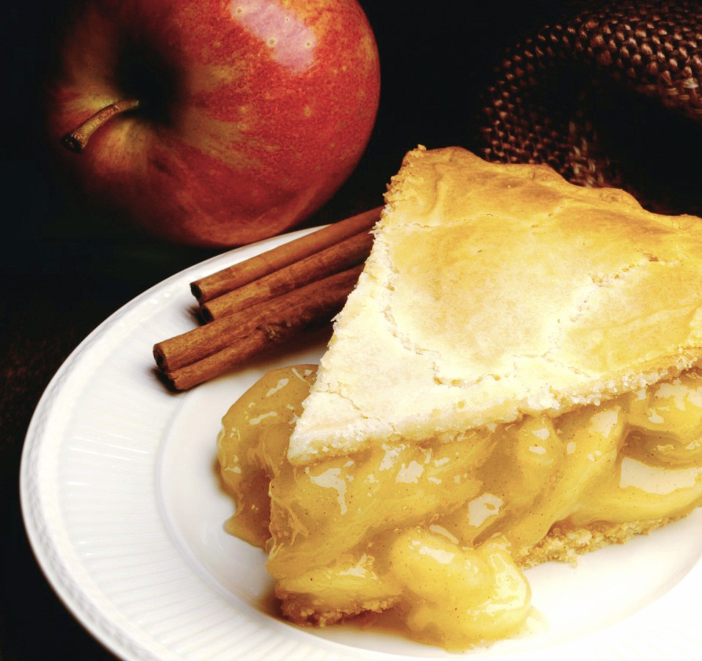
Weigh My plate (Team 19)
Enhancing Nutritional Awareness Through Image Recognition
Sumit Prakash(2023201020)
Suyash Khare(2023202017)
Suprabhat Kundu(2023201076)
Sushrut Naik(2023201064)

Slide 2
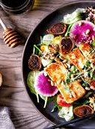
Introduction
Objective:
Revolutionize dietary choices image recognition.
Address the importance of nutritional awareness for overall well-being.
Approach:
Leverage image recognition technology.
Provide a user-friendly solution for informed food decisions.
Key Focus:
Empower individuals in making healthier dietary choices.
Foster a culture of informed decision-making through technology.
Impact:
Aim to transform how individuals perceive and select their food.
Contribute to a healthier and more conscious approach to dietary habits.

Slide 3
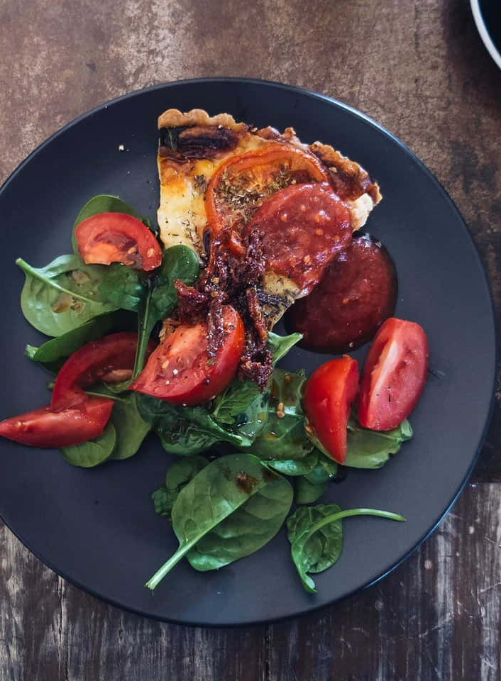
Core Features
User Login and Registration:
Enable personalized experiences through secure user authentication and registration processes.
Session Management:
Implement robust session management for a seamless and secure user interaction.
Object Detection with YOLOv5:
Utilize yellow to draw precise bounding boxes around objects and provide accurate labeling in given images.
Calorie Estimation from Object Volume:
Employ advanced algorithms to estimate the caloric content on a plate based on the volume of detected objects.
Calorie Database in MongoDB:
Utilize MongoDB to store and retrieve a comprehensive calorie database, ensuring efficient data management.

Slide 4
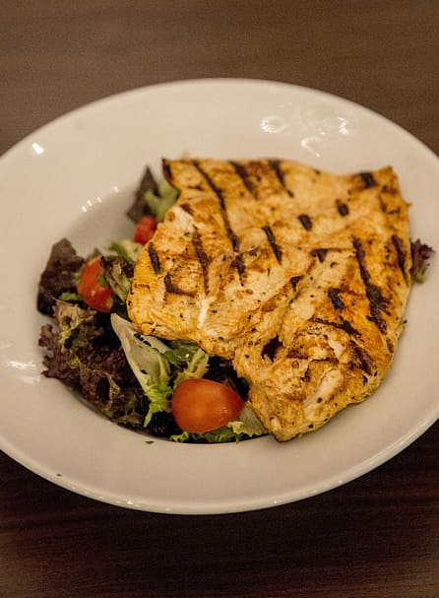
Technology Stack
MERN Stack Integration:
Leveraged the MERN stack (MongoDB, Express.js, React, Node.js) for end-to-end development.
Ensured a seamless and efficient integration of frontend (React) and backend (Node.js, Express.js) components.
Enabled dynamic and responsive user interfaces for enhanced user experience.
MongoDB Database :
Utilized MongoDB for storing and retrieving calorie data.
Ensured a scalable and efficient solution for managing a comprehensive calorie database.

Slide 5
Technology Stack
YOLOv5 Model Training :
Employed YOLOv5 for object detection, trained on a custom dataset with 557 images across 14 distinct classes.
Enabled the extraction of precise coordinates, including midpoint, height and width of bounding boxes.
Enhanced the accuracy of identifying and localizing objects on the plate.
MiDaS Model Integration :
Implemented the MiDas (Monocular Depth Estimation in an Adversarial Setting) model for depth estimation.
Generated two-dimensional depth matrix
Enabled accurate volume calculations by pinpointing depth at the midpoint of each bounding box.

Slide 6
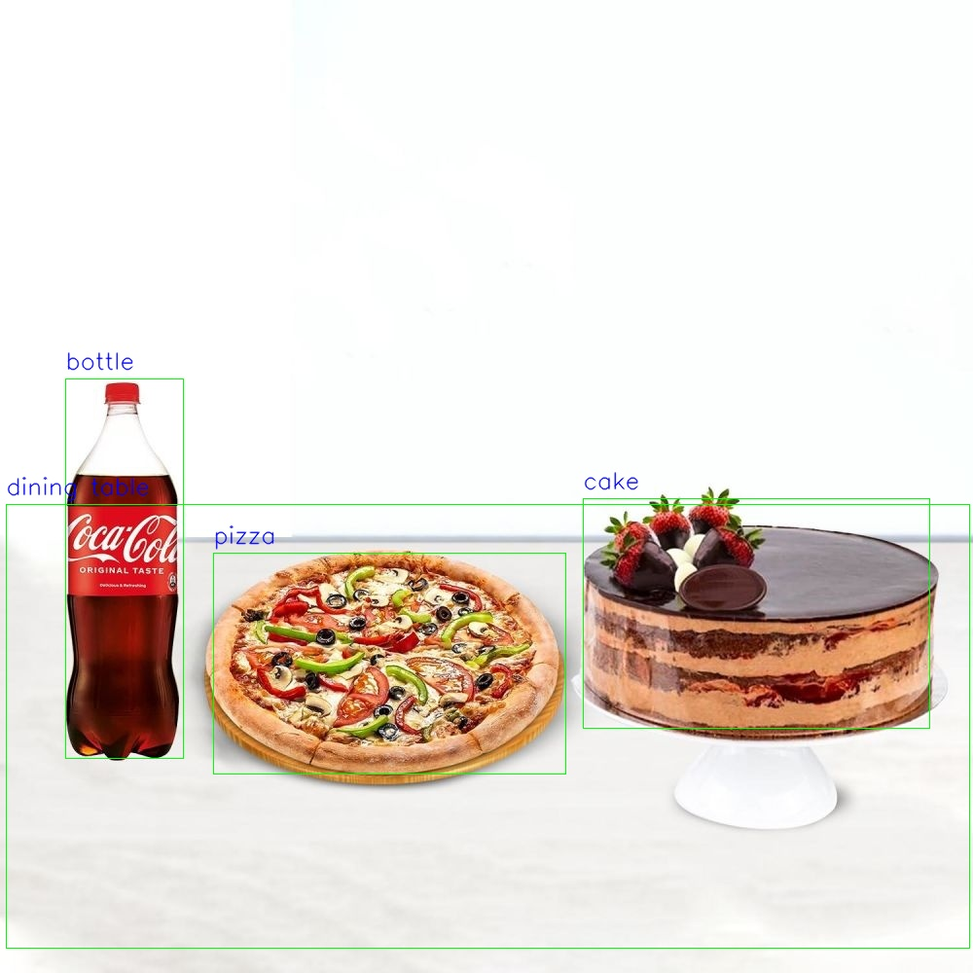
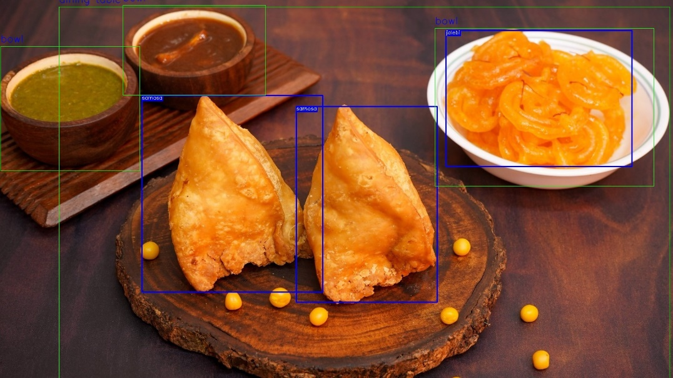
Annotated Examples

Slide 7

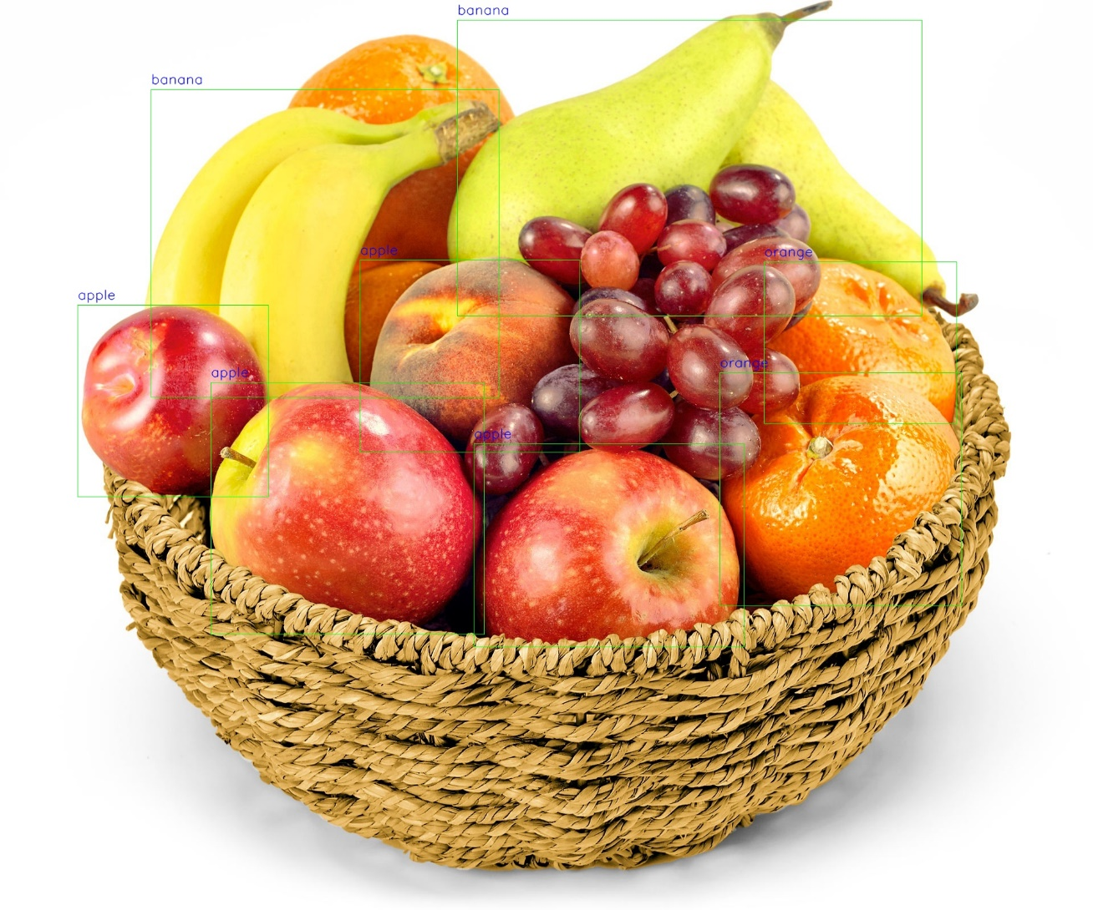

Slide 8
Future Enhancements
Integration with Wearable Devices:
Discuss the possibility of future integrations with wearable devices for continuous health monitoring and feedback.
Community and Social Features:
Explore the potential for incorporating community and social features, fostering a supportive environment for users on their health and wellness journey.
Accuracy Improvements:
Increase the dataset size, adding more images for every class from different angles to improve the accuracy of the model

Slide 9
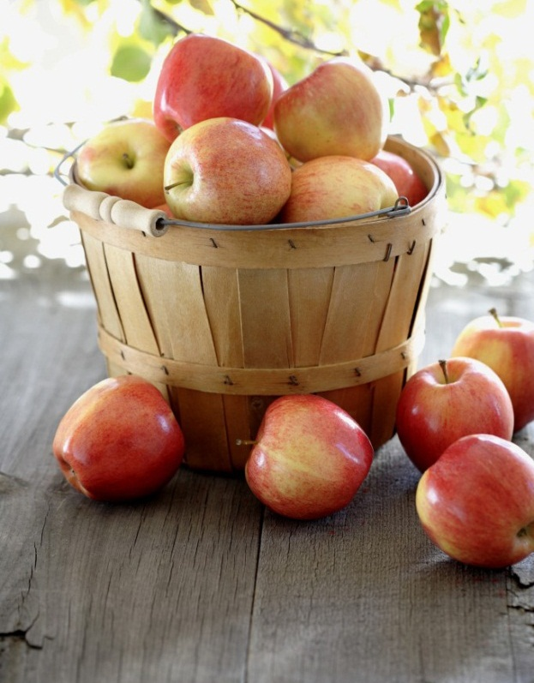
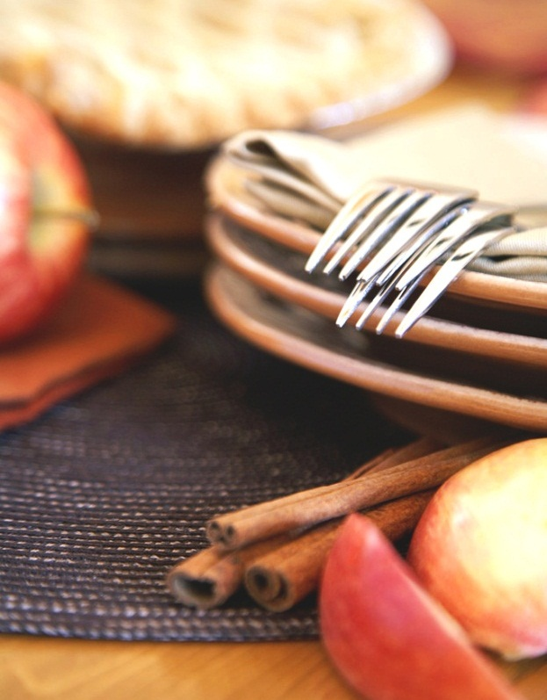
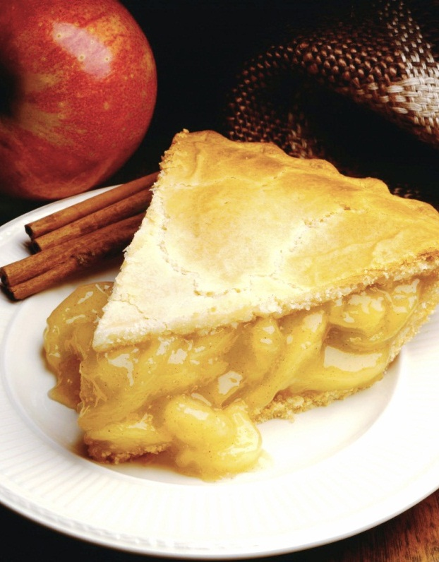
Thank You
Notes:
NOTE: To replace a picture, just select and delete it. Then use the Insert Picture icon to replace it with one of your own!

