Slide 1

Slide 1
Key concept overview
Key insight

Slide 2

Slide 2
Key concept overview
Key insight

Slide 3

Slide 3
Key concept overview
Key insight

Slide 4

Slide 4
Key concept overview
Key insight

Slide 5
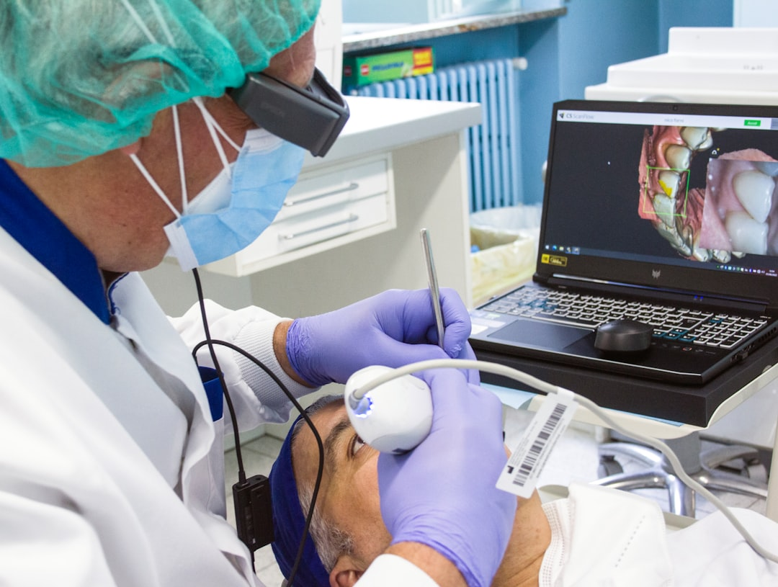
Slide 5
Key concept overview
Key insight

Slide 6

Slide 6
Key concept overview
Key insight

Slide 7

Slide 7
Key concept overview
Key insight

Slide 8
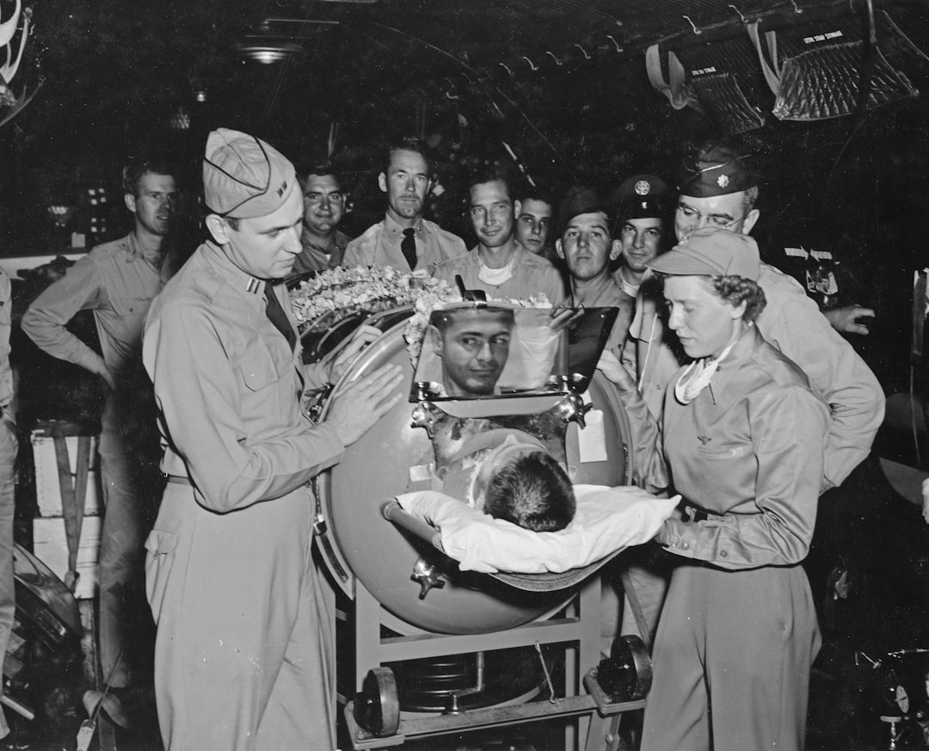
Slide 8
Key concept overview
Key insight

Slide 9
Slide 9
Key concept overview
Key insight

Slide 10
Slide 10
Key concept overview
Key insight

Slide 11
Slide 11
Key concept overview
Key insight

Slide 12
Slide 12
Key concept overview
Key insight

Slide 13
Slide 13
Key concept overview
Key insight

Slide 14
Slide 14
Key concept overview
Key insight

