Slide 1
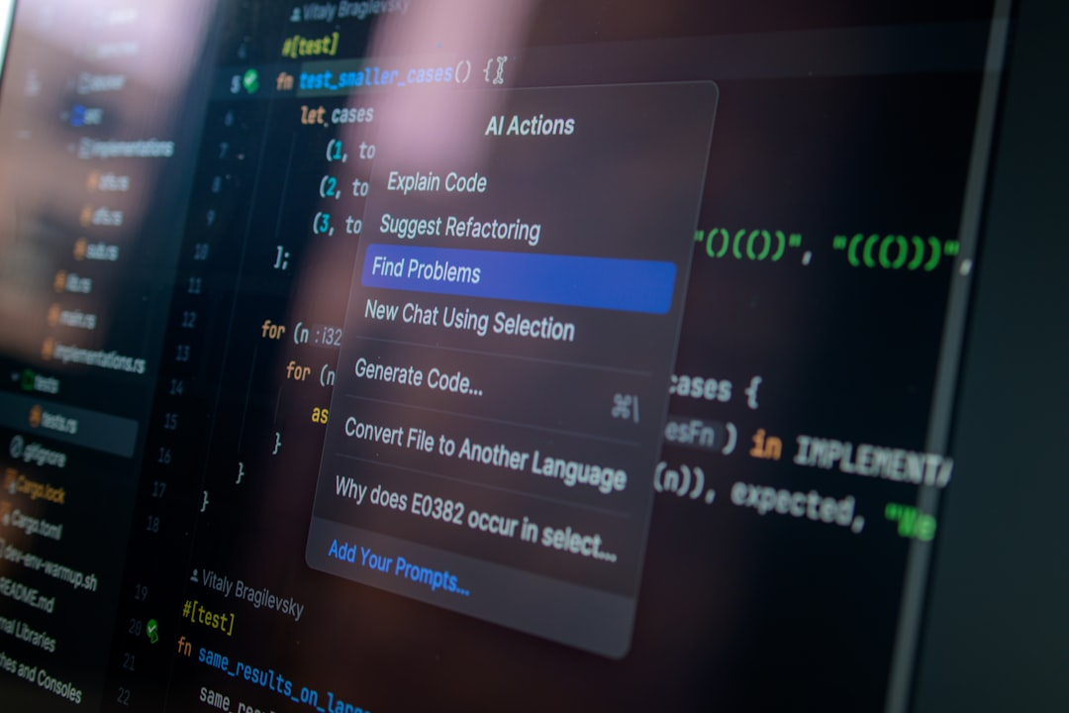
Overview of Artificial Intelligence
Artificial intelligence (AI) simulates human intelligence processes
Tasks include learning, reasoning, problem-solving, perception, and language understanding
Machine learning is a subset of AI that allows machines to learn from data
Deep learning uses neural networks to model and process data

Slide 2

Applications of Artificial Intelligence
AI is used in healthcare, finance, transportation, and entertainment
Healthcare: diagnosis, personalized treatment plans
Finance: fraud detection, trading algorithms
Transportation: autonomous vehicles, route optimization

Slide 3

Machine Learning and Deep Learning
Machine learning enables machines to learn from data without explicit programming
Deep learning uses neural networks to process complex data
Neural networks mimic the human brain's structure
Deep learning is used in image recognition, natural language processing

Slide 4

Ethical Considerations in Artificial Intelligence
Bias in algorithms can lead to discriminatory outcomes
Job displacement due to automation and AI technologies
Privacy concerns with data collection and surveillance
Transparency and accountability in AI decision-making processes

Slide 5

Future of Artificial Intelligence
Continued advancements in AI technology
Integration of AI in everyday life and business operations
Need for regulations and ethical frameworks
Collaboration between humans and AI for optimal outcomes

