Slide 1


Computations in Chemical Engineering: Graphs and Monte Carlo Simulation
Made by :
SUYASH JINDAL
221113
Mentor:-VAIBHAV AGRAWAL & SAMARTH AGRAWAL

Slide 2
STACKS AND QUEUES DATA STRUCTURES
STACK
QUEUE
LIFO (Last In, First Out) principle
Operations:
Push: Add an element to the top
Pop: Remove an element from the top
Peek/Top: View the top element
Use Cases:
Function call management
Undo mechanisms in software
FIFO (First In, First Out) principle
Operations:
Enqueue: Add an element to the end
Dequeue: Remove an element from the front
Front: View the front element
Use Cases:
Task scheduling
Order processing systems

Slide 3
LINKED LIST DATA STRUCTURE
Definition:
A collection of nodes where each node contains data and a reference to the next node in the sequence.
Types:
Singly Linked List:
Each node points to the next node.
Doubly Linked List:
Each node points to both the next and previous nodes.
Circular Linked List:
The last node points back to the first node.
Operations:
Insertion: Add a node at the beginning, end, or specific position.
Deletion: Remove a node from the beginning, end, or specific position.
Traversal: Access each node sequentially.
Use Cases:
Dynamic memory allocation
Implementing stacks and queues
Managing playlists in media players

Slide 4
TREE DATA STRUCTURE
Definition:
A hierarchical structure consisting of nodes, with a single root node and sub-nodes forming a parent-child relationship.
Key Components:
Root: The top node.
Node: Contains data and references to child nodes.
Leaf: A node with no children.
Edge: Connection between two nodes.
Types:
Binary Tree: Each node has at most two children.
Binary Search Tree (BST): Left child < Parent < Right child.
Operations:
Insertion: Add a node.
Deletion: Remove a node.
Traversal:
In-order: Left, Root, Right.
Pre-order: Root, Left, Right.
Post-order: Left, Right, Root.
Use Cases:
Hierarchical data representation (e.g., file systems)
Databases and indexing
Network routing algorithms

Slide 5
GRAPH DATA STRUCTURE
Definition:
A collection of nodes (vertices) connected by edges.
Key Components:
Vertex (Node): Fundamental unit of the graph.
Edge: Connection between two vertices.
Degree: Number of edges connected to a vertex.
Path: Sequence of edges connecting vertices.
Cycle: Path that starts and ends at the same vertex.
Types:
Undirected Graph: Edges have no direction.
Directed Graph (Digraph): Edges have a direction.
Weighted Graph: Edges have weights/costs associated.
Unweighted Graph: Edges have no weights.
Operations:
Traversal:
Depth-First Search (DFS): Explore as far as possible along a branch before backtracking.
Breadth-First Search (BFS): Explore all neighbors at the present depth prior to moving on to nodes at the next depth level.
Shortest Path: Find the minimum path between two vertices (e.g., Dijkstra's Algorithm).
Connectivity: Check if there is a path between any two vertices.
Use Cases:
Social networks (e.g., connections between people)
Network routing (e.g., internet data transfer)
Graph-based recommendation systems

Slide 6
Dijkstra's Algorithm in Graphs
Main Concept:
An algorithm for finding the shortest paths between nodes in a graph, which may represent, for example, road networks.
Key Points:
Greedy Algorithm: Always selects the shortest available path.
Weighted Graphs: Works on graphs where edges have weights/costs.
Single Source Shortest Path: Finds the shortest path from a source vertex to all other vertices in the graph.
Algorithm Steps:
Initialization:
Set the distance to the source node to 0 and all other nodes to infinity.
Mark all nodes as unvisited. Set the initial node as current.
Visit Neighbors:
For the current node, consider all unvisited neighbors and calculate their tentative distances through the current node.
Compare the newly calculated tentative distance to the current assigned value and assign the smaller one.
Mark Visited:
Once all neighbors of the current node are considered, mark the current node as visited. A visited node will not be checked again.
Select Next Node:
Select the unvisited node with the smallest tentative distance and set it as the new "current node." Repeat the process until all nodes are visited.

Slide 7
Applications:
Network Routing: Finding the shortest path in network data routing.
Geographic Mapping: GPS systems calculate the shortest travel route.
Urban Planning: Optimizing paths for transportation and logistics.
Robotics: Pathfinding for autonomous robots.
Advantages:
Efficient for graphs with non-negative weights.
Produces the shortest path tree from the source node.
Limitations:
Not suitable for graphs with negative weight edges.

Slide 8
APPLYING GRAPH THEORY AND DIJKSTRA'S ALGORITHM IN PLASMA CHEMICAL REACTION ENGINEERING
Introduction
Objective: Explore graph theory applications in plasma chemical reaction engineering.
Motivation:
Abundant raw materials.
High-energy conditions without high costs.
Rapid energy adjustments.
Challenge: Lack of selectivity at atmospheric pressure.
Key Questions in Plasma Chemical Reaction Engineering
Identify important chemical pathways.
Determine disruptive chemical species.
Explore alternative chemical mechanisms.
Investigate potential plasma chemistry.
Understand conditions affecting pathways.

Slide 9
Methodology
Building the Graph of a Plasma Chemical Reaction System
Graph Construction:
Nodes: Chemical species and reactions.
Edges: Directed edges from reactants to reactions and from reactions to products.
Weighted Edges: Rate coefficients as weights.
Variation of Rate Coefficients: Electron temperature and gas temperature dependencies are quantified as ΔkTe and ΔkTgas.
Visual Representation
Tool Used: Gephi
Graph Properties:
Edge thickness represents reaction rate (log values squared for visualization).
Filtering functions help visualize relationships and significant pathways.
Example: Ozone formation shows plasma sensitivity and pathways for efficient ozone production.

Slide 10
Mathematical Graph Theory Operations
Application of Dijkstra’s Shortest Path Algorithm
Objective: Identify the fastest reaction pathways between species.
Process:
Transform rate coefficients into inverse values to represent weights.
Use Dijkstra’s algorithm to compute shortest paths based on these weights.
Connectivity Matrix:
Shows relative potential for species formation and destruction.
Useful for identifying key reactions and pathways in the network.
Results from Dijkstra’s Algorithm
Pathway Analysis:
The shortest path between species indicates the fastest potential reactions.
The connectivity matrix helps understand the reaction system's tendencies.
Highlights reactions with high potential based on altered reactant concentrations.

Slide 11
Optimal Condition Approaching via Reaction-In-Network Analysis (OCARINA)
Purpose: Develop a graph analysis algorithm to identify optimal conditions for targeted chemical formation.
Findings:
Predictions align with known optimal conditions for ozone production.
Time-dependent simulations support the algorithm’s effectiveness.
Conclusion
Graph Theory Application: Effective in visualizing and analyzing complex plasma chemical reaction systems.
Benefits: Identifies promising simulations and experiments, highlights key reactions, and helps in optimizing reaction conditions.
Key Takeaways
Graph Visualization: Efficiently displays complex relationships in the reaction network.
Dijkstra’s Algorithm: Central to identifying fastest reaction pathways and understanding system dynamics.
OCARINA Algorithm: A potentially powerful tool for optimizing conditions for desired chemical outcomes.

Slide 12
MONTE CARLO SIMULATION - OVERVIEW
Main Concept:
A computational technique that uses repeated random sampling to estimate the probability of different outcomes.
Key Idea: Model the probability of various outcomes in a process that cannot be easily predicted due to random variables' intervention.
Process:
Define a Domain of Possible Inputs: Identify the variables that affect the system.
Generate Random Inputs: Use random number generators to produce many possible scenarios.
Perform Simulations: Compute the outcomes for each scenario.
Analyze Results: Aggregate the outcomes to estimate the probabilities of different results.

Slide 13
MONTE CARLO SIMULATION: APPLICATION AND BENEFITS
Applications:
Finance: Risk assessment, portfolio management, option pricing.
Engineering: Reliability analysis, quality control, design optimization.
Healthcare: Treatment planning, epidemiological modeling, resource allocation.
Manufacturing: Process optimization, inventory management, production forecasting.
Environmental Science: Climate modeling, resource management, disaster risk assessment.
Benefits:
Flexibility: Can model complex systems with many variables.
Uncertainty Handling: Explicitly accounts for uncertainty and variability.
Probabilistic Results: Provides a range of possible outcomes and their probabilities.
Decision Support: Helps in making informed decisions under uncertainty.

Slide 14
FINAL ASSIGNMENT
PROBLEM STATEMENT:
Using a stochastic approach, determine the ternary diagram for a mixture of benzene, toluene, and cumene using Raoult’s law with average relative volatilities of 2.4, 1, and 0.21, respectively.
Given initial mole fractions are 0.85, 0.12, and 0.03, respectively.
Plot the curve showing how the mole fraction of each compound changes with each step.
STOCHASTIC APPROACH:
Initialization:
Calculate initial amounts of benzene (A), toluene (B), and cumene (C) using total molecules 𝑁=10000 and initial mole fractions.
Simulation Loop:
Perform 𝑚=1000 simulations with 𝑛=38 steps each.
For each step:
Calculate probabilities 𝑝𝐴, 𝑝𝐵, and 𝑝𝐶​ based on current amounts and relative volatilities.
Adjust A, B, and C amounts based on random selections influenced by these probabilities.
Ensure non-negative amounts after each adjustment.
Result Storage:
Normalize and store the amounts of A, B, and C at each step to track changes in mole fractions.

Slide 15
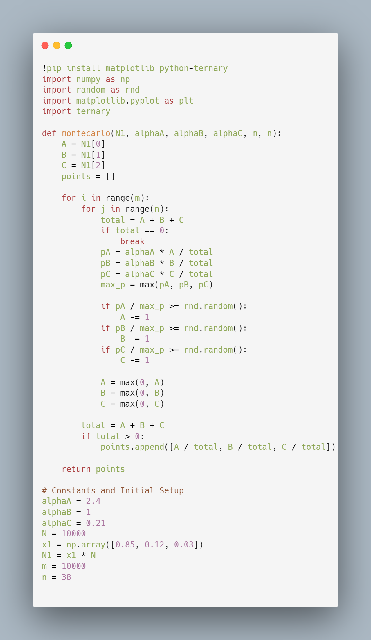
CODE FOR MONTE CARLO SIMULATION

Slide 16
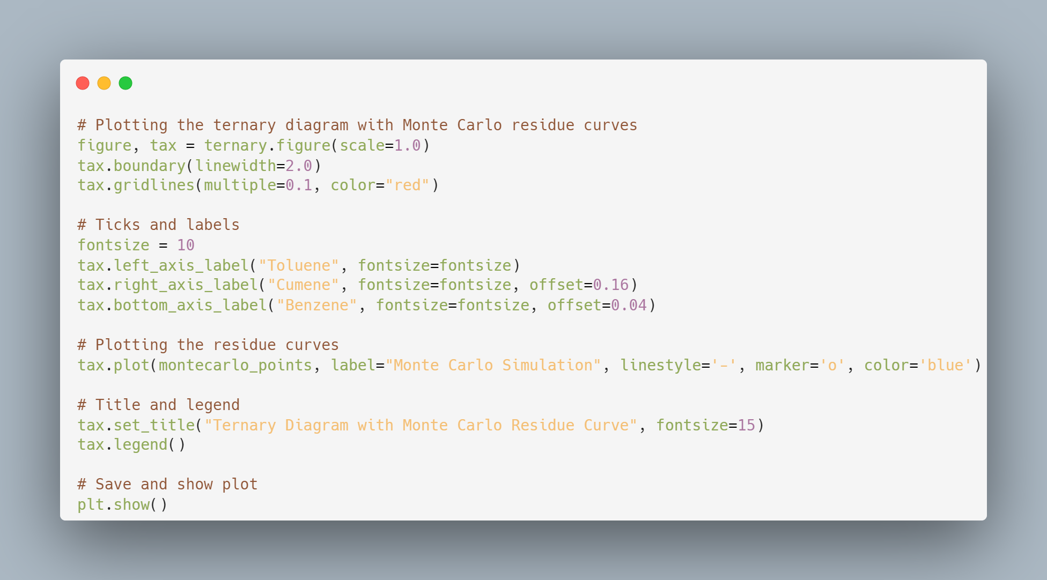
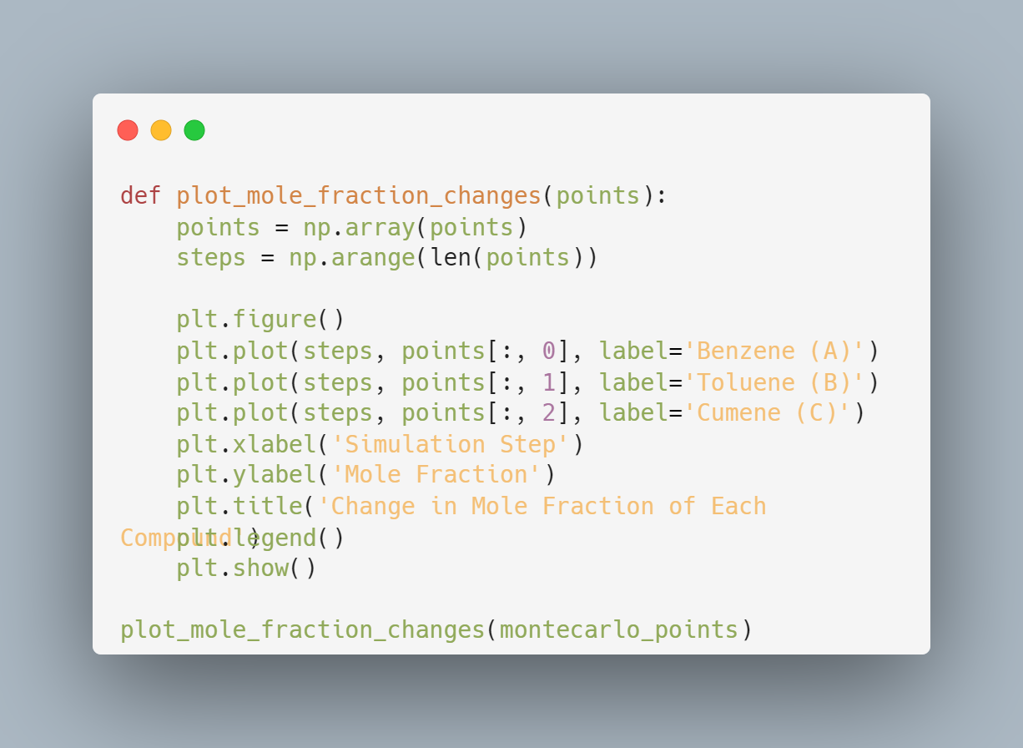
CODE FOR PLOTS
CODE FOR TERNARY PLOT
CODE FOR MOLE FRACTION CHANGES

Slide 17
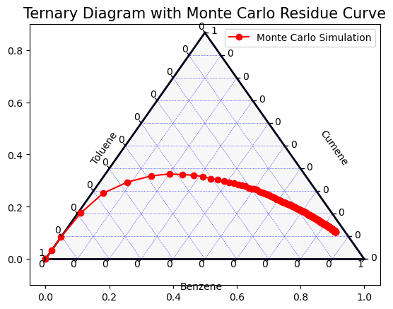
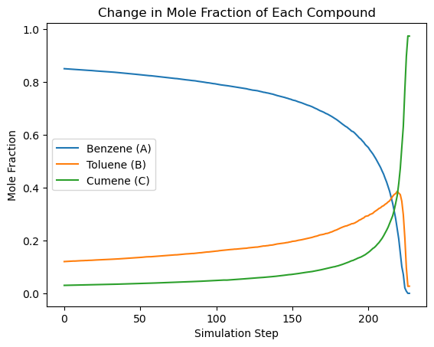
RESULTS
TERNARY PLOT
MOLE FRACTION CHANGES PLOT

Slide 18
References
https://pubs.acs.org/doi/pdf/10.1021/acs.jchemed.0c00262
Graph Theory Applied to Plasma Chemical Reaction Engineering | Plasma Chemistry and Plasma Processing (springer.com)
https://www.youtube.com/watch?v=OgO1gpXSUzU

Slide 19
THANK
YOU

