Slide 1

Unraveling Stock Market Insights with Advanced Learning Models
By
SUYASH MAURYA (Roll No:A23046 )
SK MONIRUL ISLAM (Roll No:A23040 )
NIKITA DAS (Roll No:A23027 )
SK RITUAJ ALAM (Roll No:A23042 )
SAYANTAN SAHA (Roll No:A23037 )
SHREYAN BHATTACHARJEE (A23038)
BAISAKHI BISWAS (A23011)
SK MOSIUR RAHMAN (Roll No:A23041)
of Fall 2023 Batch of Data Science
Under the supervision of
Prof. Jaydip Sen
Praxis Tech School, Kolkata, India

Slide 2
Objective of the Work
The primary aim of this study is to develop accurate predictive models for forecasting stock prices within the National Stock Exchange (NSE) of India. Utilizing advanced deep learning techniques, we seek to construct robust frameworks capable of generating precise predictions of stock prices.
In addition, our objective involves integrating data from diverse sectors and indices, including IT, steel, auto, banking, FMCG sectors and NIFTY, S&P 500 to conduct comprehensive market analyses. This holistic approach enables a thorough understanding of the various factors influencing stock price movements.
Furthermore, we aim to evaluate the performance of the developed models and compare different methodologies to optimize predictive accuracy and computational efficiency. By refining our models, we aim to enhance their effectiveness in real-world applications.

Slide 3
Data Problem
Inconsistent Data Quality: The historical data obtained from Yahoo Finance may contain inconsistencies, missing values, or errors, which can affect the accuracy and reliability of the predictive models.
Limited Historical Data: The availability of historical data only from January 01, 2018 to December 31, 2022 may limit the ability to capture long-term trends and patterns, potentially leading to less accurate predictions, especially for long-term forecasting.
When encountering a holiday within a week of 5 working days, we implement a forward fill approach to maintain continuity in the dataset.
This ensures consistency and completeness in our dataset despite the presence of holidays.

Slide 4
Contributions
The work has two major contributions:
First, the work presents a highly accurate predictive framework. The most accurate model produces a value of 4.91 as the ratio of root mean square error (RMSE) to the mean value of the target variable.
Second, the proposed models are very fast in execution. The fastest model needed 19.3s to execute on 785 training and 520 test records.

Slide 5
Outline
Related work
Methodology
Deep learning models
Convolution Neural Network models (CNN 1, 2,3))
Long and Short Term Memory network models (LSTM 1, 2, 3)
Implementation
Performance results
Observation on the results
Conclusion
References

Slide 6
Related Work
The literature on stock price forecasting encompasses various methods, categorized into regression, econometrics, and machine learning models.
Regression-based studies.
Econometric approaches
Machine learning and deep learning models
Hybrid models integrate social web inputs and combine machine learning with deep learning architectures for enhanced prediction accuracy.

Slide 7
Methodology
Daily data spanning from January 01, 2018 to December 31, 2022, was obtained from Yahoo Finance for NSE trading days, encompassing five sectors (IT, steel, auto, banking, FMCG), two indices (NIFTY, S&P 500).
The raw data consists of the following variables: (i) date, (ii) open, (iii) high, (iv) low, (v) close, (vi) volume.
The stock data is converted into a sequence consisting of records from Monday to Friday. The missing values are imputed using the records from the immediate preceding days.
The variable 'close' is chosen as the target variable (i.e., the variable to be predicted) and the remaining variables are treated as the predictors.

Slide 8
Methodology
The models were trained on historical data spanning from January 01, 2018 to December 31, 2020. Subsequently, the models were tested using a separate dataset covering the period from January 01, 2021 to December 31, 2022.
The models predicted the 'Close' value on a weekly basis for the test dataset. After each week, actual 'Close' values were incorporated into the training dataset, allowing for continuous refinement and forecasting for the subsequent week.

Slide 9
Deep Learning Models
We have exploited the power of Convolutional Neural Networks (CNN) and Long and Short Term Memory (LSTM) networks in feature extraction of input data so that the forecasted results of the models are very accurate.
The proposed two CNN models are:
CNN model with univariate input data (close values) of past one week (CNN-1)
CNN model with univariate input data (close values) of past two weeks (CNN -2)
CNN model with all five variable input data of past two weeks (CNN -3)
The proposed three LSTM model are:
LSTM model with univariate input data (close values) of past one week (LSTM -1)
LSTM model with univariate input data (close values) of past two weeks (LSTM -2)
LSTM model with all five variable input data of past two weeks (LSTM -3)

Slide 10
CNN Model -1 Univariate CNN model with past one week’s data
Univariate model with one-week prior data (N= 5) as the input.
One convolution layer with 16 feature maps and a kernel size of 3 is used so that the input sequence of five days is read in three time-steps at a time and each reading extracts 16 features.
A max pooling layer of size 2 reduces the size of the feature maps before it is flattened to one long vector.
The flattened vector is interpreted by a fully-connected layer before the output layer predicts the close values.
Except for the final output layer, ReLU has been used as the activation function and ADAM has been used as the optimizer. At the output layer the SIGMOID activation function is used.
20 epochs and a batch size of 4 have been used. Loss function used was MSE, from which RMSE values were computed.

Slide 11

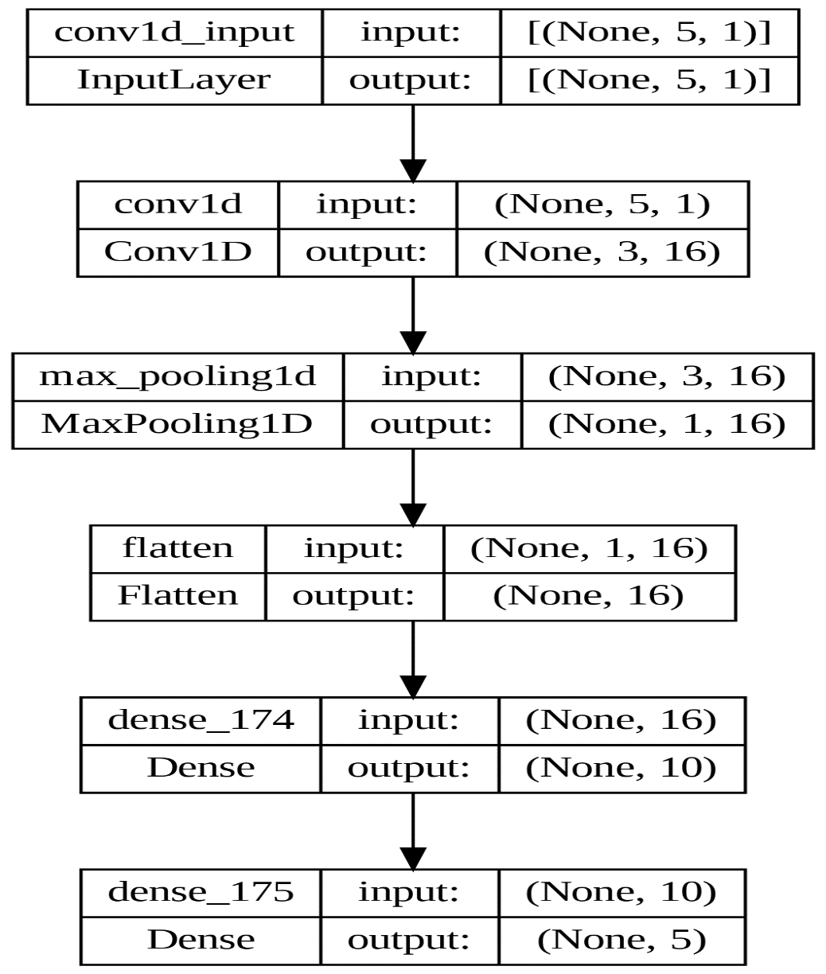
Architecture of CNN Model -1

Slide 12

CNN Model -2 Univariate CNN model with past two weeks’ data
Univariate model with prior two weeks’ data being used as the input (N= 10).
One convolution layer with 16 feature maps and a kernel size of 3 are used so that the input sequence of ten days is read in three time-steps at a time and this is performed 16 times.
A max pooling layer of size 2 reduces the size of the feature maps before it is flattened to one long vector of size 64.
The flattened vector is interpreted by a fully-connected layer before the output layer predicts the open values.
Except for the final output layer, ReLU has been used as the activation function and ADAM has been used as the optimizer. At the output layer the SIGMOID activation function is used.
20 epochs and a batch size of 4 have been used. Loss function used was MSE, from which RMSE values were computed.

Slide 13

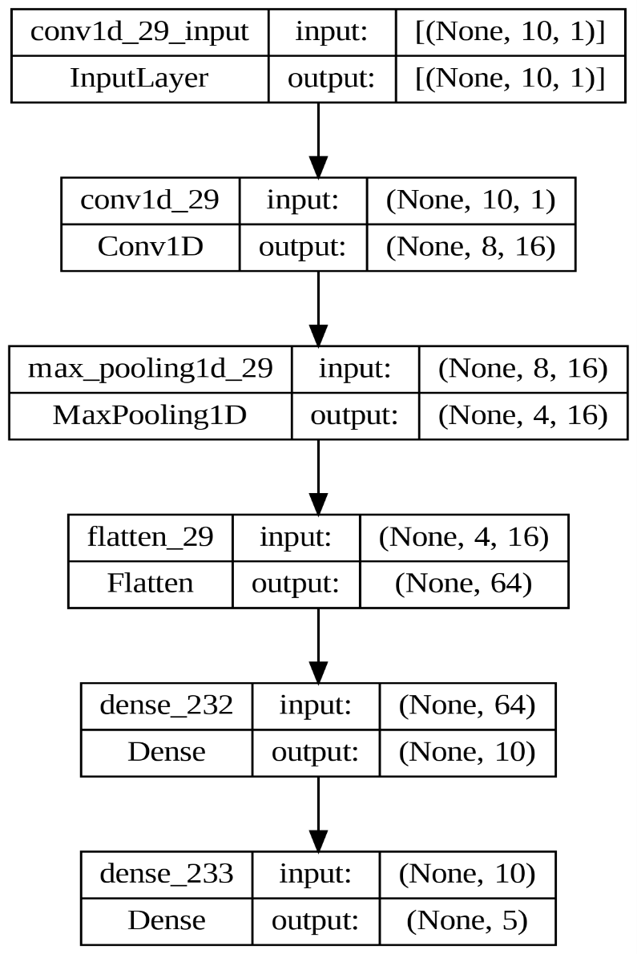
Architecture of CNN Model -2

Slide 14
CNN Model-3 Multivariate CNN model with past two weeks’ data
Multivariate with prior two weeks’ data being used as the input (N= 10).
One convolution layer with 16 feature maps and a kernel size of 3 are used so that the input sequence of ten days is read in three time-steps at a time and this is performed 16 times.
A max pooling layer of size 2 reduces the size of the feature maps before it is flattened to one long vector of size 64.
The flattened vector is interpreted by a fully-connected layer before the output layer predicts the open values.
Except for the final output layer, ReLU has been used as the activation function and ADAM has been used as the optimizer. At the output layer the SIGMOID activation function is used.
70 epochs and a batch size of 16 have been used. Loss function used was MSE, from which RMSE values were computed.

Slide 15

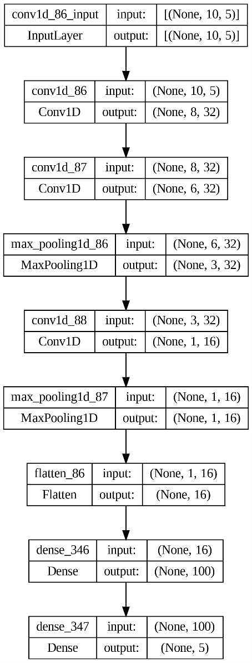
Architecture of CNN Model-3

Slide 16
LSTM Model -1 Univariate LSTM with past one weeks’ data
Univariate model with past ONE weeks data (N= 5) as the input.
The LSTM layer has 200 nodes . It receives the input sequence with shape (5,1) and produces a 200 element vector (one element per node) . These are features extracted from the 5 input values.
The first dense layer in the neural network has 100 nodes. It receives a 200-element vector from the previous LSTM layer.
The output layer with the number of nodes equal to the number of outputs
ReLU activation is used in the LSTM layers. MSE and ADAM are the loss function and optimizer respectively, used in the output layer. The training was done over 20 epochs using a batch size of 4

Slide 17

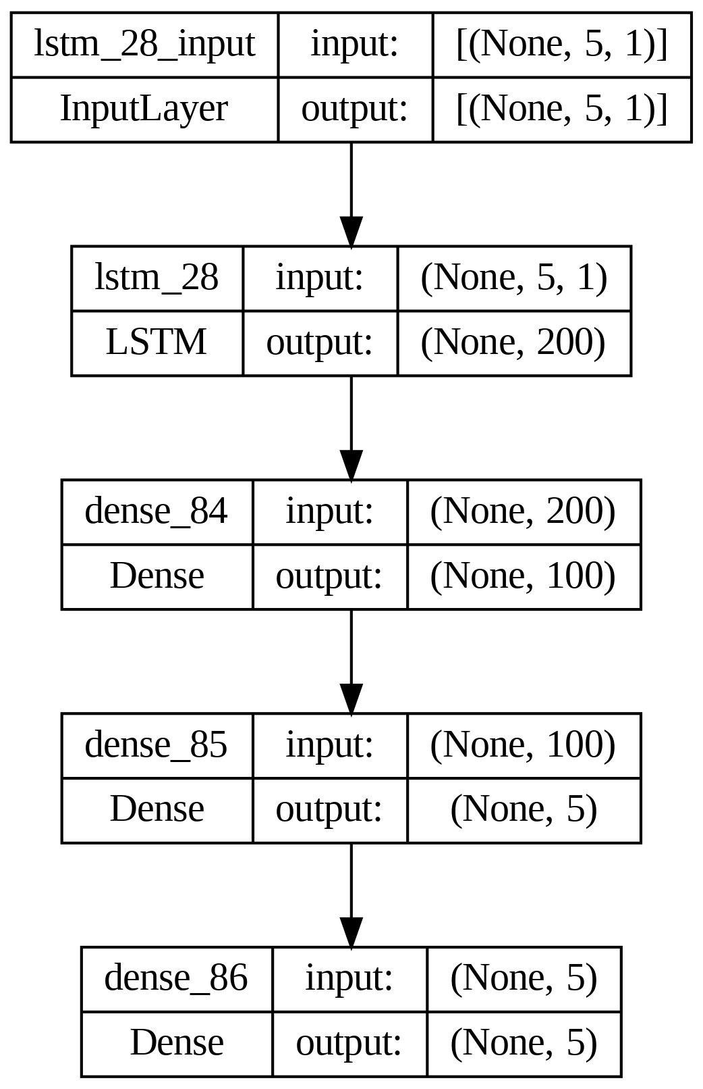
Architecture of LSTM Model -1

Slide 18
LSTM Model -2 Univariate LSTM with past two weeks’ data
Univariate model with past TWO weeks data (N= 10) as the input.
The LSTM layer has 200 nodes . It receives the input sequence with shape (10,1) and produces a 200 element vector (one element per node) . These are features extracted from the 5 input values.
The first dense layer in the neural network has 100 nodes. It receives a 200-element vector from the previous LSTM layer.
The output layer with the number of nodes equal to the number of outputs.
ReLU activation is used in the LSTM layers. MSE and ADAM are the loss function and optimizer respectively, used in the output layer. The training was done over 20 epochs using a batch size of 4

Slide 19
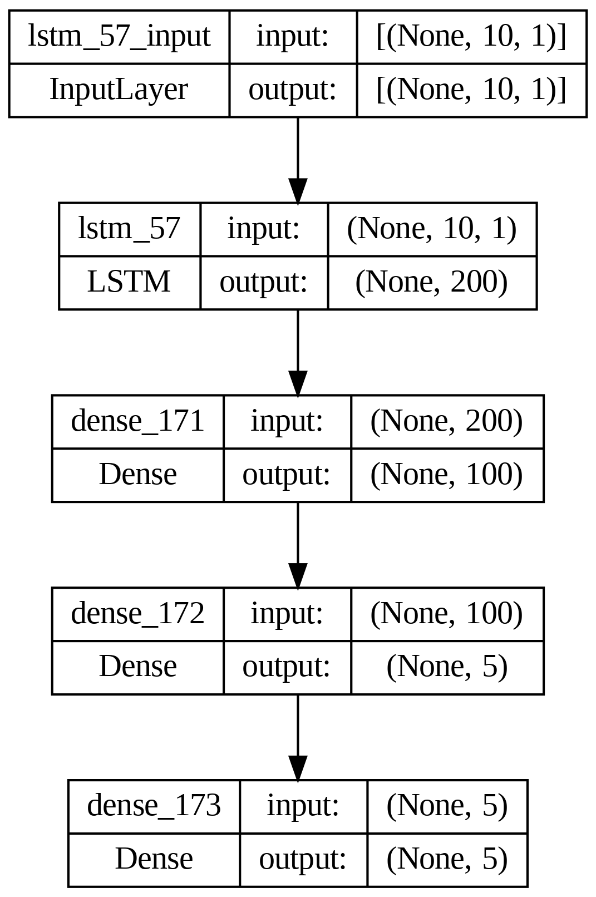
Architecture of LSTM Model -2

Slide 20
LSTM Model -3 Multivariate LSTM with past two weeks’ data
Multivariate model with past TWO weeks data (N= 10) as the input.
The LSTM layer has 200 nodes . It receives the input sequence with shape (10,1) and produces a 200 element vector (one element per node. These are features extracted from the 5 input values.
The first dense layer in the neural network has 100 nodes. It receives a 200-element vector from the previous LSTM layer.
The output layer with the number of nodes equal to the number of outputs
ReLU activation is used in the LSTM layers. MSE and ADAM are the loss function and optimizer respectively, used in the output layer. The training was done over 70 epochs using a batch size of 16

Slide 21

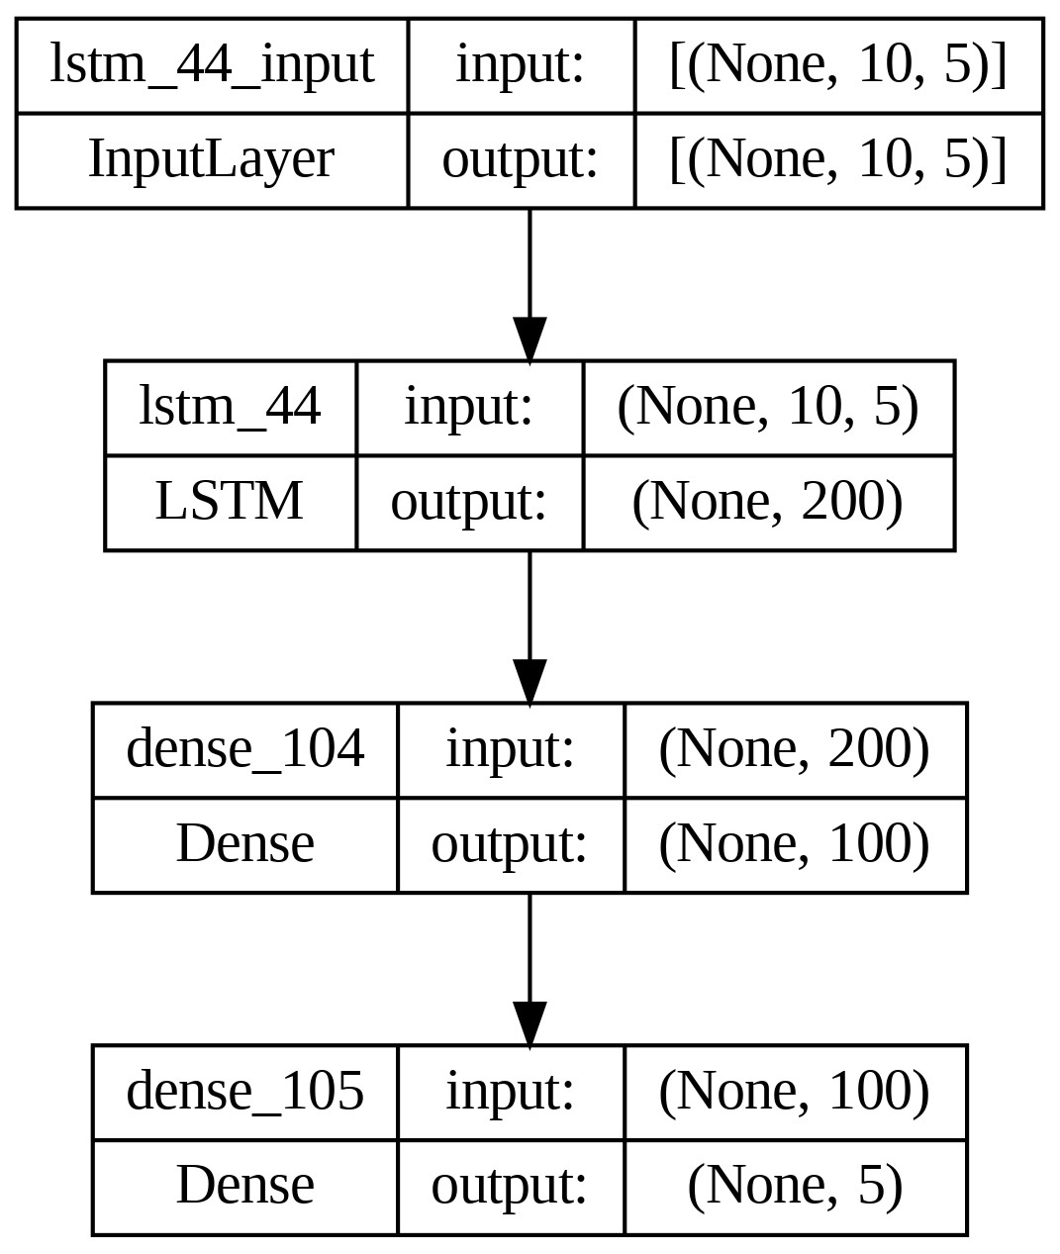
Architecture of LSTM Model #3

Slide 22
Implementation
The models have been implemented on a system consisting of an Intel i5-1035G1 processor with a clock speed of 1.00 GHz – 1.19 GHz, 8 GB RAM and running 64-bit Windows 11 operating system.
The models are implemented using Python 3..10.12 on TensorFlow 2.15.0 and Keras 2.15.0 frameworks.
Each model has been executed over data and the following metrics are noted :
Execution time of the model
The overall RMSE for the entire week (i.e. average RMSE for the 5 days)
The RMSE values of each individual day in a week
Finally the mean measure for the execution time, overall RMSE, and the RMSE for the individual day of a week are computed.

Slide 23
Results : CNN Model #1
Data | Time | RMSE/Mean | Mon | Tue | Wed | Thu | Fri | RMSE
Tata Steel | 16.5 | 8.9 | 5.3 | 5.2 | 5.2 | 6.5 | 6.6 | 5.8
Tata Consultancy Services | 17.4 | 3.9 | 67.4 | 82.3 | 86.3 | 107.9 | 115.1 | 93.4
State Bank of India | 21.6 | 6.6 | 16.0 | 19.7 | 23.5 | 25.1 | 25.5 | 22.3
NIFTY | 21.3 | 2.8 | 313.5 | 333.5 | 359.6 | 403.7 | 452.0 | 375.8
S&P | 16.4 | 3.2 | 91.0 | 100.4 | 102.8 | 116.3 | 134.0 | 109.9
Maruti Suzuki India Limited | 21.9 | 4.0 | 250.6 | 267.6 | 285.8 | 300.2 | 339.8 | 290.4
Mahindra & Mahindra Limited | 22.1 | 5.2 | 33.0 | 36.5 | 37.9 | 41.1 | 45.7 | 39.1
JSW Steel Limited | 21.4 | 7.1 | 22.5 | 25.1 | 27.1 | 32.7 | 34.6 | 28.8
Infosys Limited | 21.3 | 5.2 | 43.2 | 49.0 | 50.1 | 55.6 | 62.2 | 52.4
ITC Limited | 16.6 | 3.4 | 5.9 | 6.2 | 7.2 | 8.2 | 9.2 | 7.5
Hindustan Unilever Ltd | 20.3 | 3.8 | 62.3 | 67.6 | 71.1 | 85.7 | 88.0 | 75.6
HDFC Bank Limited | 19.9 | 4.0 | 43.2 | 45.8 | 47.5 | 50.6 | 53.7 | 48.3
MEAN | 19.7 | 4.9 | 79.5 | 86.6 | 92.0 | 102.8 | 113.9 | 95.8
MIN | 16.4 | 2.8 | 5.3 | 5.2 | 5.2 | 6.5 | 6.6 | 5.8
MAX | 22.1 | 8.9 | 313.5 | 333.5 | 359.6 | 403.7 | 452.0 | 375.8
SD | 2.3 | 1.8 | 98.9 | 105.0 | 112.8 | 123.6 | 139.5 | 116.8

Slide 24
Results : CNN Model #2
Data | Time | RMSE/Mean | Mon | Tue | Wed | Thu | Fri | RMSE
Tata Steel | 18.5 | 8.6 | 5.1 | 4.8 | 5.1 | 6.4 | 6.6 | 5.6
Tata Consultancy Services | 18.1 | 4.7 | 98.7 | 92.4 | 101.4 | 131.0 | 129.9 | 111.9
State Bank of India | 21.4 | 6.3 | 16.5 | 18.6 | 18.9 | 23.1 | 26.6 | 21.0
NIFTY | 17.6 | 3.4 | 489.2 | 355.8 | 397.6 | 535.4 | 482.4 | 456.8
S&P | 17.4 | 3.8 | 109.5 | 117.4 | 134.9 | 129.5 | 154.2 | 130.0
Maruti Suzuki India Limited | 19.0 | 4.0 | 273.1 | 287.7 | 278.5 | 289.4 | 331.2 | 292.7
Mahindra & Mahindra Limited | 21.6 | 5.2 | 34.6 | 33.8 | 36.9 | 39.3 | 46.6 | 38.5
JSW Steel Limited | 18.0 | 6.8 | 21.9 | 27.5 | 24.3 | 30.1 | 32.4 | 27.5
Infosys Limited | 21.1 | 5.5 | 47.4 | 51.4 | 56.8 | 57.4 | 62.3 | 55.3
ITC Limited | 16.8 | 4.6 | 5.7 | 8.6 | 9.5 | 11.8 | 13.0 | 10.1
Hindustan Unilever Ltd | 20.5 | 4.5 | 58.8 | 79.7 | 89.2 | 100.1 | 107.1 | 88.6
HDFC Bank Limited | 21.7 | 4.0 | 43.7 | 48.5 | 45.2 | 53.9 | 52.1 | 48.8
MEAN | 19.3 | 5.1 | 100.3 | 93.9 | 99.9 | 117.3 | 120.4 | 107.2
MIN | 16.8 | 3.4 | 5.1 | 4.8 | 5.1 | 6.4 | 6.6 | 5.6
MAX | 21.7 | 8.6 | 489.2 | 355.8 | 397.6 | 535.4 | 482.4 | 456.8
SD | 1.8 | 1.5 | 142.8 | 112.7 | 120.6 | 153.3 | 145.0 | 135.5

Slide 25
Results : CNN Model -3
Data | Time | RMSE/Mean | Mon | Tue | Wed | Thu | Fri | RMSE
Tata Steel | 18.0 | 142.3 | 89.0 | 100.8 | 88.4 | 97.5 | 89.6 | 93.2
Tata Consultancy Services | 20.9 | 98.9 | 2356.5 | 2998.7 | 2306.5 | 2130.1 | 1961.3 | 2377.0
State Bank of India | 19.2 | 2317.1 | 4712.4 | 11074.2 | 8480.5 | 5144.4 | 7713.6 | 7781.1
NIFTY | 20.8 | 3.7 | 409.8 | 430.0 | 499.0 | 491.2 | 606.8 | 492.2
S&P | 21.3 | 14986.3 | 176982.9 | 397882.8 | 468818.3 | 335330.5 | 902040.7 | 516826.5
Maruti Suzuki India Limited | 19.2 | 8.6 | 681.3 | 599.0 | 635.1 | 569.0 | 627.6 | 623.5
Mahindra & Mahindra Limited | 23.1 | 115.4 | 972.4 | 649.6 | 656.2 | 990.4 | 970.8 | 862.7
JSW Steel Limited | 18.7 | 838.0 | 2626.8 | 5036.4 | 2127.1 | 3765.6 | 2556.3 | 3391.3
Infosys Limited | 21.7 | 126.8 | 1065.4 | 1330.5 | 1466.3 | 1208.7 | 1231.4 | 1267.5
ITC Limited | 33.5 | 3221.4 | 8441.3 | 4249.4 | 12144.6 | 1338.4 | 2183.0 | 6976.6
Hindustan Unilever Ltd | 22.6 | 95.0 | 1685.9 | 2305.4 | 1942.3 | 1732.9 | 1626.6 | 1875.0
HDFC Bank Limited | 19.3 | 92.0 | 1108.9 | 1100.2 | 1058.7 | 1196.5 | 1138.1 | 1121.4
MEAN | 21.5 | 1837.1 | 16761.1 | 35646.4 | 41685.3 | 29499.6 | 76895.5 | 45307.3
MIN | 18.0 | 3.7 | 89.0 | 100.8 | 88.4 | 97.5 | 89.6 | 93.2
MAX | 33.5 | 14986.3 | 176982.9 | 397882.8 | 468818.3 | 335330.5 | 902040.7 | 516826.5
SD | 4.1 | 4270.5 | 50510.5 | 114116.0 | 134561.9 | 96322.5 | 259860.9 | 148511.0

Slide 26
Results : LSTM Model -1
Data | Time | RMSE/Mean | Mon | Tue | Wed | Thu | Fri | RMSE
Tata Steel | 32 | 8.8 | 4.6 | 5.2 | 4.8 | 6.8 | 7 | 5.8
Tata Consultancy Services | 32.5 | 4.2 | 62.9 | 111.7 | 101.4 | 104.7 | 120.3 | 102.1
State Bank of India | 33.2 | 5.9 | 15.8 | 16 | 19.7 | 20.7 | 25.6 | 19.9
NIFTY | 32.8 | 3.7 | 309.6 | 491.3 | 354.3 | 524.8 | 693.9 | 493.9
S&P | 32.5 | 3 | 74.7 | 85.2 | 119 | 107.3 | 119.9 | 102.9
Maruti Suzuki India Limited | 34.8 | 3.8 | 271.2 | 237.7 | 242.1 | 268.6 | 332 | 272.4
Mahindra & Mahindra Limited | 32.5 | 6 | 33.6 | 45.6 | 50.3 | 46.8 | 47.7 | 45.2
JSW Steel Limited | 32.7 | 7.6 | 24.8 | 21.9 | 37.5 | 33.7 | 33 | 30.7
Infosys Limited | 34.4 | 4.7 | 37.9 | 42.4 | 44.1 | 52 | 57.1 | 47.2
ITC Limited | 34.4 | 3.9 | 7.9 | 7.2 | 8.2 | 8.7 | 9.6 | 8.4
Hindustan Unilever Ltd | 32.8 | 3.4 | 49.7 | 54.1 | 68.2 | 75.1 | 80.5 | 66.6
HDFC Bank Limited | 33.8 | 3.5 | 36 | 40.2 | 42.8 | 45.3 | 48.9 | 42.8
MEAN | 33.2 | 4.9 | 77.4 | 96.5 | 91 | 107.9 | 131.3 | 103.2
MIN | 32 | 3 | 4.6 | 5.2 | 4.8 | 6.8 | 7 | 5.8
MAX | 34.8 | 8.8 | 309.6 | 491.3 | 354.3 | 524.8 | 693.9 | 493.9
SD | 0.9 | 1.8 | 102 | 139.8 | 105.3 | 149.1 | 197.7 | 142.5

Slide 27
Results : LSTM Model -2
Data | Time | RMSE/Mean | Mon | Tue | Wed | Thu | Fri | RMSE
Tata Steel | 94.3 | 10.8 | 7.3 | 5.4 | 8.2 | 6.6 | 7.6 | 7.1
Tata Consultancy Services | 92.9 | 6.4 | 147.1 | 167.9 | 129.5 | 149.8 | 168.1 | 153.2
State Bank of India | 95.8 | 6.5 | 17.3 | 19.2 | 25.1 | 21.6 | 25.3 | 21.9
NIFTY | 94.4 | 3.8 | 510.2 | 461.7 | 479.7 | 515.3 | 539.4 | 502.0
S&P | 68.0 | 3.2 | 89.1 | 94.2 | 100.0 | 130.8 | 128.9 | 110.0
Maruti Suzuki India Limited | 93.1 | 4.6 | 315.6 | 266.9 | 301.6 | 357.7 | 393.5 | 330.0
Mahindra & Mahindra Limited | 94.0 | 7.0 | 46.0 | 48.1 | 46.9 | 57.1 | 60.4 | 52.0
JSW Steel Limited | 95.8 | 10.7 | 37.6 | 39.6 | 42.4 | 46.4 | 49.1 | 43.2
Infosys Limited | 65.8 | 5.7 | 49.4 | 48.2 | 60.3 | 59.8 | 66.1 | 57.2
ITC Limited | 64.4 | 5.3 | 9.6 | 11.9 | 11.8 | 13.1 | 11.3 | 11.6
Hindustan Unilever Ltd | 93.9 | 4.1 | 60.3 | 76.1 | 76.9 | 82.5 | 98.9 | 79.9
HDFC Bank Limited | 69.9 | 5.0 | 49.8 | 61.4 | 49.9 | 59.4 | 78.2 | 60.6
MEAN | 85.2 | 6.1 | 111.6 | 108.4 | 111.0 | 125.0 | 135.6 | 119.1
MIN | 64.4 | 3.2 | 7.3 | 5.4 | 8.2 | 6.6 | 7.6 | 7.1
MAX | 95.8 | 10.8 | 510.2 | 461.7 | 479.7 | 515.3 | 539.4 | 502.0
SD | 13.5 | 2.5 | 151.5 | 133.8 | 140.4 | 155.4 | 164.4 | 149.2

Slide 28
Results : LSTM Model -3
Data | Time | RMSE/Mean | Mon | Tue | Wed | Thu | Fri | RMSE
Tata Steel | 116.8 | 58807.7 | 52945.8 | 30668.1 | 41098.4 | 34895.8 | 27774.6 | 38528.0
Tata Consultancy Services | 72.6 | 210.0 | 3566.4 | 6526.8 | 2608.9 | 5731.5 | 5690.7 | 5047.0
State Bank of India | 74.0 | 5060.7 | 18689.4 | 10883.4 | 16358.4 | 23567.1 | 12378.4 | 16994.0
NIFTY | 67.5 | 6.8 | 806.0 | 484.3 | 1228.4 | 1003.8 | 814.9 | 901.7
S&P | 92.5 | 40555.1 | 1059661.0 | 1359717.1 | 1076852.0 | 2071776.1 | 1164894.7 | 1398610.6
Maruti Suzuki India Limited | 92.3 | 13.5 | 931.0 | 859.1 | 976.5 | 1212.5 | 850.8 | 974.9
Mahindra & Mahindra Limited | 92.9 | 1018.0 | 10218.6 | 9274.6 | 7051.9 | 2704.2 | 6471.7 | 7607.4
JSW Steel Limited | 71.5 | 4799.4 | 13329.1 | 27478.9 | 14430.0 | 22425.1 | 15565.8 | 19422.5
Infosys Limited | 68.8 | 1120.3 | 9036.5 | 3496.0 | 12383.7 | 17070.5 | 9395.9 | 11197.5
ITC Limited | 71.0 | 3644.3 | 12253.2 | 9595.8 | 4265.3 | 4531.6 | 5522.0 | 7892.3
Hindustan Unilever Ltd | 75.3 | 61.4 | 1060.7 | 944.5 | 1023.1 | 1205.1 | 1679.1 | 1211.3
HDFC Bank Limited | 93.0 | 189.3 | 2804.0 | 2748.9 | 2270.8 | 1447.9 | 1992.5 | 2308.3
MEAN | 82.3 | 9623.9 | 98775.1 | 121889.8 | 98379.0 | 182297.6 | 104419.3 | 125891.3
MIN | 67.5 | 6.8 | 806.0 | 484.3 | 976.5 | 1003.8 | 814.9 | 901.7
MAX | 116.8 | 58807.7 | 1059661.0 | 1359717.1 | 1076852.0 | 2071776.1 | 1164894.7 | 1398610.6
SD | 15.0 | 19202.1 | 302939.0 | 389941.9 | 308349.1 | 595139.5 | 334053.2 | 400948.7

Slide 29
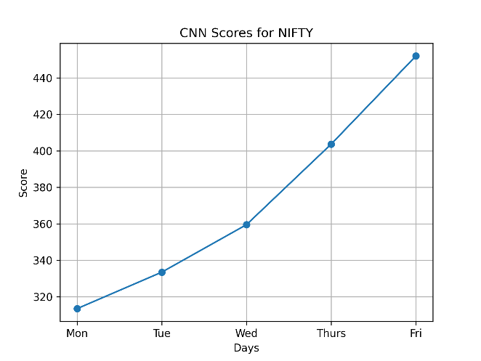
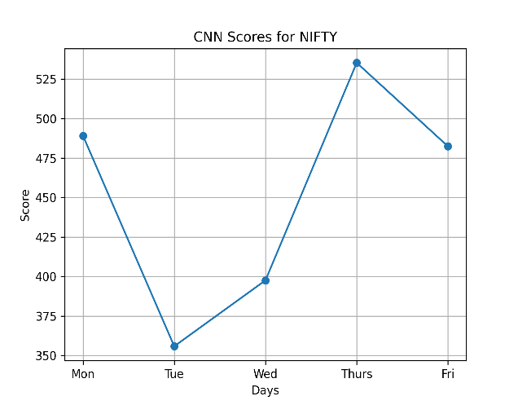
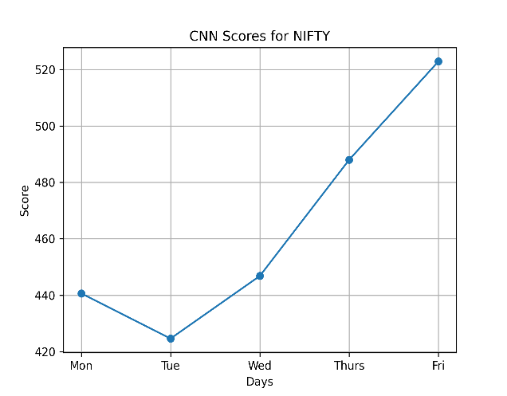
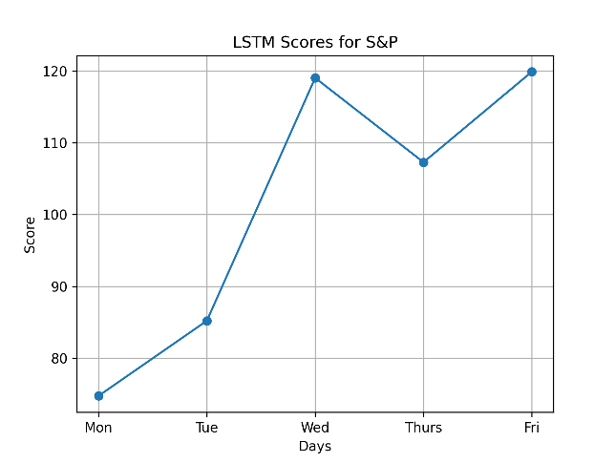
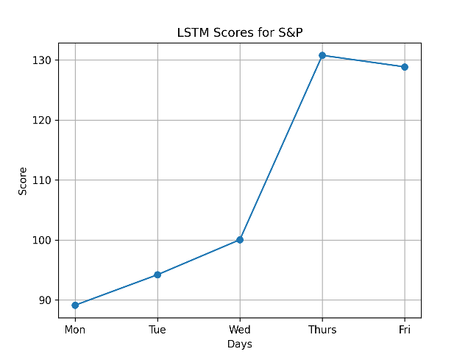
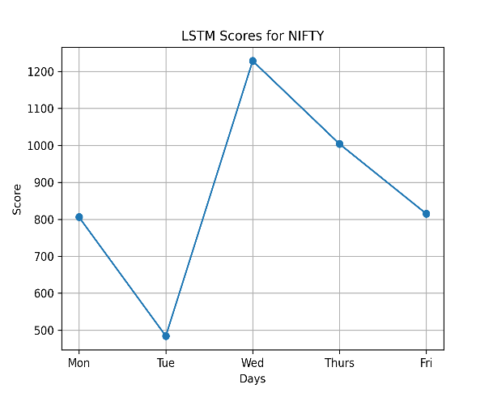
Daywise RMSE of the Models

Slide 30

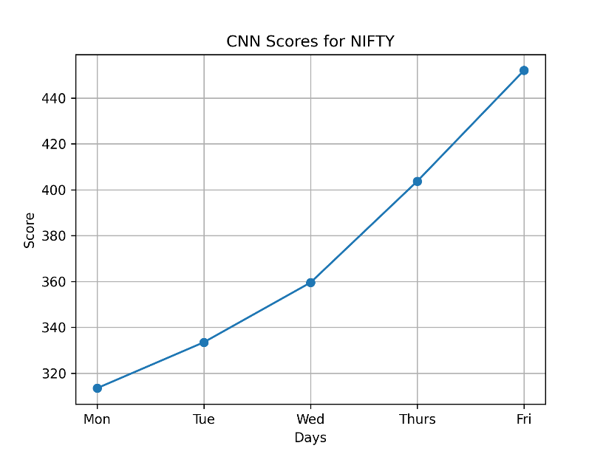

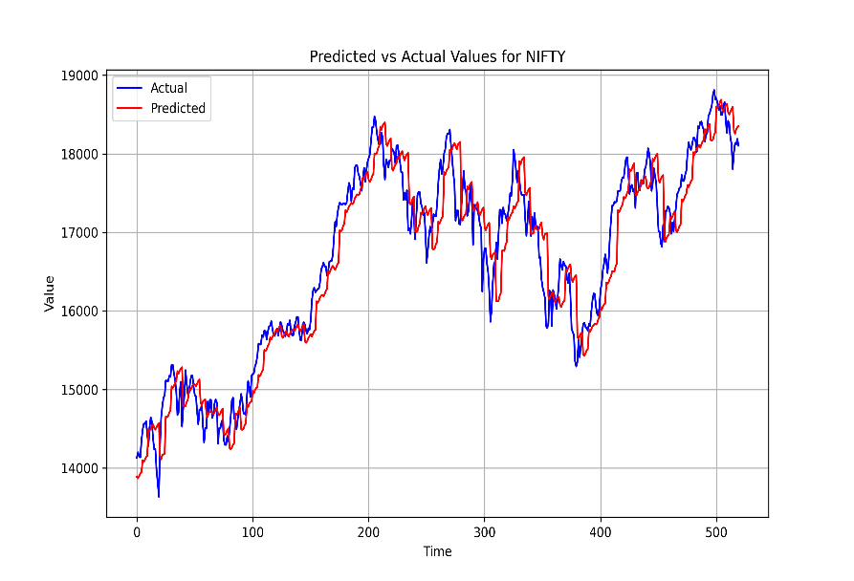
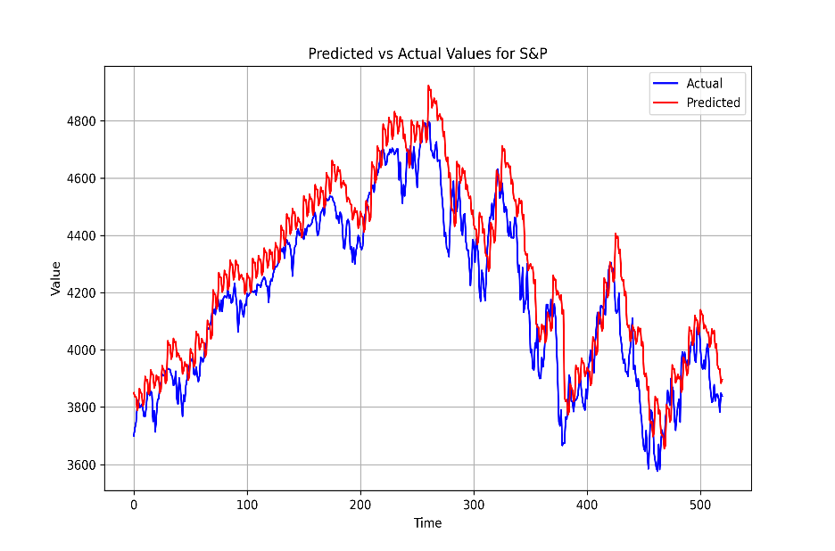
Top Models for NIFTY and S&P Indices

Slide 31
Observations on the Results
We observe that CNN -2 model – a univariate CNN model with past two week’s data as its input – turns out to be the fastest model in execution.
The model CNN -1 – a univariate CNN model with past one week’s data as its input – turned out to be the most accurate model.
Execution Time |  |  | RMSE/MEAN
Rank | Model | Value | Rank | Model | Value
1 | CNN-2 | 19.3 | 1 | CNN-1 | 4.9
2 | CNN-1 | 19.7 | 2 | LSTM-1 | 4.95
3 | CNN-3 | 21.5 | 3 | CNN-2 | 5.1
4 | LSTM-1 | 33.2 | 4 | LSTM-2 | 6.1
5 | LSTM-3 | 82.3 | 5 | CNN-3 | 1837.1
6 | LSTM-2 | 85.2 | 6 | LSTM-3 | 9623.9

Slide 32
Conclusion
We've explored various methods to forecast daily stock prices on one and two-week intervals on the National Stock Exchange (NSE) of India. To achieve this, we employed six deep learning-driven regression models.
Our lineup comprises two univariate CNN models, two univariate LSTM models, along with a combination of one CNN and one LSTM multivariate model. These models were constructed and testing has been done using data spanning from January 1, 2021, to December 31, 2022.
Across the board, all six models showcased exceptional accuracy levels. Notably, the CNN model utilizing data from the previous one and two weeks emerged as the standout performer in terms of both accuracy and speed of execution.
We plan to explore the applicability of GANs ( Generative Adversarial Networks ) in designing the stock price prediction model which possibly would yield a higher accuracy model compared to present examined model.

Slide 33
References
Damrongsakmethee,T. and Neagoe,V.-E. "Stock Market Prediction Using a Deep Learning Approach," 2020 12th International Conference on Electronics, Computers and Artificial Intelligence (ECAI), Bucharest, Romania, 2020, pp. 1-6, doi: 10.1109/ECAI50035.2020.9223142.
Mehtab,S. and Sen,J. "Stock Price Prediction Using CNN and LSTM-Based Deep Learning Models," 2020 International Conference on Decision Aid Sciences and Application (DASA), Sakheer, Bahrain, 2020, pp. 447-453, doi: 10.1109/DASA51403.2020.9317207.
Maiti,A. and Shetty D,P. "Indian Stock Market Prediction using Deep Learning," 2020 IEEE Region 10 Conference (TENCON), Osaka, Japan, 2020, pp. 1215-1220, doi: 10.1109/TENCON50793.2020.9293712.
P. S and V. P. R, "Stock Price Prediction using Machine Learning and Deep Learning," 2021 IEEE Mysore Sub Section International Conference (MysuruCon), Hassan, India, 2021, pp. 660-664, doi: 10.1109/MysuruCon52639.2021.9641664.
P. Praveen, S. Shravani, R. Srija and M. Tajuddin, "A Model to Stock Price Prediction using Deep Learning," 2023 International Conference on Sustainable Computing and Smart Systems (ICSCSS), Coimbatore, India, 2023, pp. 242-252, doi: 10.1109/ICSCSS57650.2023.10169558.
Biswas, M., Shome, A., Islam, M. A., Nova, A. J. and Ahmed, S. "Predicting Stock Market Price: A Logical Strategy using Deep Learning," 2021 IEEE 11th IEEE Symposium on Computer Applications & Industrial Electronics (ISCAIE), Penang, Malaysia, 2021, pp. 218-223, doi: 10.1109/ISCAIE51753.2021.9431817.
Hossain, M. A., Karim,R., Thulasiram, R., Bruce, N. D. B. and Y. Wang, "Hybrid Deep Learning Model for Stock Price Prediction," 2018 IEEE Symposium Series on Computational Intelligence (SSCI), Bangalore, India, 2018, pp. 1837-1844, doi: 10.1109/SSCI.2018.8628641.

Slide 34
THANK YOU

