Slide 1
Chapter 2
Computer Evolution and Performance

Slide 2
ENIAC - background
Electronic Numerical Integrator And Computer
Eckert and Mauchly
University of Pennsylvania
Trajectory tables for weapons
Started 1943
Finished 1946
  Too late for war effort
Used until 1955

Slide 3
ENIAC - details
Decimal (not binary)
20 accumulators of 10 digits
Programmed manually by switches
18,000 vacuum tubes
30 tons
15,000 square feet
140 kW power consumption
5,000 additions per second

Slide 4
von Neumann/Turing
Stored Program concept
Main memory storing programs and data
ALU operating on binary data
Control unit interpreting instructions from memory and executing
Input and output equipment operated by control unit
Princeton Institute for Advanced Studies
  IAS
Completed 1952
Used the term “organ” to describe devices

Slide 5

Structure of von Neumann machine

Slide 6
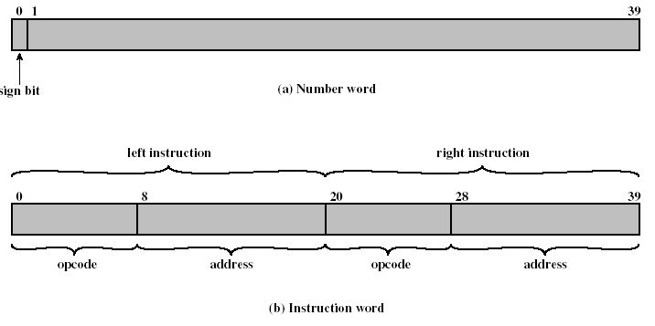
IAS - details
1000 x 40 bit words
  Binary number
  2 x 20 bit instructions

Slide 7
IAS - details
Set of registers (storage in CPU)
  Memory Buffer Register (MBR)
  Memory Address Register (MAR)
  Instruction Register (IR)
  Instruction Buffer Register (IBR)
  Program Counter (PC)
  Accumulator (AC)
  Multiplier Quotient (MQ)

Slide 8

Structure of IAS – detail
Also see Figure 2.4 that illustrates Fetch cycle and Execution cycle, which taken together is the Instruction cycle.

Slide 9
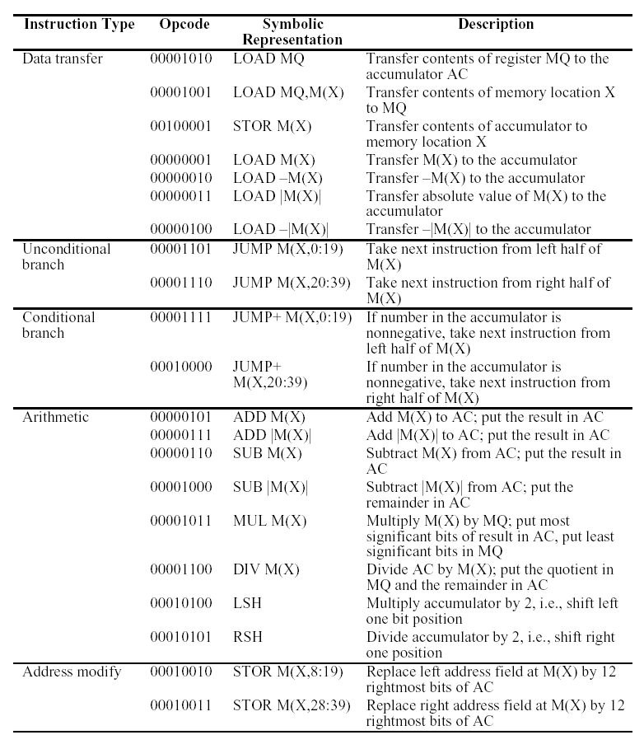
IAS Instruction Set

Slide 10
Commercial Computers
1947 - Eckert-Mauchly Computer Corporation
UNIVAC I (Universal Automatic Computer)
US Bureau of Census 1950 calculations
Became part of Sperry-Rand Corporation
Late 1950s - UNIVAC II
  Faster
  More memory

Slide 11
IBM
Punched-card processing equipment
1953 - the 701
  IBM’s first stored program computer
  Scientific calculations
1955 - the 702
  Business applications
Lead to 700/7000 series

Slide 12
Transistors
Replaced vacuum tubes
Smaller
Cheaper
Less heat dissipation
Solid State device
Made from Silicon (Sand)
Invented 1947 at Bell Labs
William Shockley et al.

Slide 13
Transistor Based Computers
Second generation machines
NCR & RCA produced small transistor machines
IBM 7000
DEC - 1957
  Produced PDP-1

Slide 14
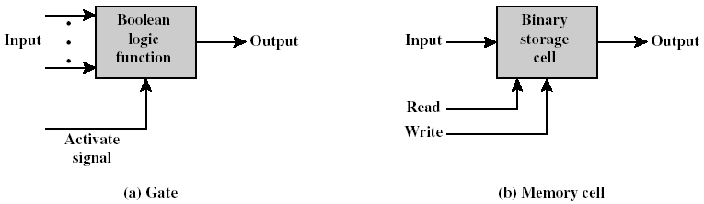
Microelectronics
Literally - “small electronics”
A computer is made up of gates, memory cells and interconnections
These can be manufactured on a semiconductor
e.g. silicon wafer

Slide 15
Generations of Computer
Vacuum tube - 1946-1957
Transistor - 1958-1964
Small scale integration - 1965 on
  Up to 100 devices on a chip
Medium scale integration - to 1971
  100-3,000 devices on a chip
Large scale integration - 1971-1977
  3,000 - 100,000 devices on a chip
Very large scale integration - 1978 to date
  100,000 - 100,000,000 devices on a chip
Ultra large scale integration
  Over 100,000,000 devices on a chip

Slide 16
Moore’s Law
Increased density of components on chip
Gordon Moore - cofounder of Intel
Number of transistors on a chip will double every year
Since 1970’s development has slowed a little
  Number of transistors doubles every 18 months
Cost of a chip has remained almost unchanged
Higher packing density means shorter electrical paths, giving higher performance
Smaller size gives increased flexibility
Reduced power and cooling requirements
Fewer interconnections increases reliability

Slide 17
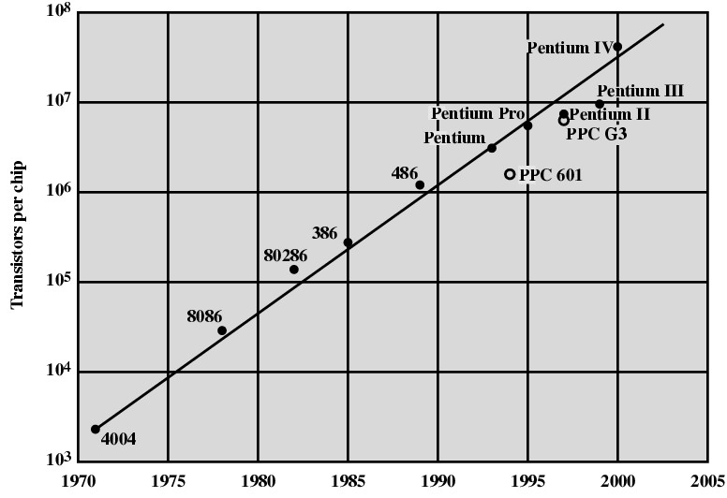
Growth in CPU Transistor Count

Slide 18
IBM 360 series
1964
Replaced (& not compatible with) 7000 series
First planned “family” of computers (See Table 2.4)
  Similar or identical instruction sets
  Similar or identical O/S
  Increasing speed
  Increasing number of I/O ports (i.e. more terminals)
  Increased memory size
  Increased cost
Multiplexed switch structure (See Fig. 2.5)

Slide 19
DEC PDP-8
1964
First minicomputer (after miniskirt!)
Did not need air conditioned room
Small enough to sit on a lab bench
$16,000
  $100k+ for IBM 360
Embedded applications & OEM
BUS STRUCTURE

Slide 20
DEC - PDP-8 Bus Structure
Console
Controller
Main Memory
I/O
Module
I/O
Module
CPU
OMNIBUS

Slide 21
Semiconductor Memory
1970
Fairchild
Size of a single core
  i.e. 1 bit of magnetic core storage
Holds 256 bits
Non-destructive read
Much faster than core
Capacity approximately doubles each year

Slide 22
Intel
1971 - 4004
  First microprocessor
  All CPU components on a single chip
  4 bit
Followed in 1972 by 8008
  8 bit
  Both designed for specific applications
1974 - 8080
  Intel’s first general purpose microprocessor

Slide 23
Speeding it up
Pipelining
On board cache
On board L1 & L2 cache
Branch prediction
Data flow analysis
Speculative execution

Slide 24
Performance Mismatch
Processor speed increased
Memory capacity increased
Memory speed lags behind processor speed

Slide 25
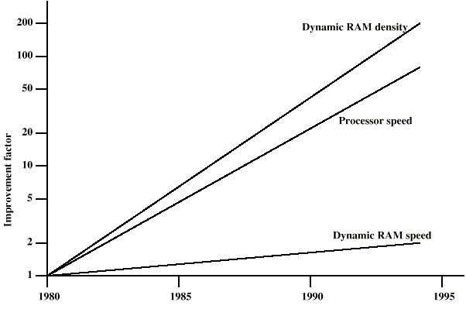
DRAM and Processor Characteristics

Slide 26
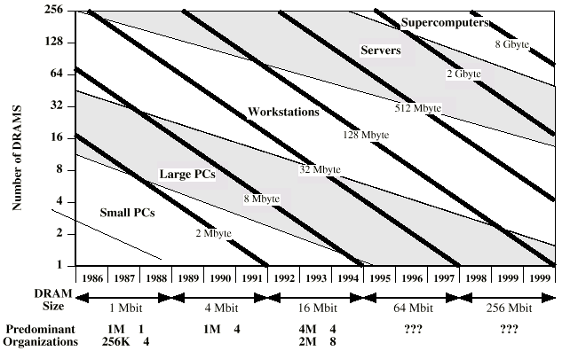
Trends in DRAM use

Slide 27
Solutions
Increase number of bits retrieved at one time
  Make DRAM “wider” rather than “deeper”
Change DRAM interface
  Cache
Reduce frequency of memory access
  More complex cache and cache on chip
Increase interconnection bandwidth
  High speed buses
  Hierarchy of buses

Slide 28
Pentium Evolution (1)
8080
  first general purpose microprocessor
  8 bit data path
  Used in first personal computer – Altair
8086
  much more powerful
  16 bit
  instruction cache, prefetch few instructions
  8088 (8 bit external bus) used in first IBM PC
80286
  16 Mbyte memory addressable
  up from 1Mb
80386
  32 bit
  Support for multitasking

Slide 29
Pentium Evolution (2)
80486
  sophisticated powerful cache and instruction pipelining
  built in maths co-processor
Pentium
  Superscalar
  Multiple instructions executed in parallel
Pentium Pro
  Increased superscalar organization
  Aggressive register renaming
  branch prediction
  data flow analysis
  speculative execution

Slide 30
Pentium Evolution (3)
Pentium II
  MMX technology
  graphics, video & audio processing
Pentium III
  Additional floating point instructions for 3D graphics
Pentium 4
  Note Arabic rather than Roman numerals
  Further floating point and multimedia enhancements
Itanium
  64 bit
  see chapter 15
See Intel web pages for detailed information on processors

Slide 31
Internet Resources
http://www.intel.com/
  Search for the Intel Museum
http://www.ibm.com
http://www.dec.com
Charles Babbage Institute
PowerPC
Intel Developer Home

