Slide 1

ML Internship TEAM 7.6
Topic:-
Alzheimer’s disease classification using ML and DL algorithms
MEMBERS:-
Suyash Ujawane
Krishnendu Bhowmick
Gaurav Insha
Kalyani Pande

Slide 2
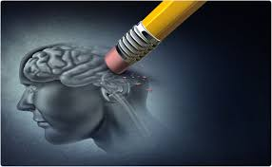
Abstract
Alzheimer’s disease, the most common form of dementia is a neurodegenerative disease.
This disease occurs when the neurons in the brain starts degenerating and it generally affects the elderly people.
It has no cure if the patient is in the last stage, so the classification of the disease at an early stage is very important for the treatment.

Slide 3
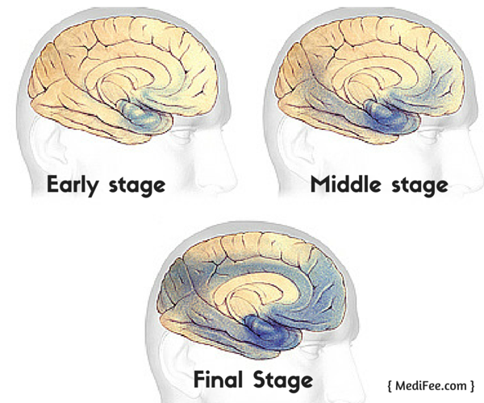
Three Stages of Alzheimer’s Disease
Mild Alzheimer’s Disease (early stage)
Moderate Alzheimer’s Disease (middle stage)
Severe Alzheimer’s Disease (late stage)

Slide 4
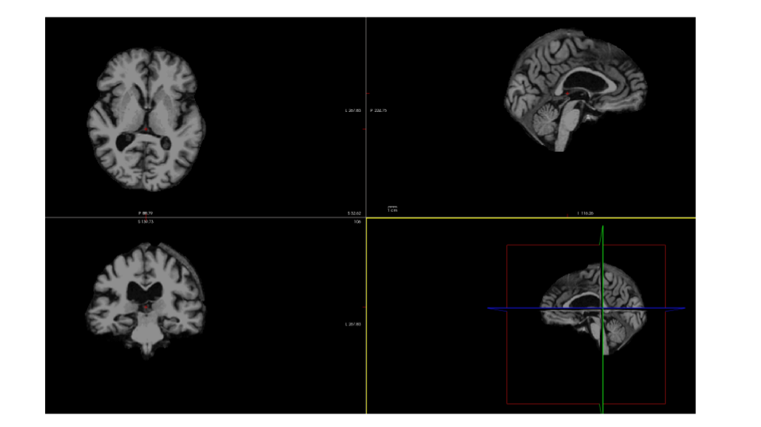
This is the View of a Pre-Processed image using free-surfer.
We need to train model on volumetric and thickness data obtained after pre- processing MRI images using Free-Surfer for various classifications tasks.
The extracted features includes the volume and thickness of different parts of the brain ,including cortical and sub-cortical parts of the brain.

Slide 5
Technology
For this We will be using various algorithms of ML and DL for classification of Alzheimer’s disease.
Some of them are---
Xgboost, Logistic Regression, SVM, Naïve Bayes, Random Forest, Gradient Boosting, Neural Networks, Discriminant Analysis, Deep Forest, ……..
So in last we can conclude that which algorithm gives better accuracy and performance.

Slide 6

Machine learning algorithms find natural patterns in data that generate insight and help you make better decisions and predictions.
They are used every day to make critical decisions in medical diagnosis, stock trading, energy load forecasting, and more.

Slide 7
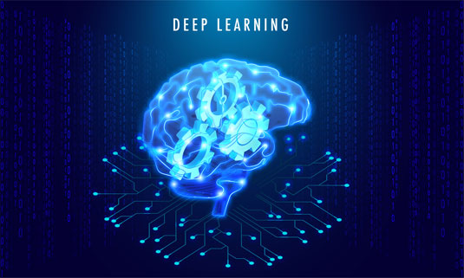
Nowdays, Deep learning plays a vital role in the classification, detection and segmentation of data. However, early diagnosis of AD can reduce the progression of the disease at the early stages.
Deep Convolutional Neural Networks (CNN), a class of Artificial Neural Network (ANN) are most popularly used by the researchers for the classification, visualization and segmentation of data.

Slide 8
Deep Neural Networks
Learning becomes deeper when tasks you solve get harder. Deep neural network represents the type of machine learning when the system uses many layers of nodes to derive high-level functions from input information. It means transforming the data into a more creative and abstract component.

Slide 9
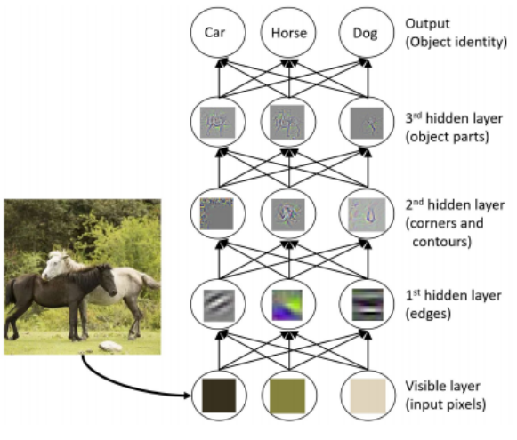
Example:-
Illustration of the layer-by-layer processing in deep neural networks: Features of higher levels of abstract emerge as the layer goes up from the bottom.

Slide 10
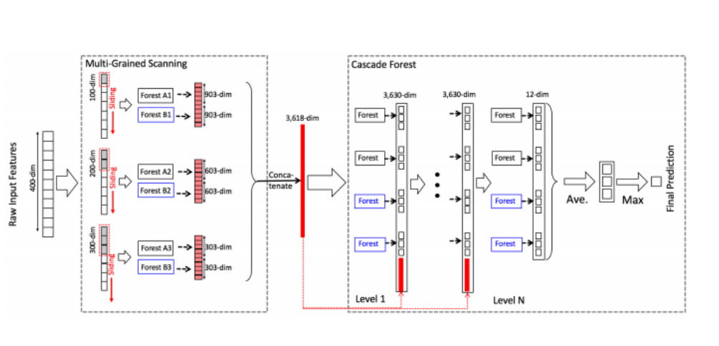
Gcforest
The gc-Forest method which is able to construct deep forest, a deep model based on decision trees, and the training process does not rely on backpropagation.
Comparing with deep neural networks, the gc-Forest has much fewer hyper-parameters.

Slide 11
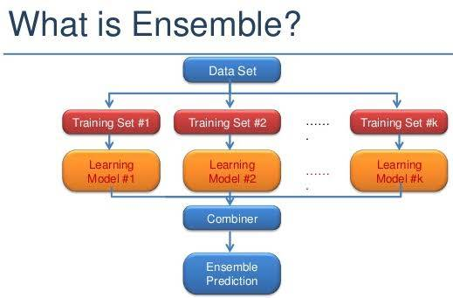
The gcForest is a decision tree ensemble approach. Ensemble methods are a kind of powerful machine learning techniques which combine multiple learners for the same task.
There are some studies showing that by using ensemble methods such as random forest facilitated with deep neural network features, the performance can be even better than simply using deep neural networks.

Slide 12
Overview Of gcForest
The gcForest (multi-Grained Cascade Forest) is a approach for constructing a deep forest. It is a decision tree ensemble, with a cascade structure learning representation learning by forests.
The final model structure of gcForest is a cascade of cascades, where each cascade consists of multiple levels each corresponding to a grain of scanning.
Its representational learning ability can be further enhanced by multi-grained scanning. As multi grained scanning uses the concept of CNN and RNN in finding feature relationships, thus it is evident that when there are special or sequential feature relationships, the multi-grained scanning process helps improve performance.

Slide 13

Data used in the preparation of this report was obtained from the Alzheimer’s Disease Neuroimaging Initiative (ADNI) database (http://adni.loni.usc.edu).

Slide 14
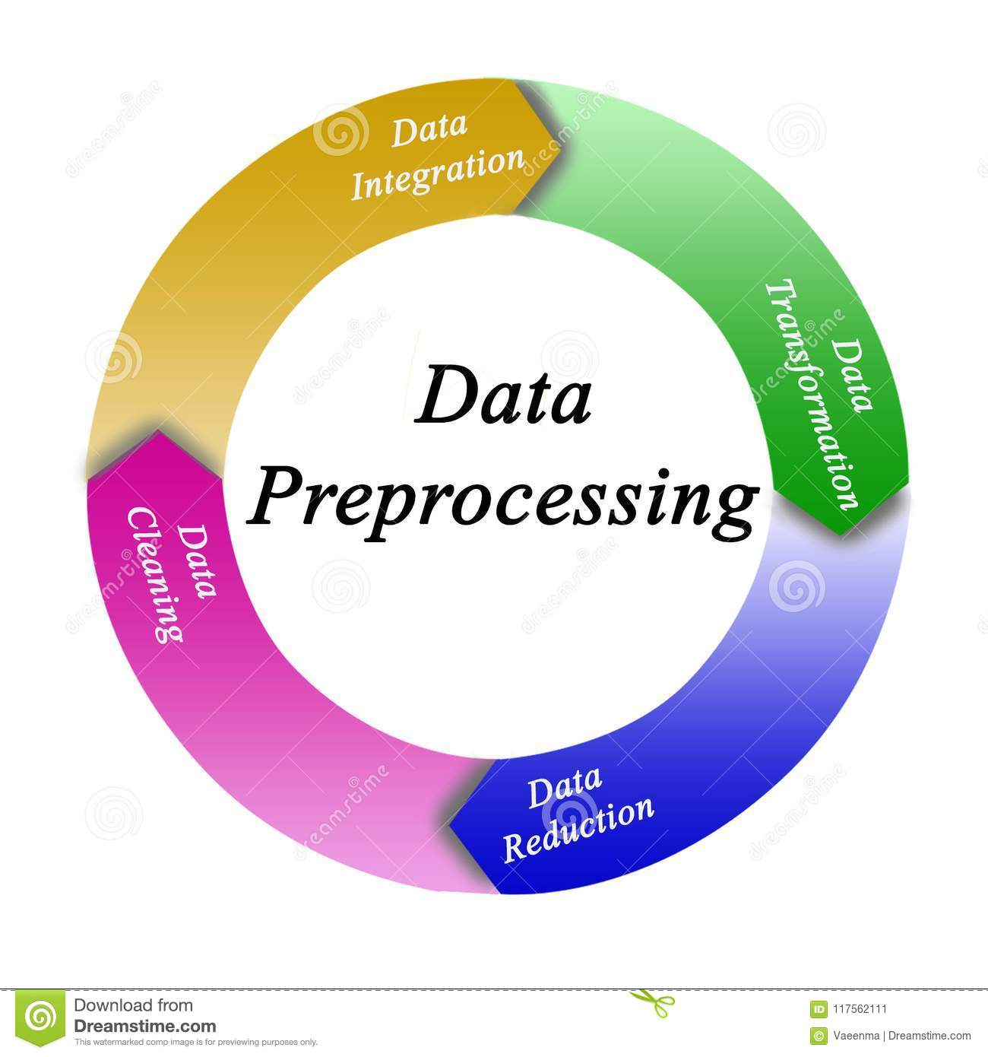
After downloading the images from ADNI database, we need to remove unnecessary details of brain MR images that might cause poor training of our classification model, cortical reconstruction and volumetric segmentation was performed with the Free-Surfer image analysis suite

Slide 15
Collecting Extracted Features
After we have pre-processed images using free-surfer software, we need to extract the features from the pre-processed images using the frees-surfer commands .
asegstats2table
aparcstats2table
It produces the volumetric data from different cortical structures of the brain segmented.
It produces the area or thickness data from different subcortical structures of left part of the brain segmented.

Slide 16
Work To Do On/Conclusion
After collecting extracted features from the pre-processed images ,we prepare 4 csv files which contains subject features of CN and AD, AD and MCI, MCI and CN .
This 3 files will be used for 2-way classification and for 3-way classification we had a file with CN, AD and MCI features.

Slide 17
Thank You

