Slide 1
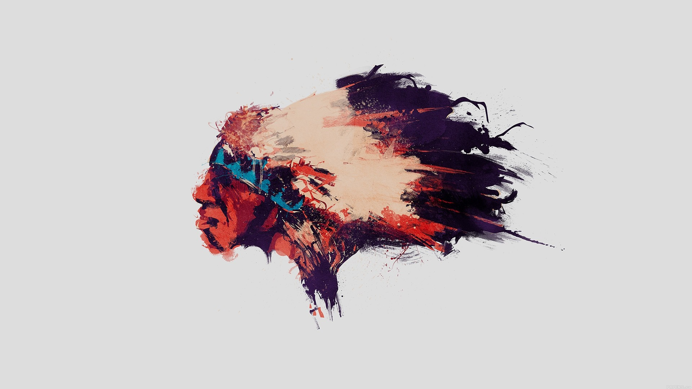
PROBLEM
Digital artists lose control before they earn revenue.
Independent creators can publish beautiful work, but the current internet sales path exposes them to theft, high platform cuts, weak auction access, and blocked buyer relationships.
Pain point summary
@MetArt protected preview
Artists upload. The internet can copy, reuse, and redistribute previews without permission.
Current path leakage
1
Upload
Traditional marketplaces can take 30-50% cuts, leaving creators with reduced earnings.
Artist publishes high-res preview
2
Copy risk
Live auctions are rarely accessible to indie artists without heavy platform support.
Preview can be copied before sale
3
Platform cut
Creator-to-collector trust is weakened when every conversation goes through a middleman.
30-50% commissions reduce income
4
No direct trust
Middleman owns the buyer relationship
MetArt starts by closing this gap: protection, selling, auctions, chat, and payment in one creator-owned journey.
MetArt Phase 1 Pitch Deck
01 / 04
Notes:
Problem slide: frame creator pain around piracy, large marketplace cuts, no accessible auction lane, and loss of direct buyer relationship.

Slide 2
SOLUTION + USER FLOW
MetArt turns upload into a protected selling journey.
What MetArt fixes
AI co-pilot
Faster professional listings
Auto-watermark
Anti-piracy preview pipeline
The product combines AI-assisted listing, anti-piracy watermarking, realtime auctions, direct DMs, and payments so artists can move from creation to revenue without losing control.
Realtime auctions
Accessible bidding for indie art
Direct DMs
Creator and collector relationship
Creator lane
Upload artwork
AI Appraiser
Protect + publish
Marketplace listing
Creator selects image and listing intent.
Title, tags, bid and watermark position.
Sharp watermark plus Cloudinary secure preview.
Browsable, shoppable and auction-ready.
Collector lane
Browse / discover
DM or bid live
Checkout
Dashboard
Collector enters catalog or auction page.
Direct chat and WebSocket bidding.
Stripe and Khalti payment flow.
Orders, uploads and activity.
One-line pitch: MetArt helps independent artists protect, sell, auction and monetize digital artwork directly with collectors.
No middleman ownership of the relationship
MetArt Phase 1 Pitch Deck
02 / 04
Notes:
Solution slide: explain MetArt as a protected product journey. The central diagram is the required user flow.

Slide 3
TOOLS + TECH STACK
The stack is built around secure media, realtime bidding, and AI listing support.
Tech snapshot
React + Redux
Node + Express
MongoDB + Mongoose
OpenAI Vision / GPT-4o
Sharp + Cloudinary
Socket.IO + JWT
Stripe + Khalti
MetArt is a MERN product architecture with AI vision, image processing, protected storage, WebSocket interactions, and payment rails aligned to the creator revenue journey.
React client
Express API
AI + media pipeline
Realtime commerce
Data + storage
Upload UI, catalog, carts, profiles, AI suggestion panel.
Routes, controllers, auth middleware, upload orchestration.
OpenAI GPT-4o vision, local fallback, Sharp watermark overlay.
Socket.IO auctions, direct DMs, Stripe and Khalti checkout.
MongoDB/Mongoose, Cloudinary images, role-based records.
Why this stack matters
Listing speed
Asset protection
Direct monetization
AI turns an image into polished catalog copy, tags, pricing and watermark placement.
Sharp overlays the watermark before secure Cloudinary upload.
Auctions, DMs and payments connect collectors to artists without extra friction.
MetArt Phase 1 Pitch Deck
03 / 04
Notes:
Tech slide: present architecture as a product system, not a generic tech list.

Slide 4

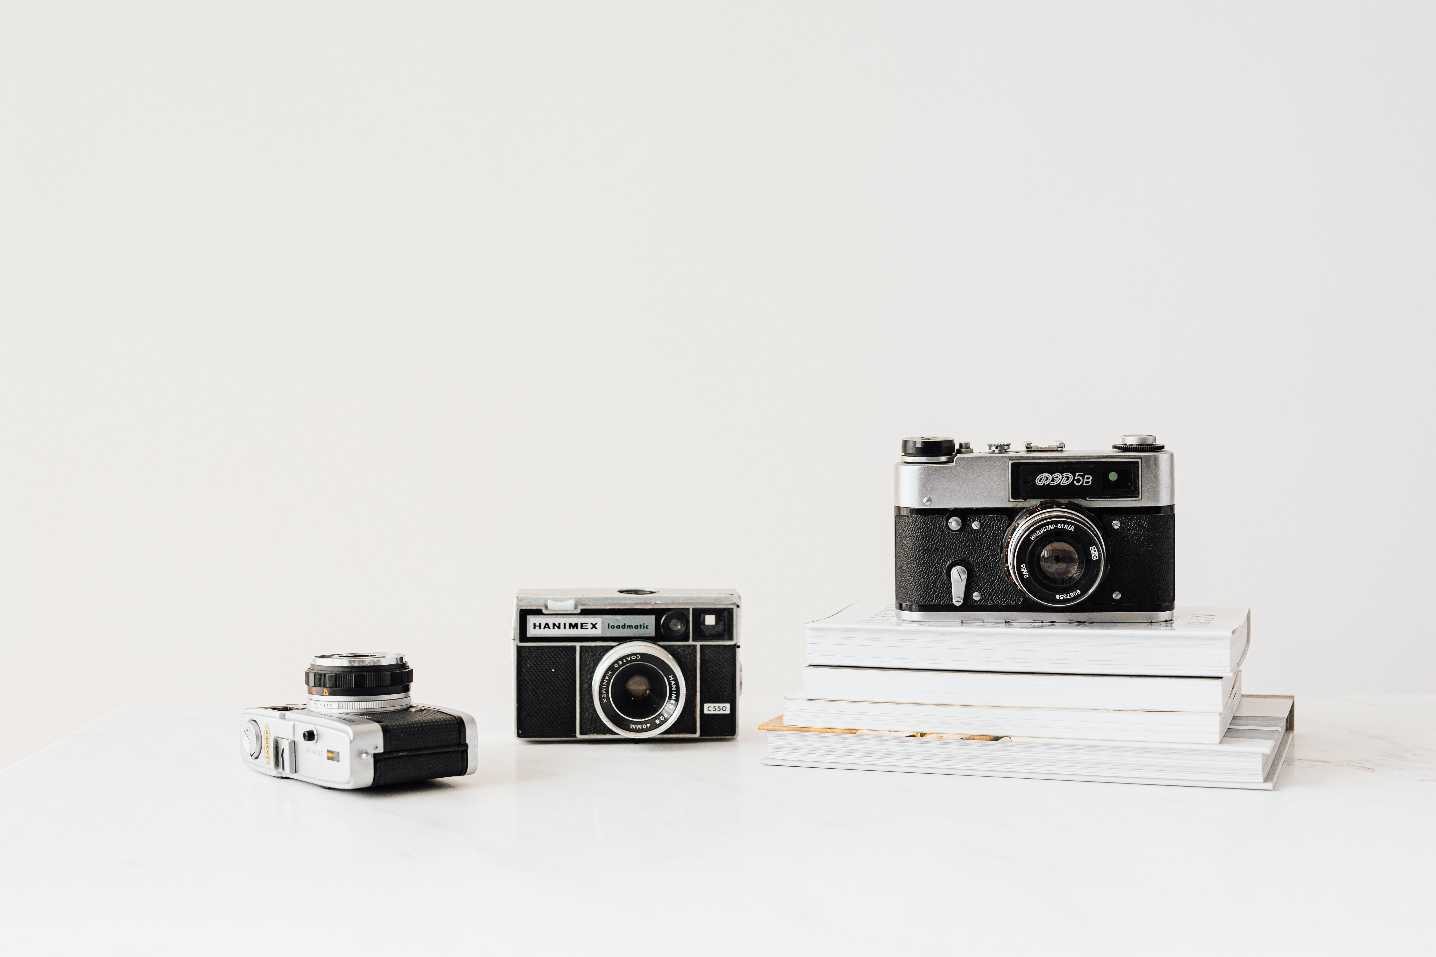
ICP + TARGET AUDIENCE
ICP: indie creators and collectors who need trust without a middleman.
MetArt's beachhead audience is independent digital artists who already share work online but need protection, better presentation, direct buyer access, and practical selling tools.
Target categories
Primary ICP
Secondary ICP
Go-to-market wedge
Independent Artists
Digital Collectors
1
Start
Artists who post on social platforms but lack a selling workflow.
Digital artists, painters, illustrators and photographers who need AI help to list work professionally, protect previews, run auctions and get paid directly.
Collectors and buyers who want unique artwork, transparent creator interaction, real-time auctions and a smoother checkout journey.
2
Convert
Use AI upload + watermarking as the reason to publish on MetArt.
3
Expand
Core need: control + monetization
Core need: authenticity + access
Add live auctions, DMs and checkout to turn followers into collectors.
Phase 1 outcome: MVP story is pitch-ready once the deck is paired with a working demo of upload, protection, auction, chat and checkout.
MetArt = protect + sell + auction + chat
MetArt Phase 1 Pitch Deck
04 / 04
Notes:
ICP slide: identify creators as primary users and collectors as secondary users; close with the Phase 1 pitch-ready outcome.

