Slide 1
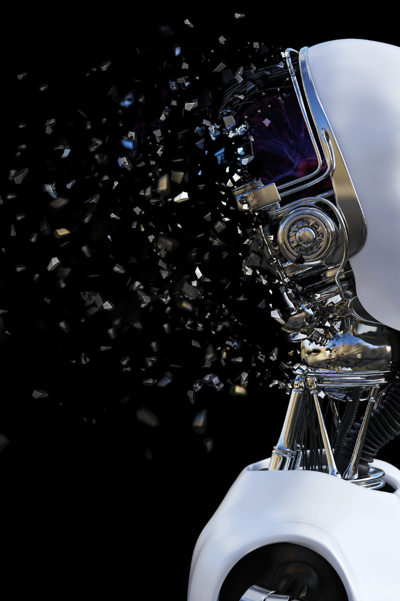
AI Bot for Playing TicTacToe
Submitted By :
Suyash Kumar- K- 2115001025
Ashutosh Singh- H- 2115000235
Deepansh Niranjan- I - 2115000324
Divyam Upadhyay- I – 2115000377

Slide 2

Introduction
The objective of creating a Tic-Tac-Toe-playing AI using the minimax algorithm is to demonstrate how AI can make intelligent decisions in a simple two-player game. This project serves as an educational and illustrative example of AI decision-making in a deterministic, zero-sum game.

Slide 3
AI Algorithm for TicTacToe
1
Minimax Algorithm
Uncover the power of the Minimax algorithm, a game theory technique that enables an AI bot to analyze all possible moves and make optimal decisions.
Evaluating Game State
2
Explore how the AI bot evaluates the game state, taking into account available moves, potential threats, and winning opportunities.
3
Simulating Game Scenarios
Unleash the AI bot's ability to simulate various game scenarios to predict the best possible moves and counter the opponent's strategies.

Slide 4

Building the AI Bot
Evaluating Game State
Understand the intricate process of evaluating the current game state to identify the most favorable next move.
Simulating Game Scenarios
Learn how the AI bot predicts and simulates future scenarios to choose a winning strategy.

Slide 5
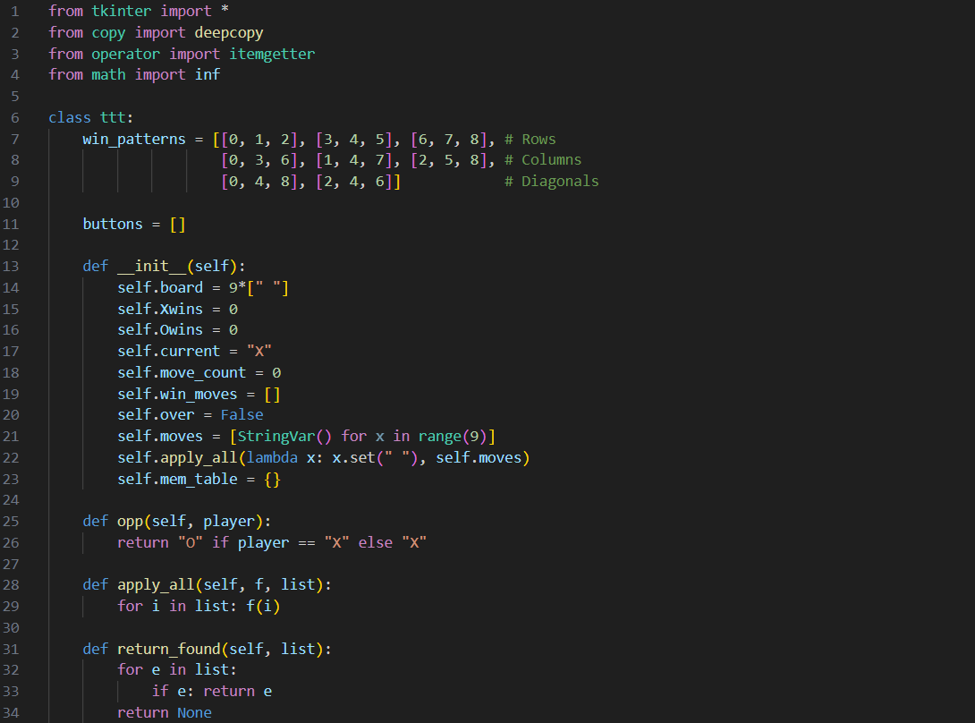

Slide 6
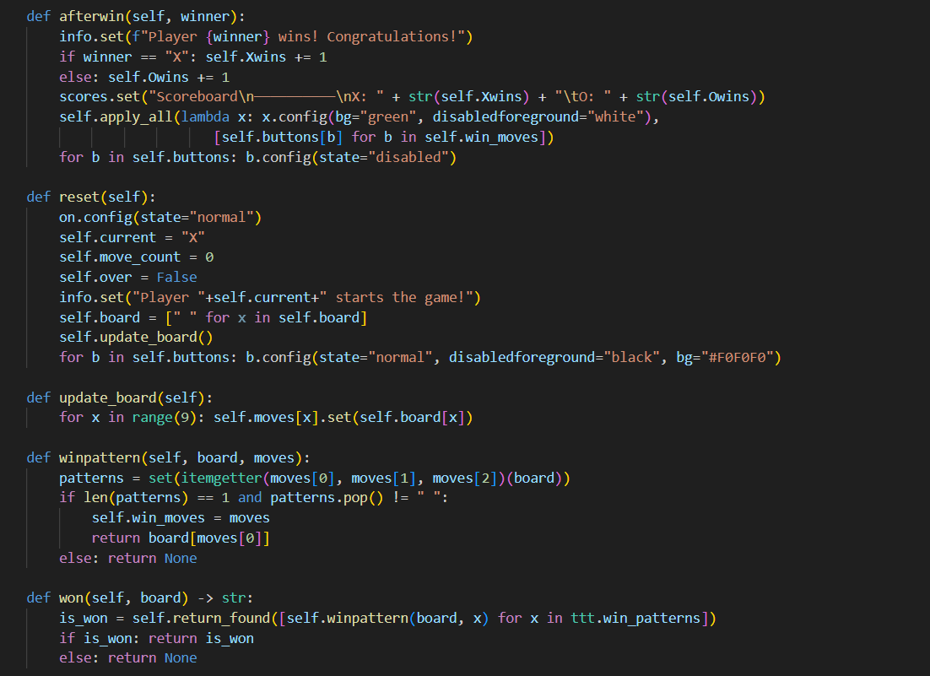

Slide 7
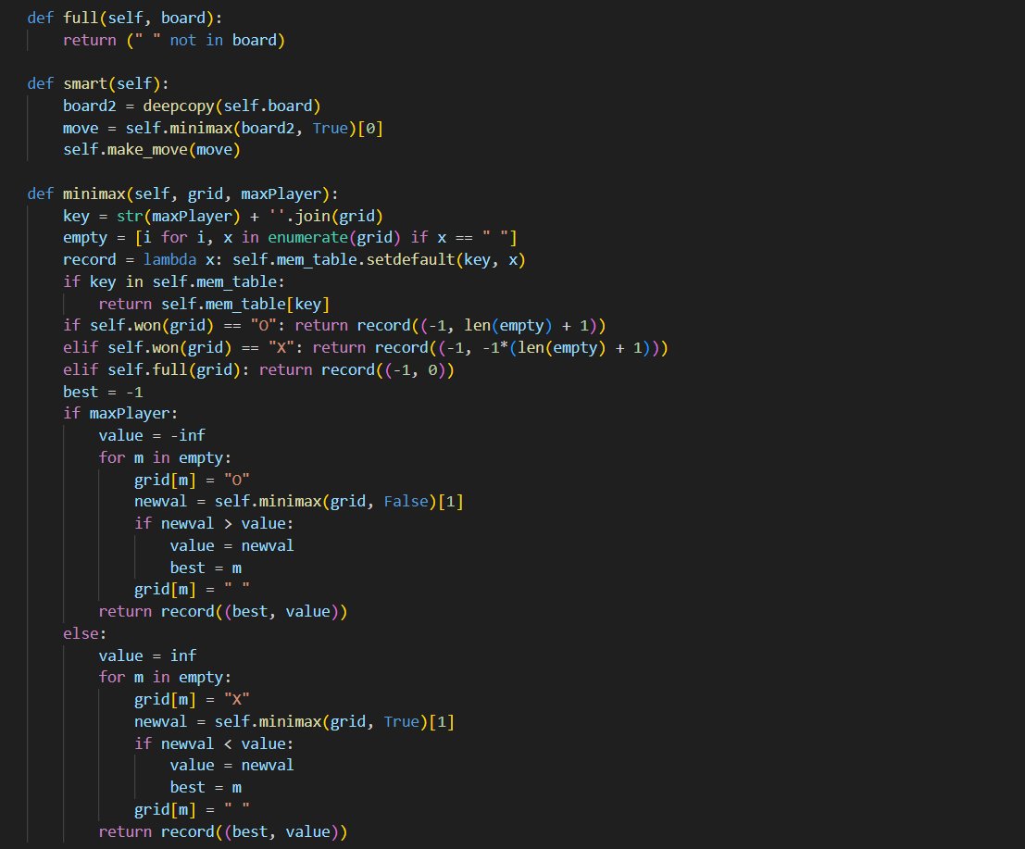

Slide 8
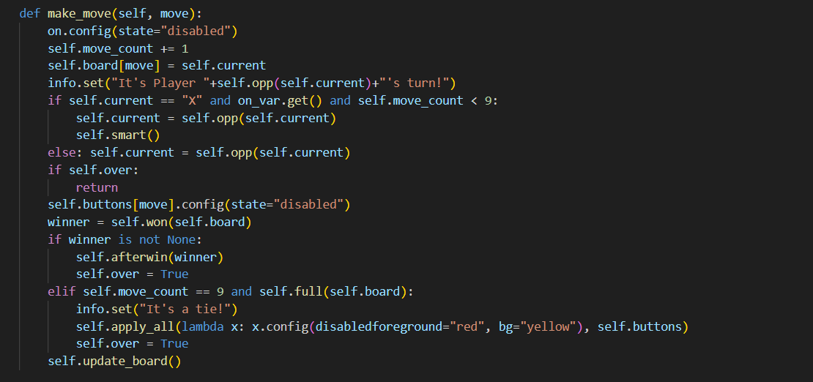

Slide 9
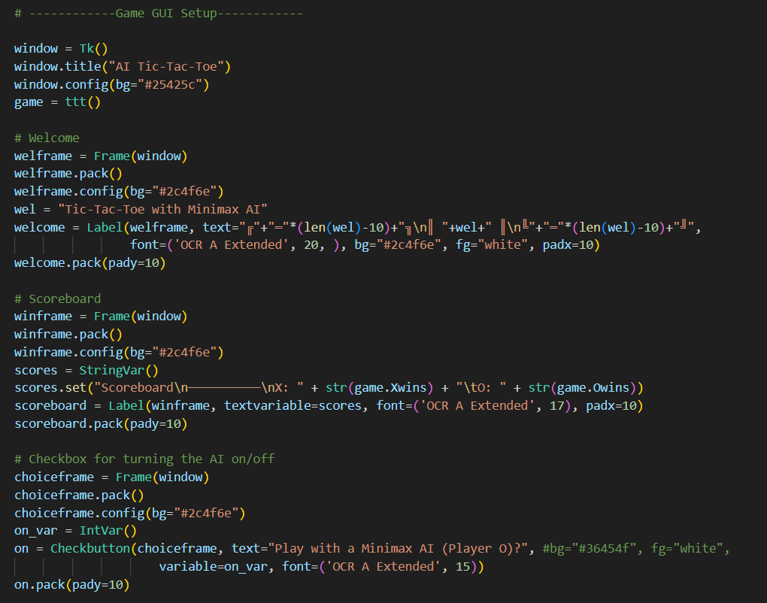

Slide 10
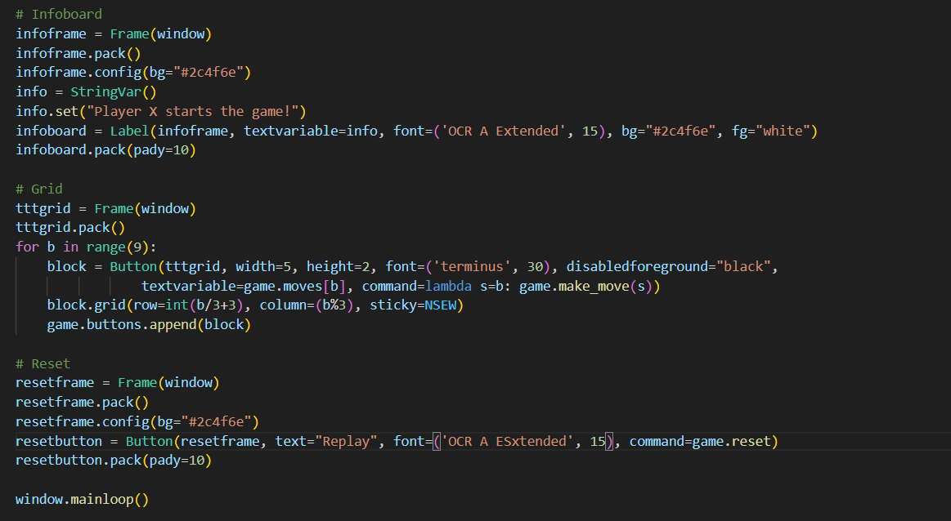

Slide 11

Challenges and Limitations
Predictability : The game has a limited number of possible moves, and with optimal play, it often leads to a predictable outcome (either a win for one player or a draw). This lack of variability can make the game less interesting for experienced players.

Slide 12
Small Game Tree: The game tree, representing all possible moves and outcomes, is relatively small. This simplicity means that computers can easily analyze all possible moves and outcomes, making it possible to create unbeatable AI opponents.
Memorizable Patterns: Since the game is simple, players can memorize winning and blocking patterns. This reduces the reliance on strategic thinking and adaptability during gameplay.

Slide 13
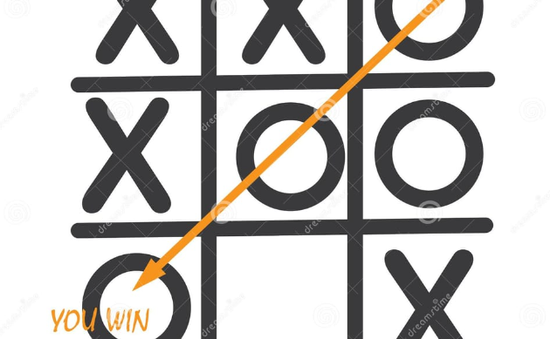

Conclusion
Future Possibilities
Impact of AI Bot on TicTacToe Game
The future scope of AI includes increased automation in various industries, transformative impacts on healthcare, advancements in autonomous vehicles, improved natural language processing, applications in finance and education, enhanced cybersecurity measures, contributions to addressing climate change, improvements in entertainment. Overall, AI is expected to play a pivotal role in shaping the future across diverse sectors of society.
Recognize the significant impact an AI bot can have on TicTacToe, challenging even the most experienced human players.

