Slide 1
Network Security: Assignment 4
On-the-go verification of Driver’s License
Submitted by:
Akash Kushwaha 2021514
Suyash Kumar 2021293

Slide 2
Project Objective & Overview
Objective:
To implement a secure and efficient system for verifying driver license data using QR codes and digital signatures, ensuring authenticity and integrity of the information during on-the-spot checks by authorities.
Overview:
Key functional blocks:
Driver’s License data
QR generation
QR verification

Slide 3
System Overview
Driver’s License: The driver’s license data contains the following fields:
DL_No – Driver’s License Number (e.g., KA01AB1234)
DOI – Date of Issue (e.g., 2020-01-01)
Validity – Expiry Date of the License (e.g., 2030-01-01)
Name – Full Name of the License Holder (e.g., Rahul Sharma)
DOB – Date of Birth (e.g., 1990-05-15)
Address – Residential Address (e.g., 123 MG Road, Bengaluru)
Categories – Vehicle Categories Authorized (e.g., LMV, MCWG)
Restrictions – Driving Restrictions, if any (e.g., Corrective Lenses)
data_signature – Placeholder for the digital signature of the data
Generate the QR code after computing the hash and signing the concatenated (actual data + hash) data.
Verify the QR Code after decoding it and comparison of hashed data with the counterpart

Slide 4
QR Generation
Generate.py:
Loads driver license data from driver_data.json, which includes:
Name, DOB, DL number, categories, restrictions, etc.
Generates a new RSA key pair (2048-bit)
Saves private.pem (for signing)
Saves public.pem (for verification)
Hashes the license data using SHA256.
Signs the hash using the private key via PKCS#1 v1.5.
Combines original data and base64-encoded signature into a single payload.
Converts this payload into a QR code and saves it as driver_license_qr.png.
Purpose: Ensure the license information is authentic and tamper-evident.

Slide 5
Tampering Simulation
make_tampered_qr.py:
Manually creates a fake driver profile:
E.g., name: "Evil Hacker", DL_No: "FAKE0000", etc.
Generates a different RSA key pair (not from the authority).
Signs the fake data with this unauthorized private key.
Bundles the fake data and its signature into a QR payload.
Saves the tampered QR code as tampered_qr.png.
Purpose: To demonstrate how unauthorized signing can be detected at verification time.

Slide 6
QR Verification
QR_verify.py:
Loads the public key from public.pem (originally created during QR generation).
Reads and decodes the QR code from an image (driver_license_qr.png or tampered_qr.png).
Extracts JSON payload: separates data and signature.
Hashes the extracted data using SHA256.
Uses the public key to verify the signature.
If valid → Prints full license info.
If invalid → Displays “Signature invalid – data may be tampered.”
Features:
Handles binarization if QR reading fails due to poor contrast.
Gracefully handles malformed payloads or unreadable QR codes.
Purpose: Authenticate license data and detect tampering or forgery.

Slide 7
Simulation and Example
Run the generate.py to first generate the RSA public and private key and save them as private.pem and public.pem, it will also generate the QR code and save it in the same directory as driver_license_qr.png.
Run QR_verify.py to verify the generated QR code, if it gets verified it will display full license info else it displays “Signature invalid – data may be tampered.”
if you want to check the verification for a tampered data, run make_tampered_qr.py and then again the run the QR_verify.py.

Slide 8
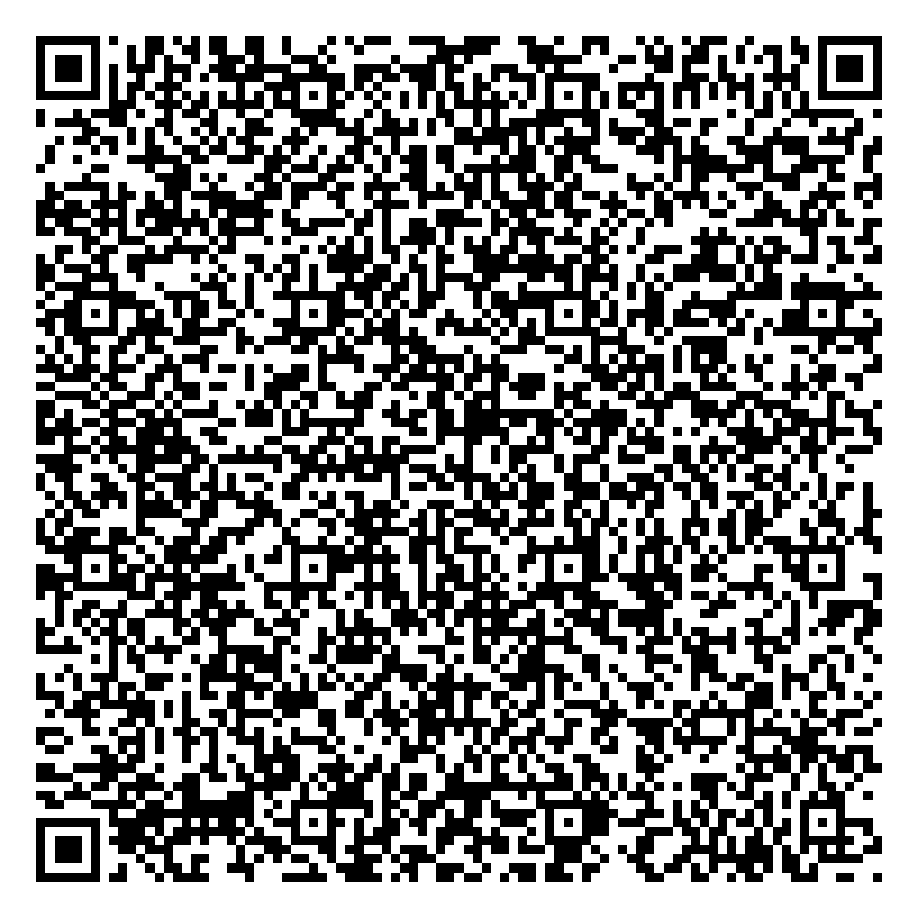
Example
Driver’s license data: Generated QR Code:
{
"DL_No": "KA01AB1234",
"DOI": "2020-01-01",
"Validity": "2030-01-01",
"Name": "Rahul Sharma",
"DOB": "1990-05-15",
"Address": "123 MG Road, Bengaluru",
"data_signature": "",
"categories": ["LMV", "MCWG"],
"restrictions": ["Corrective Lenses"]
}

Slide 9
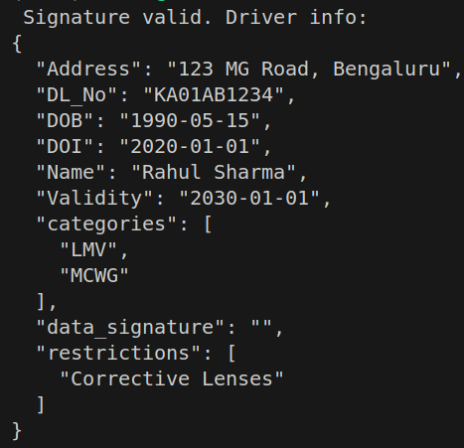
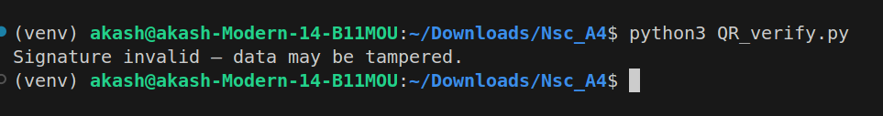
Outputs:
If valid: If Invalid:

