Slide 1
Network Security: Programming Ex 2
AES-128 Encryption and Decryption
Submitted by:
Akash Kushwaha 2021514
Suyash Kumar 2021293

Slide 2
Objective & Overview
Objective:
Implement AES-128 encryption and decryption from scratch
Utilize a 128-bit key with 10 encryption rounds
Overview:
Key functional blocks:
Initialization
Key Expansion
Encryption Process
Decryption Process

Slide 3
S-box and Key Expansion
The program initializes with a 128-bit key and loads two substitution boxes:
S-box Usage (Encryption):
Replaces each byte in the state matrix with its corresponding value from the AES S-box for substitution in the SubBytes step.
Inverse S-box Usage (Decryption):
Replaces each byte in the state matrix with its corresponding value from the Inverse S-box to reverse substitution in the InvSubBytes step
Key Expansion:
The key Expansion method generates round keys from the initial key using byte substitution, rotation, and XOR operations with round constants.

Slide 4
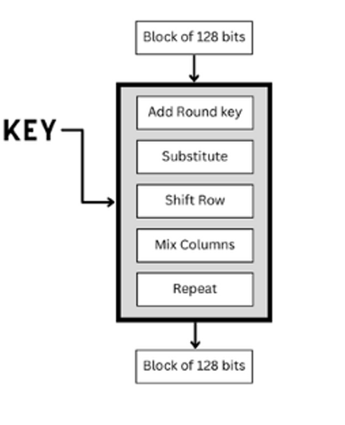
Encryption
Initial Round:
AddRoundKey: XORs the plaintext with the initial round key.
Main Rounds (1 to 9):
SubBytes: Each byte is replaced according to the S-box.
ShiftRows: Rows of the state are cyclically shifted.
MixColumns: Combines bytes within each column.
AddRoundKey: XORs state with the round key.
Final Round (10th Round):
Includes SubBytes, ShiftRows, and AddRoundKey, omitting MixColumns.

Slide 5
Decryption
Initial Round:
Encrypted data (ciphertext) is XORed with the last round key generated during the key
expansion process
First round:
Includes AddRoundKey, InvShiftRows, InvSubBytes, and omitting MixColumns.
Main Rounds (2 to 9):
AddRoundKey: XORs state with the round key.
InvMixColumns: Performs inverse mixing on each column.
InvShiftRows: Rows are cyclically shifted in reverse.
InvSubBytes: Each byte is replaced using the Inverse S-box.
Final Round (Decryption Round 10, Corresponds to First Encryption Round:
AddRoundKey (XORs state with the initial round key.

Slide 6
Test Cases and Results
Sample Input is a 16 Bytes plaintext:
0x32 0x43 0xf6 0xa8
0x88 0x5a 0x30 0x8d
0x31 0x31 0x98 0xa2
0xe0 0x37 0x07 0x34
After converting into decimal with base 10, plaintext is:
50, 67, 246, 168,
136, 90, 48, 141,
49, 49, 152, 162,
224, 55, 7, 52

Slide 7
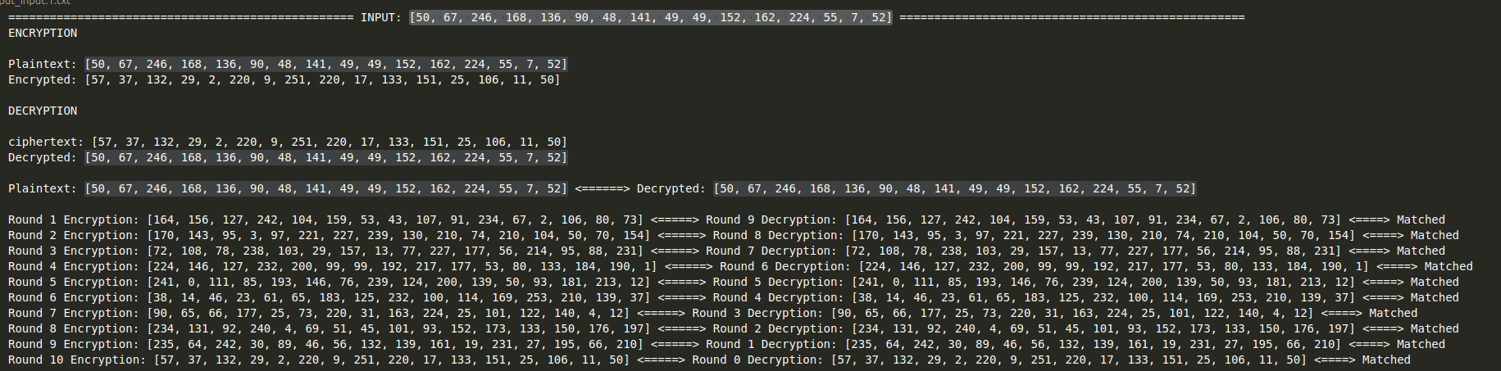
Test Cases and Results
Output below describes the encryption and decryption after each round

