Slide 1

Harnessing Big Data and Sentiment Analysis for Enhanced Restaurant Recommendations
Team Members
H.D. Nandish BL.EN.U4EAC20027
Rahul R BL.EN.U4EAC20060
Suyash Mishra BL.EN.U4EAC20077
Date: 07-12-2023
Course :Big Data Analytics 19CSE357
EAC 7th sem –H Sec

Slide 2
Outline
Introduction
Literature Survey
Understanding Sentiment Analysis
Dataset Overview
Exploratory Data Analysis
Proposed Framework
Evaluation Metrics
Results
Conclusion and scope for improvements

Slide 3
INTRODUCTION
Project Purpose:
Transforming restaurant selection with big data analytics and sentiment analysis.
Implementing Apache Spark for scalable data processing and machine learning.
Objectives:
Accurately extract sentiments from restaurant reviews using Apache Spark's MLlib.
Develop a sophisticated sentiment classification model.
Create a Spark-based recommendation system that integrates user ratings and sentiment analysis for personalized suggestions.

Slide 4
Literature Survey
Study Reference | Dataset and techniques used | Achievements and findings
1. | Amazon dataset; Tokenization, Normalization, Stemming, Lemmatization, TF-IDF | Achieved accuracy scores of 90-93%, demonstrating the robustness of NLP
2. | Microblogging data (e.g., Twitter); Sentiment analysis for movie recommendations | Enhanced recommendation performance, especially for users with sparse interactions
3. | Twitter data; Utilized Apache Spark for distributed data processing | Highlighted efficiency and scalability in handling large datasets, effective in understanding public sentiments

Slide 5
Understanding Sentiment Analysis
Definition:
Sentiment Analysis, also known as opinion mining, is part of Natural Language Processing (NLP) focusing on identifying and categorizing opinions in text to assess attitudes as positive, negative, or neutral.
Importance in the Project:
Applied to restaurant reviews in our project, sentiment analysis decodes the emotions and opinions expressed by customers.
How it Works:
Utilizes advanced algorithms to analyze text data, like reviews, examining language and context to assign a sentiment score reflecting the text's overall emotion.
.

Slide 6
Dataset Overview for Sentiment Analysis
Dataset Description:
Our dataset comprises an extensive collection of restaurant reviews, capturing diverse customer experiences and opinions.
Source of the Dataset:
This rich dataset is sourced from a amazon repository, aggregating varied customer feedback.
Key Features:
business_id: Unique identifier for each restaurant.
review_text: Customer reviews providing valuable insights into dining experiences.
rating: Numerical ratings given by customers, indicating overall satisfaction.
Volume of Data:
The dataset contains 1088890 of reviews, covering of unique restaurants, offering a comprehensive view of the dining landscape.

Slide 7
Exploratory Data Analysis
Rating Distribution Analysis
Sentiment Categorization and Analysis
Word Cloud Analysis for Reviews
Review Length Analysis
Pearson’s Correlation Coefficient

Slide 8
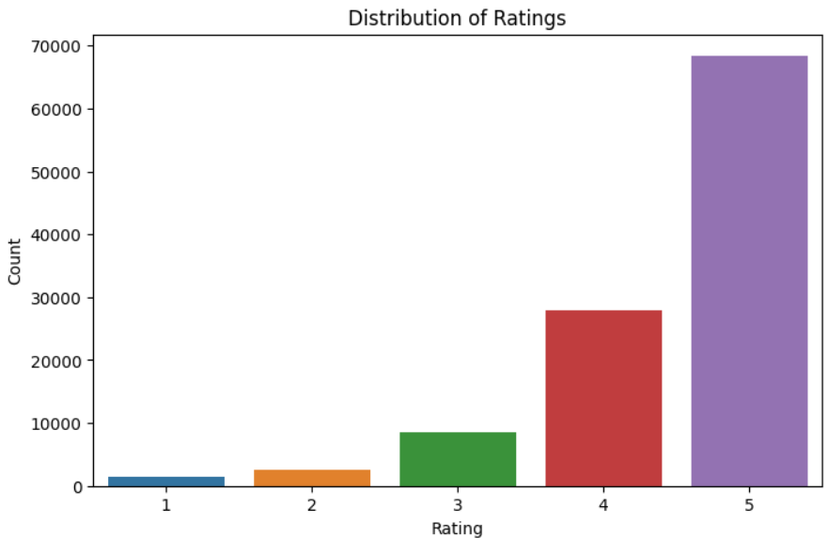
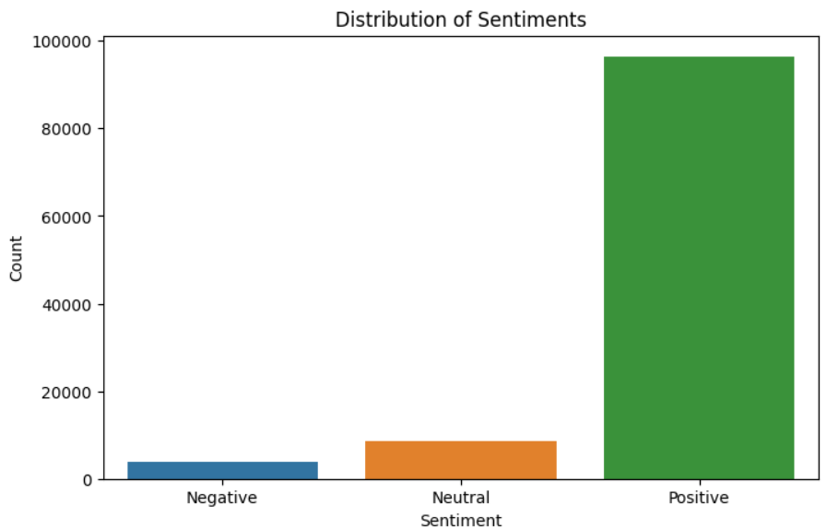
Exploratory Data Analysis

Slide 9
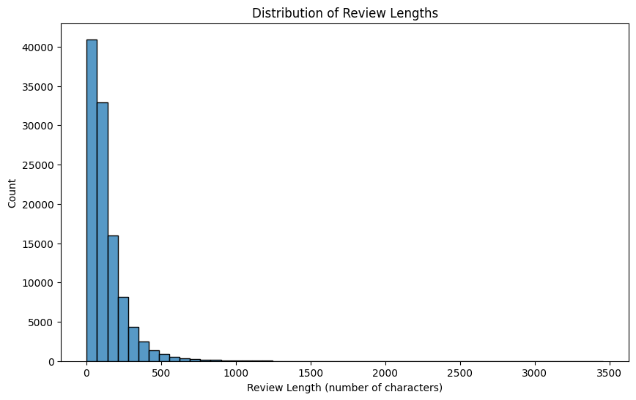
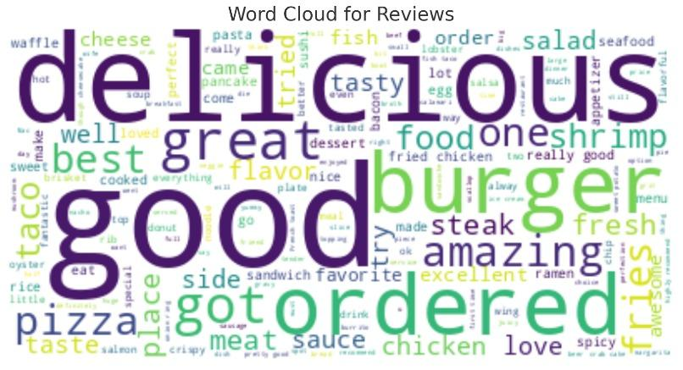
Exploratory Data Analysis

Slide 10
Proposed Framework
Sentiment Analysis
Data-Preprocessing Using NLP :
Dropping
Tokenizer
VADER (Valence Aware Dictionary sEntiment Reasoner)
TF-IDF (Term Frequency-Inverse Document Frequency)

Slide 11
Proposed Framework
ML Models
Decision Tree
Naive Bayes
Logistic Regression
ML Model Used | Precision | Accuracy | F1 Score | Recall
Decision Tree | 0.64 | 0.78 | 0.68 | 0.78
Naïve Bayes | 0.78 | 0.73 | 0.76 | 0.74
Logistic Regression | 0.83 | 0.85 | 0.83 | 0.85

Slide 12
Proposed Framework
Recommendation system
Restaurant sentiment score: it takes the mean of the prediction values which was obtained from sentiment analysis.
Restaurant score: it was used to add an additional column to the table named ‘overall score’
Overallscore = 1.8 ∗ (rating) + 1 ∗ [label]

Slide 13
Methodology in a nutshell
System
Sentiment analysis | Machine Learning Model | Recommendation system | Final output
Model: Dropping Tokenizer VADER TF-IDF | Model: String Indexer Decision Tree Naïve Bayes Logistic Regression | Model: Input Rating Label Output Overall score | Top 5 Restaurants Medium 5 Restaurants Bottom 5 Restaurants

Slide 14
Evaluation Metrics
The MulticlassClassificationEvaluator in PySpark supports various evaluation metrics.
The metrics that we are using is “Accuracy”
The accuracy value shows the accuracy of categorizing the restaurant as good, neutral and bad.
Based on rating and reviews.

Slide 15
Results
To show the accuracy of the sentiment analysis implemented.
To showcase the top 10 recommended restaurant.
To showcase the bottom 10 unrecommended restaurants.

Slide 16
Conclusion and Scope for Improvements
We have achieved to implement a recommendation system over the sentiment analysis of a review data.
The accuracy can be improved by having better data pre processing.
More parameter like ‘restaurant cuisine’ and better overall_score formula for recommendation can be used for future scope.
Use of better machine learning models along with deep learning can give a more precise output.

Slide 17
References
1. Hafiz Muhammad Ahmed, Mazhar Javed Awan, Nabeel Sabir Khan, Sentiment Analysis of Online Food Reviews using Big Data Analytics, Ilkogretim Online - Elementary Education Online, 2021; Vol 20 (Issue 2).
2. Samar Al-Saqqa, Ghazi Al-Naymat, Arafat Awajan, A Large-Scale Sentiment Data Classification for Online Reviews Under Apache Spark, Procedia Computer Sci- ence, Volume 141, 2018.
3. Bineet Kumar Jha, Sivasankari G.G, Venugopal K.R, Sentiment Analysis for E- Commerce Products Using Natural Language Processing, AMC Engineering Col- lege, CMR Institute of Technology.
4. Y. K. Guntupalli, V. S. Saketh, S. Amudheswaran and D. S. Vaishnav, ”High-Scale Food Recommendation Built on Apache Spark using Alternating Least Squares,” 2020 5th IEEE International Conference.
5. Abbasi-Moud, Hamed Vahdat-Nejad, Javad Sadri, Tourism recommendation sys- tem based on semantic clustering and sentiment analysis, Expert Systems with Applications,Volume 167, 2021.
6. S. Kumar, K. De and P. P. Roy, ”Movie Recommendation System Using Sentiment Analysis From Microblogging Data,” in IEEE Transactions on Computational So- cial Systems, vol. 7, no. 4, pp. 915-923, Aug. 2020.

Slide 18
Thank You

