Slide 1


“Sports Performance Analysis and Monitoring”
A
PRESENTATION
ON
Presented By,
SUYESHA PATIL
FOR
Mini Project Presentation
UNDER THE GUIDANCE OF
MRS. P.A.SATARKAR
DEPARTMENT OF COMPUTER SCIENCE & ENGINEERING
SVERI’S COLLEGE OF ENGINEERING, PANDHARPUR.

Slide 2

AGENDA
INTRODUCTION
PROBLEM STATEMENT
OBJECTIVES
LITERATURE REVIEW
PROPOSED SYSTEM ARCHITECTURE
ALGORITHMS
IMPLEMENTATION
PROPOSED vs CURRENT TECHINIQUE
FINAL RESULT
CONCLUSION
REFERENCES

Slide 3
INTRODUCTION
In modern sports, winning often depends on small margins. Even a slight improvement in performance can make a huge difference.
Performance analysis involves gathering data during training or games and converting it into meaningful insights that athletes and coaches can use to improve.
Technology plays a key role: wearable sensors, video analysis, GPS trackers, and machine learning algorithms allow detailed performance tracking.
This helps in identifying patterns, measuring strengths and weaknesses, and tracking improvements over time. Real-time monitoring enables immediate adjustments to training strategies.
By using data-driven insights, teams and athletes can make informed decisions that optimize performance and minimize risks of injury or burnout.

Slide 4

PROBLEM STATEMENT
Limited Data Insight: Traditional methods like basic statistics and visual observation fail to provide in-depth insights into an athlete's full performance (e.g., muscle fatigue or biomechanics).
Slow Feedback: Coaches often get performance data after games or training sessions, which leads to delayed decision-making and limits real-time adjustments.
Injury Risk: Overtraining or incorrect movements may go unnoticed until an injury occurs. Without proper monitoring, these risks can't be identified early.
Lack of Personalization: Most training programs are generalized and may not address the specific needs, weaknesses, or strengths of each individual athlete.

Slide 5
OBJECTIVE
Develop a system for real-time performance monitoring and analysis.
Provide detailed feedback to help athletes and coaches improve.
Detect strengths, weaknesses, and potential injury risks.
Support better decision-making and training strategies.
To design a system which is user friendly

Slide 6
LITERATURE SURVEY
Sr.no | Title | Author | Technology | Limitation
1 | Real-Time Performance Monitoring in Football Using GPS and Wearable Sensors | John Smith, Emily Clark | GPS technology and wearable accelerometers to track speed, distance, and heart rate during training and games | Limited to outdoor sports; cannot function accurately indoors or in obstructed areas.
2 | Machine Learning for Predicting Athlete Fatigue in Endurance Sports | Mark Johnson, Sarah Lee | Machine learning models (Random Forest, SVM) applied to training load and recovery data | Data collection is time-consuming, and real-time prediction is still challenging.

Slide 7
LITERATURE SURVEY
Sr.no | Title | Author | Technology | Limitation
3 | Video-Based Motion Analysis in Basketball Training | Ahmed Khan, Maria Gonzales | Cascade one-sided perceptron (COS-P) algorithm, mapped and kernelized versions. | Accuracy decreases in complex game environments with multiple players and overlapping movements.
4 | Heart Rate Variability and AI in Tennis Performance Monitoring | Kevin Liu, Rachel Ford | Heart rate variability sensors combined with AI algorithms to assess player stress and recovery | AI models require large datasets for accuracy, and short-term changes can lead to false positives.
5 | Using Neural Networks for Predicting Injury Risk in Soccer Players | David Green, Lisa White | Neural network-based system using past injury data and real-time biomechanical information | Neural networks require vast amounts of historical data, which can be difficult to obtain for individual athletes.

Slide 8
PROPOSED SYSTEM ARCHITECTUTE
Wearable Sensors
Data Collection Platform
Machine Learning Models
Fig.1 System Architecture

Slide 9
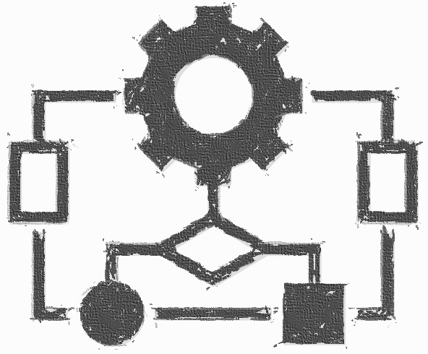
ALGORITHM
Random Forest
Support Vector Machine (SVM)
K-Nearest Neighbors (KNN)
Neural Networks
Linear Regression

Slide 10

IMPLEMENTATION
Data Collection:
Equip athletes with wearable sensors (GPS, accelerometers, heart rate monitors) to track various metrics such as speed, movement, and heart rate during training or matches.
Set up a reliable data transmission system to collect this information in real-time.
Central Data Storages:
Create a Data Collection Platform, either a cloud-based system or local database, to gather and store all the collected data.
Ensure secure and scalable storage that can handle large volumes of incoming data.
Preprocessing of Data
Clean and normalize the raw sensor data (e.g., handling missing values, filtering noise).
Segment the data into meaningful units like time intervals or sessions to prepare for analysis.
Feature Extraction
Extract key features such as average speed, fatigue levels, heart rate variability, and movement patterns.
This step helps in summarizing the raw data into meaningful metrics for further analysis.

Slide 11
IMPLEMENTATION
Model Training with Machine Learning Algorithms
Use algorithms like Random Forest, SVM, Neural Networks to train models on historical performance data.
The models will be trained to detect patterns, make predictions, and provide insights into performance trends or injury risks..
Real-Time Analysis and Prediction
Implement real-time analysis by running the data through machine learning models to generate insights on-the-go.
For example, detect fatigue in an athlete and notify the coach immediately if performance declines during training.
Feedback System
Develop a user interface, such as a mobile app or dashboard, for athletes and coaches to receive real-time insights and feedback.
The feedback should be clear, actionable, and based on the predictions made by the machine learning models.
Model Evaluation and Continuous Improvement
Continuously monitor the performance of the models by comparing predictions with actual outcomes.
Fine-tune the models regularly based on new data and feedback to improve accuracy and reliability over time.

Slide 12
PROPOSED VS CURRENT TECHNIQUE
CURRENT TECHNIQUE
PROPOSED TECHNIQUE
Mostly manual analysis
basic stats,
delayed feedback
Automated
real-time feedback using advanced data analytics
machine learning.

Slide 13
FINAL RESULT
Real-time performance insights help athletes improve faster.
Reduction in injury risks by detecting fatigue or poor movement early.
More precise and personalized training programs.

Slide 14

CONCLUSION
Advanced sports performance analysis systems provide valuable insights that traditional methods cannot. Combining sensors, data analytics, and machine learning leads to more effective training and better results for athletes.

Slide 15
REFERENCES
Claudino, J.G.; de Oliveira Capanema, D.; De Souza, T.V.; Serr˜ao, J.C.; Pereira, A.C.M.; Nas_x0002_sis, G.P. Current Approaches to the Use of Artificial Intelligence for Injury Risk Assessment and Performance Prediction in Team Sports: A Systematic Review. Sports Med. Open 2019, 5
Marmolejo-Ramos, F., Palmer, C. (2021). Machine learning and artificial intelligence in sports performance: A systematic review. International Journal of Performance Analysis in Sport,21(3), 283-302. doi: 10.1080/24748668.2021.1903321
Schlapkohl, N., Schlapkohl, M. (2021). Using artificial intelligence and machine learning in sports performance analysis: A systematic review. International Journal of Computer Science in Sport, 20(1), 17-36. doi: 10.2478/ijcss-2021-0002
De Sousa Vieira, T., Silveira, P., de Castro, H. (2020). Artificial intelligence in sports perfor_x0002_mance analysis: A systematic review. International Journal of Performance Analysis in Sport,20(6), 947-967. doi: 10.1080/24748668.2020.1801867
Ding, J., Wang, G. (2021). The applications of machine learning in sports science: A review. Journal of Sports Sciences, 39(6), 607-619. doi: 10.1080/02640414.2020.1743074

Slide 16


