Slide 1
EXPLORING CRICKET PLAYER SIMILARITY AND REPLACEMENT USING DATA SCIENCE TECHNIQUES

Slide 2
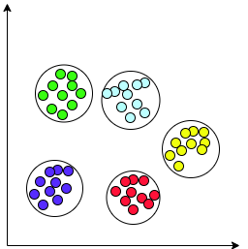
Players Clustered in 28-dimensional space in 5 different clusters.

Slide 3
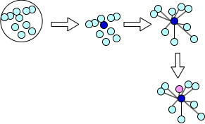
Search for player cluster.
Calculate distance of all the players with the player of interest.
Return players having top-4 shortest Euclidian Distance.

Slide 4
Format Specific
name = 'Virat Kohli'
Given format: TEST
Model
['Kane Williamson', 'Steven Smith', 'Joe Root', 'Cheteshwar Pujara']
Similar Players

