Slide 1

Traditional water monitoring relies on slow, manual observation. This critical delay in alerting leads to severe structural damage and extreme safety hazards.
We need a system that detects danger and acts instantly.
Sudden Urban Flooding
Flash floods strike communities rapidly, often leaving residents with no time for evacuation or asset protection.

Slide 2
Traditional water monitoring relies on slow, manual observation. This critical delay in alerting leads to severe structural damage and extreme safety hazards.
We need a system that detects danger and acts instantly.
Sudden Urban Flooding
Flash floods strike communities rapidly, often leaving residents with no time for evacuation or asset protection.
Traditional water monitoring relies on slow, manual observation. This critical delay in alerting leads to severe structural damage and extreme safety hazards.
We need a system that detects danger and acts instantly.
Sudden Urban Flooding
Flash floods strike communities rapidly, often leaving residents with no time for evacuation or asset protection.

Slide 3

Our project acts as an automated digital watchman. By placing sensors in flood-prone zones, the system monitors water levels in real-time, 24/7.
Warning alone is not enough. Our system interfaces directly with mechanical barriers to physically block rising waters.
Simultaneous to the alarm, the microcontroller dictates a motorized gate to deploy, demonstrating how smart cities can automatically protect infrastructure.
The moment water breaches the safety threshold, the system triggers a high-decibel acoustic alarm to alert the local community immediately.

Slide 4
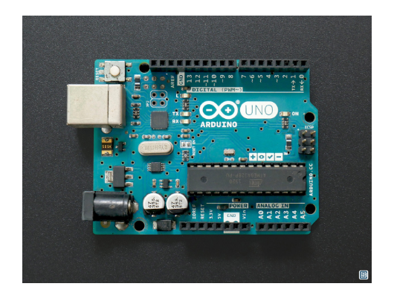
Circuit Integration
Seamless Module Communication
All requested components work together in a closed-loop system:
The Water Level Sensor provides analog input.
The Breadboard distributes 5V power and ground to all parts.
The Arduino Uno processes the data.
The Buzzer and Servo Motor receive digital output commands to actuate the defense mechanism.

Slide 5

Operational Flow
2. Analyze
4. Actuate
Arduino continuously reads analog values to check if safe limits are breached.
Servo motor receives PWM signal and deploys the physical flood gate.
a
1. Detect
3. Alert
Water level sensor traces make contact with rising flood waters.
System triggers digital pin to sound the high-decibel buzzer siren.

Slide 6
Operational Flow
2. Analyze
4. Actuate
Arduino continuously reads analog values to check if safe limits are breached.
Servo motor receives PWM signal and deploys the physical flood gate.
a
1. Detect
3. Alert
Water level sensor traces make contact with rising flood waters.
System triggers digital pin to sound the high-decibel buzzer siren.

Slide 7
The Cost of Inaction
804
Confirmed Casualties in Region
RIP
Why Automation Matters
Thousands remain vulnerable across border regions to delayed manual warnings. Implementing micro-automated bridges the critical gap between detection and disaster response.

Slide 8
Conclusion
By combining basic microelectronics with smart programming logic, we can build scalable, automated infrastructure that saves both property and lives.
"
"
- BY INNOVATORS
TEAM

