Slide 1

Financial Trading Platform
Dylan Yong

Slide 2
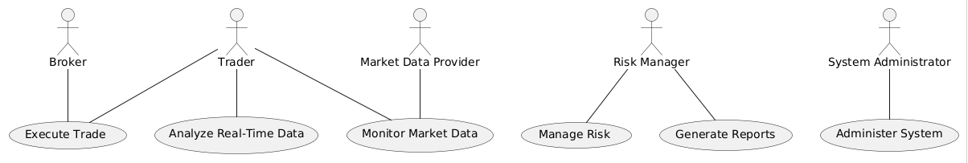
UML Use Case Diagram

Slide 3
UML Domain Model
Key entities and their relationships in a high-frequency trading platform:
Trader: Represents the user who places trades.
Trade: Represents a trade order placed by a Trader.
MarketData: Represents real-time market data provided by a Market Data Provider.
Broker: Facilitates the execution of trades.
RiskManager: Monitors and manages risk associated with trades.
Report: Represents reports generated for analytics and risk management.
SystemAdmin: Manages the system configurations and maintenance.
Relationships:
A Trader places many Trades.
Trades are executed through a Broker.
Trades are influenced by MarketData.
A RiskManager monitors many Trades.
Reports are generated based on Trades and MarketData.
A SystemAdmin manages the system, which includes all entities.

Slide 4
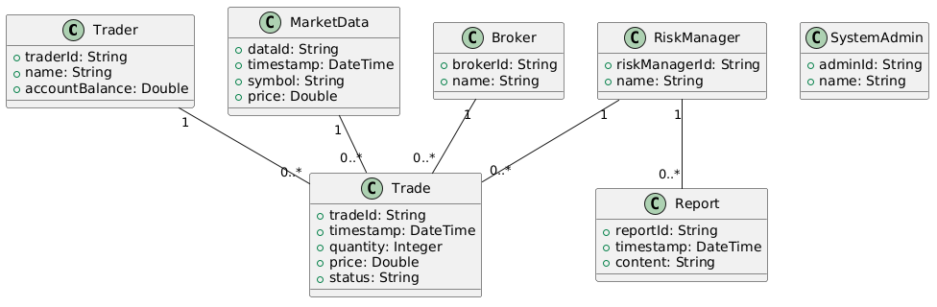
UML Class Diagram

Slide 5
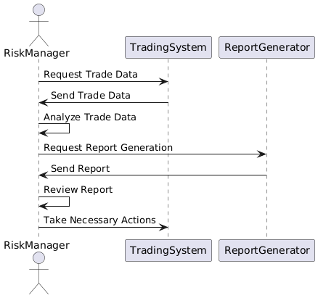
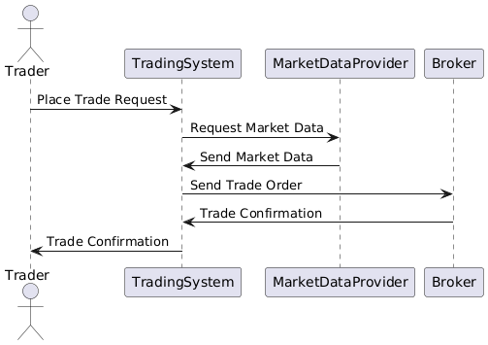
UML Sequence Diagram

Slide 6
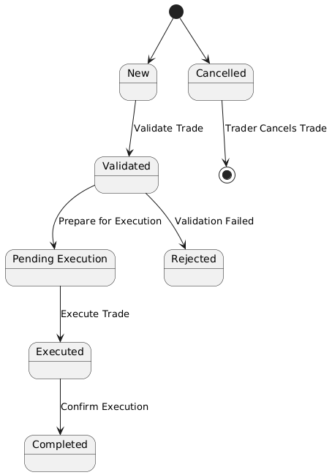
UML State Diagram

Slide 7
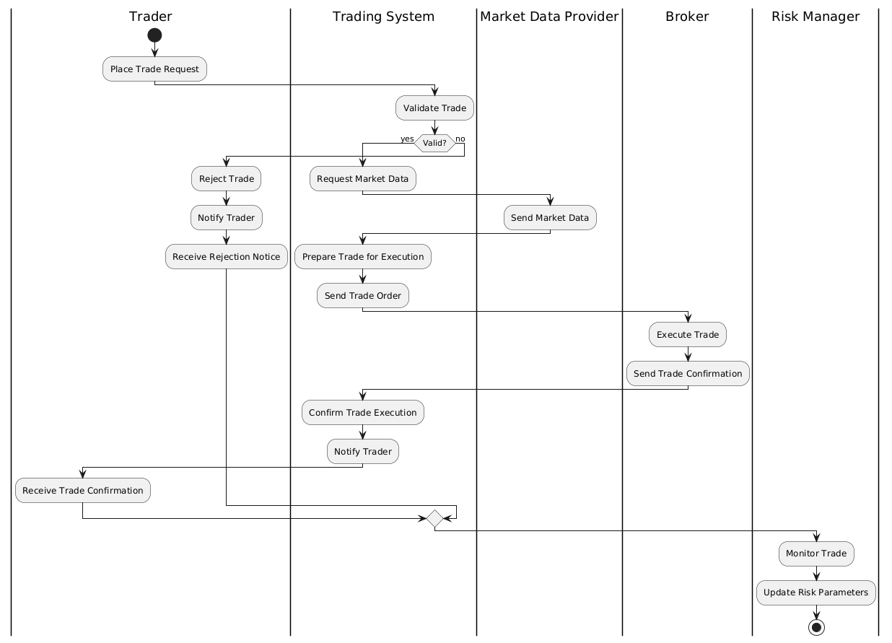
UML Activity Diagram

Slide 8
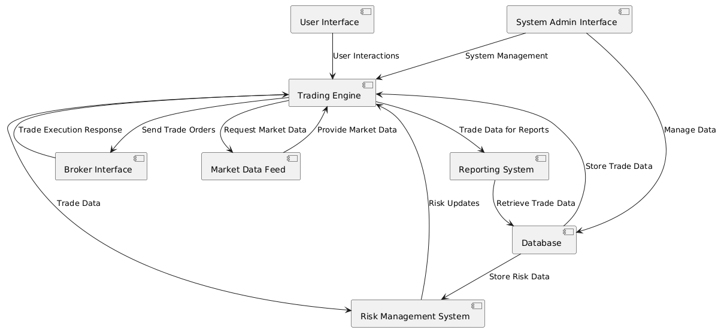
UML Component Diagram

Slide 9
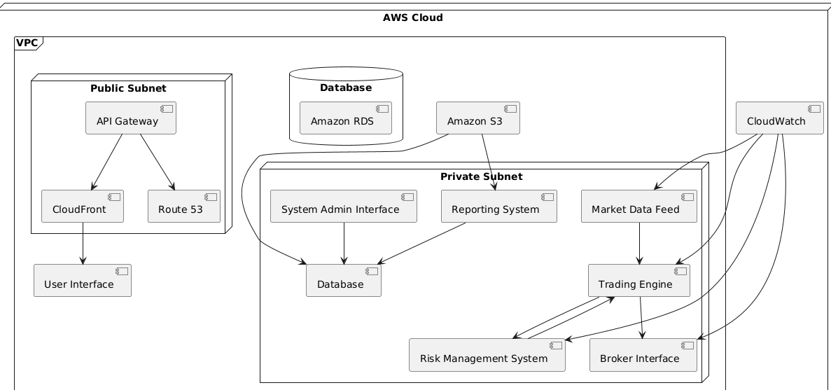
Cloud Deployment Diagram

Slide 10
Skeleton Classes
1. Trader
Attributes:
traderId: Unique identifier for the trader.
name: The trader's name.
accountBalance: The current balance in the trader's account.
Methods:
placeTrade(trade): Places a new trade order.
viewAccountBalance(): Displays the trader's account balance.
cancelTrade(tradeId): Cancels a specific trade.
2. Trade
Attributes:
tradeId: Unique identifier for the trade.
timestamp: Date and time when the trade was placed.
quantity: Number of units being traded.
price: Price per unit at the time of the trade.
status: Current status of the trade (e.g., new, validated, executed, rejected, cancelled).
traderId: Identifier linking the trade to a specific trader.
Methods:
validate(): Checks if the trade meets all necessary conditions.
execute(): Executes the trade.
cancel(): Cancels the trade.
3. MarketData
Attributes:
dataId: Unique identifier for the market data entry.
timestamp: Date and time of the data.
symbol: The market symbol (e.g., stock ticker).
price: Current price of the asset.
Methods:
getPrice(): Retrieves the latest price of the asset.
4. RiskManager
Attributes:
riskManagerId: Unique identifier for the risk manager.
name: The name of the risk manager.
Methods:
monitorTrade(trade): Monitors trades for potential risks.
updateRiskParameters(): Updates the risk parameters based on the current trading environment.
generateRiskReport(): Generates a report on the current risk levels.

Slide 11
GRASP, SOLID, and Microservices Design Pattern
GRASP – Controller
SOLID – Single Responsibility Principle (SRP)
Microservices Design Pattern – API Gateway

Slide 12
Github link: https://github.com/Suzakijun1/SWENG837-CourseProject

