Slide 1
Lesson 5
Single Page Applications
React

Slide 2
Topics
Structuring a web app
Single page applications in general
Fetch API
Component-based architecture
Single page application with React

Slide 3
Structuring a web app.
There are 3 strategies we are interested in for architecting a web application:
Server-side rendering:
Server sends a new HTML page for each unique path. Data binding happens at the server-side
Single-page application: Server sends the exact same web page for every unique path (and the page runs JS to change what it look like). Data binding happens at the client-side
Combination of 1 and 2
We will discuss the second approach

Slide 4
Single page application
The server always sends the same one HTML file for all requests to the web server
The server is configured so that requests to any end point /<word> would still return E.g. index.html.
The client JavaScript parses the URL to get the route parameters and initialize the application
Another way to think of it:
You embed all your views into one HTML page. For example: index.html
You use JavaScript to switch between the views
You configure JSON routes for your server to handle client-side HTTP requests

Slide 5
Client-side HTTP requests
To load the data from the server we need a standard API
Fetch API is the native JavaScript API for that purpose

Slide 6
Client-side HTTP requests.
To load the data from the server we need a standard API
Fetch API is the native JavaScript API for that purpose
To display the data in the view, the client makes one or more fetch() requests to retrieve data from the server.

Slide 7
Client-side HTTP requests..
To load the data from the server we need a standard API
Fetch API is the native JavaScript API for that purpose
To display the data in the view, the client makes one or more fetch() requests to retrieve data from the server.
Our server is written to respond to HTTP requests by means of controllers
The Fetch API is the API to use to load external resources (text, JSON, etc) in the browser.

Slide 8
Client-side HTTP requests…
To load the data from the server we need a standard API
Fetch API is the native JavaScript API for that purpose
To display the data in the view, the client makes one or more fetch() requests to retrieve data from the server.
Our server is written to respond to HTTP requests by means of controllers
The Fetch API is the API to use to load external resources (text, JSON, etc) in the browser.
The Fetch API is made up of one function:
fetch( “data.txt” );
The fetch() method takes the string path to the resource you want to fetch as a parameter
Additional header information for the requests are optional
It returns a Promise of type T

Slide 9
Promises
A Promise:
An object used to manage asynchronous results
Has a then() method that lets you attach functions to execute code on su
Has a catch() method that lets you attach functions to execute onFail
Allows you to build chains of asynchronous results
function onSuccess(response) {
...
}
function onFail(response) {
...
}
fetch(“data.txt”).then(onSuccess).catch(onFail);
Note: type declaration is removed to simplify the example

Slide 10
Promises.
The object fetch() returns is of type Promise.
A promise is in one of three states:
pending: initial state, not fulfilled or rejected.
fulfilled: the operation completed successfully.
rejected: the operation failed.
You attach handlers to the promise via .then()
var promise = fetch('images.txt');
promise.then(onSuccess).catch(onFail);

Slide 11
Promises..
Promises can be chained
function onStreamProcessed(text) {
console.log(text);
} function onResponse(response) {
return response.text();
} function onError(error) {
console.log('Error: ' + error);
}
fetch(“data.txt”)
.then(onResponse)
.then(onStreamProcessed)
.catch(onError);

Slide 12
Promises…
Promises can be implemented using lambda’s
fetch(“data.txt” )
.then(res => res.text())
.then(data => console.log(data))
.catch(error => console.log('Error:’, error));
In ES7 another syntax has been added by means of async/await example:
async function loadData() {
try {
const res = await fetch (“data.txt” );
const data = await res.text();
console.log(data);
}
catch (error) {
console.log(error); }
}
loadData();

Slide 13
Single page application with React

Slide 14
Component-based architecting
What is component-based architecting?

Slide 15
Component-based architecting.
What is component-based architecting?
Assemble systems out of (reusable) components
In a component model there is
a definition of the types of building block,
and the recipe for putting them together.
Think of Lego as an analogy

Slide 16
Component-based architecting..
What is component-based architecting?
Assemble systems out of (reusable) components
In a component model there is
a definition of the types of building block,
and the recipe for putting them together.
Think of Lego as an analogy
So the Models defines standards for:
properties individual components must satisfy
methods and mechanisms for composing components

Slide 17
React
React is a JavaScript library for building user interfaces.
It encapsulates individual pieces of a larger user interface into components
Each component have their own structure, their own methods and their own APIs.
A component can refresh without affecting other components or the UI as a whole
The render engine renders part of the DOM that is relevant for the request or event

Slide 18
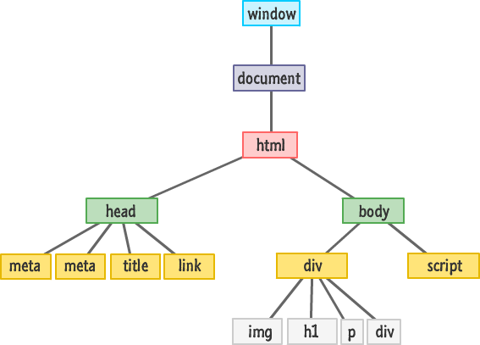
React.
React has a virtual DOM
Structure of the virtual DOM is checked with the actual DOM
HTML elements are implemented through the use of JavaScript eXtension (JSX)
// in JSX. The bracket allows to write expressions
<h1> {10+1} </h1>
//in HTML
<h1> 11 </h1>
React components render JSX elements as HTML elements
React builds the requested DOM part dynamically
The communication between components is unidirectional

Slide 19
React..
Demo
Notes:
Explain the template and run the commands:
- npm install ( in client-app)
Show the routing component as an example
Show how the states, props works

Slide 20
React..
Unidirectional Data-Flow:
Data flow is the flow of data from the parent to the children component
Only one parent is responsible to update the states and passing the value to the children components via props.
setState() is used to update/refresh the UI when the state changes and the value can be passed to the children component by the this.props

Slide 21
React…
Components:
Components are interactive and reusable. They have state and props
Props: are like the HTML Properties
They are used to pass the data between the components
In React the props can be accessed by this.props.propsname
Props can be define by name= “value”. To access this we have to call this.props.name
State: every component has a State object
It can be set by using the setState() method or this.state = {}.
setState() method triggers UI updates
to get the initial state before the setState() you can call : getInitialState.getDefaultProps

Slide 22
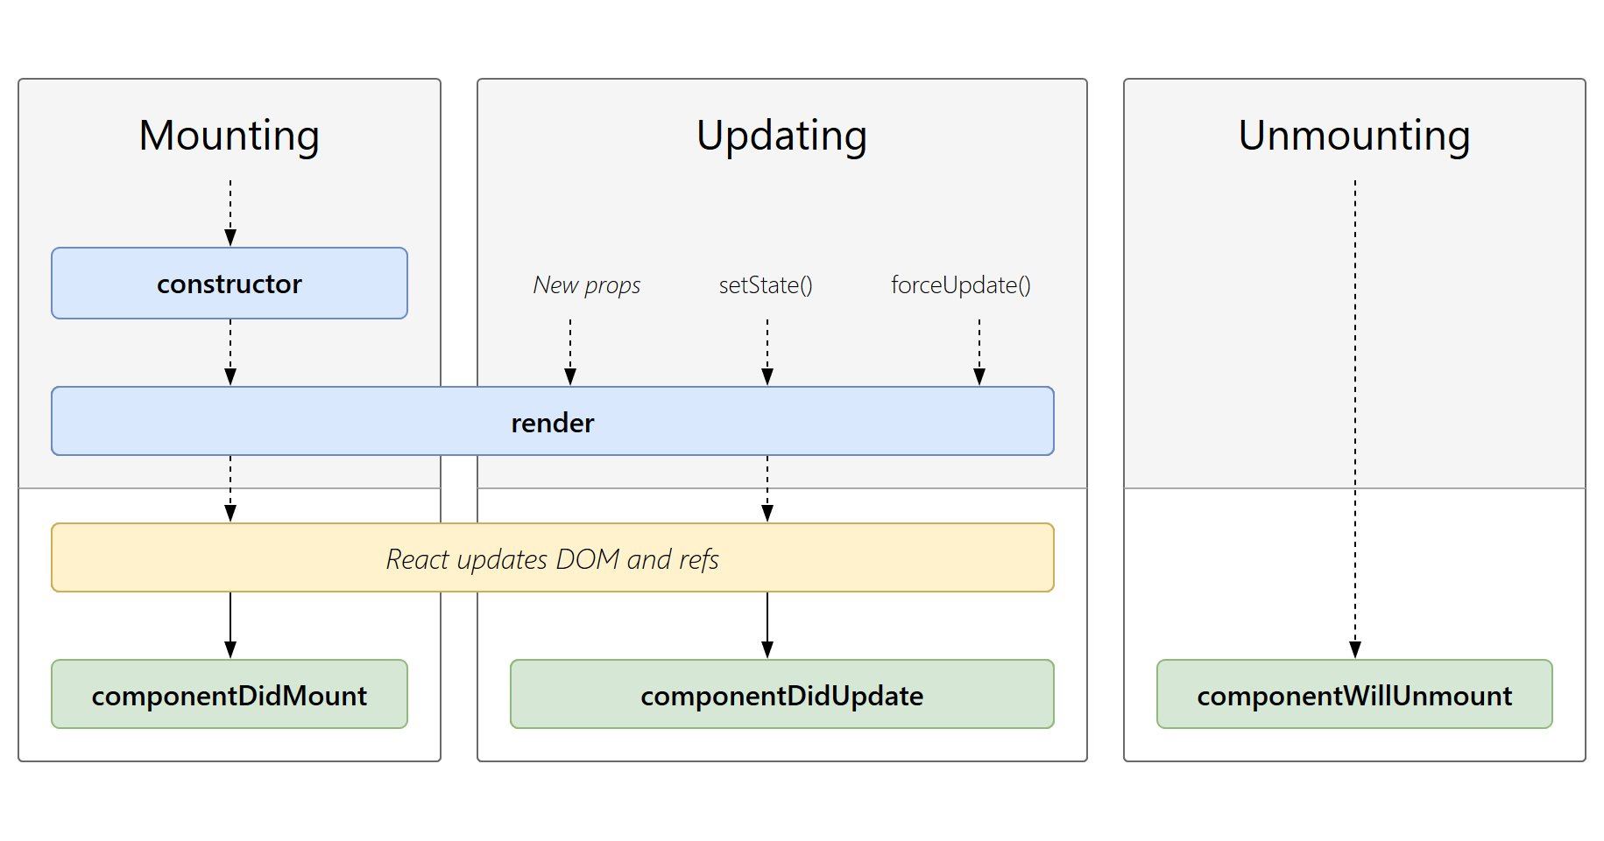
React….
Component Lifecycle:
Events: React has the concept of events that can be attached with the components similar to the props of the components
Events can trigger methods implemented inside a components

Slide 23
React….
Demo
Notes:
Build the movie components

