Slide 1
Design and Implementation of a Multi-Vendor E-Commerce Platform with Integrated Courier Delivery Service
Kelly Mbuyu · Kapembwa Phiri · Suzi Matambose Kazonga
Grace Chisomo Mkandawire · Mwamba Chinyimba
[Computer Numbers]
Final Year Project Presentation
University of Zambia
School of Natural and Applied Sciences
Department of Computing and Informatics
2026
Notes:
Good morning. Our project is a multi-vendor e-commerce platform for clothing and footwear in Zambia, with the courier delivery built into the platform rather than arranged separately. Supervisor: Mr Alinani Simukonga.

Slide 2
Team Roles and Responsibilities
Member | Computer No. | Primary Role / Responsibilities
Kelly Mbuyu | [Computer No.] | Team lead · orders, parcels and the courier handover · admin console · testing and documentation
Kapembwa Phiri | [Computer No.] | Authentication and authorisation · automated test setup, Docker and continuous integration
Suzi Matambose Kazonga | [Computer No.] | Database design and the relational schema · data modelling
Grace Chisomo Mkandawire | [Computer No.] | Frontend components and page layout · catalogue, cart and dashboard screens
Mwamba Chinyimba | [Computer No.] | Product data and media · seeded catalogue content
Supervisor: Mr Alinani Simukonga
Notes:
Five of us. The computer numbers still need filling in before the presentation.

Slide 3
Presentation Overview
1
Background and Context
the problem, and who it is for
5
Discussion
what the results mean against the objectives
2
System Analysis and Design
architecture, data model, technical decisions
6
Conclusion
what was achieved, and what comes next
3
Implementation / Development
what was built, and how
7
System Demonstration
the running platform
4
Testing, Results and Evaluation
349 automated checks
Notes:
Seven parts, ending with a live demonstration of the platform.

Slide 4
Background and Context
Zambian clothing and footwear retail is moving online through social media pages, where a shopper cannot tell a genuine seller from a fraudulent one, and delivery is arranged by hand over phone calls between the seller and a courier.
A marketplace that verifies its sellers and carries the delivery itself removes both problems at once: trust is visible, and the parcel is tracked from the shop counter to the door.
Why it matters
Buyers risk paying a seller nobody has checked.
Sellers lose sales they cannot deliver reliably.
Couriers are booked ad hoc, with no record of who holds a parcel.
An order spanning two shops has no single place to be tracked.
Most Zambians reach the internet by phone, so it has to work on a phone.
Shoppers — Browse verified shops, order from several at once, track each parcel
Shops — List stock, pack parcels, hand them over, answer ratings
Couriers — Claim parcels from a shared pool, collect and deliver
Administrators — Verify shops, approve riders, act on complaints
Notes:
The problem statement in the proposal: customers cannot tell a checked seller from an unchecked one, and logistics are organised manually between sellers and courier services.

Slide 5
Aim and Objectives
Aim — to design and implement a secure multi-vendor e-commerce platform for Zambian clothing and footwear businesses, with a courier delivery service integrated into the platform itself.
1
Build a secure multi-vendor e-commerce system
Several independent shops trading in one marketplace, with one basket across them
2
Integrate a courier module for delivery scheduling and tracking
Dispatch and tracking of every parcel, from release to delivery
3
Provide user-friendly interfaces for customers and store owners
Dashboards for each kind of user, usable on a phone
4
Implement secure authentication and data protection
Hashed passwords, signed sessions, role and ownership checks on every route
Each objective is traced to the feature that meets it and the tests that prove it — see "Evidence for each objective".
Notes:
These are the four objectives exactly as the proposal states them. The second is the one we qualify later.

Slide 6
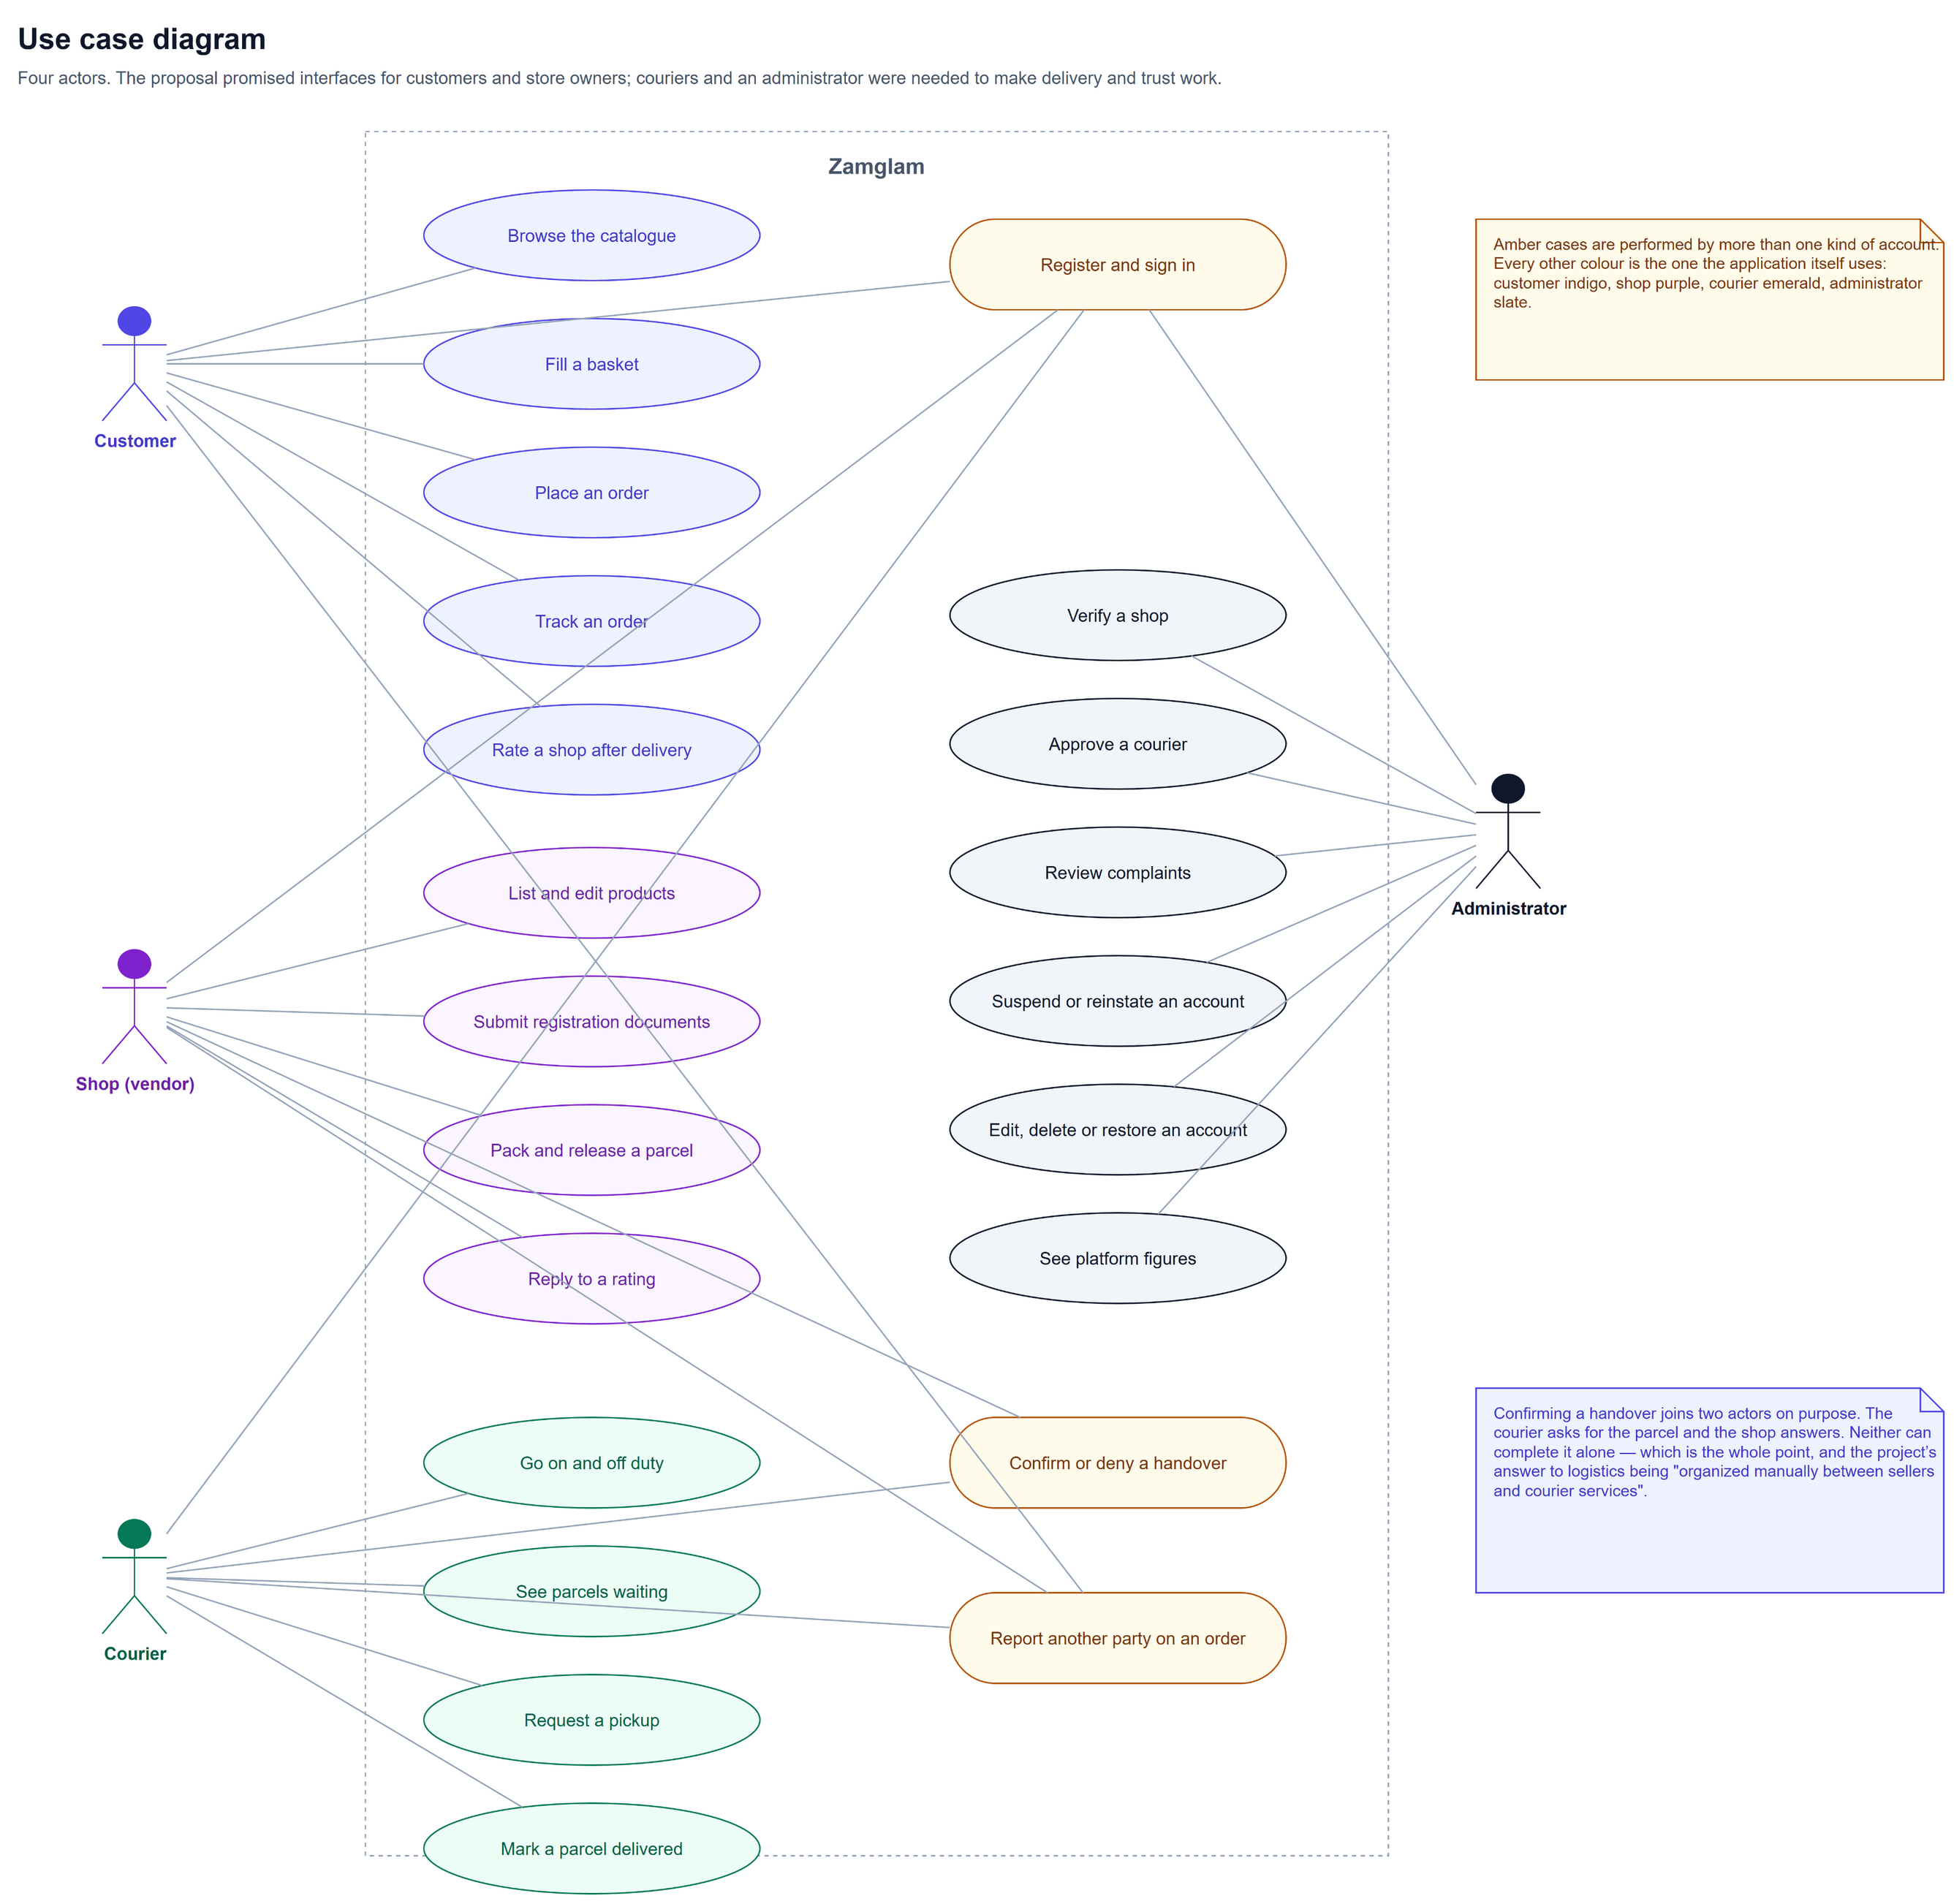
Requirements by User
Shopper
Register, sign in, agree to the terms
Browse, search and filter the catalogue
Hold a basket across several shops
Check out with an address and a payment method
Track each parcel and rate the shop
Shop
Register a storefront and upload documents
List, edit and withdraw products
Release a packed parcel, confirm or deny a pickup
Answer ratings, see its own orders only
Courier
Go on and off duty
See parcels waiting, ask for one
Collect, deliver, and report a problem
Administrator
Verify shops, approve couriers
Act on complaints: suspend, reinstate
Edit, delete and restore accounts
Notes:
Functional requirements, grouped by who needs them. The diagram is the use-case view of the same thing.

Slide 7
System Architecture
User interface — React + Vite + Tailwind
Three layers, one language
Customer pages
Shop dashboard
Courier dashboard
Admin console
React + Vite in the browser; every call goes through one API client.
Express holds routes, middleware and controllers — HTTP only.
Models hold all the SQL and the rules that must always hold.
MySQL/MariaDB stores it; there is no ORM between them.
app.js builds the app, server.js listens — so tests drive the real app.
API — Express
Routes
Auth, role and suspension checks
Controllers
Error handling
Domain models — every rule, and all the SQL
Accounts
Catalogue
Orders and parcels
Delivery and trust
Data — MySQL / MariaDB
15 tables, created and migrated on startup
Uploaded photographs
Notes:
Requests pass through helmet, CORS, body parsing, rate limiting, then the route, authentication, role check and suspension check before any handler runs.

Slide 8
What Happens to a Request
helmet
security headers
→
CORS
who may call
→
body parsing
JSON and uploads
→
rate limit
how often
route
which handler
→
auth
is the token real
→
role
right kind of account
→
suspension
still allowed to trade
Only then does a handler run — and a handler never reaches the database directly.
64
4
3
0
endpoints across 11 route files
roles the routes distinguish
layers a request passes through
SQL statements outside the models
Example — PATCH /api/orders/shipments/:id/pickup-confirm: signed in, role seller, not suspended, owns this parcel, parcel is in pickup_requested. Any one of those failing answers with a reason, not a crash.
Notes:
This is the answer to "how do you know a seller cannot touch another shop's parcel" — the checks are in that order on every protected route.

Slide 9
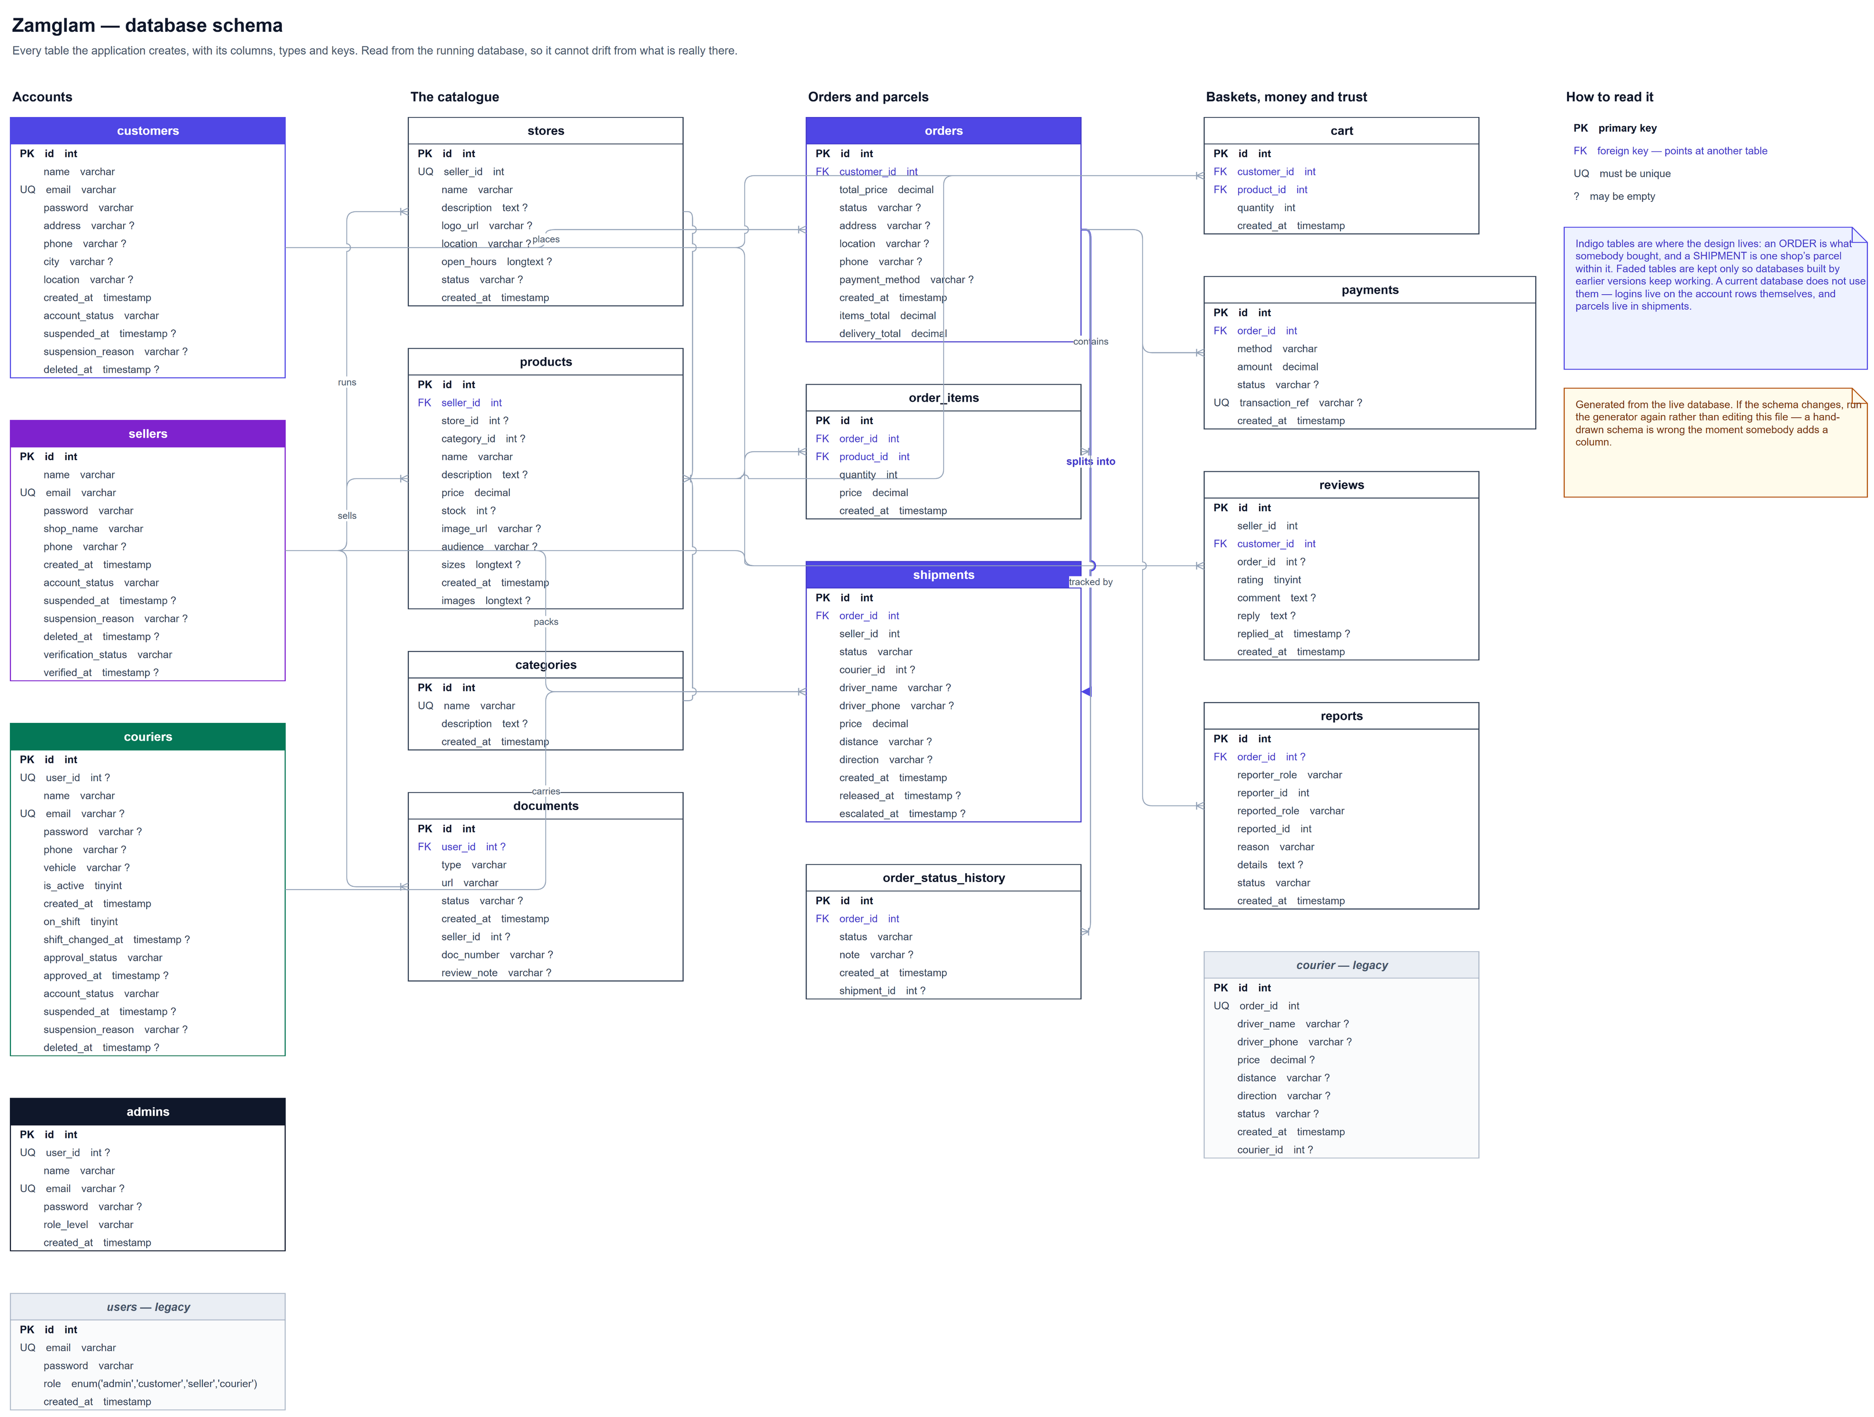
Database / Data Design
Decisions that shaped it
One order splits into one shipment per shop — each packs and delivers on its own.
The order status is a rollup of its least advanced parcel.
Prices are copied onto order lines, so a later price change never rewrites a receipt.
Deleting an account is reversible for 30 days before anything is removed.
The schema builds and migrates itself on startup: no SQL is run by hand.
Notes:
Fifteen tables. The parcel table is what makes a multi-vendor order work: without it, two shops share one status and neither can act.

Slide 10
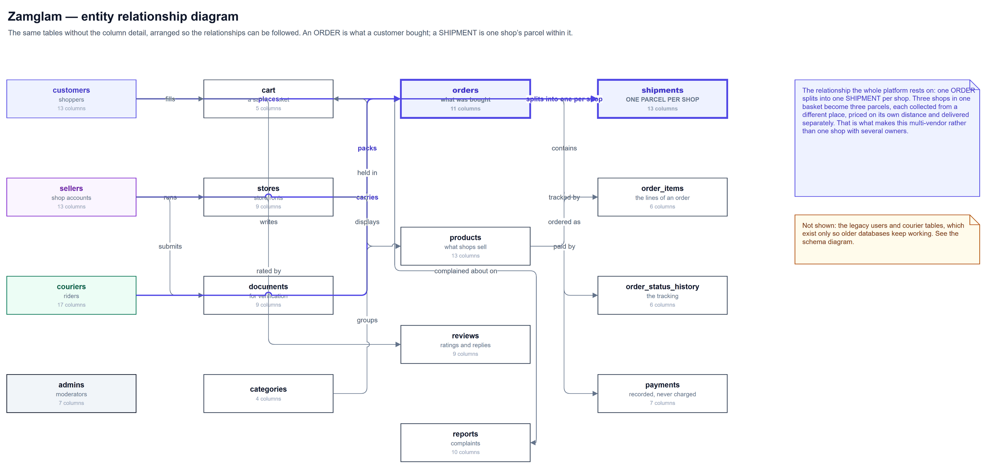
One Order, Two Shops
1
The basket
Items from Mud and from Jets sit in one basket and are quoted together.
2
The order
One order row, with the goods total and the delivery total kept apart.
3
The parcels
One shipment per shop: Mud packs its own, Jets packs its own, each with its own courier and its own fee.
4
The status
The order shows whichever parcel is least far along, so it never claims to be delivered while half of it is still in a shop.
Notes:
This is the heart of "multi-vendor". Without the shipment table, two shops share one status and neither can act on their own half.

Slide 11
Algorithms and Technical Design
1
Splitting an order into parcels
Items are grouped by shop inside one transaction — stock, order, lines and parcels are written together or not at all.
2
Pricing a delivery
A typed address is matched to a table of Zambian towns, the great-circle distance is measured, and each shop is charged from its own town.
3
Two-party handover
A courier requests a parcel; a conditional UPDATE means only one of two simultaneous requests can win. The shop then confirms it.
4
Escalation
A parcel nobody claims within 60 minutes is assigned to the least-loaded courier on duty by a sweep that runs every few minutes.
Notes:
The conditional update is the important one: it is what stops two couriers claiming the same parcel, without locking the table.

Slide 12
Pricing a Delivery: a Worked Example
price = base fee + (distance × rate per km)
ZMW 20 base, ZMW 5 per kilometre — both set by environment variable, so a real courier's tariff replaces them without touching the code.
Honest about guessing
An address nobody recognises falls back to central Lusaka and the quote is flagged as an estimate, rather than quietly pretending to know.
A second shop in the same order is measured from its own town, so two parcels rarely cost the same.
1
Read the address
"Kabulonga, Lusaka" is matched against a table of Zambian towns and Lusaka neighbourhoods.
2
Measure the distance
The great-circle distance from the shop's town to that point — 7.4 km from a shop in Lusaka's centre.
Ready for a real courier
3
Price it
ZMW 20 + (7.4 × 5) = ZMW 57.00, charged for this shop's parcel alone.
Every quote goes through one provider interface.
Our own riders are one implementation; an outside company exposing a quote endpoint is another.
Swapping them changes no other code.
4
Estimate the time
4 to 6 minutes per kilometre, never under 20 — "30-45 min".
Notes:
If asked why not Google Maps: a geocoder needs a billed API key. The town table is accurate for the towns it knows and says so when it does not.

Slide 13
Development Environment
Operating system | Windows 11 · the stack also runs on macOS and Linux
Programming language | JavaScript (ES modules) across the whole system
Frameworks | Express 4 on the server · React 18 with Vite in the browser · Tailwind CSS
Database | MySQL / MariaDB through XAMPP · mysql2 with parameterised SQL
Testing | Jest and supertest · Cypress for the browser
Tools | Visual Studio Code · draw.io for diagrams · Postman and curl
Version control | Git and GitHub · GitHub Actions runs the tests on every push
Notes:
The proposal named Django and Express; we consolidated on Express alone rather than splitting the system across two languages. That is a departure we state openly.

Slide 14
How the Work Was Organised
1
Built in increments
Accounts first, then the catalogue, then orders, then the courier handover, then trust and administration. Each one worked end to end before the next began.
15,500
lines of JavaScript
2
Everything through Git
69 commits on a shared GitHub repository, with work merged from five contributors and larger features developed on their own branches.
27
pages, 50 components
3
Tests run on every push
A GitHub Actions workflow installs the stack, starts MySQL and runs both suites, so a merge that breaks something is visible straight away.
21
database tables
4
Documentation kept with the code
Nine numbered documents and seven diagrams live in the repository and are updated in the same commit as the change they describe.
69
commits
Notes:
If asked about methodology: incremental and iterative, with a working vertical slice at each step, and the test suite as the safety net rather than a formal sprint ceremony.

Slide 15
System Components and Modules
1 · Accounts and access
2 · Catalogue and storefronts
3 · Orders and basket
Four roles, each with its own dashboard
Sign-up takes consent to the terms
bcrypt passwords, JWT sessions, rate limits
A shop, its storefront and its stock
Photographs required on every listing
Verified and suspended shops read differently
A basket spanning several shops
Quote, then checkout in one transaction
Per-parcel tracking for the shopper
4 · Courier delivery
5 · Trust and administration
A pool of released parcels
Request, confirm, deny, escalate
Shifts, approval and parcel counts
Ratings and replies held in the database
Complaints, flags and suspension
Verification, editing, reversible deletion
Notes:
Five modules. The fourth is the one the proposal cared most about — the courier service inside the platform rather than beside it.

Slide 16
Key Implementation Details
1
Nothing half-written
Stock, order, lines and parcels are one transaction; prices are read on the server, never taken from the request.
Shop releases the parcel
It appears in the pool every on-duty courier sees
1
2
Nobody sees what they should not
The courier's phone number reaches the customer only once the shop has confirmed the handover.
2
A courier asks for it
One conditional UPDATE — a second rider finds nothing to claim
3
Every rule twice
Ownership is checked in the controller and again in the model, so no route can reach data it should not.
3
The shop confirms the handover
Only now does the customer get the courier's number
4
The courier marks it delivered
Tracking reads Delivered, and the shopper can rate the shop
4
Removal without loss
A deleted account is hidden for 30 days, then purged — unless order history still refers to it.
A shop that reports a no-show sends the parcel back to the pool, and the reason reaches the customer.
Notes:
The diagram is the handover: courier asks, shop confirms, contact details unlock, delivery is marked. A denial puts the parcel back in the pool.

Slide 17
Security in Practice
Passwords
Sessions
bcrypt with a cost of 10. A stolen copy of the database hands over nobody's password, and the hash can never be turned back.
A signed JWT carrying id, email and role, valid for 7 days. A tampered or expired token ends the session cleanly instead of leaving a broken dashboard.
Brute force
Authorisation
10 failed sign-ins per address every 15 minutes — successes are never counted, so switching accounts never locks you out. 10 sign-ups an hour, 600 requests a minute overall.
Role on the route, ownership in the model. A shop asking for another shop's parcel is refused twice over.
Injection
Privacy
Every statement is parameterised; no query is ever built by joining strings. Uploads are limited by type and size.
The courier's number is released only after the handover; a seller never sees the customer's address on the orders list; consent to the terms is recorded with its date.
Objective 4 in full, except TLS — which is configured where the system is deployed, not in a local setup.
Notes:
Nineteen of the backend tests exist only to prove these: forged tokens, expired tokens, a deleted account, the limiter counting failures rather than requests.

Slide 18
Challenges and Solutions
Payment gateways need a registered business
Airtel Money and MTN MoMo require a signed commercial agreement, which a student project cannot obtain. The order records the chosen method and writes a payment row; no money moves, and we say so plainly.
Two couriers could claim one parcel
Reading then writing left a race between two riders tapping at once. A single conditional UPDATE now claims the parcel, so the second request simply finds nothing to claim.
Tests blocked each other for 931 seconds
Resetting the database across a pool meant foreign-key checks and truncates landed on different connections. One connection with a 30-second lock timeout turned a silent wait into a readable error — that suite went from 1030 seconds to 125.
Notes:
The payment one was a risk we identified in the proposal; the mitigation we planned turned out not to be available to a student project.

Slide 19
How the System Was Tested
1
They drive the real application
The backend tests import the same Express app the server runs and call it over HTTP; the frontend tests render the real components. Nothing is re-implemented inside a test.
What the tests found
The schema was never created on a fresh clone — the first query failed with "Unknown database".
A new courier was stored active and quietly promoted to approved, skipping the administrator.
The basket answered 500 on any current database.
The product page crashed for every real product.
Sign-up accepted role "admin" — anybody could make themselves an administrator.
2
On their own database
A separate database is created on the first run and reset between tests, so the development data is never touched.
3
Written as sentences
Each test says what should be true — "a second courier cannot ask for a parcel already spoken for" — so a failure names a behaviour, not a line number.
4
Three levels
Unit tests for pricing and place lookup; integration tests through the API; Cypress for whole journeys in a real browser.
Every one of these would have met the first person to clone the repository.
Notes:
This is the slide to linger on if the panel asks how you know it works. The bugs on the right are the argument for testing, found by these tests rather than by a marker.

Slide 20
Test Results
Suite | What it drives | Tests | Result
TC-01 · Registration and sign-in | Hashing, duplicate emails, forged tokens, consent to the terms | 19 | PASS
TC-02 · Catalogue | Listing with photos, ownership, filtering, verification | 24 | PASS
TC-03 · Orders | Quoting, splitting per shop, stock, cancellation | 41 | PASS
TC-04 · Courier handover | Pool, shifts, racing couriers, denial, escalation, delivery | 39 | PASS
TC-05 · Complaints and suspension | Who may report whom, the three-report flag, what suspension blocks | 29 | PASS
TC-06 · Admin console | Figures, approval, editing, soft delete, restore, purge | 28 | PASS
TC-07 · Remaining backend suites | Rate limits, deals, messages, delivery pricing, account resolution, comment guard | 79 | PASS
TC-08 · Frontend components | Session handling, basket limits, sign-up checks, tracking | 82 | PASS
TC-09 · Browser journeys (Cypress) | Sign in, sign up, browse, buy, track — in a real browser | 8 | PASS
349 automated checks, all passing — and every one drives the real application, not a copy of its rules.
Notes:
259 backend, 82 frontend, 8 in a browser. They run on their own database and are run by GitHub Actions on every push.

Slide 21
Evidence for Each Objective
Objective | What was built | How it is proved
1 · A secure multi-vendor marketplace | Several shops in one marketplace; a basket across them; one parcel per shop, each priced from its own town | TC-02 and TC-03 — 65 tests through the API, plus a purchase clicked through in a browser
2 · Courier delivery and tracking | A pool of released parcels, a claim that only one rider can win, a shop-confirmed handover, escalation after an hour, and per-parcel tracking | TC-04 — 39 tests, including two couriers racing for one parcel and a denied handover returning it
3 · Interfaces for customers and store owners | Four dashboards — shopper, shop, courier, administrator — all working at phone width | TC-08 and TC-09 — 90 checks, including a whole purchase in a real browser
4 · Authentication and data protection | bcrypt, signed sessions, rate limits, role and ownership checks, parameterised SQL, consent recorded | TC-01 and TC-06 — 47 tests, including forged tokens and a deleted account being refused
Nothing in this table rests on a demonstration going well on the day: each row is a suite that can be run in front of you.
Notes:
If one slide answers "did you meet your objectives", it is this one. Offer to run the suite live.

Slide 22
Discussion of Findings
Objective 1 — a secure multi-vendor marketplace
The finding that matters
Met. Several shops sell in one marketplace, a basket can span them, and the order splits into a parcel each.
The platform answers the proposal's own problem statement: a shopper can tell a checked shop from an unchecked one, and the delivery is organised by the system rather than by phone calls.
Where the build departs from the proposal — one backend language instead of two, simulated payment — the reason is stated rather than hidden.
Objective 2 — courier scheduling and tracking
Tracking met in full. "Scheduling" was built as dispatch — pool, claim, handover, escalation — not customer-chosen time slots.
Objective 3 — interfaces for customers and store owners
Exceeded. Four dashboards rather than two, and they work on a phone.
Objective 4 — authentication and data protection
Met in the application: bcrypt, JWT, rate limiting, role and ownership checks, parameterised SQL. TLS belongs to deployment.
Notes:
Be ready for the scheduling question: if "scheduling" meant time slots, that is not built; if it meant organising and assigning deliveries, it is, and more thoroughly than a manual arrangement.

Slide 23
Limitations
Payment is simulated
Distances come from a town lookup
The method is recorded and a payment row written, but no money moves. A gateway needs a registered business.
Addresses are matched against Zambian towns, not a geocoder, and an unrecognised address is flagged as an estimate.
Dashboards are not browser-tested
Deployment is not yet proven
The API beneath them is covered thoroughly; the seller, courier and admin screens are verified by use.
The Docker stack was corrected against the code but never run, and the local setup is plain HTTP.
None of these affect the parts the objectives are judged on: ordering, splitting, delivery and trust all run on real data.
Notes:
Say these before the panel finds them. Each one has a reason and a route forward.

Slide 24
Conclusion
A working multi-vendor marketplace with the courier service built into it
All four objectives are met, with one qualification stated openly: delivery is dispatched rather than booked into time slots. The platform runs end to end — a shopper orders from two shops, each packs its own parcel, a courier collects it from the counter, and both parcels are tracked to the door.
It is verified the way working software should be: 349 automated checks against the real application, run on every push, plus a fresh clone that seeds and runs with no SQL typed by hand.
What comes next
A payment gateway, once a registered business can hold the agreement
Real geocoding and courier routing in place of the town lookup
Browser tests across the seller, courier and admin dashboards
A proven deployment, over HTTPS
349
4
15
100%
automated checks
roles, four dashboards
database tables
of objectives addressed
Notes:
Close on the two things that matter: it works end to end, and it is checked by tests that drive the real system.

Slide 25
Thank you
Questions?
System demonstration to follow
Notes:
Hand over to the demonstration: sign in as a shopper, order from two shops, release a parcel as the shop, collect it as the courier, deliver it, then show the admin console.

