Slide 1
Custom Roslyn Tool for Static Code Analysis
Zuzana Dankovčíková
Spring 2017

Slide 2
Goal
Static code analysis tool for Kentico Software
Check compliance to company’s internal guidelines
Real-time static code analysis in Visual Studio
Provide automated code fixes
Performance optimization
Notes:
The goal of this thesis was to develop a static code analysis tool…

Slide 3
Motivation
Need for static code analysis tool
Many internal conventions and guidelines
Complicated code reviews
Replace existing console application (“BugHunter”)
Dummy string matching
Many false negatives and positives
External application
Obscure and not granular configuration
Notes:
Why is such a tool needed at Kentico? Well, the company has been developing a single product for over ten years now and over that time many internal rules and coding guidelines were created. It became increasingly hard…
To automate some of the manual and repetitive tasks that the reviewer had to perform, they have developed a console application “BugHunter”. Since the time and resources were limited it is very simple…
Size of the company and the product
Code reviews too extensive
String matching – how to deal with spaces, tabs, new lines… Equals() on string vs on object…
Config – v jednom subore je to chyba, v druhom nie< preco, nevidietelne pre developera, malo granularne

Slide 4
.NET Compiler Platform (“Roslyn”)
Compiler-as-a-service
Internals of the compiler pipeline as API
Analysis APIs
Refactoring APIs
Notes:
So what does Roslyn have to do with all of this. In 2014 Microsoft introduced new compilers for C# and Visual Basic called .NET compiler platform, commonly referred to as Roslyn. They provide compiler as a service. So, instead of a black box which takes source files as an input and outputs the IL, both the compilers now expose the internals of the pipeline as an API. Apart from that, Roslyn also provides Analysis APIs, Refactoring APIs
This means that we are no longer limited to the predefined static code analysis rules shipped by Microsoft, but basically anyone can write their own – custom - rules using Roslyn Analysis APIs. They do not have to parse the code themselves and have the Syntax trees and all the semantic information about the analyzed code provided by the Analysis API. The analyzers and code fixes can be then integrated to the Visual Studio.

Slide 5
Thesis development
Analyzing the old tool
Implementation
Analyzers
Code fixes
Unit tests
Documentation
Performance optimization
Notes:
How I approached the work on the thesis

Slide 6
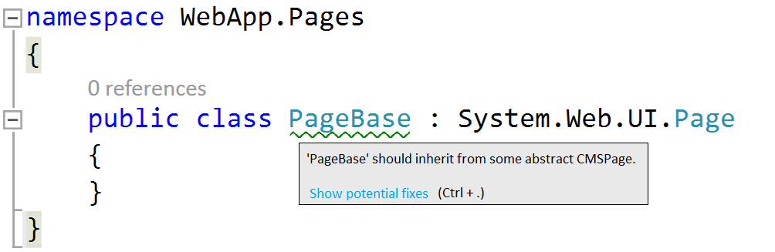
Analyzer
Microsoft API
Notes:
You may be wondering what an Analyzer in Roslyn context actually is. Well, imagine you want to…

Slide 7
Analyzer
Microsoft API

Slide 8
Analyzer
Microsoft API
Kentico API

Slide 9
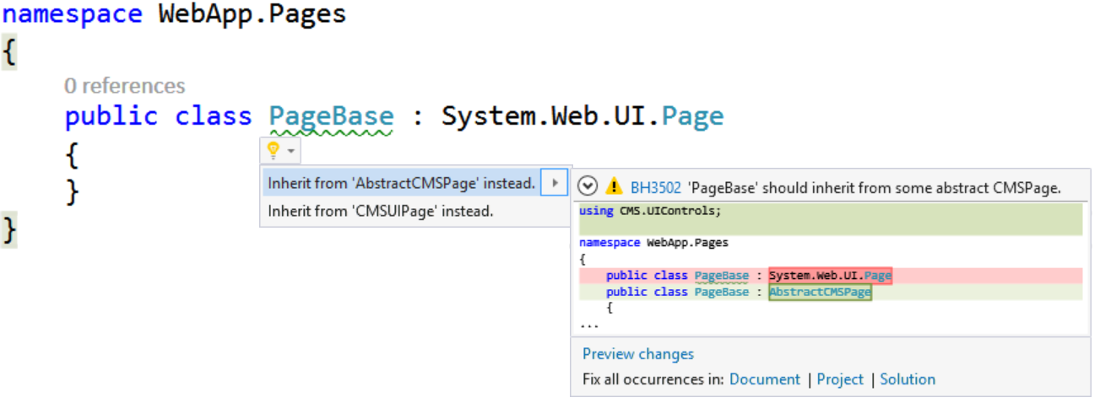
Code fix
Notes:
What about new developers on the team? How do they find out about the existence of class to be used?

Slide 10
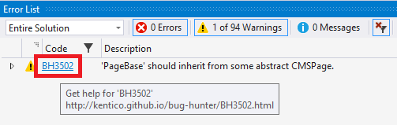
Online documentation
Clicking on the analyzer ID in Error list window
Notes:
Apart from the information message, you can click…

Slide 11
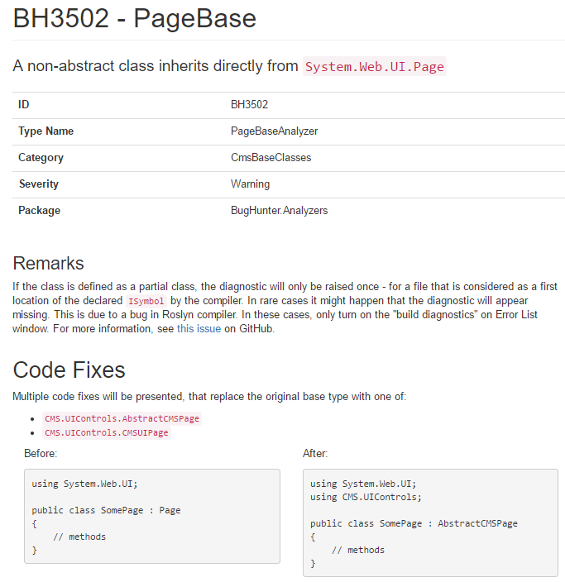
Online documentation

Slide 12
Unit tests
Rewriting Microsoft utilities for testing analyzers and code fixes
Discovered hidden bugs in existing BugHunter
Tracking Kentico API changes
Notes:
As for the unit testing the analyzers and code fixes, I had to rewrite part of the…. To accommodate possibility of testing some advanced functions of the analyzers

Slide 13
Performance of the analyzers
Analyzed solution of Kentico’s CMS contains over 240 projects
Performance of the analyzers is crucial
Tune performance of the slowest analyzers
Analyze total impact on build times
Notes:
Another big challenge of this thesis was measuring and optimizing the performance of the analyzers…

Slide 14
Analyzers’ execution times
NuGet package with analyzers + MSBuild with /ReportAnalyzer switch
Total analyzer execution time: 0.017 seconds. (TaskId:3718)
NOTE: Elapsed time may be less than analyzer execution time because analyzers can run concurrently. (TaskId:3718)
Time (s) % Analyzer (TaskId:3718)
0.017 100 BugHunter.Analyzers, Version=1.0.0.0, Culture=neutral, PublicKeyToken=null (TaskId:3718)
0.009 51 BugHunter.Analyzers.CmsApiReplacementRules.Analyzers.SystemIOAnalyzer (TaskId:3718)
0.002 10 BugHunter.Analyzers.CmsBaseClassesRules.Analyzers.ModuleRegistrationAnalyzer (TaskId:3718)
0.001 7 BugHunter.Analyzers.CmsApiReplacementRules.Analyzers.HttpSessionElementAccessAnalyzer (TaskId:3718)
<0.001 3 BugHunter.Analyzers.StringAndCultureRules.Analyzers.StringCompareToMethodAnalyzer (TaskId:3718)
<0.001 3 BugHunter.Analyzers.AbstractionOverImplementation.Analyzers.LuceneSearchDocumentAnalyzer (TaskId:3718)
<0.001 2 BugHunter.Analyzers.CmsApiReplacementRules.Analyzers.HttpRequestQueryStringAnalyzer (TaskId:3718)
<0.001 1 BugHunter.Analyzers.CmsApiReplacementRules.Analyzers.ClientScriptMethodsAnalyzer (TaskId:3718)
<0.001 1 BugHunter.Analyzers.CmsApiGuidelinesRules.Analyzers.EventLogArgumentsAnalyzer (TaskId:3718)
<0.001 1 BugHunter.Analyzers.CmsApiGuidelinesRules.Analyzers.WhereLikeMethodAnalyzer (TaskId:3718)
<0.001 1 BugHunter.Analyzers.CmsApiReplacementRules.Analyzers.FormsAuthenticationSignOutAnalyzer (TaskId:3718)
<0.001 1 BugHunter.Analyzers.StringAndCultureRules.Analyzers.StringEqualsMethodAnalyzer (TaskId:3718)
Per-project execution time
Analyzer name
Notes:
To measure the performance of single analyzers I

Slide 15
Analyzers’ execution times
MSBuild /ReportAnalyzer (100x)
Parse analyzers’ execution times
Sum per-project results
Aggregate results from multiple runs
MSBuild logs
Times in each run
execution-times.csv
CMS.sln
Notes:
You clearly cannot rely on one single run to provide a representative sample, so I created an automated process that runs the MS 100x…
Running the MSBuild 100 times
Parsing the analyzer execution times
Summing the per-project results
Aggregating the results from multiple runs into a CSV file
Analyzing the results

Slide 16
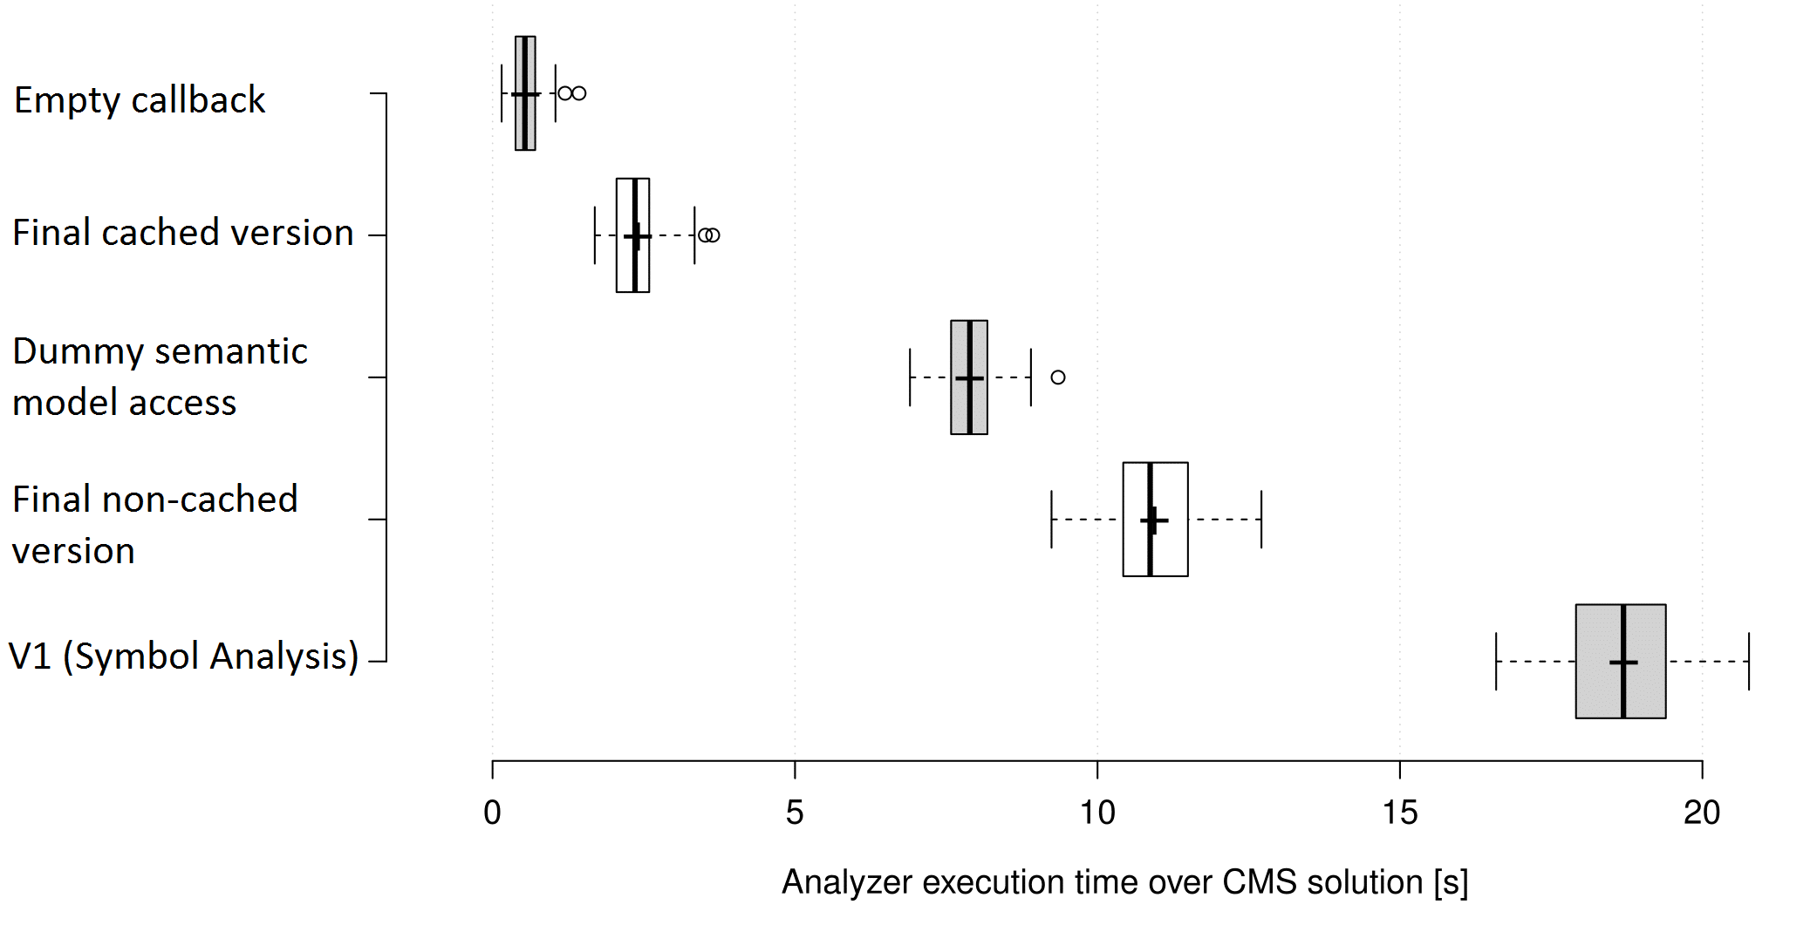
Tuning the performance
Different versions of SystemIOAnalyzer
18 seconds → 2,4 seconds
Notes:
The measurements show that one particular analyzer performed extremely slow. It took over 18s ….

Slide 17
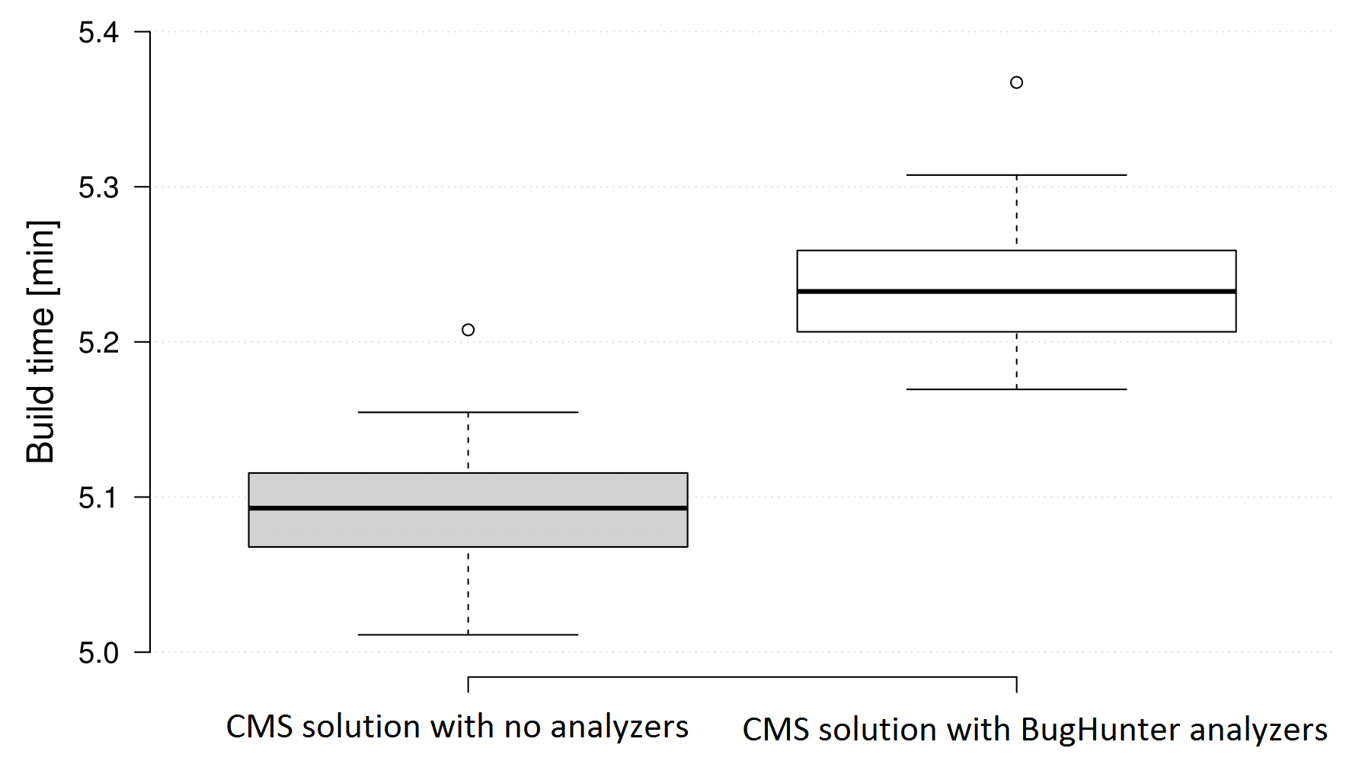
Total impact on performance
100 build runs
5:05 minutes without analyzers
5:14 minutes with analyzers
+2,9% (9 seconds) slowdown
Notes:
Considering the total impact…

Slide 18
Benefits
Checks for types, not strings
Runs inside of Visual Studio
Immediate feedback
Provides code fixes
Teaching new developers the internal rules
Online documentation
Transparent configuration
Extensive unit testing
Tracks Kentico API changes
Notes:
As for…

Slide 19
Current state
The new BugHunter has been deployed in April
Available via company’s internal NuGet feed
The questionnaire did not show any performance nor correctness issues

Slide 20
Future work
More rules that were not possible in the old version of the tool
Upgrade to .NET Compiler Platform v2.0
Making BugHunter available to Kentico’s customers via Microsoft NuGet Gallery

Slide 21
Thank you for your attention

Slide 22
Question
“As stated in the thesis, at the time of writing there are no tools for performance analysis of the analyzers.
Would a more generic solution than the one provided for the validation of the thesis make sense?
What would be the challenges of such development?“

Slide 23
Would a more generic solution than the one provided for the validation of the thesis make sense? What would be the challenges of such development?
Problems obtaining the “real” execution time
Running analyzers manually does not give same results
Many internal optimizations performed by Roslyn
Experiments with measuring using Benchmark .NET were not successful
Only viable option is /ReportAnalyzer switch in csc.exe
The proposed process of running the analysis multiple times, parsing and aggregating the results can be run on any solution with any set of analyzers
“More generic” in terms of running the analysis itself?

Slide 24
Would a more generic solution than the one provided for the validation of the thesis make sense? What would be the challenges of such development?
Cannot not run on any solution
References to Kentico.Libraries are necessary
Generating lot’s of code is possible but does not make sense
Running on artificial generated source codes poses many questions
Test the analyzers separately?
What about invocations on unintended nodes?
Provide only code with diagnostics or test also on compliant code?
“More generic” in terms of running on different source codes than Kentico’s CMS solution?

