Slide 1
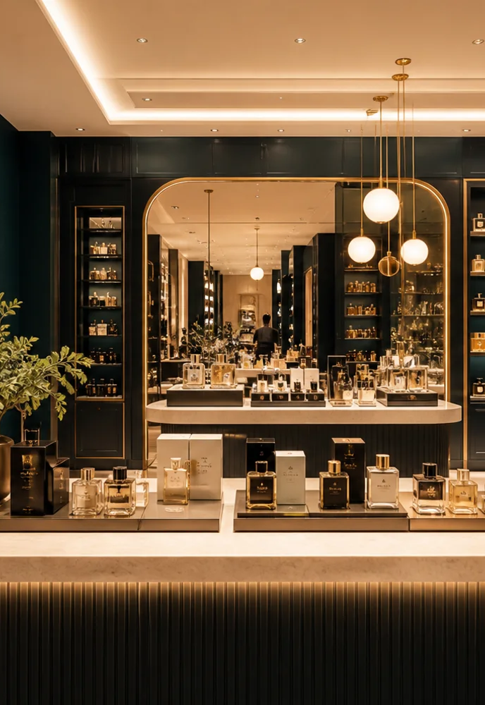

A CONNECTED FUTURE FOR FLAIR
One business.
One connected ERP.
Retail • Wholesale • E-commerce
Platform vision & live demonstration
September 2026
Notes:
OPENING — 30 seconds. Say: “Today we will follow one product through your business: who can access it, where it is stocked, how it is sold, and how the day closes. Then we will show how purchasing, wholesale, online channels, forecasting and finance connect to the same foundation.”
The source proposal is a future-state scope. The current implementation is a local demo. Do not imply that all nine modules are live.
[Sources]
D:/echo-work/flair-perfumes/ERP_Modules.pdf
D:/echo-work/flair-perfumes/public/brand/flair-logo.png
D:/echo-work/flair-perfumes/public/demo/locations/harwin-store.webp
[/Sources]

Slide 2
FLAIR ERP / THE CONNECTED BUSINESS
The outcome: clearer control at every step
Know your stock
Serve every channel
Location visibility
Traceable movements
Retail, reseller and online orders
Consistent product information
YOUR BUSINESS
IN ONE VIEW
Buy with confidence
Understand performance
Demand-led replenishment
Vendor accountability
Cash, contribution and stock trends
Decisions from shared records
FLAIR COSMETIC & FRAGRANCE
02
Notes:
DISCOVERY — Ask: “Which costs you more time today: finding stock, buying the right quantities, managing channels, or closing the books?” Use the answer to emphasize the relevant branch. These are intended benefits of the completed ERP, not measured results or guarantees. Transition: “Nine connected modules support those outcomes.”
[Sources]
D:/echo-work/flair-perfumes/README.md
D:/echo-work/flair-perfumes/ERP_Modules.pdf
[/Sources]

Slide 3
THE COMPLETE ERP / SCOPE MAP
Nine modules. One operating model.
A phased platform designed around perfume and cosmetics operations.
FLAIR ERP
Shared business records
01–04 Operate
05–07 Expand
08–09 Optimize
01 Core Setup
05 Wholesale & B2B Portal
08 Smart Demand Forecasting
02 Product & Inventory
06 E-Commerce Hub
09 Accounting & Finance
03 Retail POS
07 Reports & Dashboards
04 Purchasing & Vendors
FLAIR COSMETIC & FRAGRANCE
03
Notes:
Explain the three business layers. Core Setup and Product & Inventory provide the foundation. POS, purchasing, wholesale and online operations feed reporting and finance. Forecasting depends on reliable inventory and sales-channel history. Do not call the current sidebar a completed nine-module system.
[Sources]
D:/echo-work/flair-perfumes/ERP_Modules.pdf (pages 4–6, 21)
D:/echo-work/flair-perfumes/types/core-setup.ts
[/Sources]

Slide 4
DEMO STATUS / SCOPE CLARITY
What you can see today—and what comes next
TODAY’S DEMONSTRATION
COMPLETED ERP VISION
Core Setup & sign-in
Modules 04–09
Location, staff and policy demos; real login roles.
Purchasing, B2B, online channels, reports,
forecasting and finance remain planned.
Inventory + Retail POS
Production rollout
Catalog, stock operations, sales, returns,
customer credit and shift reconciliation.
Integrations, data migration, operational controls
and acceptance testing complete the journey.
FLAIR COSMETIC & FRAGRANCE
04
Notes:
CRITICAL POSITIONING — The latest README and code supersede the old Module 01-only build specification. Authentication, inventory and POS are server-backed in a local single-process JSON adapter. Core Setup staff, location and policy screens use separate browser-local demo data; they do not update real login accounts or synchronize location edits into inventory. Real enforced roles are administered through Login Access. Modules 04–09 are roadmap items. Production infrastructure, durable transactional database, backups, identity hardening and security review remain rollout work. Keep this explanation short in the meeting, expand only when asked.
[Sources]
D:/echo-work/flair-perfumes/README.md
D:/echo-work/flair-perfumes/components/shell/app-shell.tsx
[/Sources]

Slide 5
END-TO-END FLOW / COMPLETED ERP VISION
Follow one product through the whole business
Set up
Buy & receive
Allocate
Sell
People, locations
and access
›
Vendor order
to stock
›
Store and online
availability
›
Retail, B2B
and channels
Return
Reconcile
Learn
Reorder
Invoice-linked
stock and credit
›
Cash, payouts
and ledgers
›
Performance
and demand
›
Approved
purchase plan
Every handoff should leave a record the next team can use.
FLAIR COSMETIC & FRAGRANCE
05
Notes:
Walk left-to-right on the top row, then left-to-right on the lower row. This is the full intended lifecycle. Today’s live example proves inventory-to-retail-to-return-to-shift-close; purchase orders, B2B, channels, financial posting and forecast planning are future modules. Transition to the first live capability: foundation and access.
[Sources]
D:/echo-work/flair-perfumes/README.md
D:/echo-work/flair-perfumes/ERP_Modules.pdf
[/Sources]

Slide 6
01 / CORE SETUP & ACCESS
Give each team the right workspace
Location structure
Role-based sign-in
Stores, warehouses and fulfillment hubs
Admin, inventory, POS manager and cashier
PEOPLE +
LOCATIONS
Business settings
Information control
Company profile and operating preferences
Restricted costs, module access
and cashier activity
FLAIR COSMETIC & FRAGRANCE
06
Notes:
SHOW: /core-setup, /core-setup/stores-warehouses, then /core-setup/login-access. Spend only a minute on configuration. SAY: “We start by organizing the business and deciding who can do what.” PROOF: Login Access has the actual authentication roles. If you show Users & Roles or Permissions, state they are policy design demonstrations, not the authorization engine. Optional prepared cashier login demonstrates restricted navigation; never change permissions during the meeting. Benefit: clearer responsibility and appropriate data access.
[Sources]
D:/echo-work/flair-perfumes/README.md
D:/echo-work/flair-perfumes/components/auth/accounts-page.tsx
D:/echo-work/flair-perfumes/components/core-setup/locations-page.tsx
[/Sources]

Slide 7
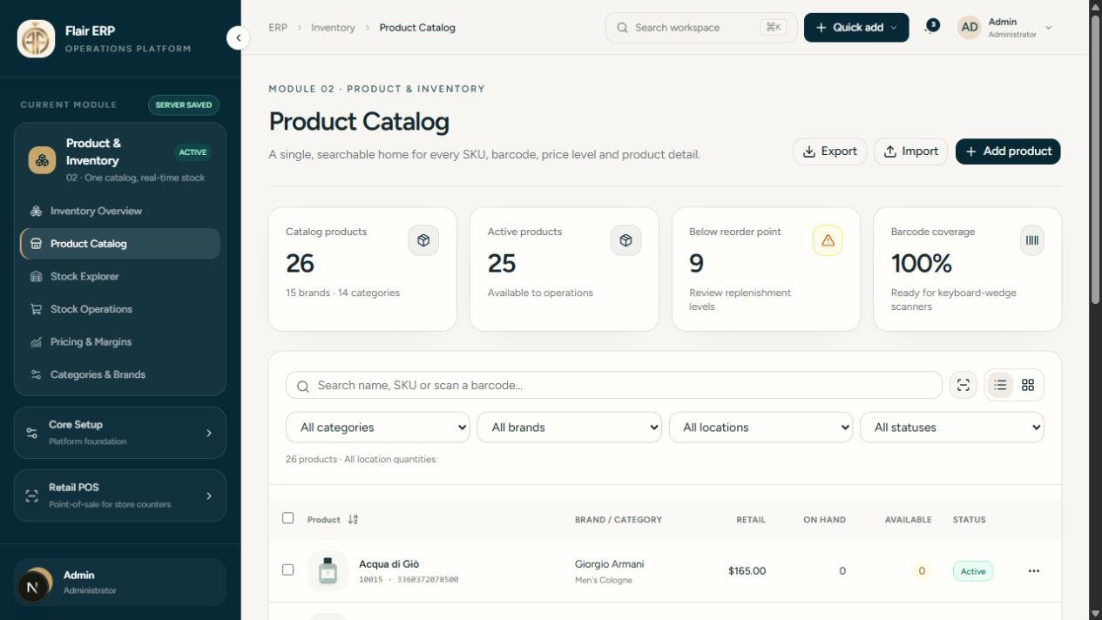
02 / PRODUCT & INVENTORY
One catalog connects products, prices and stock
Actual demo interface • illustrative catalog data
Identify
SKU, barcode, brand,
category and size
Price
Retail, wholesale,
VIP and web levels
Control
Costs, thresholds
and product status
FLAIR COSMETIC & FRAGRANCE
07
Notes:
SHOW: /product-inventory/products. Search SKU 10000, Lattafa Yara Pink; open its detail/edit view. Point to SKU, barcode, size and price levels. Switch to /product-inventory/pricing if pricing is a client priority. SAY: “One product record serves the whole operation.” No need to edit a price live. Catalog seed contains 26 illustrative products, not the client’s full database. Do not claim a completed legacy import. Current stock and prices may differ after prior demos.
[Sources]
D:/echo-work/flair-perfumes/README.md
D:/echo-work/flair-perfumes/data/inventory.ts
D:/echo-work/flair-perfumes/tmp/presentation-flair/catalog.png (local UI capture, 2026-09-02)
[/Sources]

Slide 8
02 / STOCK OPERATIONS
Know what is available—and why it changed
Receive
Transfer
Count
Trace
Post goods into
a location
›
Move units between
locations
›
Compare physical
and recorded stock
›
Review the
movement history
Available stock
A posted movement preserves
On hand − committed − held
Product • quantity • location
Reference • actor • date
FLAIR COSMETIC & FRAGRANCE
08
Notes:
SHOW: /product-inventory/stock, filter SKU 10000 and the Harwin Flagship location. Record baseline on-hand and available values. Go to /product-inventory/operations, create a receipt for 5 units of the same SKU at Harwin, use an illustrative cost, save draft then post. Return to stock: on-hand should rise by 5, assuming no concurrent activity. Optional transfer: 2 units from Harwin to Houston Main Warehouse, then inspect both balances. Drafts do not affect stock; posted documents are immutable. Supplier and bill fields are receipt references, not vendor payables. Held POS carts do not reserve inventory.
[Sources]
D:/echo-work/flair-perfumes/README.md
D:/echo-work/flair-perfumes/components/inventory/operation-dialog.tsx
D:/echo-work/flair-perfumes/types/inventory.ts
[/Sources]

Slide 9
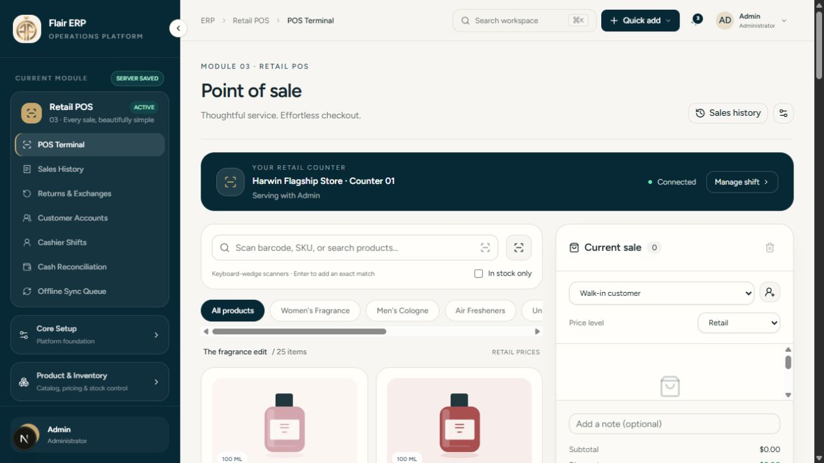
03 / RETAIL POS
Turn a counter sale into a traceable record
Actual demo interface • current counter workspace
Scan & serve
Find products, attach
a customer, review price
Confirm & sell
Record tender and
issue a receipt
See the result
Sale history and
updated stock
FLAIR COSMETIC & FRAGRANCE
09
Notes:
SHOW: /retail-pos. Preflight must confirm the tax configuration and an open cashier shift at the intended location. Attach a clearly labeled demo customer before sale if you will show store credit. Enter SKU 10000, sell 2 units, review the actual total, choose cash and confirm the demo tender. Only proceed once the server returns a confirmed receipt. Open /retail-pos/sales to retrieve it, then verify stock reduced by 2. SAY: “The receipt and stock movement are part of the same posted transaction.” Card and other external payments are recorded references only; Flair does not process a charge. Use the real on-screen tax/total, never an invented amount.
[Sources]
D:/echo-work/flair-perfumes/README.md
D:/echo-work/flair-perfumes/components/pos/terminal-page.tsx
D:/echo-work/flair-perfumes/tmp/presentation-flair/pos.png (local UI capture, 2026-09-02)
[/Sources]

Slide 10
03 / RETURNS, EXCHANGES & STORE CREDIT
Returns keep the original sale in view
Find invoice
Review return
Issue credit
Keep history
Select the original
confirmed sale
›
Choose quantity
and restock decision
›
Refund within limits
or create store credit
›
Retain receipt, return
and credit movement
Resellable
Damaged
Exchange
Restock returned units
when appropriate.
Keep non-resellable goods
out of sellable stock.
Return to customer credit,
then create a new sale.
FLAIR COSMETIC & FRAGRANCE
10
Notes:
SHOW: /retail-pos/returns as an administrator or POS manager. Find the 2-unit demo sale, return 1 unit, choose restock=true and store credit for the attached demo customer. Check /retail-pos/customers: customer credit rises by the allocated original amount; inventory rises by 1. A manager must use the original invoice and cannot return more than sold. Exchanges are a separate sale after a credit return, not an atomic exchange operation. Non-restocked goods do not add to sellable stock. Do not promise a full repair/quarantine workflow today. Accounting customer/vendor ledgers for all channels arrive in later modules.
[Sources]
D:/echo-work/flair-perfumes/README.md
D:/echo-work/flair-perfumes/components/pos/management-pages.tsx
[/Sources]

Slide 11
03 / SHIFTS & RECONCILIATION
Close the day with accountable cash control
Open shift
Record activity
Count & close
Review
Cashier, register
and opening float
›
Cash sales, refunds
and cash movements
›
Physical cash count
with variance reason
›
Frozen closing record
and manager export
Expected cash
Variance
Opening float + net cash activity
Counted − expected
FLAIR COSMETIC & FRAGRANCE
11
Notes:
SHOW: /retail-pos/shifts. Confirm you are on the disposable demo shift before closing it. Review expected cash, enter the physical demo count and supply a reason if there is a variance. Open /retail-pos/reconciliation and inspect the closed record and export. SAY: “Managers see a recorded close, not a changing estimate.” Closed shifts cannot accept new sales or returns. Card-provider settlements are external and are not reconciled by this current cash report. Complete returns before closing the shift.
[Sources]
D:/echo-work/flair-perfumes/README.md
D:/echo-work/flair-perfumes/components/pos/management-pages.tsx
[/Sources]

Slide 12
04 + 05 / PROPOSED NEXT CAPABILITIES
Connect replenishment and reseller sales
PURCHASING & VENDORS
WHOLESALE & B2B PORTAL
Order
Receive
Reseller
Order
Vendor pricing
and terms
›
Match goods
to the PO
Approved access
and price terms
›
Self-service
B2B ordering
Bills, purchase returns and vendor credits
create an accountable buying trail.
Shared catalog and inventory support
a consistent reseller experience.
Detailed B2B pricing, approvals and order rules are confirmed during discovery.
FLAIR COSMETIC & FRAGRANCE
12
Notes:
These are roadmap modules. Purchasing scope in the proposal includes POs, goods received, vendor prices/terms/bills, history, suggested reorder quantities and vendor credit adjustments. The supplied PDF identifies Module 05 and the reseller network but does not include a dedicated detailed B2B page. Self-service ordering is named in the implemented roadmap sidebar; finer B2B workflows shown here are proposed for validation, not agreed commitments. Ask about minimum order quantities, credit limits, approvals and negotiated pricing.
[Sources]
D:/echo-work/flair-perfumes/ERP_Modules.pdf (pages 2, 4, 11)
D:/echo-work/flair-perfumes/components/shell/app-shell.tsx
[/Sources]

Slide 13
06 / E-COMMERCE HUB — PLANNED
Online orders use the same stock foundation
Shopify • WooCommerce • eBay • TikTok Shop • Whatnot
Channel order
Allocate
Fallback
Fulfill & sync
Order, pricing
and stock signals
›
Check dedicated
e-commerce stock
›
Pull from main
warehouse if needed
›
Update status
and availability
Client-defined allocation rules
Connection readiness
Decide which SKUs live in each warehouse.
Validate seller access and supported sync
for each channel before rollout.
FLAIR COSMETIC & FRAGRANCE
13
Notes:
This is the target scope from the proposal, not evidence of live integrations. Do not assert current API capability, instant synchronization or universal approval. Each seller account, region, platform permission, API behavior and sync cadence must be validated during discovery. Where direct access is restricted, agree a controlled import/export approach and its limitations. The dedicated e-commerce warehouse checks stock first, with main-warehouse fallback according to agreed allocation rules. Ask which channel should be connected first and who owns seller access.
[Sources]
D:/echo-work/flair-perfumes/ERP_Modules.pdf (pages 12–13, 20)
D:/echo-work/flair-perfumes/README.md
[/Sources]

Slide 14
07 / REPORTS & DASHBOARDS — PLANNED
See what each channel actually contributes
Order contribution
Sales − discounts − refunds − channel fees
− shipping cost − product cost
Compare
Spot exceptions
Act
Order • channel • brand
Retail vs. wholesale
Slow stock • weak contribution
Returns • reconciliation gaps
Adjust buying, pricing
and channel priorities
FLAIR COSMETIC & FRAGRANCE
14
Notes:
The source proposal labels this formula Net Profit. Present it more precisely as order contribution because company overheads, financing and income tax may sit outside it. It is not the company’s final net income. Module 07 is planned and depends on all operational sales/purchase feeds; profitability requires reliable fee, shipping and cost capture. Map payout timing and each channel’s cost fields before defining dashboards. No illustrative revenue or ROI claims are used.
[Sources]
D:/echo-work/flair-perfumes/ERP_Modules.pdf (pages 14–15)
[/Sources]

Slide 15
08 / SMART DEMAND FORECASTING — PLANNED
Turn demand history into a buying plan
What to buy. How much. When.
01
02
03
Read demand
Recommend
Decide
30 / 60 / 90-day sales
and inventory history
Reorder quantities, safety
stock and seasonal needs
Buyer reviews and approves
the replenishment plan
Better recommendations begin with reliable stock and sales-channel data.
FLAIR COSMETIC & FRAGRANCE
15
Notes:
Position this as the flagship proposed capability. SAY: “The goal is to turn recurring spreadsheet review into a ranked buying recommendation your team can inspect.” Inputs must include sufficient sales history, stock accuracy, lead-time assumptions and relevant channel feeds. Keep buyer review in the loop; do not promise zero manual work, perfect forecasts or guaranteed savings. Agree how to evaluate recommendations and measure forecast error before production use. Depends on Modules 02 and 06 in the supplied scope.
[Sources]
D:/echo-work/flair-perfumes/ERP_Modules.pdf (pages 6–7, 16)
[/Sources]

Slide 16
09 / ACCOUNTING & FINANCE — PLANNED
Bring finance closer to daily operations
Customer side
Financial control
Invoices, receivables, refunds
and customer credit notes
General ledger, bank reconciliation
and sales-tax workflows
OPERATIONAL
RECORD → BOOKS
Vendor side
Management view
Bills, payables, purchase returns
and vendor credits
P&L, Balance Sheet, payroll entries
and post-dated check tracking
FLAIR COSMETIC & FRAGRANCE
16
Notes:
All accounting capabilities are planned. The intended result is operational transactions feeding agreed accounting mappings. Scope includes basic payroll entries, not a complete payroll service. PDCs cover customer and vendor checks, due/clearance dates, pending/due-soon/cleared/bounced statuses and reminders. Confirm chart of accounts, opening balances, tax rules, cutoffs and accounting ownership with the client’s finance lead. POS customer store credit today is not yet a full accounts-receivable ledger.
[Sources]
D:/echo-work/flair-perfumes/ERP_Modules.pdf (pages 17–19)
D:/echo-work/flair-perfumes/README.md
[/Sources]

Slide 17
CUSTOMER HANDOVER / PROPOSED ACCEPTANCE PACKAGE
What your team receives at completion
Configured platform
Operational visibility
Nine agreed modules
Roles, locations and workflows
Reports, exports and traceable
stock, sales and financial activity
YOUR ERP
READY TO RUN
Connected information
Ready-to-run handover
Approved migration and channel feeds
Validated balances and records
Training, operating guides, access
and agreed recovery procedures
FLAIR COSMETIC & FRAGRANCE
17
Notes:
The nine-module platform is the source proposal scope. The handover package is our proposed completion checklist and must be confirmed in the implementation agreement: configuration, agreed migration, integrations, acceptance evidence, training, guides, administrator access and tested recovery procedures. Do not promise unlimited support, hosting, source-code/IP ownership or a maintenance SLA without agreement. The proposal states that post-implementation maintenance and support are quoted separately.
[Sources]
D:/echo-work/flair-perfumes/ERP_Modules.pdf (pages 4, 21–22)
D:/echo-work/flair-perfumes/README.md
[/Sources]

Slide 18
ROLLOUT / THREE DELIVERY GATES
Deliver in phases. Validate before expanding.
01 Operate
02 Expand
03 Optimize
Setup • inventory • POS
Purchasing & vendors
Gate: stock, sale, return
and buying flows accepted.
Wholesale • e-commerce
Reports & dashboards
Gate: channel orders, stock
and cost data reconcile.
Forecasting • finance
Gate: buying recommendations
and financial outputs
validated by business owners.
Dates and investment follow confirmed scope, data readiness and integration access.
FLAIR COSMETIC & FRAGRANCE
18
Notes:
The three phases reproduce the source proposal. Current demo covers portions of Phase 1; purchasing and production readiness remain to be completed. Recommend a controlled pilot, migration rehearsal, reconciled opening balances, trained users and business sign-off before broad rollout. Agree a rollback/recovery procedure. Do not invent weeks, launch dates, pricing or percentages. Client prerequisites include data, access and business process decisions.
[Sources]
D:/echo-work/flair-perfumes/ERP_Modules.pdf (pages 4, 21–22)
D:/echo-work/flair-perfumes/README.md
[/Sources]

Slide 19
EXPECTED BENEFITS / VALIDATE THROUGH THE PILOT
Measure the change that matters to the business
BUSINESS AREA
INTENDED BENEFIT
MEASURE TO AGREE
Stock confidence
Fewer stock discrepancies
Count accuracy; oversell exceptions
Counter efficiency
Smoother customer service
Checkout time; return handling time
Cash accountability
Clearer daily close
Close time; unexplained variance
Buying quality
More informed replenishment
Stockout days; aged-stock value
Channel visibility
Better commercial decisions
Orders with complete cost data
FLAIR COSMETIC & FRAGRANCE
19
Notes:
These are qualitative expected benefits and proposed measures, not achieved results. Capture a baseline before the pilot, agree target improvements with the client and review after an agreed period. Ask: “Which two measures would make this a clear success for you?” Do not quote invented savings or guaranteed ROI.
[Sources]
D:/echo-work/flair-perfumes/ERP_Modules.pdf (pages 2, 7, 14–16)
D:/echo-work/flair-perfumes/README.md
[/Sources]

Slide 20
DISCUSSION / NEXT DECISIONS
Let’s agree the first operating milestone
Start with one location.
Prove one connected flow.
01
Priority
Which process should improve first?
02
Pilot
Which location, users and products?
03
Readiness
Who provides data, rules and channel access?
04
Acceptance
What evidence will confirm success?
FLAIR COSMETIC & FRAGRANCE
20
Notes:
CLOSE — Say: “You have seen the operational foundation and the path to a complete ERP. Let’s choose the pilot location and the first outcome we will prove together.” Capture four decisions: priority process, pilot owner/location, data/access owner and acceptance criteria. Then agree the next discovery session. Avoid committing to dates or commercial terms before scope is confirmed. Client-facing presentation ends here. The remaining slides are a presenter playbook and are hidden from normal slideshow playback.
[Sources]
D:/echo-work/flair-perfumes/README.md
D:/echo-work/flair-perfumes/ERP_Modules.pdf
[/Sources]

Slide 21
PRESENTER PLAYBOOK / SUGGESTED 30-MINUTE RUN
Run the meeting as one business story
00–03
Discover the priority
Open on slides 1–2; ask about their biggest operational bottleneck.
03–07
Frame the platform
Use slides 3–5 to explain nine modules, today’s demo and the full flow.
07–20
Demonstrate one SKU
Setup → catalog → receive → sell → return → close → verify.
20–26
Show the completed ERP
Use slides 12–19; emphasize the modules tied to their stated priority.
26–30
Agree the next step
Slide 20: pilot location, owner, inputs and acceptance measures.
FLAIR COSMETIC & FRAGRANCE
21
Notes:
Keep the slideshow on slide 5 while introducing the live demo, then switch to the app. Slides 6–11 are supporting explanations and screenshot fallback; do not narrate every slide and then repeat it in the app. Return at slide 12. If time is short, show a 2-unit sale, 1-unit return and stock change; skip transfer and optional pricing views. Customer-facing sequence ends at slide 20.
[Sources]
D:/echo-work/flair-perfumes/README.md
D:/echo-work/flair-perfumes/ERP_Modules.pdf
[/Sources]

Slide 22
PRESENTER PLAYBOOK / PRE-FLIGHT
Prepare the demo before the customer arrives
Environment
Scenario
Checkout
Use a disposable demo dataset.
Confirm server and login.
Keep app and deck ready.
Rehearse the exact route.
SKU 10000: Yara Pink.
Harwin Flagship location.
One labeled demo customer.
Record opening stock values.
Confirm sample tax settings.
Open the demo cashier shift.
Check opening cash float.
Test receipt print preview.
Use demo tender only. Keep business inventory and the client’s live register untouched.
FLAIR COSMETIC & FRAGRANCE
22
Notes:
Current project location: D:/echo-work/flair-perfumes. Local app: http://localhost:3000. Use an authorized prepared administrator/POS manager session and a separate prepared cashier session only if needed. Do not put credentials on screen or in the deck. The demo modifies stock, sales, credit and shifts: rehearse in a disposable data directory, not business inventory. FLAIR_DATA_DIR can select an isolated persistent folder for a separately prepared instance. Do not reset the live app during the meeting. Stock seed is illustrative; use the observed baseline. Complete setup and verify stock, tax configuration and correct location before admitting the client. Hardware compatibility and actual printer/scanner behavior must be tested on the intended device.
[Sources]
D:/echo-work/flair-perfumes/README.md
D:/echo-work/flair-perfumes/data/inventory.ts
[/Sources]

Slide 23
PRESENTER PLAYBOOK / LIVE ACTIONS 1–4
Demo route: establish control, then receive stock
1
Core Setup → Login Access
Show actual sign-in roles. “People get the right workspace.”
Proof: role-specific access is visible.
2
Product Catalog → search 10000
Open Yara Pink. Show SKU, barcode, price levels and size.
Proof: one identifiable product record.
3
Stock Explorer → Harwin
Record on-hand and available stock before any posting.
Proof: a baseline the customer can compare.
4
Stock Operations → receipt
Receive 5 units; save the draft, post, then refresh stock.
Proof: on-hand = baseline + 5.
FLAIR COSMETIC & FRAGRANCE
23
Notes:
PATHS:
1 /core-setup and /core-setup/login-access. Optional /core-setup/stores-warehouses. Explain browser-local setup limitations when relevant.
2 /product-inventory/products. Use SKU 10000 / Lattafa Yara Pink; do not rely on product row position.
3 /product-inventory/stock. Filter product and Harwin; record actual onHand and available values.
4 /product-inventory/operations. Choose Stock receipt, Harwin, one line, SKU 10000, quantity 5, an explicitly illustrative unit cost and a DEMO reference. Save then post. Confirm stock +5 and inspect movement history. Do not describe receipt supplier fields as a PO or payable.
Optional: transfer 2 units to Houston Main Warehouse. If performed, adjust the later expected Harwin stock by -2. Avoid this optional step when time is tight.
[Sources]
D:/echo-work/flair-perfumes/README.md
D:/echo-work/flair-perfumes/components/inventory/operation-dialog.tsx
D:/echo-work/flair-perfumes/data/inventory.ts
[/Sources]

Slide 24
PRESENTER PLAYBOOK / LIVE ACTIONS 5–8
Demo route: sell, return and close the loop
5
POS → attach demo customer → sell 2
Review price and tax; record demo cash; show confirmed receipt.
Proof: sale recorded; stock decreases by 2.
6
Returns → original receipt → return 1
Choose restock and store credit for the attached customer.
Proof: stock increases by 1; credit history records the amount.
7
Customer Accounts → inspect credit
Show purchase history, credit balance and credit movement.
Proof: the customer account links back to the transaction.
8
Cashier Shifts → close → reconciliation
Review expected cash; enter count; explain any variance.
Proof: frozen close record. Final stock = baseline + 4.*
*Assumes +5 received, −2 sold, +1 restocked, no transfer and no concurrent activity.
FLAIR COSMETIC & FRAGRANCE
24
Notes:
PATHS:
5 /retail-pos then /retail-pos/sales. Ensure configured tax and an open shift. Attach the labeled demo customer first. Enter 10000, quantity 2. Use current actual price and tax, not a preset total. Record cash only in the disposable demo; await confirmed sale.
6 /retail-pos/returns. Use manager/admin, select the original receipt and quantity 1. Restock true, issue store credit. Returns use original price/discount/tax allocation.
7 /retail-pos/customers. Check customer credit and history. Optional exchange: redeem part of the credit in a separate sale; if you do, recompute expected stock and mention it.
8 /retail-pos/shifts then /retail-pos/reconciliation. Close only the demo shift after completing sales and returns. Expected cash includes the full cash sale when the return is store credit, because no cash refund left the drawer. Show the frozen report and export.
Numeric proof: baseline B → B+5 after receipt → B+3 after 2-unit sale → B+4 after restocking 1. This proves the transaction chain without inventing a starting quantity.
[Sources]
D:/echo-work/flair-perfumes/README.md
D:/echo-work/flair-perfumes/components/pos/terminal-page.tsx
D:/echo-work/flair-perfumes/components/pos/management-pages.tsx
[/Sources]

Slide 25
PRESENTER PLAYBOOK / QUESTIONS & FALLBACK
Answer clearly—and always return to value
“Is everything live?”
Inventory and retail flows are working; Modules 04–09 are planned.
“Are cards and channels connected?”
Card approvals are external today. Seller connections require validation.
“Does it work offline?”
Loaded checkout can queue cash commands; only confirmed sales are final.
“What about rollout and support?”
Agree data, pilot and acceptance first; ongoing support is quoted separately.
If the app stalls: use slides 7–11, explain the intended result, and capture the open question.
FLAIR COSMETIC & FRAGRANCE
25
Notes:
OFFLINE DETAIL: The current implementation supports an active-session cash-only pending queue if server confirmation fails. It is not an installable offline-first app. Initial load, external tenders and store credit need connection; stock/price/tax changes or a closed shift can conflict. Pending commands are not final receipts. Do not collect payment or release goods until confirmed; do not clear browser storage with pending sales.
PAYMENTS: Flair records externally processed card references and never collects card details or charges a card.
ACCESS: Core Setup staff/policy editors are demo configuration; Login Access controls real roles.
PRODUCTION: Current JSON persistence is a local single-process adapter. A production plan needs transactional storage, recovery, identity/security work and operational acceptance.
COMMERCIAL: No dates, pricing or support SLA are confirmed in this deck.
FALLBACK: Do not repeatedly click payment/post. Inspect Sales History first if confirmation is uncertain. Present screenshot slides, state what was and was not confirmed, and agree follow-up.
CLOSE: “Which location should we pilot, who will own the data, and what result should we prove first?”
[Sources]
D:/echo-work/flair-perfumes/README.md
D:/echo-work/flair-perfumes/ERP_Modules.pdf (page 22)
[/Sources]

