Slide 1
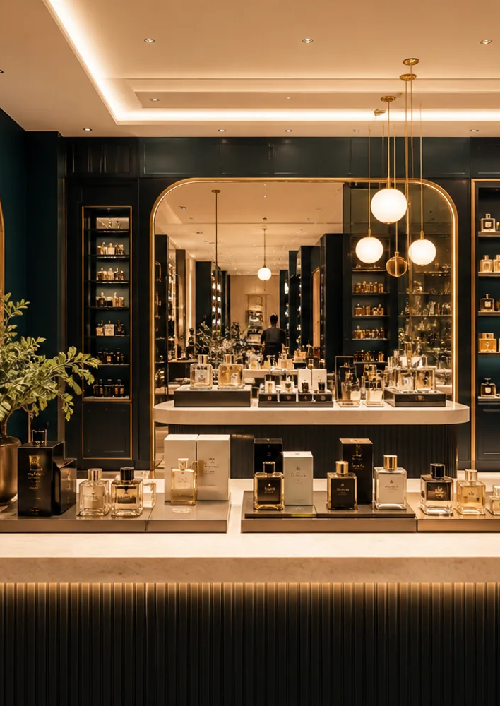

CLIENT PROGRESS REVIEW
Flair ERP
Friday to now
Working Phase One flows, complete demo data and interactive previews for finance, forecasting and operations.
Prepared 7 September 2026
Notes:
Opening slide for the client progress review. The photograph and logo come from the application brand assets.
[Sources]
D:\echo-work\flair-perfumes\public\brand\flair-logo.png
D:\echo-work\flair-perfumes\public\demo\locations\harwin-store.webp
[/Sources]

Slide 2
UPDATE 02
Friday feedback became a working client demo
Nine production commits moved the application from static coverage to connected, testable workflows.
FRI 04 SEP
WEEKEND
MON 07 SEP
LIVE NOW
Client priorities
Operational controls
Commercial workflows
Client-ready data
Retail discounting, returns, refunds, customer follow-up, hold and recall, closing reports.
POS history, invoice-linked returns, store credit, shifts, 8.25% tax and safer Vercel storage.
Split tender, margin tiers, bulk import, multi-company setup and modules 04 to 09.
Interactive purchasing, finance, forecasting and populated operational records.
37
unit checks
51
API checks
29
built routes
FLAIR ERP · CLIENT UPDATE · 7 SEP 2026
02
Notes:
Timeline summarizes commits created from Friday 4 September through Monday 7 September in the Asia/Karachi timezone. Validation figures come from the current unit, API and production build runs.
[Sources]
git log --since=2026-09-04
npm test
npm run test:api
npm run build
[/Sources]

Slide 3
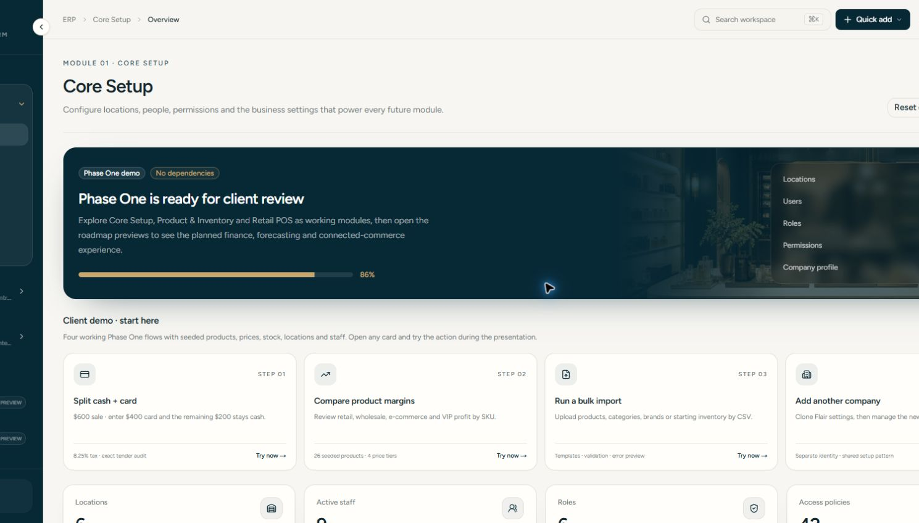
UPDATE 03
Phase One now gives the client a clear starting path
The overview points directly to four working demonstrations instead of leaving the client to explore without context.
CHANGE MADE
A guided sequence covers split tender, product margins, bulk import and company setup.
PROBLEM SOLVED
The meeting has an obvious route. Every step opens the exact screen the presenter needs.
Core Setup · Inventory · Retail POS
FLAIR ERP · CLIENT UPDATE · 7 SEP 2026
03
Notes:
Live application screenshot captured after deployment on 7 September 2026.
[Sources]
D:\echo-work\flair-perfumes\tmp\client-overview-build\screenshots\core-overview.png
[/Sources]

Slide 4
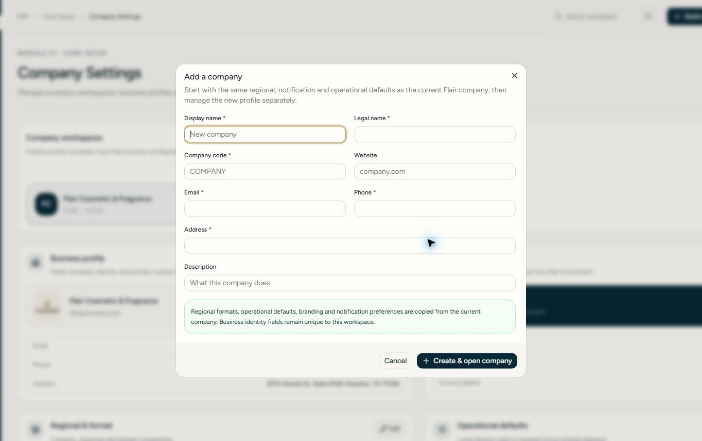
UPDATE 04
A second company starts from proven Flair settings
The new workspace keeps its own identity while copying regional and operating defaults from the current company.
01
Required identity
Name, code, contact and address fields keep each company distinct.
02
Faster setup
Regional formats, branding and notification defaults copy from the active company.
03
Independent control
The user can switch the active company and maintain its profile separately.
FLAIR ERP · CLIENT UPDATE · 7 SEP 2026
04
Notes:
Live multi-company creation dialog. No company record was submitted while capturing this screenshot.
[Sources]
D:\echo-work\flair-perfumes\tmp\client-overview-build\screenshots\multi-company.png
D:\echo-work\flair-perfumes\components\core-setup\settings-page.tsx
[/Sources]

Slide 5
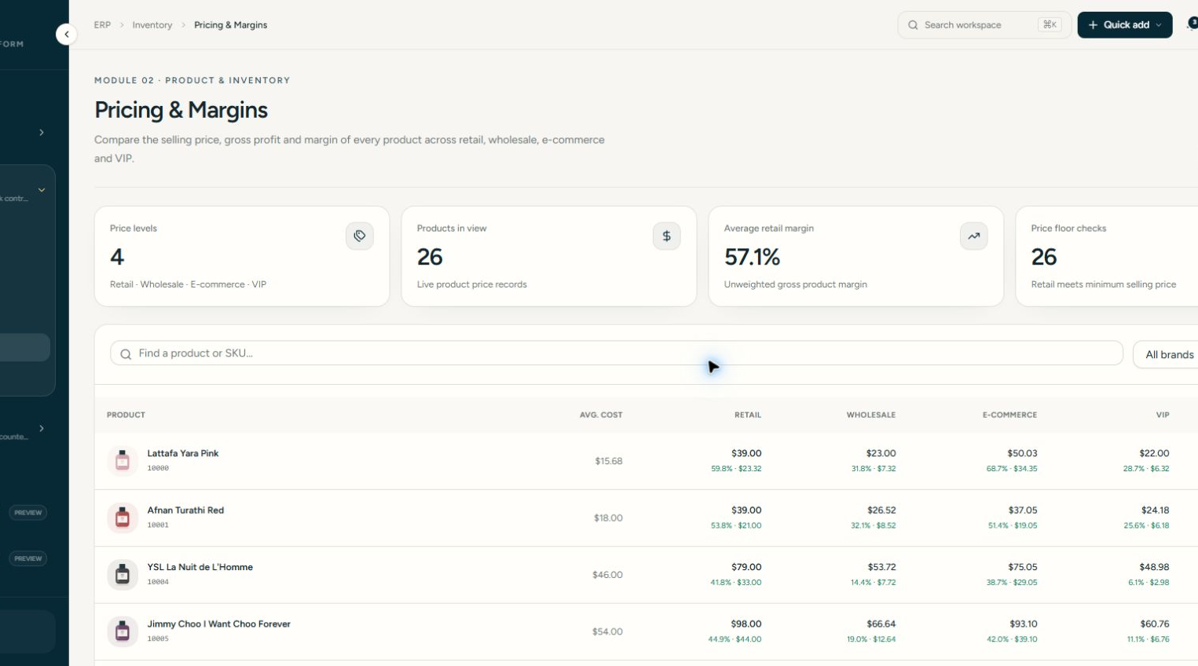
UPDATE 05
Every product shows the margin for each sales channel
Retail, wholesale, e-commerce and VIP prices use the same average cost, with gross profit and margin visible by SKU.
CHANGE MADE
Four price tiers now calculate profit and margin independently.
PROBLEM SOLVED
Management can compare channel contribution before approving prices or discounts.
26 seeded products
FLAIR ERP · CLIENT UPDATE · 7 SEP 2026
05
Notes:
Live pricing and margins screenshot with illustrative product data.
[Sources]
D:\echo-work\flair-perfumes\tmp\client-overview-build\screenshots\pricing-margins.png
D:\echo-work\flair-perfumes\components\inventory\pricing-page.tsx
[/Sources]

Slide 6
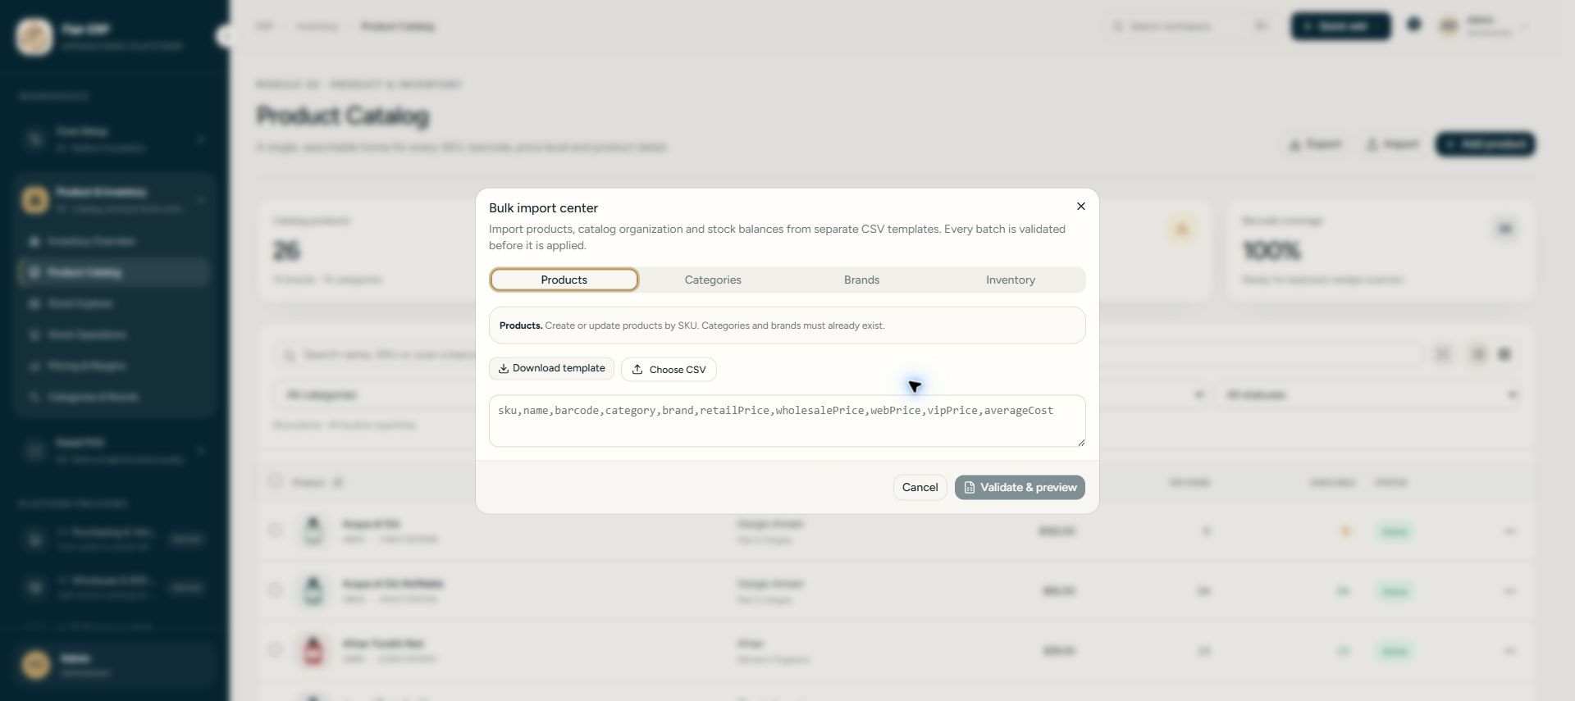
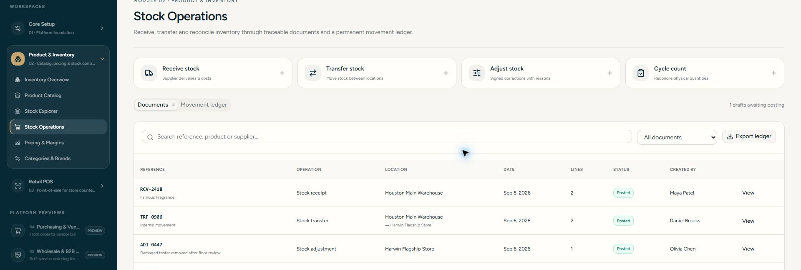
UPDATE 06
Bulk import and stock documents make the demo practical
Products, organization and starting quantities can enter through validated CSV files, then move through traceable stock records.
01
Four import modes
Separate templates cover products, categories, brands and inventory balances.
02
Validation before posting
The preview catches missing fields and invalid identifiers before changing data.
03
Traceable stock history
Seeded receipts, transfers, adjustments and counts show the full document lifecycle.
FLAIR ERP · CLIENT UPDATE · 7 SEP 2026
06
Notes:
Live screenshots of the bulk import center and seeded stock operations.
[Sources]
D:\echo-work\flair-perfumes\tmp\client-overview-build\screenshots\bulk-import.png
D:\echo-work\flair-perfumes\tmp\client-overview-build\screenshots\inventory-operations.png
D:\echo-work\flair-perfumes\components\inventory\tools-dialogs.tsx
D:\echo-work\flair-perfumes\data\inventory.ts
[/Sources]

Slide 7
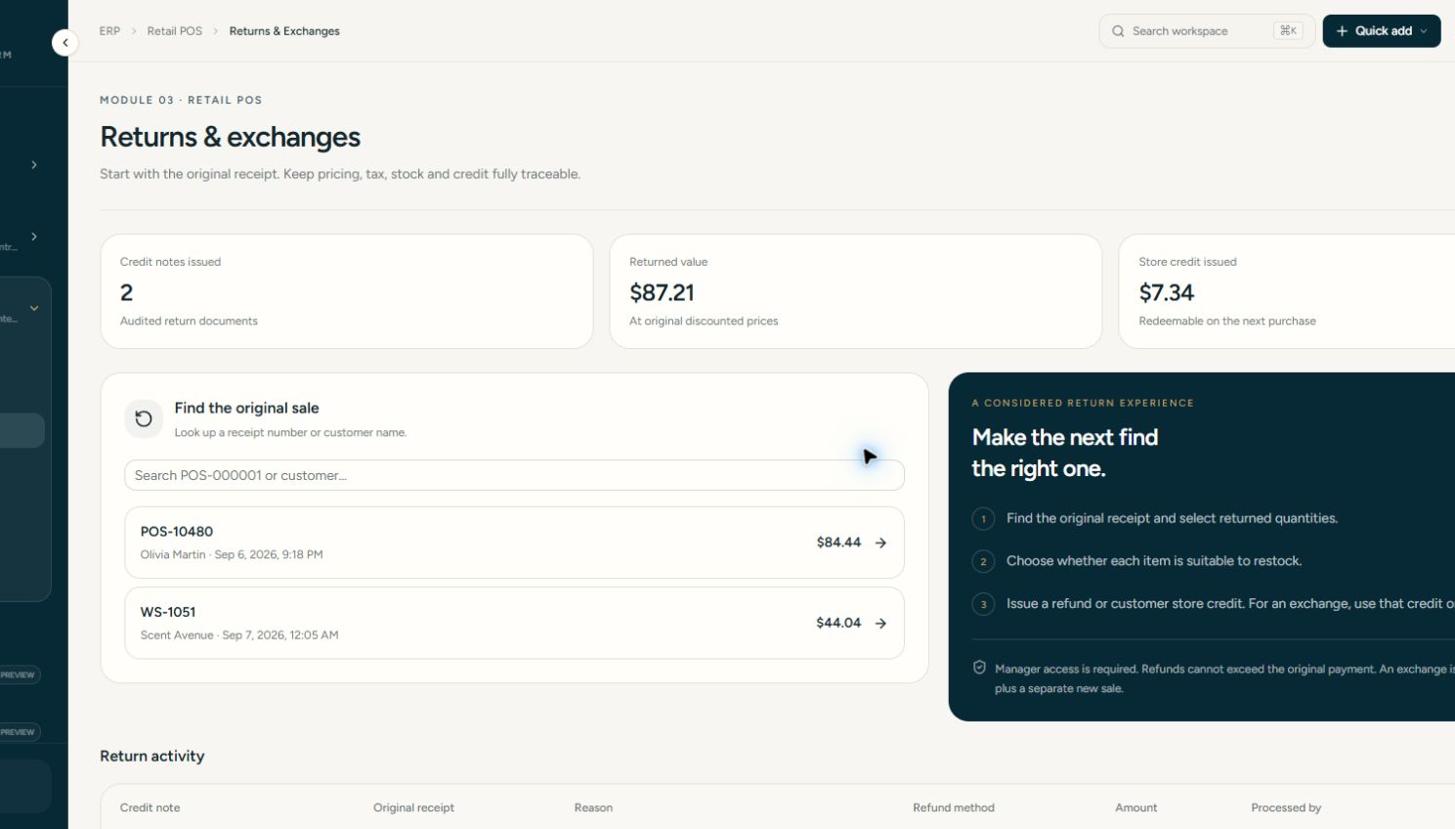
UPDATE 07
POS history keeps the sale, return and customer credit connected
Seeded receipts and credit notes let the client inspect the full flow without entering setup data first.
RETAIL CONTROLS ADDED
Split cash and card
Buy one, second 50% off
Last sale lookup
Hold and recall
Refund or store credit
Retail and wholesale close
PROBLEM SOLVED
Staff can recover the original transaction and keep stock and credit adjustments auditable.
FLAIR ERP · CLIENT UPDATE · 7 SEP 2026
07
Notes:
Live returns screen showing seeded linked records. The listed controls were implemented in the POS workflow between 4 and 7 September.
[Sources]
D:\echo-work\flair-perfumes\tmp\client-overview-build\screenshots\returns-credit-notes.png
D:\echo-work\flair-perfumes\components\pos\terminal-page.tsx
D:\echo-work\flair-perfumes\components\pos\management-pages.tsx
[/Sources]

Slide 8
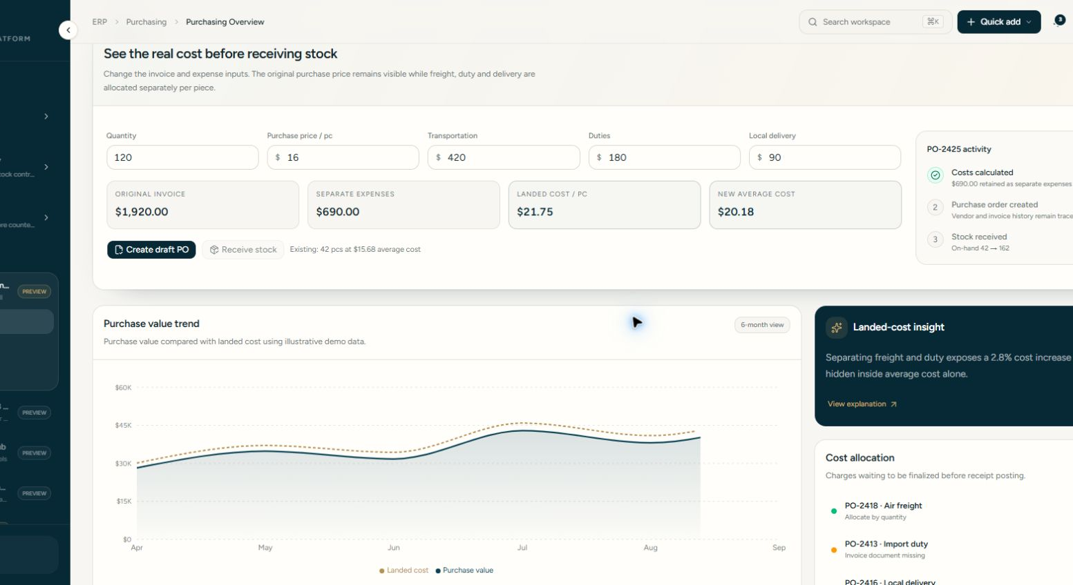
UPDATE 08
Purchasing preserves the real invoice cost
Transportation, duty and local delivery stay separate while the application calculates landed and weighted average cost per piece.
EXAMPLE RESULT
$16.00
original unit price
$5.75
allocated extra cost
$21.75
landed cost per piece
The purchase history remains comparable without reopening a physical invoice.
FLAIR ERP · CLIENT UPDATE · 7 SEP 2026
08
Notes:
Interactive purchasing screenshot. Amounts are seeded demonstration values, not client accounting results.
[Sources]
D:\echo-work\flair-perfumes\tmp\client-overview-build\screenshots\purchasing-landed-cost.png
D:\echo-work\flair-perfumes\components\roadmap\interactive-workflows.tsx
[/Sources]

Slide 9
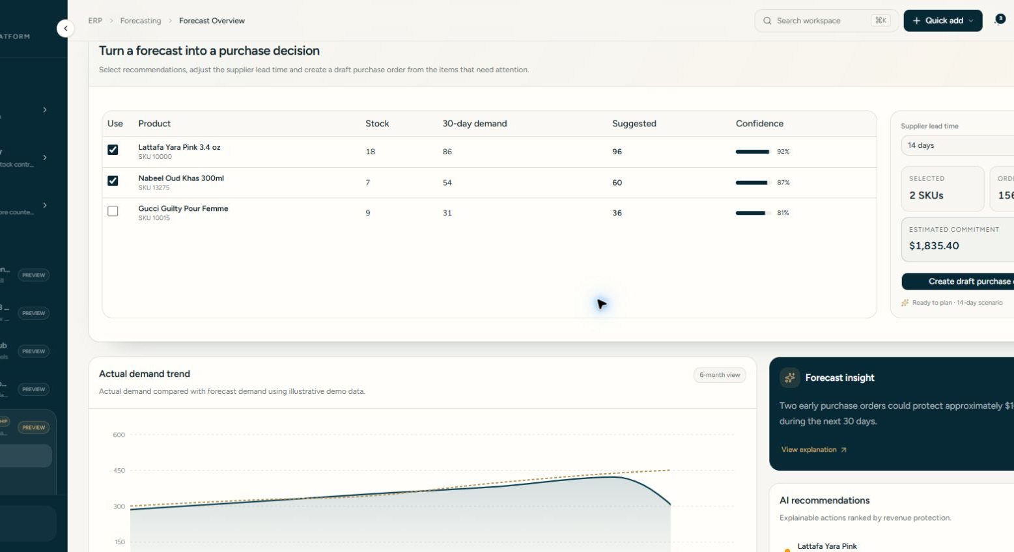
UPDATE 09
The sales forecast produces a purchase decision
The presenter can select recommended SKUs, change lead time and create a draft purchase order from the scenario.
01
Demand signal
Thirty-day demand sits next to available stock for each product.
02
Confidence
Each suggestion shows the model confidence used in the demo scenario.
03
Purchase action
Selected recommendations become an estimated commitment and draft order.
FLAIR ERP · CLIENT UPDATE · 7 SEP 2026
09
Notes:
Interactive forecast screenshot with illustrative data. Recommendations are a demo of the planned interface, not a trained production forecast.
[Sources]
D:\echo-work\flair-perfumes\tmp\client-overview-build\screenshots\sales-forecast.png
D:\echo-work\flair-perfumes\components\roadmap\interactive-workflows.tsx
[/Sources]

Slide 10
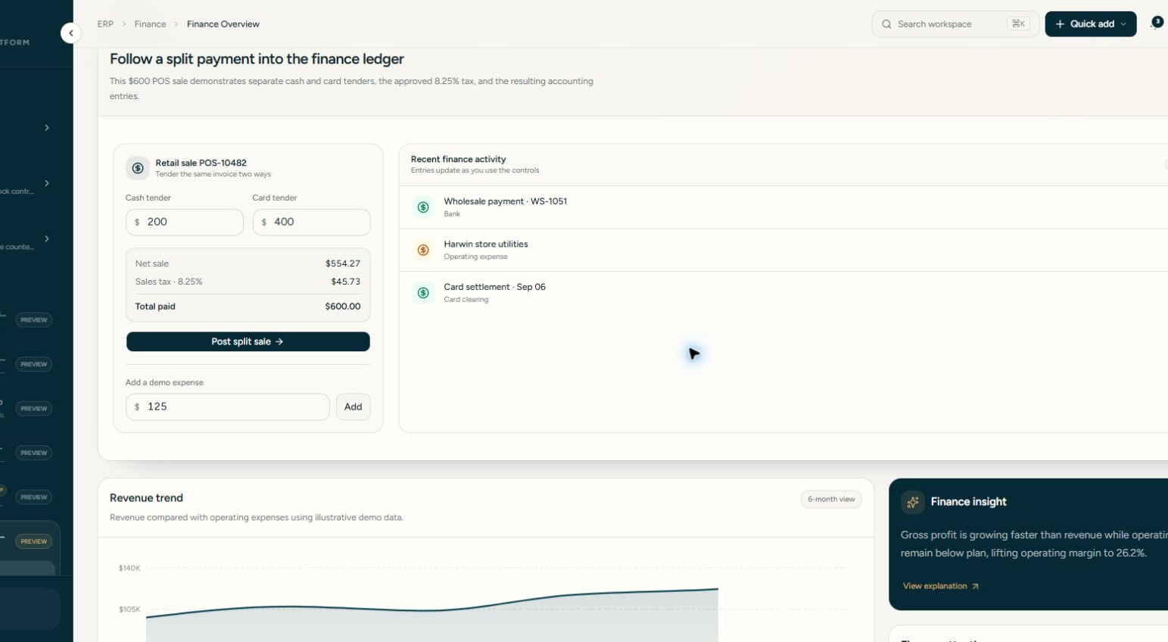
UPDATE 10
A split payment becomes clear finance activity
The $600 example records $200 cash and $400 card, separates 8.25% sales tax and posts a readable ledger entry.
TRANSACTION
$600.00
$554.27 net sale
$45.73 tax
$200 cash
$400 card
PROBLEM SOLVED
Cash drawer and card settlement no longer appear as one unexplained payment.
FLAIR ERP · CLIENT UPDATE · 7 SEP 2026
10
Notes:
Interactive finance screenshot using the client-provided split tender example. Figures are correctly derived from a $600 tax-inclusive sale at 8.25%.
[Sources]
D:\echo-work\flair-perfumes\tmp\client-overview-build\screenshots\finance-split-payment.png
D:\echo-work\flair-perfumes\components\roadmap\interactive-workflows.tsx
[/Sources]

Slide 11
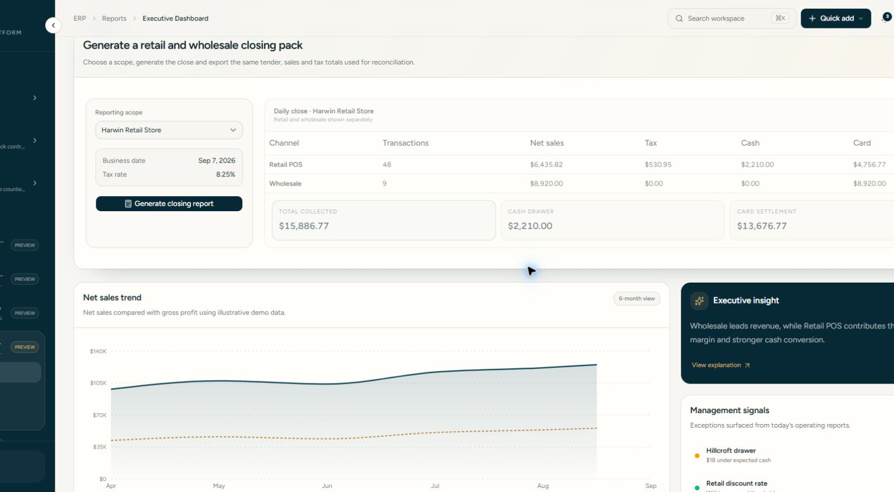
UPDATE 11
Daily closing separates retail, wholesale and tender totals
One report shows transactions, net sales, tax, cash and card settlement, with a CSV export for reconciliation.
WHAT THE CLIENT SEES
Retail POS
Wholesale
Sales tax
Cash drawer
Card settlement
PROBLEM SOLVED
Managers can reconcile both selling channels without combining tender types or rebuilding totals manually.
FLAIR ERP · CLIENT UPDATE · 7 SEP 2026
11
Notes:
Interactive closing report screenshot with illustrative data.
[Sources]
D:\echo-work\flair-perfumes\tmp\client-overview-build\screenshots\closing-report.png
D:\echo-work\flair-perfumes\components\roadmap\interactive-workflows.tsx
[/Sources]

Slide 12
UPDATE 12
The client can now test the whole operating story
The live demo combines populated records with safe reset controls and direct links to each important workflow.
01
Set up
Locations, users, access and companies
02
Control stock
Products, margins, imports and movements
03
Serve customers
Sales, promotions, returns and credit
04
Plan and close
Purchasing, forecasting, finance and reports
Live application
https://flaiur-erp.vercel.app
FLAIR ERP · CLIENT UPDATE · 7 SEP 2026
12
Notes:
Closing slide. The live URL points to the deployment verified after commit 4fa765e. Demo records are synthetic. Offline sync remains empty when the device has no unconfirmed payments, which represents a healthy state.
[Sources]
https://flaiur-erp.vercel.app
git commit 4fa765e
D:\echo-work\flair-perfumes\data\inventory.ts
[/Sources]

