Slide 1
DG-estate (real-estate Website)
By Darshan A Nariya seat no: 2019031804 (E19110403000110036)

Slide 2
Project profile
Title | DG-Estate
Organization | KG-Krunch Solutions
Category | Local Property listing Website
Duration | 3 Months
Front-end | Blade (Laravel Framework)
Back-end | Laravel Framework(PHP) + MySQL
Guide | Drashti Bhatt (Internal Guide)
Submitted by | Darshan A Nariya
Submitted to | Vidhyadeep Institute of Computer & Information Technology

Slide 3
Objective of project
User
Admin
Root
Enable to surf all listed properties.
Surf properties without the need of creating account.
Filter properties by category, city, and search by property title.
Create account and manage their profile, save properties, review properties, and change their password.
Add, and update existing category, facilities, city, property.
Add and delete images in property gallery.
Delete user reviews.
Give other users admin access.
Access to all mentioned features.
Only one who can delete existing category, facility, city, property, and users.
Manage website’s home, about, FAQ, terms page in CMS.
Manage website’s other settings in site settings option.

Slide 4
H/w requirements
Server
Client
Processor | 3rd Gen and above
Memory | 4 GB and above
Storage | 6 GB and above
Processor | 3rd Gen and above
Memory | 4 GB and above
Storage | 6 GB and above

Slide 5
s/w requirements
Server
Client
Operating System | Windows 7 and above Any linux based on 64bit arch.
Server | Apache v 2.4 and above
Php | V6 and above
MySQL | V7 and above
Operating System | Windows 7 and above
Browser | Any Chromium based browser

Slide 6
Development Environment
H/W
S/W
Processor | Ryzen 5 3550H
Memory | 8 GB
Storage | 256 GB
Operating System | Windows 10/11
WAMP | V 4.1
Chrome | V 99.0.4
Git | V 2.34.1
Composer | V 2.2.3
VS Code | V 1.50^
Diagrams.net | V 17.2.3

Slide 7
Technologies used
PHP
MySQL
MVC
Laravel v8
Bootstrap
JQuery
Composer

Slide 8
User requirements
Users are registered users whom have signed up in website. New Users have default type ‘U’.
Login
Signup
Logout
User Profile
Change Password
Save/Bookmark Property
Review

Slide 9
Admin requirements
User who is type ‘A’ is considered Admin.
Login
Logout
Category
City
Facility
Property
Gallery
Reviews
Users
Change Password
Save/Bookmark Property
Review

Slide 10
Root requirements
Root is super user of this website who has access to all the features and functionalities available on the website. User with type ‘R’ is considered Root.
Root can Delete Category/City/Facility/Property/User.
Root can modify Page content from CMS menu which is only accessible by type ‘R’ User or Root user.
Root can change site title, logo, and contact details from Site Settings option.

Slide 11
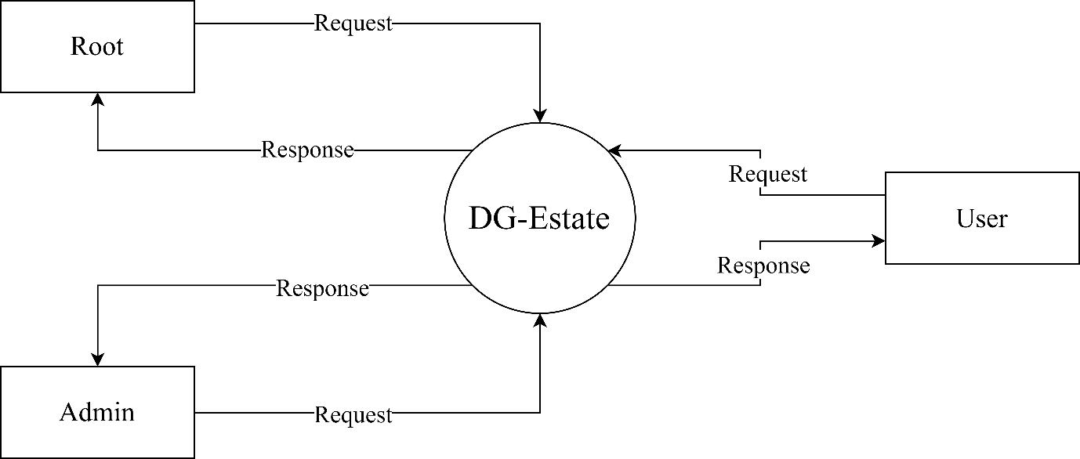
Context level DFD

