Slide 1
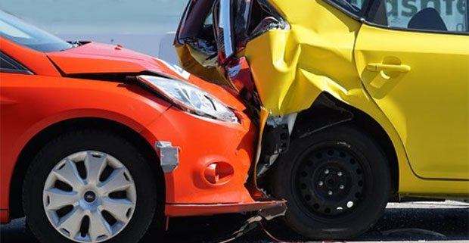
Motor Vehicle Crashes in Texas
DATA DIVE
Suzy Jones
This Photo by Unknown Author is licensed under CC BY

Slide 2
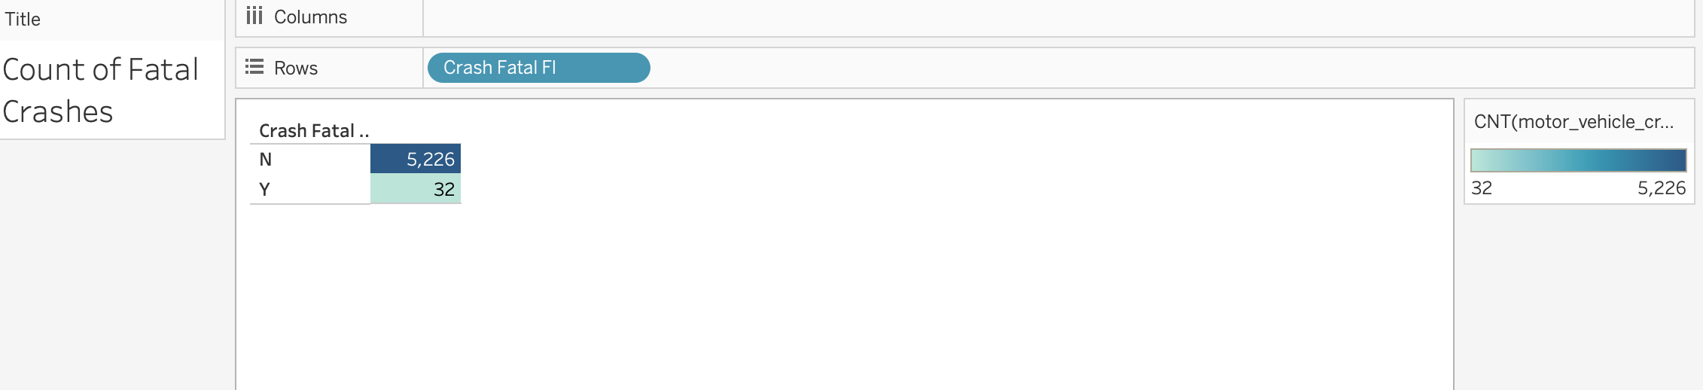
Number of Crashes VS Number of Fatal Crashes:
It is surprising out of 5,258 car crashes, only 32 were fatal.

Slide 3
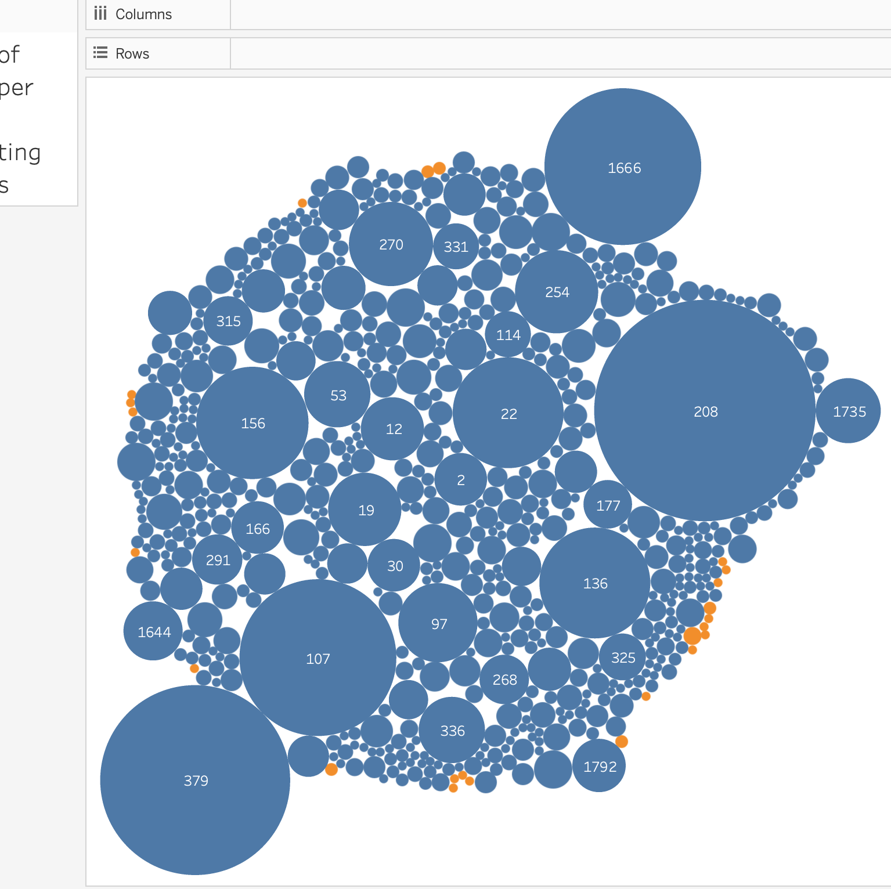
Number of Crashes Per City ID:
Highlighting the fatal crashes in orange, it is interesting to notice the the cities with the most crashes are not the cities who have fatal crashes.

Slide 4
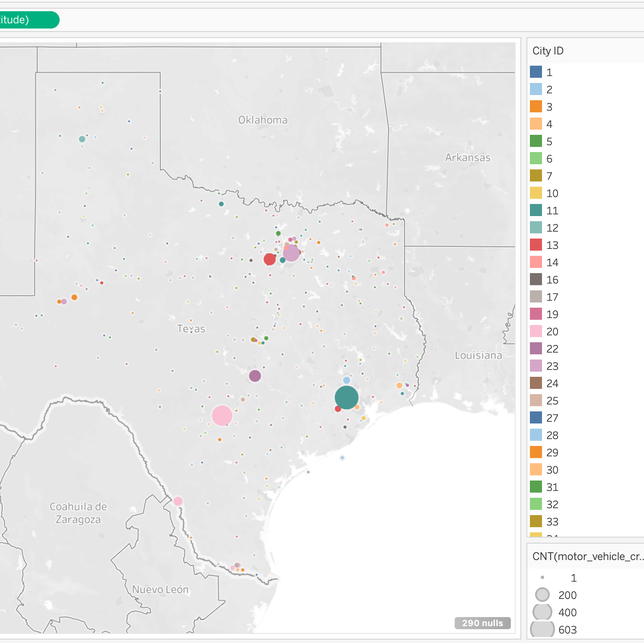
Map of Crashes per City ID:
Considering the map of where the most crashes happen, we see the green area which is Houston, the light pink which is San Antonio, the purple which is Austin, and then the cluster in the northeast which is Dallas and Fort Worth Area, the number crashes correlates with the most populated areas in the state.

Slide 5
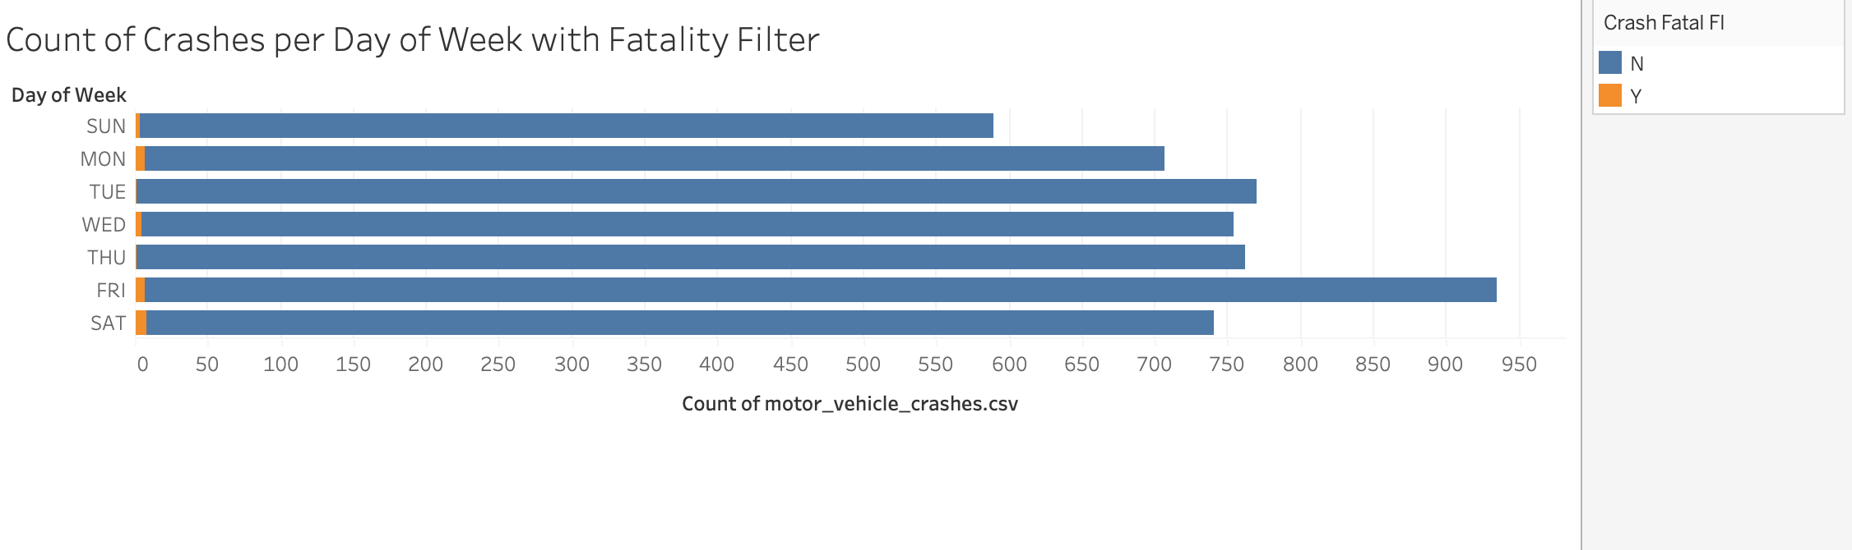
Crashes per Day of the Week:
It makes sense the most crashes are on a Friday since it’s at the end of the week, but there isn’t a striking difference in numbers between the days.

