Slide 1
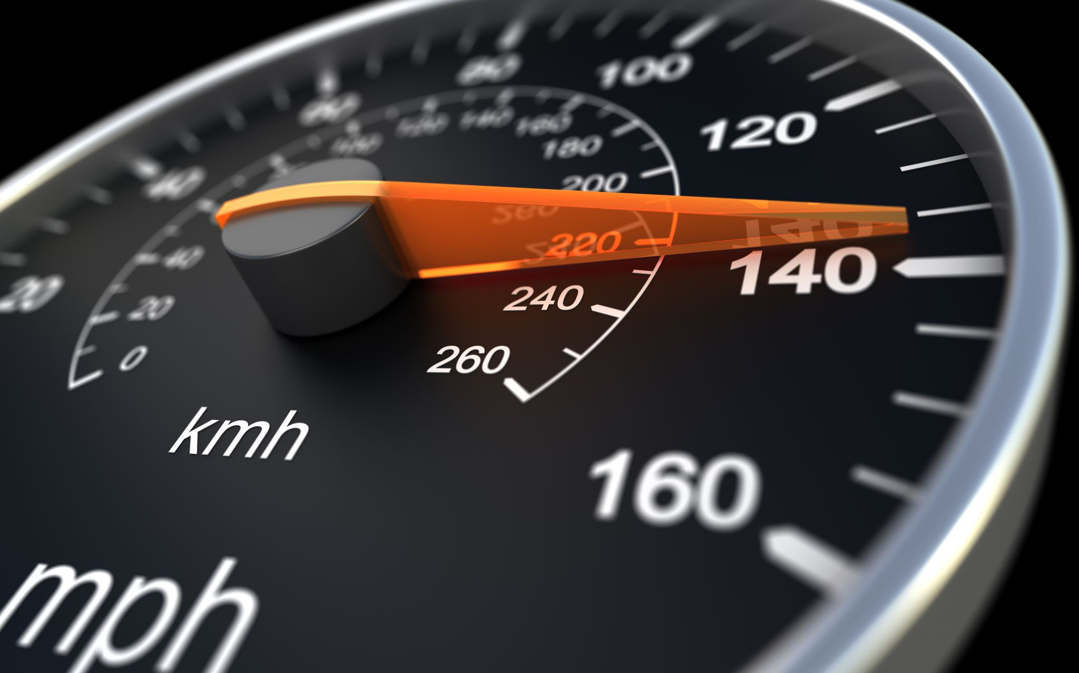
Correlations and Regressions in MotorCars Data
Suzy Jones
DS102L8HandsOn

Slide 2
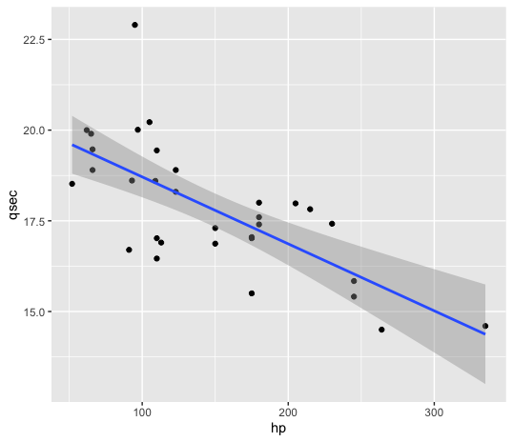
Horsepower VS Quarter-Mile-Time #scatterplot library("ggplot2") ggplot(data=mtcars, aes(x = hp, y = qsec)) + geom_point() + geom_smooth(method='lm', se = TRUE) #Linear Regression: regression <- lm(qsec~hp, mtcars) summary(regression)
There is a negative correlation because the points have a top to bottom trend.
y = -0.018458x + 20.556354
r^2 = .49
*Conclusion: Horsepower explains 49% of the variance in quarter-mile-time and this makes sense that the amount of horsepower a car has would impact its quarter mile time.

Slide 3
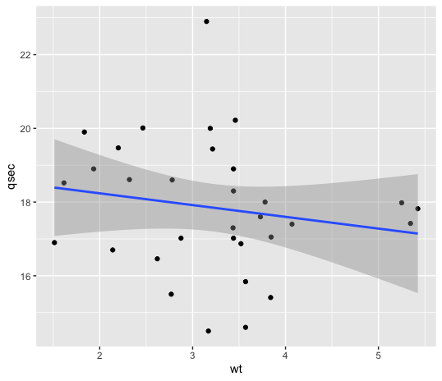
Vehicle Weight VS Quarter-Mile-Time library("ggplot2") ggplot(data=mtcars, aes(x = wt, y = qsec)) + geom_point() + geom_smooth(method='lm', se = TRUE) #linear regression regression2 <- lm(qsec~wt, mtcars) summary(regression2)
There is no correlation or it is uncorrelated because the points have no trend.
y = -0.3191x + 18.8753
r^2 = -0.00179
*Conclusion: Weight does not contribute to the quarter mile time (speed). It is rather inspiring because I do not have a typical runner’s body and have wanted to start running. If a heavy car can go fast… So can I.

