Slide 1

The Reliability and Validity of the Student Survey
DS103
Lesson 5
Reliability and Validity
Hands On
Suzy Jones
This Photo by Unknown Author is licensed under CC BY-NC-ND

Slide 2


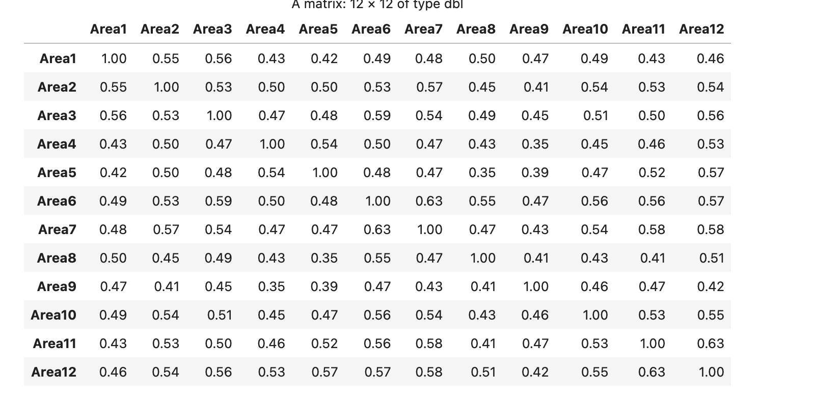
Is the data suitable for factor analysis? YES, Dearest!
If there is too much overlapping between
variables (multicollinearity), it will be very
difficult to sort the data into distinct groups. So
we run a Bartlett’s Test. The p. value is 0, so we are
Good.
We don’t want multicollinearity, but we
want the variables to have some relationship.
So we run a correlation matrix. As long
as the If we look at the table to the left, we want
items to be between .3 and .9. We are good to go.
We have the range we need for some relation.
They are buddies enough.
We also look at the determinant of the correlation matrix which gives us: 0.00218064461136125, which also concludes the
variables are appropriately related because the results are greater than .00001.

Slide 3
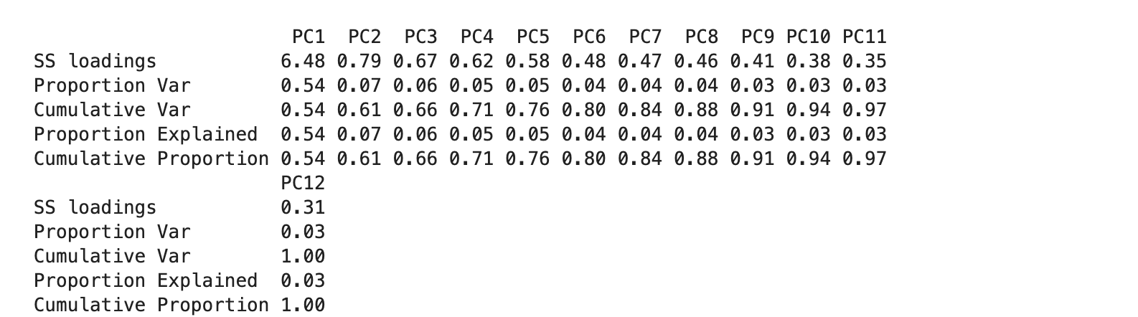

Is there an appropriate number of factors? YES, so the model fits!
Looking at the SS loadings, there is one one factor that is >1.

Slide 4
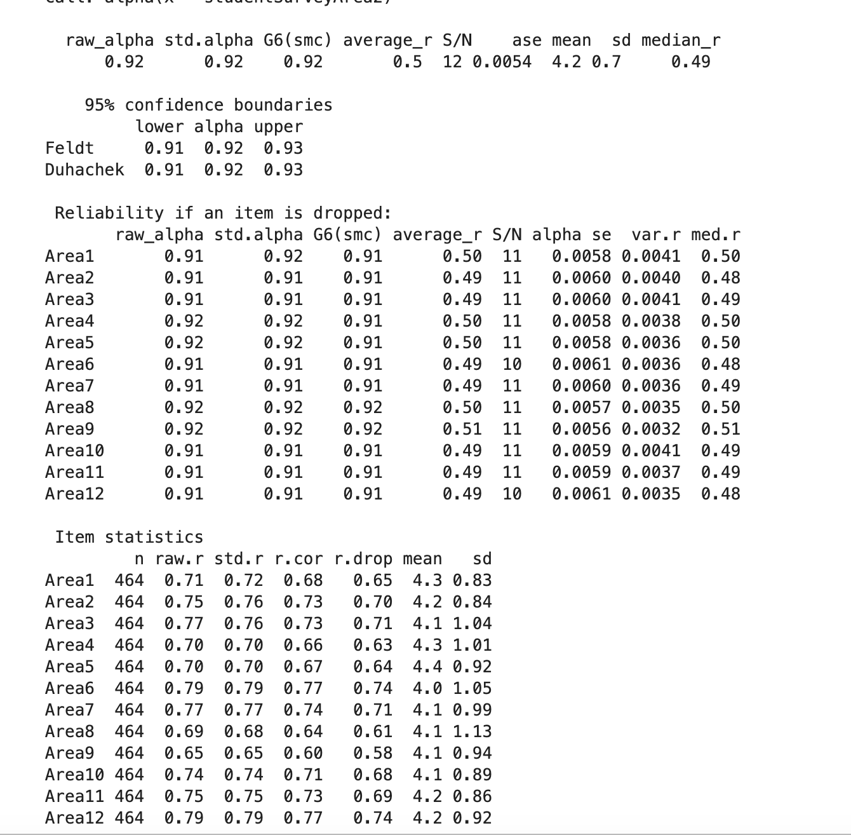

Is the scale reliable through inter-rater and inter-item? Yes, both!
Looking at the table to the right, we ran the Chronbach’s Alpha
to determine the inter-rater and inter-item reliability. The raw
alpha is score is .92 (anything over .8 is good to go).This data has
high inter-rater reliability and predicts precision. Looking at the
r.drop for inter-item reliability, they are all above .3 and
moderately correlated.

Slide 5

Conclusion:
In conclusion, based on the tests conducted, the data’s reliability is valid.

