Slide 1
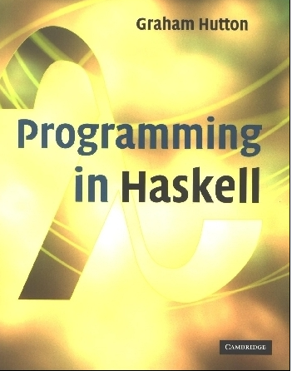
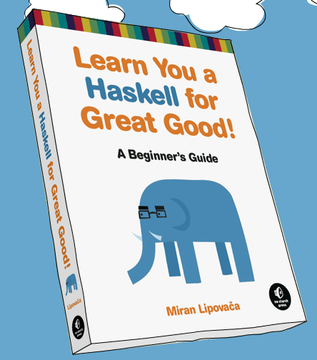
PROGRAMMING IN HASKELL
An Introduction
Based on lecture notes by Graham Hutton

Slide 2
What is a Functional Language?
Opinions differ, and it is difficult to give a precise definition, but generally speaking:
Functional programming is style of programming in which the basic method of computation is the application of functions to arguments;
A functional language is one that supports and encourages the functional style.

Slide 3
Example
Summing the integers 1 to 10 in an imperative language:
total = 0;
for (i = 1; i ≤ 10; ++i)
total = total+i;
The computation method is variable assignment.
2

Slide 4
Example
Summing the integers 1 to 10 in Haskell:
sum [1..10]
The computation method is function application.
3

Slide 5
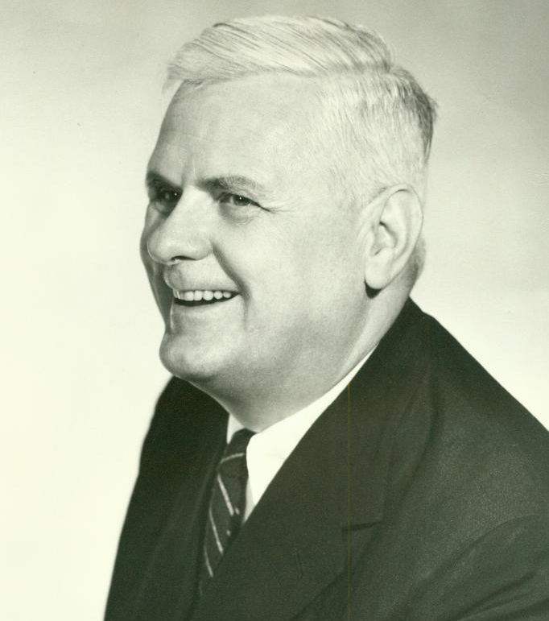

Historical Background
1930s:
Alonzo Church develops the lambda calculus, a simple but powerful theory of functions.
4

Slide 6
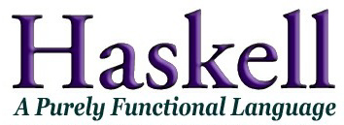
Historical Background
1987:
An international committee of researchers initiates the development of Haskell, a standard lazy functional language.
Partially in response to “Can programming be liberated from the Von Neuman style?”, by John Backus.
(Named in honor of logician Haskell B. Curry.)
5

Slide 7
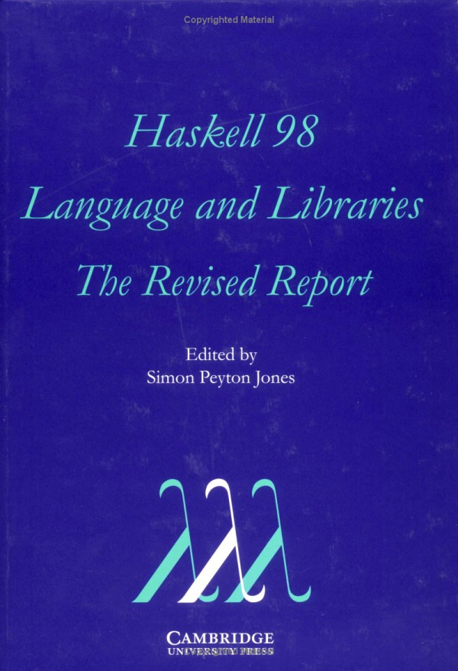
Historical Background
2003:
The committee publishes the Haskell 98 report, defining a stable version of the language.
6

Slide 8
A Taste of Haskell
f [] = []
f (x:xs) = f ys ++ [x] ++ f zs
where
ys = [a | a ← xs, a ≤ x]
zs = [b | b ← xs, b > x]
?
7

Slide 9
Basic Structure
Purely function
Lazy evaluation
Statically typed with strong typing
Uses type inference (like Python)
VERY concise – small and elegant code
Types are KEY (like Java or C – but more)
Features we care about:
On turing
Website with interface (somewhat limited functionality)
Free and easy to download locally

Slide 10
Glasgow Haskell Compiler
GHC is the leading implementation of Haskell, and comprises a compiler and interpreter;
The interactive nature of the interpreter makes it well suited for teaching and prototyping;
GHC is freely available from:
www.haskell.org/platform

Slide 11
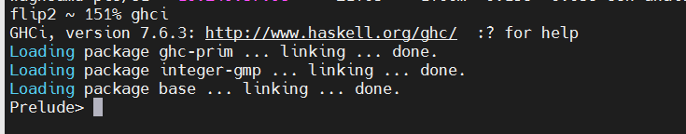
Starting GHC on Flip server
The GHC interpreter can be started from the Unix command prompt by simply typing ghci:

Slide 12
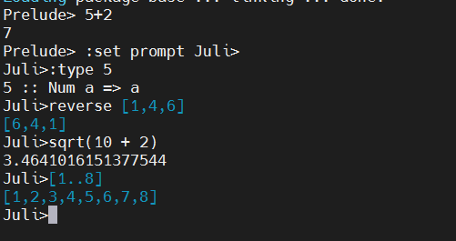
The GHCi prompt > means that the interpreter is ready to evaluate an expression.
For example:

Slide 13
The Standard Prelude: List Madness!
Haskell comes with a large number of standard library functions. In addition to the familiar numeric functions such as + and *, the library also provides many useful functions on lists.
Select the first element of a list:
> head [1,2,3,4,5]
1
Calculate the length of a list:
> length [1,2,3,4,5]
5

Slide 14
Remove the first element from a list:
> tail [1,2,3,4,5]
[2,3,4,5]
Select the nth element of a list:
> [1,2,3,4,5] !! 2
3
Select the first n elements of a list:
> take 3 [1,2,3,4,5]
[1,2,3]

Slide 15
Calculate the product of a list of numbers:
> product [1,2,3,4,5]
120
Append two lists:
> [1,2,3] ++ [4,5]
[1,2,3,4,5]
Reverse a list:
> reverse [1,2,3,4,5]
[5,4,3,2,1]

Slide 16
Function Application
In mathematics, function application is denoted using parentheses, and multiplication is often denoted using juxtaposition or space.
f(a,b) + c d
Apply the function f to a and b, and add the result to the product of c and d.

Slide 17
In Haskell, function application is denoted using space, and multiplication is denoted using *.
f a b + c*d
As previously, but in Haskell syntax.

Slide 18
Moreover, function application is assumed to have higher priority than all other operators.
f a + b
Means (f a) + b, rather than f (a + b).

Slide 19
Examples
Mathematics
Haskell
f(x)
f x
f(x,y)
f x y
f(g(x))
f (g x)
f(x,g(y))
f x (g y)
f(x)g(y)
f x * g y

Slide 20
Types
All computation in Haskell is done via evaluation of expressions to get values. Every value has an associated type, and is a first class object.
Examples:
Integer
Int
Float
Char
Integer->Integer
[a] -> Integer
e :: t
If evaluating an expression e would produce a value of type t, then e has type t, written

Slide 21
All type errors are found at compile time, which makes programs safer and faster by removing the need for type checks at run time.
In GHCi, the :type command calculates the type of an expression, without evaluating it:
> not False
True
> :type not False
not False :: Bool
> :t head
head :: [a] -> a

Slide 22
My First Script
When developing a Haskell script, it is useful to keep two windows open, one running an editor for the script, and the other running GHCi.
Start an editor, type in the following two function definitions, and save the script as test.hs:
myDouble :: Num a => a -> a
myDouble x = x + x
intDouble :: Int -> Int
intDouble x = x + x
Leaving the editor open, in another window start up GHCi with the new script:
% ghci test.hs
% ghci test.hs

Slide 23
Useful GHCi Commands
Command Meaning
:load name load script name
:reload reload current script
:edit name edit script name
:edit edit current script
:type expr show type of expr
:? show all commands
:quit quit GHCi

Slide 24
Leaving GHCi open, return to the editor, add the following two definitions, and resave:
myFactorial n = product [1..n]
myAverage ns = sum ns `div` length ns
Note:
div is enclosed in back quotes, not forward;
x `f` y is just syntactic for f x y.
So this is just saying div (sum ns) (length ns)

Slide 25
GHCi does not automatically detect that the script has been changed, so a reload command must be executed before the new definitions can be used:
> :reload
Reading file "test.hs"
> factorial 10
3628800
> average [1,2,3,4,5]
3

Slide 26
Functions are often done using pattern matching, as well as a declaration of type (more later):
head :: [a] -> a
head (x:xs) = x
Now you try one…

Slide 27
Exercise
Write a program to find the number of elements in a list. Here’s how to start:
myLength :: [a] -> Int
myLength [] =
myLength (x:xs) =
How do you test this to be sure it works?

Slide 28
Naming Requirements
Function and argument names must begin with a lower-case letter. For example:
myFun
fun1
arg_2
x’
By convention, list arguments usually have an s suffix on their name. For example:
xs
ns
nss

Slide 29
The Layout Rule
In a sequence of definitions, each definition must begin in precisely the same column:
a = 10
b = 20
c = 30
a = 10
b = 20
c = 30
a = 10
b = 20
c = 30

Slide 30
The layout rule avoids the need for explicit syntax to indicate the grouping of definitions.
a = b + c
where
b = 1
c = 2
d = a * 2
a = b + c
where
{b = 1;
c = 2}
d = a * 2
means
implicit grouping
explicit grouping

Slide 31
Exercise
Fix the syntax errors in the program below, and test your solution using GHCi.
N = a ’div’ length xs
where
a = 10
xs = [1,2,3,4,5]

Slide 32
What is a Type?
A type is a name for a collection of related values. For example, in Haskell the basic type
Bool
contains the two logical values:
False
True

Slide 33
Type Errors
Applying a function to one or more arguments of the wrong type is called a type error.
> 1 + False
Error
1 is a number and False is a logical value, but + requires two numbers.

Slide 34
Basic Types
Haskell has a number of basic types, including:
Bool
- logical values
Char
- single characters
String
- strings of characters
Int
- fixed-precision integers
Integer
- arbitrary-precision integers
Float
- floating-point numbers

Slide 35
List Types
A list is sequence of values of the same type:
[False,True,False] :: [Bool]
[‘a’,’b’,’c’] :: [Char]
[[‘a’],[‘b’, ‘c’ ]] :: [[Char]]
In general:
[t] is the type of lists with elements of type t.

Slide 36
Tuple Types
A tuple is a sequence of values of different types:
(False,True) :: (Bool,Bool)
(False,’a’,True) :: (Bool,Char,Bool)
In general:
(t1,t2,…,tn) is the type of n-tuples whose ith components have type ti for any i in 1…n.

Slide 37
Function Types
A function is a mapping from values of one type to values of another type:
not :: Bool -> Bool
isDigit :: Char -> Bool
In general:
t1 → t2 is the type of functions that map values of type t1 to values to type t2.

Slide 38
The arrow → is typed at the keyboard as ->.
The argument and result types are unrestricted. For example, functions with multiple arguments or results are possible using lists or tuples:
addXY :: (Int,Int) -> Int
addXY (x,y) = x+y
zeroto :: Int -> [Int]
zeroto n = [0..n]

Slide 39
Curried Functions
Functions with multiple arguments are also possible by returning functions as results:
myAdd :: Int -> Int -> Int
myAdd x y = x+y
map (myAdd 6) [1,2,3,4]
myAdd2 = myAdd 2
myAdd takes one argument at a time

Slide 40
As a consequence, it is then natural for function application to associate to the left.
mult x y z
Means ((mult x) y) z.
Unless tupling is explicitly required, all functions in Haskell are normally defined in curried form.

Slide 41
Polymorphic Functions
A function is called polymorphic (“of many forms”) if its type contains one or more type variables.
length :: [a] → Int
for any type a, length takes a list of values of type a and returns an integer.

Slide 42
Ranges in Haskell
As already discussed, Haskell has extraordinary range capability on lists:
ghci> [1..15]
[1,2,3,4,5,6,7,8,9,10,11,12,13,14,15]
ghci> ['a'..'z']
"abcdefghijklmnopqrstuvwxyz"
ghci> ['K'..'Z']
"KLMNOPQRSTUVWXYZ”
ghci> [2,4..20]
[2,4,6,8,10,12,14,16,18,20]
ghci> [3,6..20]
[3,6,9,12,15,18]

Slide 43
Infinite Lists
A few useful infinite list functions:
ghci> take 10 (cycle [1,2,3])
[1,2,3,1,2,3,1,2,3,1]
ghci> take 12 (cycle "LOL ")
"LOL LOL LOL "
ghci> take 10 (repeat 5)
[5,5,5,5,5,5,5,5,5,5]

Slide 44
List Comprehensions
Very similar to standard set theory list notation:
ghci> [x*2 | x <- [1..10]]
[2,4,6,8,10,12,14,16,18,20]
Can even add predicates to the comprehension:
ghci> [x*2 | x <- [1..10], x*2 >= 12]
[12,14,16,18,20]
ghci> [ x | x <- [50..100], x `mod` 7 == 3]
[52,59,66,73,80,87,94]

Slide 45
Pattern Matching
Functions can often be defined in many different ways using pattern matching. For example
(&&) :: Bool → Bool → Bool
True && True = True
True && False = False
False && True = False
False && False = False
can be defined more compactly by
True && True = True
_ && _ = False
However, the following definition is more efficient, because it avoids evaluating the second argument if the first argument is False:
True && b = b
False && _ = False
Note: The underscore symbol _ is a wildcard pattern that matches any argument value.
Note: The underscore symbol _ is a wildcard pattern that matches any argument value.

Slide 46
Patterns are matched in order. For example, the following definition always returns False:
_ && _ = False
True && True = True

Slide 47
List Patterns
Internally, every non-empty list is constructed by repeated use of an operator (:) called “cons” that adds an element to the start of a list.
[1,2,3,4]
Means 1:(2:(3:(4:[]))).

Slide 48
Functions on lists can be defined using x:xs patterns.
head :: [a] → a
head (x:_) = x
tail :: [a] → [a]
tail (_:xs) = xs
head and tail map any non-empty list to its first and remaining elements.

Slide 49
Type of functions
It’s good practice (and REQUIRED in this class) to also give functions types in your definitions.
removeNonUppercase :: [Char] -> [Char]
removeNonUppercase st =
[ c | c <- st, c `elem` ['A'..'Z']]
addThree :: Int -> Int -> Int -> Int
addThree x y z = x + y + z

Slide 50
Type Classes
In a typeclass, we group types by what behaviors are supported. (These are NOT object oriented classes – closer to Java interfaces.)
Example:
ghci> :t (==)
(==) :: (Eq a) => a -> a -> Bool
Everything before the => is called a type constraint, so the two inputs must be of a type that is a member of the Eq class.

Slide 51
Type Classes
Other useful typeclasses:
Ord is anything that has an ordering.
Show are things that can be presented as strings.
Enum is anything that can be sequentially ordered.
Bounded means has a lower and upper bound.
Num is a numeric typeclass – so things have to “act” like numbers.
Integral and Floating what they seem.

Slide 52
Overloaded Functions
A polymorphic function is called overloaded if its type contains one or more class constraints.
sum :: Num a ⇒ [a] → a
for any numeric type a, sum takes a list of values of type a and returns a value of type a.

Slide 53
Overloaded functions
Constrained type variables can be instantiated to any types that satisfy the constraints:
> sum [1,2,3]
6
> sum [1.1,2.2,3.3]
6.6
> sum [’a’,’b’,’c’]
ERROR
a = Int
a = Float
Char is not a numeric type

Slide 54
Useful functions: map
The function map applies a function across a list:
map :: (a -> b) -> [a] -> [b]
map _ [] = []
map f (x:xs) = f x : map f xs
ghci> map (+3) [1,5,3,1,6]
[4,8,6,4,9]
ghci> map (replicate 3) [3..6]
[[3,3,3],[4,4,4],[5,5,5],[6,6,6]]
ghci> map (map (^2)) [[1,2],[3,4,5,6],[7,8]]
[[1,4],[9,16,25,36],[49,64]]

Slide 55
Useful functions: filter
The function fliter:
filter :: (a -> Bool) -> [a] -> [a]
filter _ [] = []
filter p (x:xs)
| p x = x : filter p xs
| otherwise = filter p xs
ghci> filter (>3) [1,5,3,2,1,6,4,3,2,1]
[5,6,4]
ghci> filter (==3) [1,2,3,4,5]
[3]
ghci> filter even [1..10]
[2,4,6,8,10]

Slide 56
Conditional Expressions
As in most programming languages, functions can be defined using conditional expressions.
abs :: Int → Int
abs n = if n ≥ 0 then n else -n
Note: In Haskell, conditional expressions must always have an else branch, which avoids any possible ambiguity issues.

Slide 57
Guarded Equations
As an alternative to conditionals, functions can also be defined using guarded equations.
abs n
| n ≥ 0 = n
| otherwise = -n
As previously, but using guarded equations.

Slide 58

Exercise
Create a function allX that returns a list of the x’s in a list of ordered pairs (x,y)
allX :: [(Int, Int)] -> [Int]

Slide 59
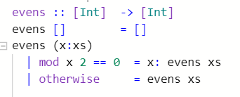
Exercise
Create a function evens that returns a list of even numbers from a list.
evens :: [Int] -> [Int]

Slide 60
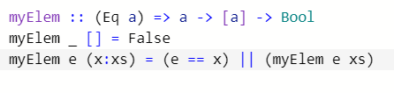
Exercise
Create a function myElem that returns True if an element is in a given list and returns False otherwise
myElem :: (Eq a) -> a -> [a] -> Bool

Slide 61
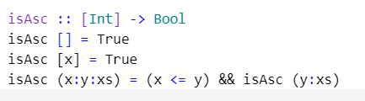
Exercise
Create a function isAsc that returns True if if the list given is in ascending order
isAsc :: [Int] -> Bool

Slide 62

Exercise
Create a list of the factors of an integer
factors :: Int -> [Int]

Slide 63
Lambda Expressions
Functions can be constructed without naming the functions by using lambda expressions.
λx → x+x
the nameless function that takes a number x and returns the result x+x.

Slide 64
Note:
The symbol λ is the Greek letter lambda, and is typed at the keyboard as a backslash \.
In mathematics, nameless functions are usually denoted using the  symbol, as in x  x+x.
In Haskell, the use of the λ symbol for nameless functions comes from the lambda calculus, the theory of functions on which Haskell is based.

Slide 65
Lambda expressions are useful when defining functions that return functions as results.
For example:
const :: a → b → a
const x _ = x
is more naturally defined by
const :: a → (b → a)
const x = \_ → x

Slide 66
Lambda expressions can be used to avoid naming functions that are only referenced once.
For example:
odds n = map f [0..n-1]
where
f x = x*2 + 1
can be simplified to
odds n = map (\x → x*2 + 1) [0..n-1]

Slide 67
Sections
An operator written between its two arguments can be converted into a curried function written before its two arguments by using parentheses.
For example:
> 1+2
3
> (+) 1 2
3

Slide 68
This convention also allows one of the arguments of the operator to be included in the parentheses.
For example:
> (1+) 2
3
> (+2) 1
3
In general, if ⊕ is an operator then functions of the form (⊕), (x⊕) and (⊕y) are called sections.

Slide 69
Why Are Sections Useful?
Useful functions can sometimes be constructed in a simple way using sections. For example:
(1+)
- successor function
(1/)
- reciprocation function
(*2)
- doubling function
(/2)
- halving function

Slide 70
Higher-order Functions
A function is higher-order if it takes a function as ab argument or returns a function as a result.
twice :: (a -> a) -> a -> a
twice f x = f (f (x) )
Twice is higher-order because it takes a function as its first argument.

Slide 71
The Foldr Function
A number of functions on lists can be defined using the following simple pattern of recursion:
f [] = v
f (x:xs) = x ⊕ f xs
f maps the empty list to some value v, and any non-empty list to some function ⊕ applied to its head and f of its tail.

Slide 72
For example:
sum [] = 0
sum (x:xs) = x + sum xs
v = 0
⊕ = +
product [] = 1
product (x:xs) = x * product xs
v = 1
⊕ = *
and [] = True
and (x:xs) = x && and xs
v = True
⊕ = &&

Slide 73
The higher-order library function foldr (fold right) encapsulates this simple pattern of recursion, with the function ⊕ and the value v as arguments.
For example:
sum = foldr (+) 0
product = foldr (*) 1
or = foldr (||) False
and = foldr (&&) True

Slide 74
Foldr itself can be defined using recursion:
foldr :: (a → b → b) → b → [a] → b
foldr f v [] = v
foldr f v (x:xs) = f x (foldr f v xs)
However, it is best to think of foldr non-recursively, as simultaneously replacing each (:) in a list by a given function, and [] by a given value.

Slide 75
For example:
sum [1,2,3]
=
foldr (+) 0 [1,2,3]
=
foldr (+) 0 (1:(2:(3:[])))
=
1+(2+(3+0))
=
6
Replace each (:)
by (+) and [] by 0.

Slide 76
For example:
product [1,2,3]
=
foldr (*) 1 [1,2,3]
=
foldr (*) 1 (1:(2:(3:[])))
=
1*(2*(3*1))
=
6
Replace each (:)
by (*) and [] by 1.

Slide 77
Now recall the reverse function:
reverse [] = []
reverse (x:xs) = reverse xs ++ [x]
For example:
Replace each (:) by λx xs → xs ++ [x] and [] by [].
reverse [1,2,3]
=
reverse (1:(2:(3:[])))
=
(([] ++ [3]) ++ [2]) ++ [1]
=
[3,2,1]

Slide 78
The library function all decides if every element of a list satisfies a given predicate.
all :: (a → Bool) → [a] → Bool
all p xs = and [p x | x ← xs]
For example:
> all even [2,4,6,8,10]
True

Slide 79
Type Declarations
In Haskell, a new name for an existing type can be defined using a type declaration.
type String = [Char]
String is a synonym for the type [Char].

Slide 80
Type declarations can be used to make other types easier to read. For example, given
type Point = (Int,Int)
we can define:
origin :: Point
origin = (0,0)
left :: Point → Point
left (x,y) = (x-1,y)

Slide 81
Like function definitions, type declarations can also have parameters. For example, given
type Pair a = (a,a)
we can define:
mult :: Pair Int → Int
mult (m,n) = m*n
copy :: a → Pair a
copy x = (x,x)

Slide 82
Data Declarations
A completely new type can be defined by specifying its values using a data declaration.
data Pet = Cat | Dog
Pet is a new type, with two new values Cat and Dog.
The two values Cat and Dog are called the constructors for the type Pet.
Type and constructor names must begin with an upper-case letter.
Data declarations are similar to context free grammars. The former specifies the values of a type, the latter the sentences of a language.

Slide 83
Values of new types can be used in the same ways as those of built in types. For example, given
data Answer = Yes | No | Unknown
we can define:
answers :: [Answer]
answers = [Yes,No,Unknown]
flip :: Answer → Answer
flip Yes = No
flip No = Yes
flip Unknown = Unknown

Slide 84
The constructors in a data declaration can also have parameters. For example, given
data Shape = Circle Float | Rect Float Float
we can define:
square :: Float → Shape
square n = Rect n n
area :: Shape → Float
area (Circle r) = pi * r^2
area (Rect x y) = x * y

Slide 85
Note:
Shape has values of the form Circle r where r is a float, and Rect x y where x and y are floats.
Circle and Rect can be viewed as functions that construct values of type Shape:
Circle :: Float → Shape
Rect :: Float → Float → Shape

Slide 86
Not surprisingly, data declarations themselves can also have parameters. For example, given
data Maybe a = Nothing | Just a
we can define:
safediv :: Int → Int → Maybe Int
safediv _ 0 = Nothing
safediv m n = Just (m `div` n)

Slide 87
Binary Trees
In computing, it is often useful to store data in a two-way branching structure or binary tree.
data Tree = Node Int Tree Tree | Leaf
deriving Show
5
3
7
1
4
6
9
Node 5 (Node 3(Node 1 Leaf Leaf)(Node 4 Leaf Leaf))
(Node 7 (Node 6 Leaf Leaf) (Node 9 Leaf Leaf))

Slide 88
We can now define a function for a traversal of a binary tree:
inorder :: Tree -> [Int]
inorder Leaf = []
inorder (Node x l r) = inorder l ++ [x] ++ inorder r

Slide 89
Search trees have the important property that when trying to find a value in a tree we can always decide which of the two sub-trees it may occur in:
occurs m (Leaf) = False
occurs m (Node n l r)
| m==n = True
| m<n = occurs m l
| m>n = occurs m r
This definition is efficient, because it only traverses one path down the tree.

Slide 90
Modules
So far, we’ve been using built-in functions provided in the Haskell prelude. This is a subset of a larger library that is provided with any installation of Haskell.
Examples of other modules:
- lists
- concurrent programming
- complex numbers
- char
- sets
- …
89

Slide 91
Example: Data.List
To load a module, we need to import it:
import Data.List
All the functions in this module are immediately available:
numUniques :: (Eq a) => [a] -> Int
numUniques = length . nub
This is a function in Data.List that removes duplicates from a list.
function
concatenation
90

Slide 92
File I/O
So far, we’ve worked mainly at the prompt, and done very little true input or output. This is logical in a functional language, since nothing has side effects!
However, this is a problem with I/O, since the whole point is to take input (and hence change some value) and then output something (which requires changing the state of the screen or other I/O device.
Luckily, Haskell offers work-arounds that separate the more imperative I/O.
91

Slide 93
A simple example: save the following file as helloword.hs
main = putStrLn "hello, world"
Now we actually compile a program:
$ ghc --make helloworld
[1 of 1] Compiling Main
( helloworld.hs, helloworld.o )
Linking helloworld ...
$ ./helloworld
hello, world
92

Slide 94
What are these functions?
ghci> :t putStrLn
putStrLn :: String -> IO ()
ghci> :t putStrLn "hello, world"
putStrLn "hello, world" :: IO ()
So putStrLn takes a string and returns an I/O action (which has a result type of (), the empty tuple).
In Haskell, an I/O action is one with a side effect - usually either reading or printing. Usually some kind of a return value, where () is a dummy value for no return.
93

Slide 95
More on getLine:
ghci> :t getLine
getLine :: IO String
This is the first I/O we’ve seen that doesn’t have an empty tuple type - it has a String.
Once the string is returned, we use the <- to bind the result to the specified identifier.
Notice this is the first non-functional action we’ve seen, since this function will NOT have the same value every time it is run! This is called “impure” code, and the value name is “tainted”.
94

