Slide 1
CS 381-001 Programming Language Fundamentals
4 credits
OSU catalog course description including pre-requisites/co-requistes: An introduction to the concepts found in a variety of programming languages. Programming languages as tools for problem solving. A brief introduction to languages from a number of different paradigms. Prerequisites: CS 261 and (MTH 231 or CS225)

Slide 2
CS 381
Instructor: Julianne Coffman
Office Hours: M&W 12:30-2:00pm in KEC 3109
E-mail: coffmaju@oregonstate.edu
Email should be a secondary with the primary contact being Canvas messaging.
Meetings: M&W 10:00 – 11:50am in Linc 210 (1/9 to 3/17)
Textbooks: Concepts of Programming Languages by Robert W. Sebesta, 12th Edition.
CS 381 Class Notes by Dr. Martin Erwig
TAs : Information on Canvas

Slide 3
Learning Objectives: On completion of the course, students should be able to perform the following tasks.
Create functional programs using algebraic data types and recursive functions.
Produce and explain the type and result of an expression in the context of functional programming.
Produce an abstract syntax for a language given its concrete syntax.
Create a denotational semantics for a language given its abstract syntax and an informal specification of its behavior.
Produce and explain the behavior of a program under static vs. dynamic typing, and discuss the benefits and drawbacks of each approach.
Produce and explain a program’s output under static vs. dynamic scoping of names.
Produce and explain a program’s output under different parameter passing schemes, such as call-by-value vs. call-by-name vs. call-by-need.
Create logic programs and express queries using predicates.

Slide 4
Grade Evaluation: Your course grade will be based on the following:
Homework 50%
Quizzes 30%
Final Exam 20%
TOTAL ------- 100%

Slide 5
Week | Topics | Readings
1 | Intro, Haskell | LN: Unit 1- Introduction CPL: Ch 1- Preliminaries CPL: Ch 2 - Evolution of Major Languages & Paradigms
1&2 | Haskell | LN: Unit 2 – Haskell Haskell Tutorials
3 | Syntax | CPL: Ch 3 – Sections 1-3 Describing Syntax LN: Unit 3 – Syntax
4&5 | Semantics | LN: Unit 4 – Semantics
6 | Types | LN: Unit 5 – Types CPL: Ch 6 – Data Types
7 | Scope | LN: Unit 6 – Scope CPL: Ch 5 – Names, Binding & Scope CPL: Ch 7 – Expressions and Statements
8 | Parameter Passing | LN: Unit 7 – Parameter Passing CPL: Ch 9 – Subprograms
9&10 | Prolog | LN: Unit 8 – Prolog CPL: Ch 16 – Logical Programming Languages
LN: Lecture Notes for Programming Language Fundamentals by Dr Martin Erwin
CPL: Concepts of Programming Languages by Robert Sebasta

Slide 7
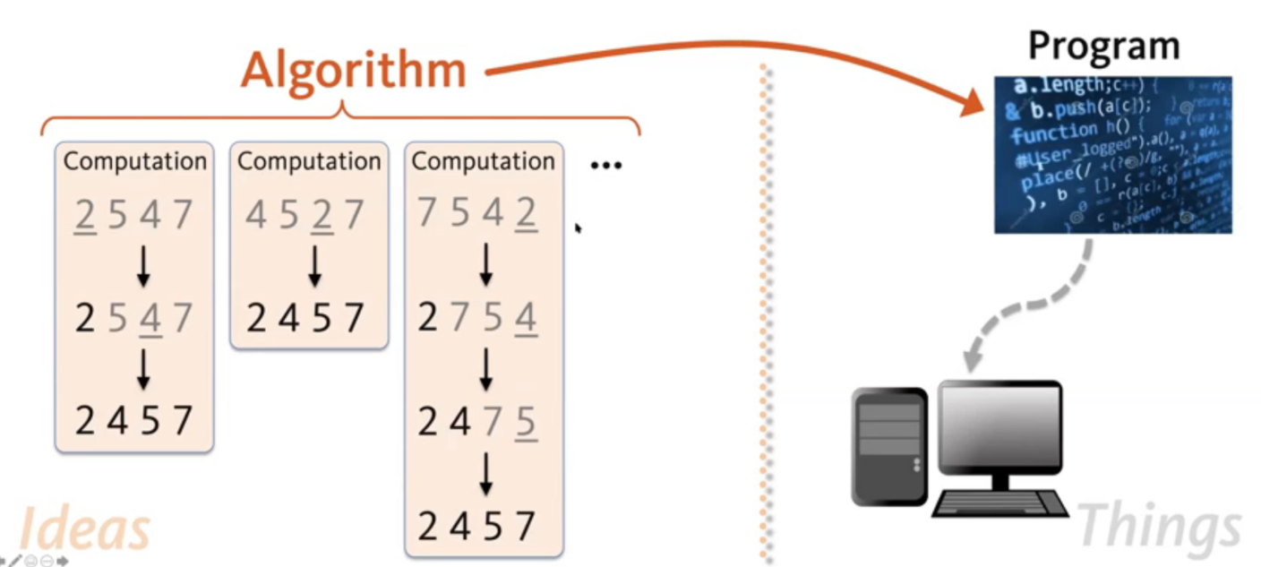
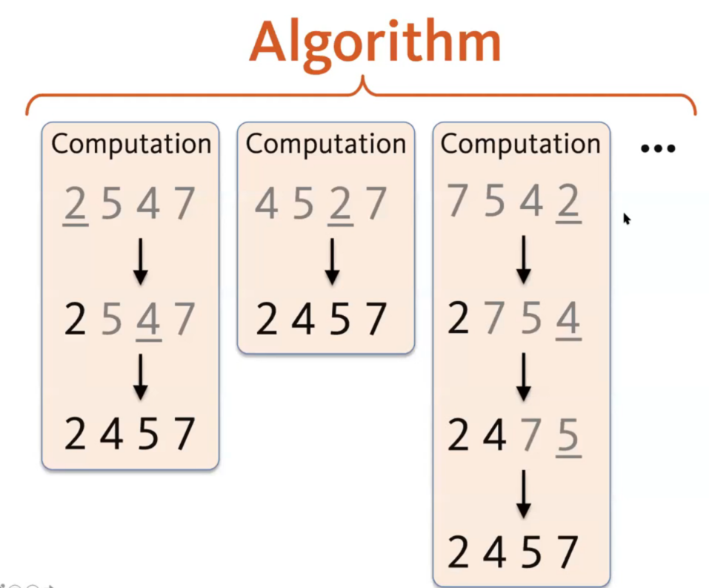
What is a Programming Language?
What is Programming?

Slide 8
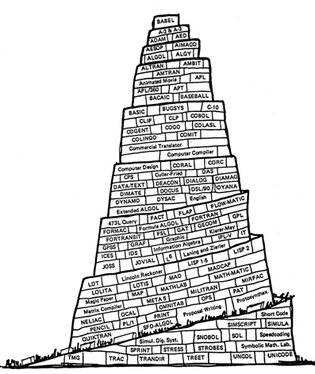
Languages in CS
Programming Languages
Java, C, Python, Haskell, Prolog, …
Domain-Specific Languages
SQL, HTML, R, LaTex, Excel, …
Metalanguages
BNF (grammars), Rule Systems, ..
Formal Models
Automata, Logic(s), …
Cover of the Communications of
The ACM 1961

Slide 9
Science vs. Engineering
Science
Newton’s Laws
Maxwell’s Equations
Principles of Life
Computational Limits
Biology
Physics
Computer Science
Programming Lang
Fundamentals
Mechanical
Engineering
Agriculture
Medicine
Civil
Engineering
Software Engineering
Programming
Applied Knowledge

Slide 10
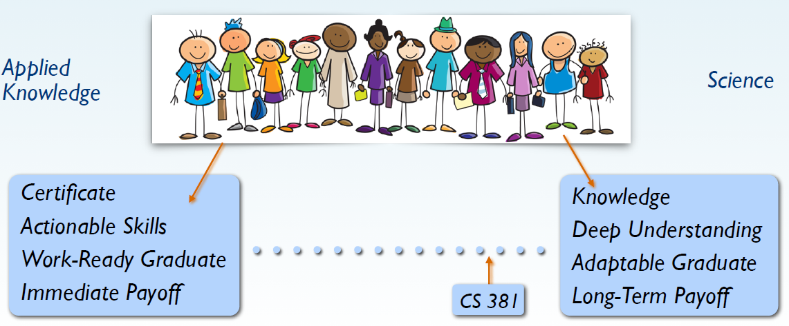
Programming vs Computer Science

Slide 11
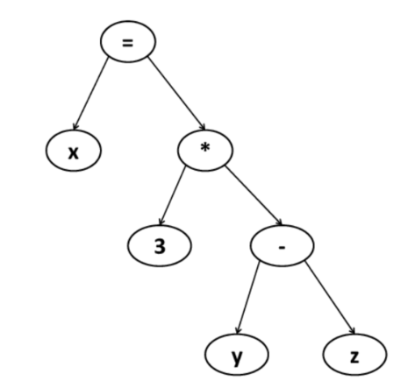
What is CS 381 About?
What exactly is a programming language?
Recursion?
Functional Programming
int x;
int f(int z) {x:= f(y)…};
{ int x;
f(3)
}
Value or Address?
When to evaluate?
Parameter Passing
Semantics
Based on what?
Abstract Syntax
AST
x:= f(y) * g(z-1)
Which x?
Scoping
“Determine” value of RHS and “assign it” to x
How to express computation?
Programming Paradigms

Slide 12
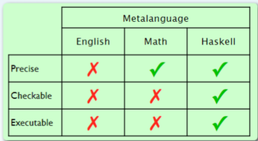
The Role of Haskell in CS 381
Example of a non-imperative programming paradigm
Tool for describing language concepts: syntax, semantics, scope, typing
Executable PL Theory

Slide 13
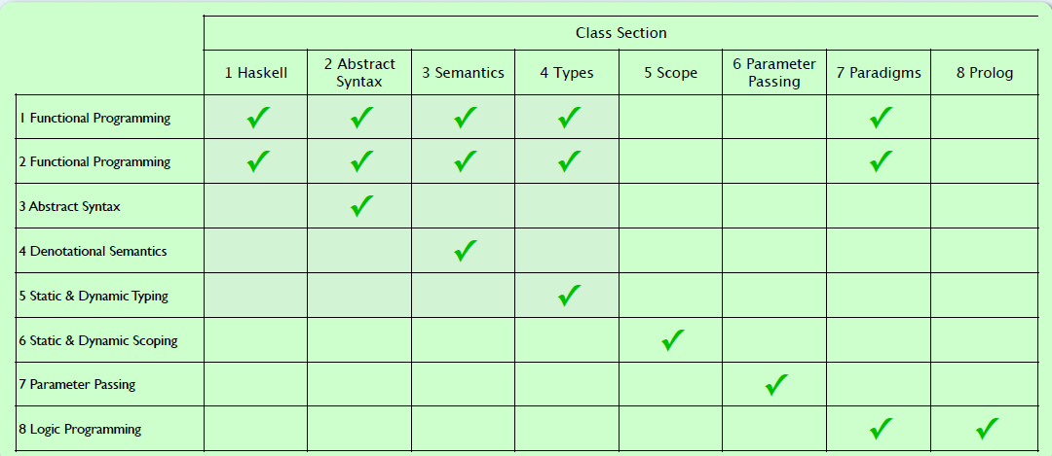
Learning Objectives

Slide 14
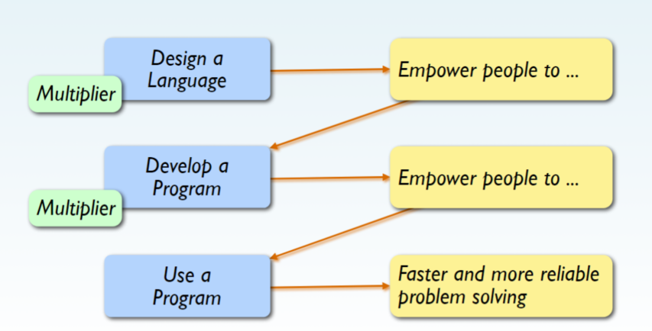
Impacts of Languages & Programs

Slide 15
Practical Benefits of Studying Programming Languages
Increased ability to express ideas
Improved background for choosing appropriate languages
Increased ability to learn new languages
Better understanding of significance of implementation
Better use of languages that are already known
Become more productive

Slide 16
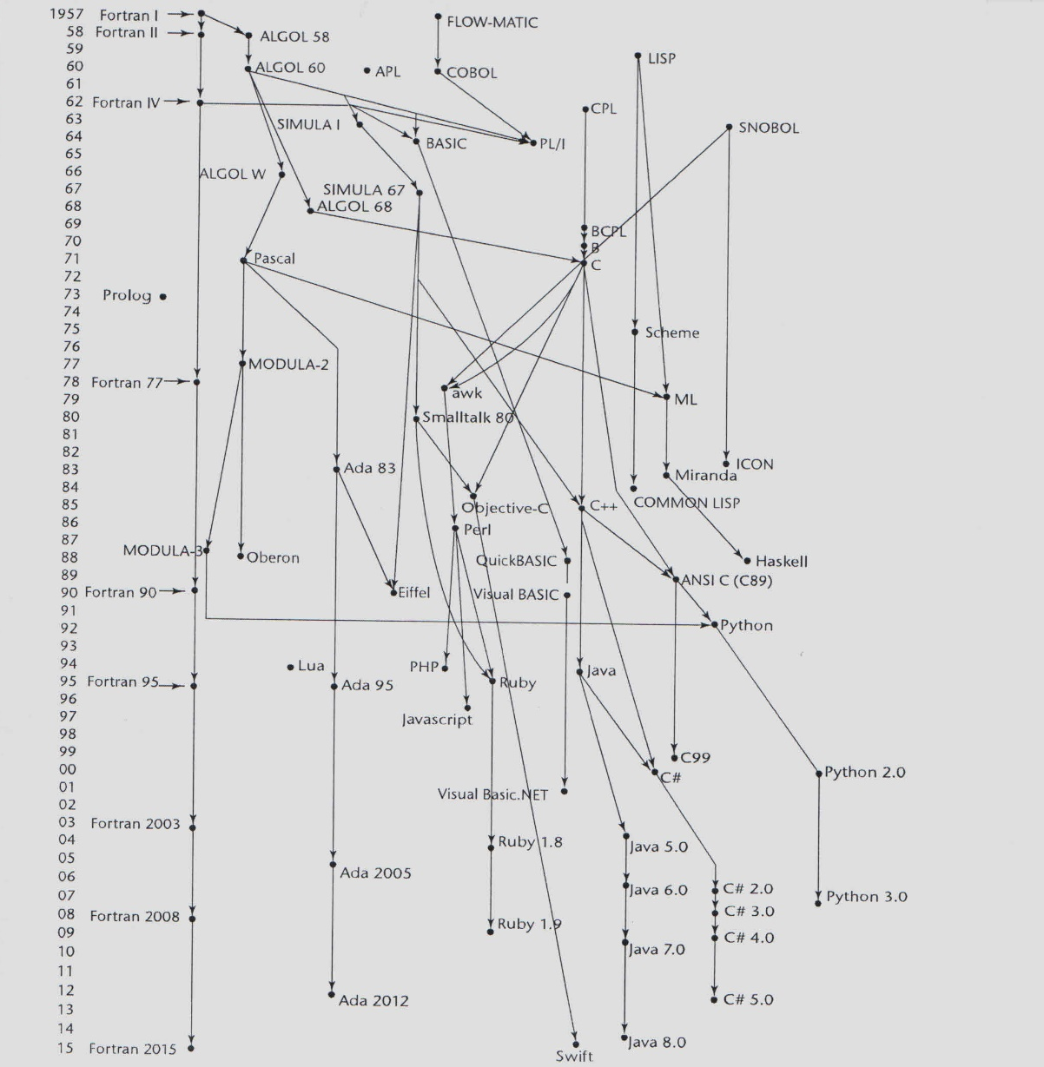
Genealogy of Common Languages

Slide 17
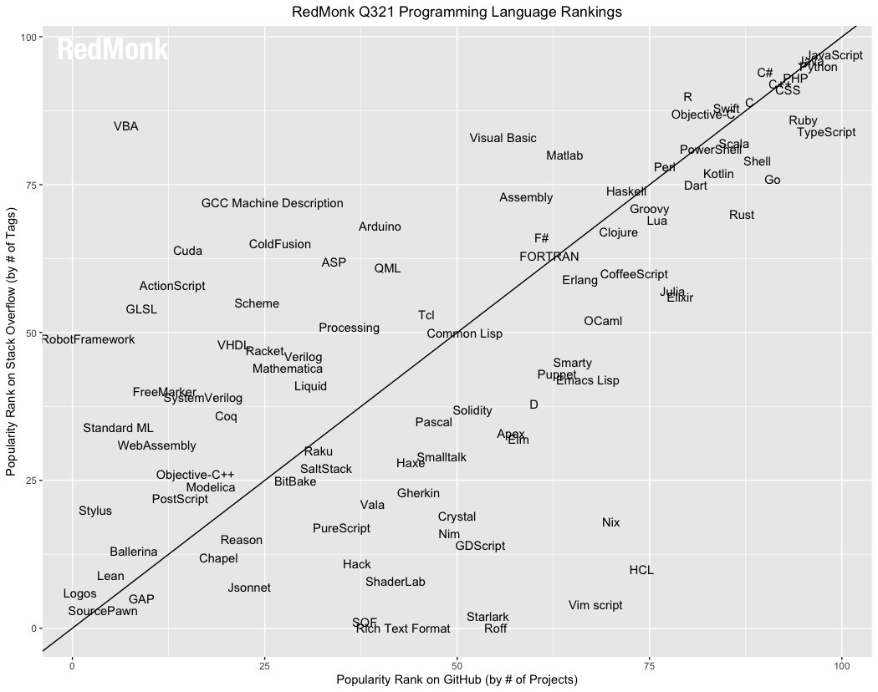
Popularity
RedMonk has a language ranking scheme that combines pull requests on GitHub and questions on StackOverflow. June 2021.

Slide 18
Programming Domains
Scientific applications
Large numbers of floating point computations; use of arrays
Fortran
Business applications
Produce reports, use decimal numbers and characters
COBOL
Artificial intelligence
Symbols rather than numbers manipulated; use of linked lists
LISP
Systems programming
Need efficiency because of continuous use
C
Web Software
Eclectic collection of languages: markup (e.g., HTML), scripting (e.g., PHP), general-purpose (e.g., Java)

Slide 19
Language Evaluation Criteria
Readability: the ease with which programs can be read and understood
Writability: the ease with which a language can be used to create programs
Reliability: conformance to specifications (i.e., performs to its specifications)

Slide 20
Evaluation Criteria: Readability
Overall simplicity
A manageable set of features and constructs
Minimal feature multiplicity
Minimal operator overloading
Orthogonality
A relatively small set of primitive constructs can be combined in a relatively small number of ways
Every possible combination is legal
Data types
Adequate predefined data types
Syntax considerations
Identifier forms: flexible composition
Special words and methods of forming compound statements
Form and meaning: self-descriptive constructs, meaningful keywords

Slide 21
Evaluation Criteria: Writability
Simplicity and orthogonality
Few constructs, a small number of primitives, a small set of rules for combining them
Support for abstraction
The ability to define and use complex structures or operations in ways that allow details to be ignored
Expressivity
A set of relatively convenient ways of specifying operations
Strength and number of operators and predefined functions

Slide 22
Evaluation Criteria: Reliability
Type checking
Testing for type errors
Exception handling
Intercept run-time errors and take corrective measures
Aliasing
Presence of two or more distinct referencing methods for the same memory location
Readability and writability
A language that does not support “natural” ways of expressing an algorithm will require the use of “unnatural” approaches, and hence reduced reliability

Slide 23
Evaluation Criteria: Cost
Training programmers to use the language
Writing programs (closeness to particular applications)
Executing programs
Reliability: poor reliability leads to high costs
Maintaining programs

Slide 24
Evaluation Criteria: Others
Portability
The ease with which programs can be moved from one implementation to another
Generality
The applicability to a wide range of applications
Well-definedness
The completeness and precision of the language’s official definition

Slide 25
Influences on Language Design
Computer Architecture
Languages are developed around the prevalent computer architecture, known as the von Neumann architecture
Program Design Methodologies
New software development methodologies (e.g., object-oriented software development) led to new programming paradigms and by extension, new programming languages

Slide 26
Computer Architecture Influence
Well-known computer architecture: Von Neumann
Imperative languages, most dominant, because of von Neumann computers
Data and programs stored in memory
Memory is separate from CPU
Instructions and data are piped from memory to CPU
Basis for imperative languages
Variables model memory cells
Assignment statements model piping
Iteration is efficient

Slide 27
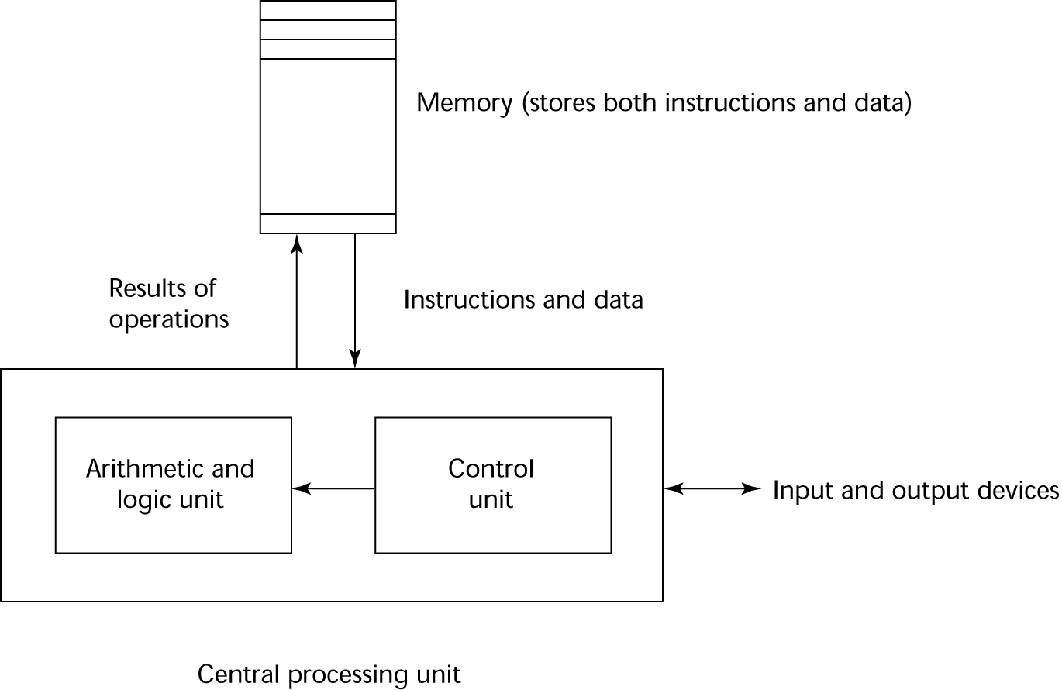
The von Neumann Architecture

Slide 28
The von Neumann Architecture
Fetch-execute-cycle (on a von Neumann architecture computer)
initialize the program counter
repeat forever
fetch the instruction pointed by the counter
increment the counter
decode the instruction
execute the instruction
end repeat

Slide 29
Language Paradigms
Imperative
Central features are variables, assignment statements, and iteration
Include languages that support object-oriented programming
Include scripting languages
Include the visual languages
Examples: C, Java, Perl, JavaScript, Visual BASIC .NET, C++
Functional
Main means of making computations is by applying functions to given parameters
Examples: Haskell, LISP, Scheme, ML, F#
Logic
Rule-based (rules are specified in no particular order)
Example: Prolog
Markup/programming hybrid
Markup languages extended to support some programming
Examples: JSTL, XSLT

Slide 30
Language Design Trade-Offs
Reliability vs. cost of execution
Example: Java demands all references to array elements be checked for proper indexing, which leads to increased execution costs
Readability vs. writability
Example: APL provides many powerful operators (and a large number of new symbols), allowing complex computations to be written in a compact program but at the cost of poor readability
Writability (flexibility) vs. reliability
Example: C++ pointers are powerful and very flexible but are unreliable

Slide 31
Implementation Methods
Compilation
Programs are translated into machine language; includes JIT systems
Use: Large commercial applications
Pure Interpretation
Programs are interpreted by another program known as an interpreter
Use: Small programs or when efficiency is not an issue
Hybrid Implementation Systems
A compromise between compilers and pure interpreters
Use: Small and medium systems when efficiency is not the first concern

Slide 32
Compilation
Translate high-level program (source language) into machine code (machine language)
Slow translation, fast execution
Compilation process has several phases:
lexical analysis: converts characters in the source program into lexical units
syntax analysis: transforms lexical units into parse trees which represent the syntactic structure of program
Semantics analysis: generate intermediate code
code generation: machine code is generated

Slide 33
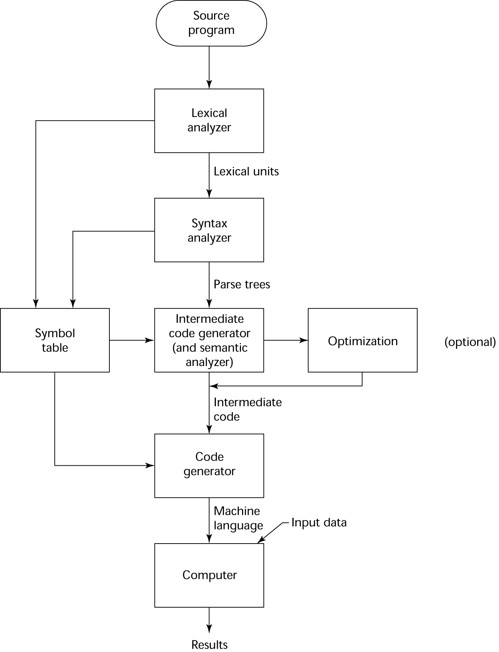
The Compilation Process (CS 480)

Slide 34
Additional Compilation Terminologies
Load module (executable image): the user and system code together
Linking and loading: the process of collecting system program units and linking them to a user program

Slide 35
Von Neumann Bottleneck
Connection speed between a computer’s memory and its processor determines the speed of a computer
Program instructions often can be executed much faster than the speed of the connection; the connection speed thus results in a bottleneck
Known as the von Neumann bottleneck; it is the primary limiting factor in the speed of computers

Slide 36
Pure Interpretation
No translation
Easier implementation of programs (run-time errors can easily and immediately be displayed)
Slower execution (10 to 100 times slower than compiled programs)
Often requires more space
Now rare for traditional high-level languages
Significant comeback with some Web scripting languages (e.g., JavaScript, PHP)

Slide 37
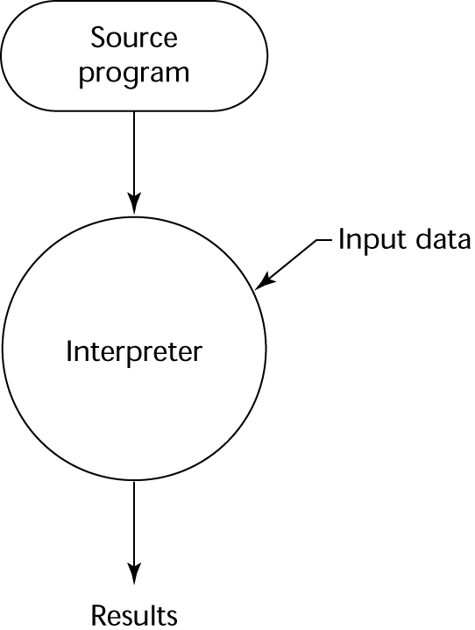
Pure Interpretation Process

Slide 38
Hybrid Implementation Systems
A compromise between compilers and pure interpreters
A high-level language program is translated to an intermediate language that allows easy interpretation
Faster than pure interpretation
Examples
Perl programs are partially compiled to detect errors before interpretation
Initial implementations of Java were hybrid; the intermediate form, byte code, provides portability to any machine that has a byte code interpreter and a run-time system (together, these are called Java Virtual Machine)

Slide 39
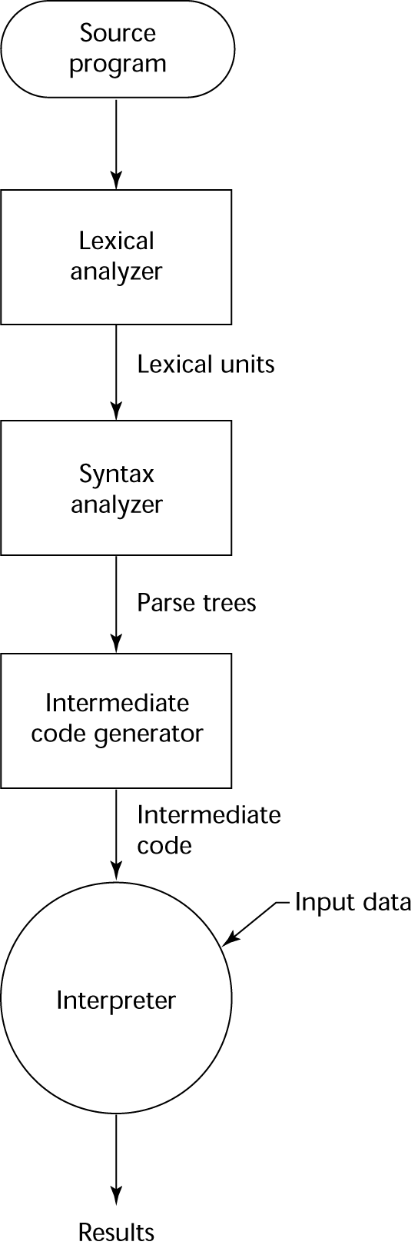
Hybrid Implementation Process

Slide 40
Languages

Slide 41
IBM 704 and Fortran
Fortran 0: 1954 - not implemented
Fortran I:1957
Designed for the new IBM 704, which had index registers and floating point hardware
- This led to the idea of compiled programming languages, because there was no place to hide the cost of interpretation (no floating-point software)
Environment of development
Computers were small and unreliable
Applications were scientific
No programming methodology or tools
Machine efficiency was the most important concern

Slide 42
Fortran I Overview
First implemented version of Fortran
Names could have up to six characters
Post-test counting loop (DO)
Formatted I/O
User-defined subprograms
Three-way selection statement (arithmetic IF)
No data typing statements

Slide 43
Fortran 77
Became the new standard in 1978
Character string handling
Logical loop control statement
IF-THEN-ELSE statement

Slide 44
Fortran 90
Most significant changes from Fortran 77
Modules
Dynamic arrays
Pointers
Recursion
CASE statement
Parameter type checking

Slide 45
Latest versions of Fortran
Fortran 95 – relatively minor additions, plus some deletions
Fortran 2003 – support for OOP, procedure pointers, interoperability with C
Fortran 2008 – blocks for local scopes, co-arrays, Do Concurrent

Slide 46
Fortran Evaluation
Highly optimizing compilers (all versions before 90)
Types and storage of all variables are fixed before run time
Dramatically changed forever the way computers are used

Slide 47
Functional Programming: Lisp
LISt Processing language
Designed at MIT by McCarthy
AI research needed a language to
Process data in lists (rather than arrays)
Symbolic computation (rather than numeric)
Only two data types: atoms and lists
Syntax is based on lambda calculus

Slide 48
Lisp Evaluation
Pioneered functional programming
No need for variables or assignment
Control via recursion and conditional expressions
Still the dominant language for AI
Common Lisp and Scheme are contemporary dialects of Lisp
ML, Haskell, and F# are also functional programming languages, but use very different syntax

Slide 49
Scheme
Developed at MIT in mid 1970s
Small
Extensive use of static scoping
Functions as first-class entities
Simple syntax (and small size) make it ideal for educational applications

Slide 50
ALGOL 60 Overview
Modified ALGOL 58 at 6-day meeting in Paris
New features
Block structure (local scope)
Two parameter passing methods
Subprogram recursion
Stack-dynamic arrays
Still no I/O and no string handling

Slide 51
Computerizing Business Records: COBOL
Environment of development
UNIVAC was beginning to use FLOW-MATIC
USAF was beginning to use AIMACO
IBM was developing COMTRAN

Slide 52
COBOL Historical Background
Based on FLOW-MATIC
FLOW-MATIC features
Names up to 12 characters, with embedded hyphens
English names for arithmetic operators (no arithmetic expressions)
Data and code were completely separate
The first word in every statement was a verb

Slide 53
COBOL Design Process
First Design Meeting (Pentagon) - May 1959
Design goals
Must look like simple English
Must be easy to use, even if that means it will be less powerful
Must broaden the base of computer users
Must not be biased by current compiler problems
Design committee members were all from computer manufacturers and DoD branches
Design Problems: arithmetic expressions? subscripts? Fights among manufacturers

Slide 54
COBOL Evaluation
Contributions
First macro facility in a high-level language
Hierarchical data structures (records)
Nested selection statements
Long names (up to 30 characters), with hyphens
Separate data division

Slide 55
COBOL: DoD Influence
First language required by DoD
would have failed without DoD
Still the most widely used business applications language

Slide 56
SNOBOL
Designed as a string manipulation language at Bell Labs by Farber, Griswold, and Polensky in 1964
Powerful operators for string pattern matching
Slower than alternative languages (and thus no longer used for writing editors)
Still used for certain text processing tasks

Slide 57
The Beginning of Data Abstraction: SIMULA 67
Designed primarily for system simulation in Norway by Nygaard and Dahl
Based on ALGOL 60 and SIMULA I
Primary Contributions
Coroutines - a kind of subprogram
Classes, objects, and inheritance

Slide 58
Orthogonal Design: ALGOL 68
From the continued development of ALGOL 60 but not a superset of that language
Source of several new ideas (even though the language itself never achieved widespread use)
Design is based on the concept of orthogonality
A few basic concepts, plus a few combining mechanisms

Slide 59
ALGOL 68 Evaluation
Contributions
User-defined data structures
Reference types
Dynamic arrays (called flex arrays)
Comments
Less usage than ALGOL 60
Had strong influence on subsequent languages, especially Pascal, C, and Ada

Slide 60
Pascal - 1971
Developed by Wirth (a former member of the ALGOL 68 committee)
Designed for teaching structured programming
Small, simple, nothing really new
Largest impact was on teaching programming
From mid-1970s until the late 1990s, it was the most widely used language for teaching programming

Slide 61
C - 1972
Designed for systems programming (at Bell Labs by Dennis Richie)
Evolved primarily from BCLP and B, but also ALGOL 68
Powerful set of operators, but poor type checking
Initially spread through UNIX
Though designed as a systems language, it has been used in many application areas

Slide 62
Programming Based on Logic: Prolog
Developed, by Comerauer and Roussel (University of Aix-Marseille), with help from Kowalski ( University of Edinburgh)
Based on formal logic
Non-procedural
Can be summarized as being an intelligent database system that uses an inferencing process to infer the truth of given queries
Comparatively inefficient
Few application areas

Slide 63
History’s Largest Design Effort: Ada
Huge design effort, involving hundreds of people, much money, and about eight years
Sequence of requirements (1975-1978)
(Strawman, Woodman, Tinman, Ironman, Steelman)
Named Ada after Augusta Ada Byron, the first programmer

Slide 64
Ada Evaluation
Contributions
Packages - support for data abstraction
Exception handling - elaborate
Generic program units
Concurrency - through the tasking model
Comments
Competitive design
Included all that was then known about software engineering and language design
First compilers were very difficult; the first really usable compiler came nearly five years after the language design was completed

Slide 65
Ada 95
Ada 95 (began in 1988)
Support for OOP through type derivation
Better control mechanisms for shared data
New concurrency features
More flexible libraries
Ada 2005
Interfaces and synchronizing interfaces
Popularity suffered because the DoD no longer requires its use but also because of popularity of C++

Slide 66
Object-Oriented Programming: Smalltalk
Developed at Xerox PARC, initially by Alan Kay, later by Adele Goldberg
First full implementation of an object-oriented language (data abstraction, inheritance, and dynamic binding)
Pioneered the graphical user interface design
Promoted OOP

Slide 67
Combining Imperative and Object-Oriented Programming: C++
Developed at Bell Labs by Stroustrup in 1980
Evolved from C and SIMULA 67
Facilities for object-oriented programming, taken partially from SIMULA 67
A large and complex language, in part because it supports both procedural and OO programming
Rapidly grew in popularity, along with OOP
ANSI standard approved in November 1997
Microsoft’s version: MC++
Properties, delegates, interfaces, no multiple inheritance

Slide 68
A Related OOP Language
Swift – a replacement for Objective-C
Released in 2014
Two categories of types, classes and struct, like
C#
Used by Apple for systems programs
Delphi – another related language
A hybrid language, like C++
Began as an object-oriented version of Pascal
Designed by Anders Hejlsberg, who also designed Turbo Pascal and C#

Slide 69
An Imperative-Based Object-Oriented Language: Java
Developed at Sun in the early 1990s
C and C++ were not satisfactory for embedded electronic devices
Based on C++
Significantly simplified (does not include struct, union, enum, pointer arithmetic, and half of the assignment coercions of C++)
Supports only OOP
Has references, but not pointers
Includes support for applets and a form of concurrency

Slide 70
Java Evaluation
Eliminated many unsafe features of C++
Supports concurrency
Libraries for applets, GUIs, database access
Portable: Java Virtual Machine concept, JIT compilers
Widely used for Web programming
Use increased faster than any previous language

Slide 71
Scripting Languages for the Web
Perl
Designed by Larry Wall—first released in 1987
Variables are statically typed but implicitly declared
Three distinctive namespaces, denoted by the first character of a
variable’s name
Powerful, but somewhat dangerous
Gained widespread use for CGI programming on the Web
Also used for a replacement for UNIX system administration language
JavaScript
Began at Netscape, but later became a joint venture of Netscape and Sun Microsystems
A client-side HTML-embedded scripting language, often used to create dynamic HTML documents
Purely interpreted
Related to Java only through similar syntax
PHP
PHP: Hypertext Preprocessor, designed by Rasmus Lerdorf
A server-side HTML-embedded scripting language, often used for form processing and database access through the Web
Purely interpreted

Slide 72
The Flagship .NET Language: C#
Part of the .NET development platform (2000)
Based on C++ , Java, and Delphi
Includes pointers, delegates, properties, enumeration types, a limited kind of dynamic typing, and anonymous types
Is evolving rapidly

