Slide 1
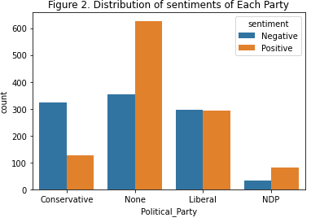
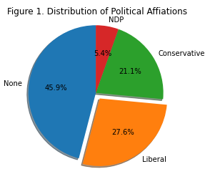
Exploratory Analysis
From figure 1 above, we can see that the code detected 45.9% None party in the CA elections dataset. This might because we used the text_clean to do the analysis, therefore most of the political key words can not be identified.
The pie chart indicated that more tweets are related to liberal party (27.6% of the overall tweets), following by conservative party (21.1%), and only a small number of tweets are related to NDP (5.4%).
Figure 2 shows the distribution of the positive and negative sentiments of each political party.
We can see that for liberal party, the sentiments of the tweets are half positive and half negative
More negative sentiments are in the conservative party tweets than positive sentiments.
NDP has the least number of related tweets but it has more positive sentiments compare to negative.

Slide 2
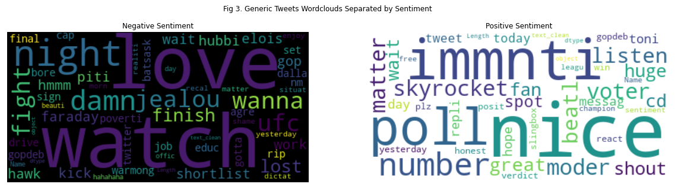
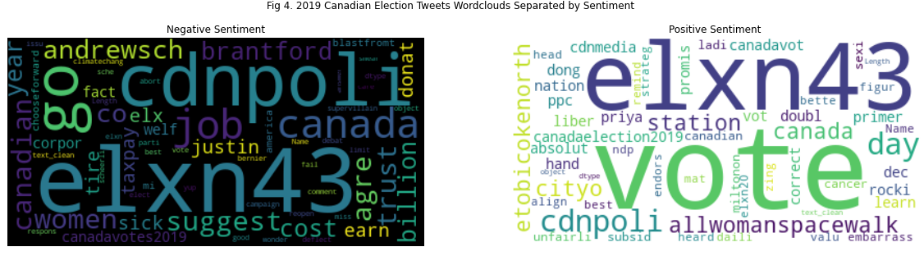
Exploratory Analysis cont.
From Fig 3. word cloud generated words like "Damn", "Jealous", "lost", "pity", etc. which clearly indicated negative sentiments. But it also generate words like "love", this might because the twitter is tweeting negatively with positive words.
For positive sentiments, words like "nice", "great" which nicely indicated positive sentiment. But there also are words like "yesterday", "today", "day", etc. These words has no help to the sentiment analysis, we can later add those words to our stop words.
From Fig 4, it appears "Justin" and “Andrewsch" while Andre has larger font size than Justin. This indicates that tweets talking about conservative has more negative sentiments than tweets talking about liberal.
In the positive sentiment word cloud, most of the tweets are talking about voting and this election. we could not see very clearly which political party they are talking about.

Slide 3
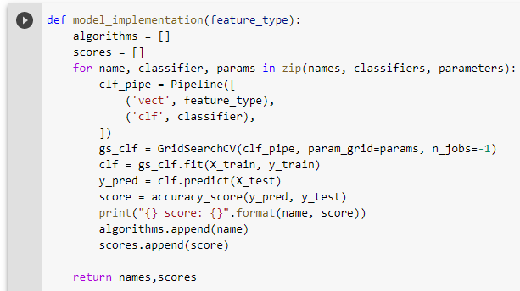

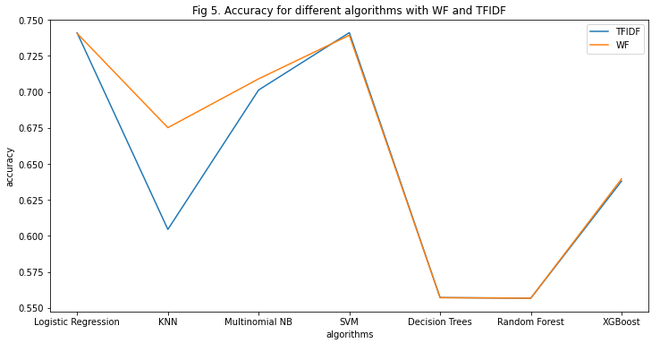
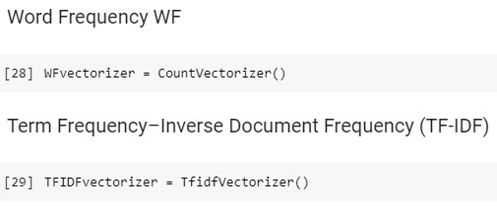
Model Preparation and Feature Importance
The procedures of doing the model preparation are as follows:
Split the data into training data(70%) and test data(30%).
Define a function to iterate through different algorithms and there hyperparameters. This function will return the algorithm name and its accuracy score.
Prepare the vectorizer for WF and TF-IDF
From Fig 5. we can see that both feature types WF and TFIDF both performed better with logistic regression and SVM, while TFIDF has a higher accuracy at 74.1% than WF at 74.0%. Decision Trees and Random Forest has the lowest accuracy for both feature types. The WF performed better with KNN than TFIDF, and the accuracies are the same with XGBoost algorithm for WF and TFIDF. From here, we conclude that Logistic regression performed the best with TFIDF, with an accuracy of 74.1%.

Slide 4
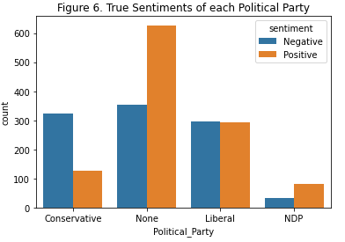
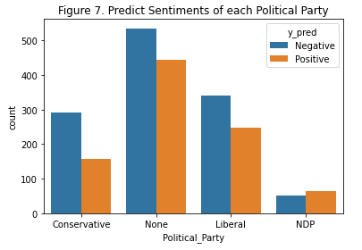
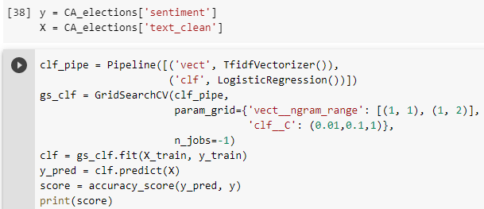
Model Implementation and Result (on CA Election data)
Figure 6 shows the true sentiments distribution of each political party, while Figure 7 shows the model’s prediction sentiment distribution of each party.
From Fig 6. above we can see that for liberal and conservative party, we predicted more negative sentiments than positive for the corresponding CA election tweets. The predictions have half positive and half negative sentiments for NDP.
By comparing the true and prediction sentiment, conservation party's prediction has higher accuracy as the counts of the neg and pos sentiments are similar. The model predict more negative sentiments for conservative and NDP, as well as tweets about None party. Those tweets has lower accuracy which influenced the overall performance.
Next, the model with best performance and the corresponding feature type will be implemented on to CA Election Data.
The code was shown in the above picture, and the accuracy is around 62.1%.

Slide 5
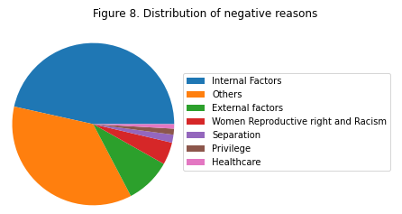
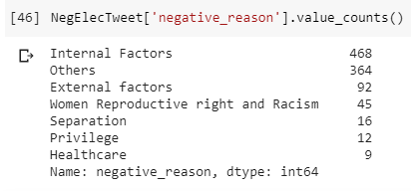
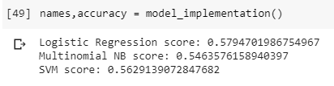
Model Implementation and Result (on negative CA Election data)
From Figure 8, we can notice that we have an imbalanced dataset. We only have a few numbers of counts for negative reasons such as “Separation”, “Healthcare”, and “Privilege”. This could have negative impact on our model’s performance.
The result accuracy for Logistic Regression, Naive Bayes, and SVM are 57.9%, 54.6%, and 56.3% respectively. The highest accuracy belongs to logistic regression.

