Slide 1

Predicting Parkinson’s Disease with Voice Signals using Machine Learning Algorithms
Presented by: Group 1

Slide 2
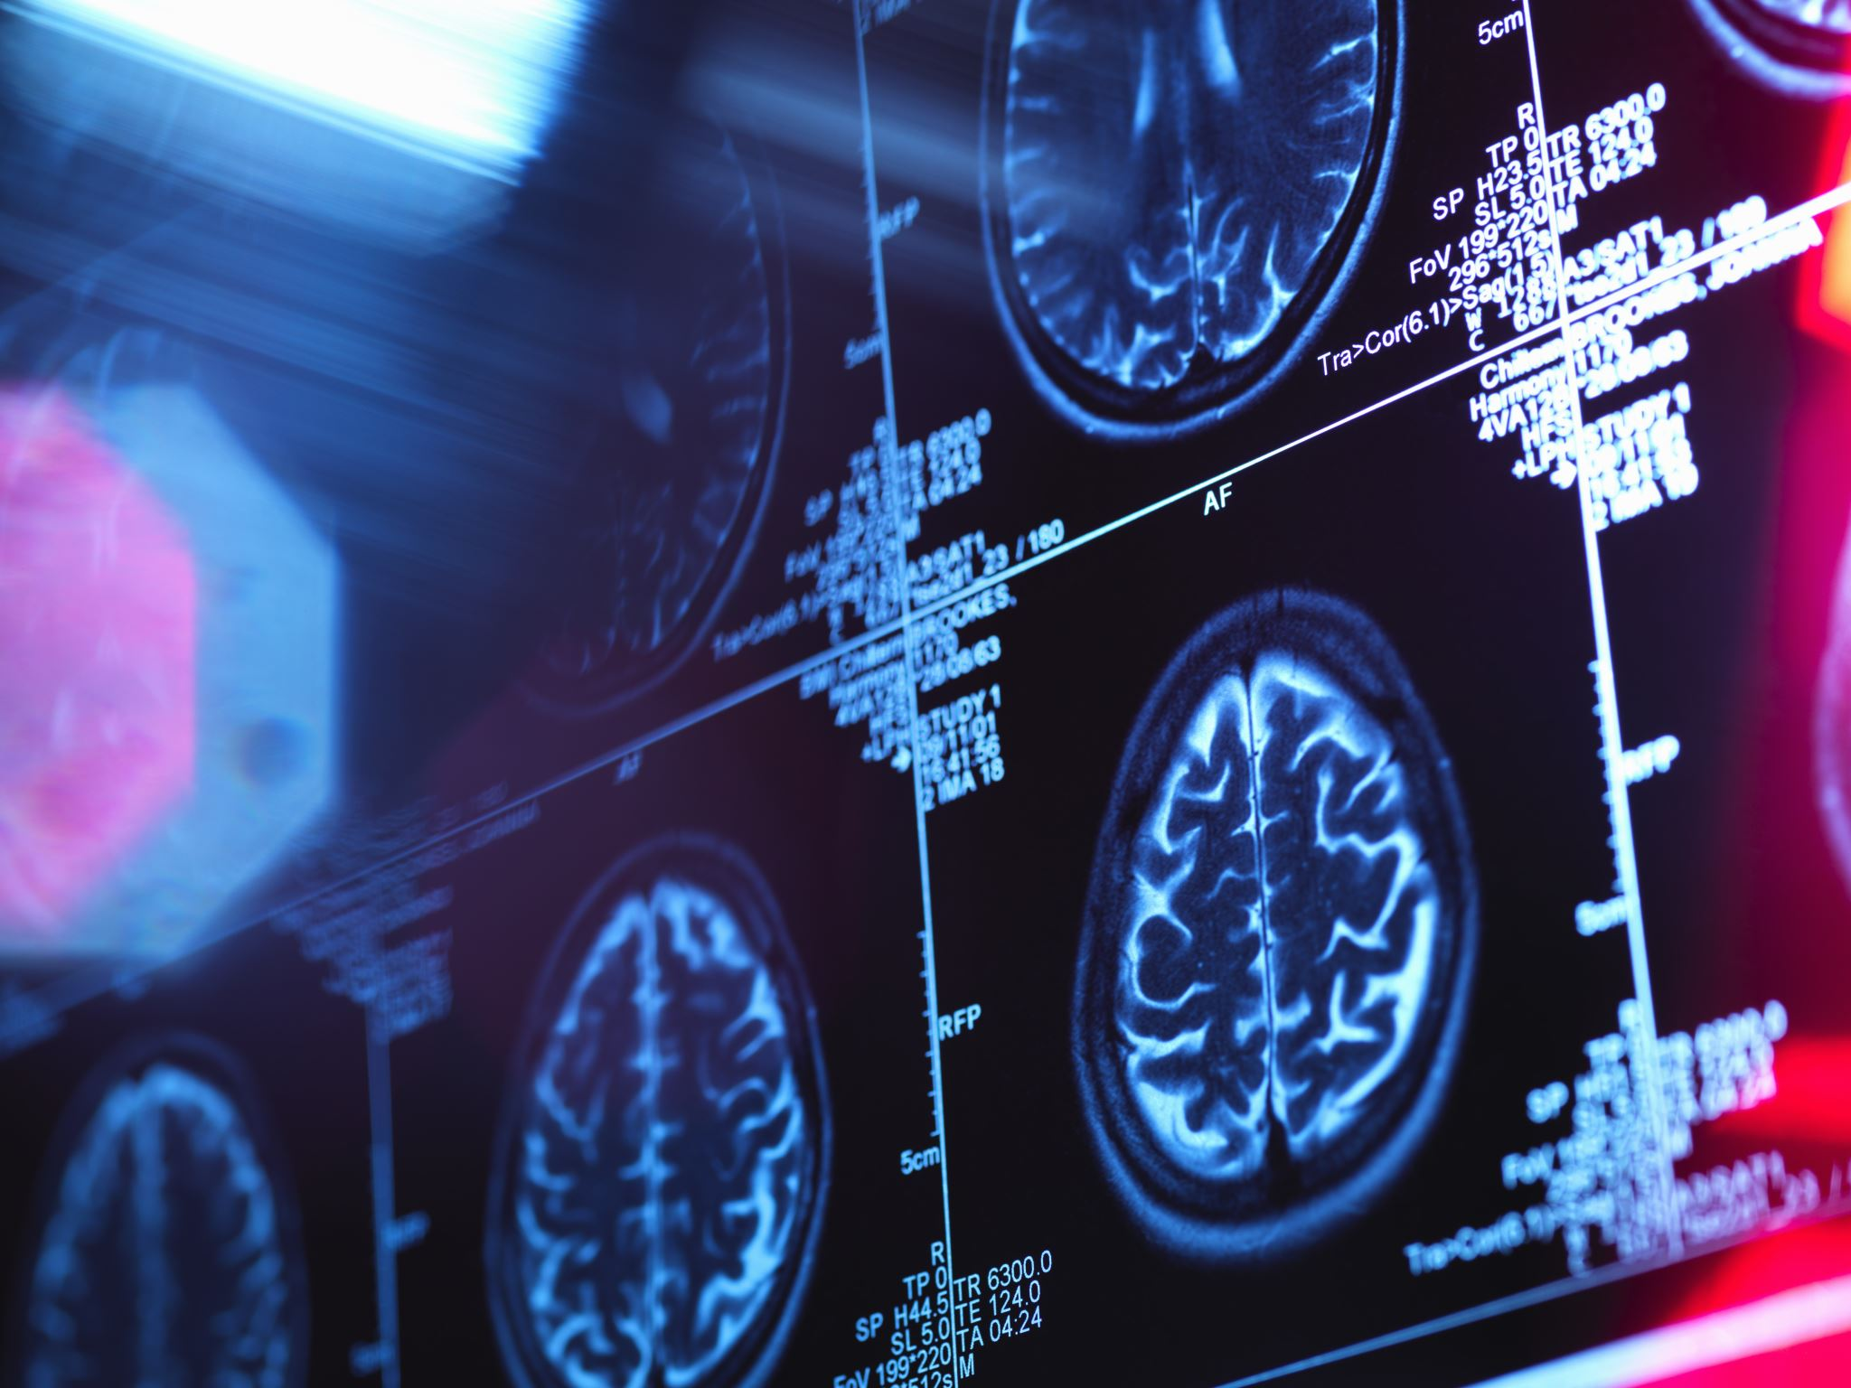
Parkinson’s disease
Second most common neurological disease in the US
Affects an estimated 1% of the population aged 60 years and older
5 to 10% of Parkinson’s disease (PD) cases occur in adults aged 50 years and younger
Up to 90% of patients with PD present with voice changes
47% have moderate to severe voice changes
Notes:
Starting with a little bit of background…
Parkinson’s disease is the second most common neurological disease in the US, affecting an estimated 1% of the population aged 60 years and older.
While the risk of PD increases with age, it can also occur in adults before the age of 50 years, accounting for approximately 5-10% of PD cases
In addition to motor skill deterioration, up to 90% of patients with PD present with voice changes, such as soft, monotone, or slurred speech, and 47% have moderate to severe voice changes.
Studies have shown that voice algorithms can detect PD before the appearance of motor symptoms, to which early treatment interventions can be applied.​²​
However, the prediction of PD is highly dependent on the features selected and the machine-learning method used in the detection algorithm.

Slide 3

Study purpose
To explore various machine learning techniques to accurately classify and predict patients with PD and healthy individuals using voice recordings
Notes:
Therefore, this study explored various machine learning techniques to accurately classify and predict patients with PD and healthy individuals using voice recordings of patients.

Slide 4
Methods
Secondary analysis using machine learning classification algorithms
252 persons
Patients with PD and healthy individuals
Data were split into training (n = 176) and test (n = 76) sets
Notes:
Now moving on to the methods.
This secondary analysis used machine learning algorithms to classify and predict PD. A total of three voice recordings were collected from 252 patients consisting of patients with PD and healthy individuals.
These data were separated into training and testing sets.

Slide 5

Primary outcome
Detection of PD
Patient with PD or healthy individual
Notes:
The primary outcome, detection of PD, was measured as a binary variable and defined as either a patient with PD or a healthy individual

Slide 6
Measures
753 predictor variables (features)
Baseline features: Jitter and shimmer variances, fundamental frequency parameters, harmonicity parameters, Recurrence Time Density Entropy (RPDE), Detrended Fluctuation Analysis (DFA), and Pitch Period Entropy (PPE).
Time frequency features: intensity parameters, bandwidth, and format frequencies
Mel Frequency Cepstral Coefficients: 84 features
Wavelet transform-based features: 182 features
Vocal fold features: Glottis quotient (GQ), glottal to noise extraction (GNE), vocal fold excitation ratio (VFER), and empirical mode decomposition (EMD).
Tunable Q-factor wavelet transform-based features: 432 features
Notes:
A total of 753 predictor variables, excluding participant ID and gender, herein referred to as features, were extracted and subset into feature sets including
baseline features
time frequency features
Mel Frequency Cepstral Coefficients
wavelet transform-based features
vocal fold features and
tunable Q-factor wavelet transform-based features

Slide 7
Statistical analysis
Cross-validation
10-fold
Leave-one-out
Model building and training were streamlined using the caret package
Model evaluation
Accuracy
Cohen’s kappa
PR-AUC
Sensitivity
Specificity
ROC-AUC
Notes:
To classify patients with PD and healthy individuals, we employed leave-one-out 10-fold cross-validation, which randomly divided the training data into 10 groups, trained the model with nine and used the remaining group for predictions.
Model building and training were streamlined using the caret package to select the best-performing tuning parameters for each machine-learning algorithm
The models with the best fit for each algorithm were evaluated by plotting the Receiver Operating Characteristic and precision-recall area under the curve, indicated as ROC-AUC and PR AUC, respectively.
We also calculated the accuracy, Cohen’s kappa, sensitivity, and specificity.
Finally, we used the model with the best training accuracy and ROC-AUC to predict the PD class of patients in the test set.

Slide 8
Machine learning algorithms
Parametric
Multiple logistic regression
Quadratic discriminant analysis (QDA)
Lasso regression
Naïve Bayes
Non-parametric
Radial Kernel vector classifier (SVM)
Classification trees
K-nearest neighbor (KNN)
Notes:
Several parametric and nonparametric machine-learning algorithms were applied to classify the primary outcome.
The parametric methods applied for classifying patients with PD and healthy individuals were multiple logistic regression, Quadratic Discriminant Analysis (QDA), Lasso regression, and Naïve Bayes.
Because the data were high-dimensional and the number of predictors was greater than the number of observations, forward selection was utilized as a feature selection method to fit the QDA, as backward selection is not recommended under these circumstances.
For non-parametric classification methods in predicting PD, we fit the radial Kernel vector classifier (SVM), classification trees, and K-nearest neighbor (KNN).

Slide 9
Model improvement
Neural networks
Feature selection
Boruta with 1000 importance source runs
154 of 753 features were identified as most important
Repeated measures
Mixed effects radial SVM
Mixed effects random forest classification trees
Notes:
Finally, additional statistical methodologies were implemented to determine whether the performance could be improved.
These methods included neural networks, feature selection to reduce the dimensional space, and accounting for repeated measures as not considering between-subject and within-subject variability can result in a biased model.

Slide 10
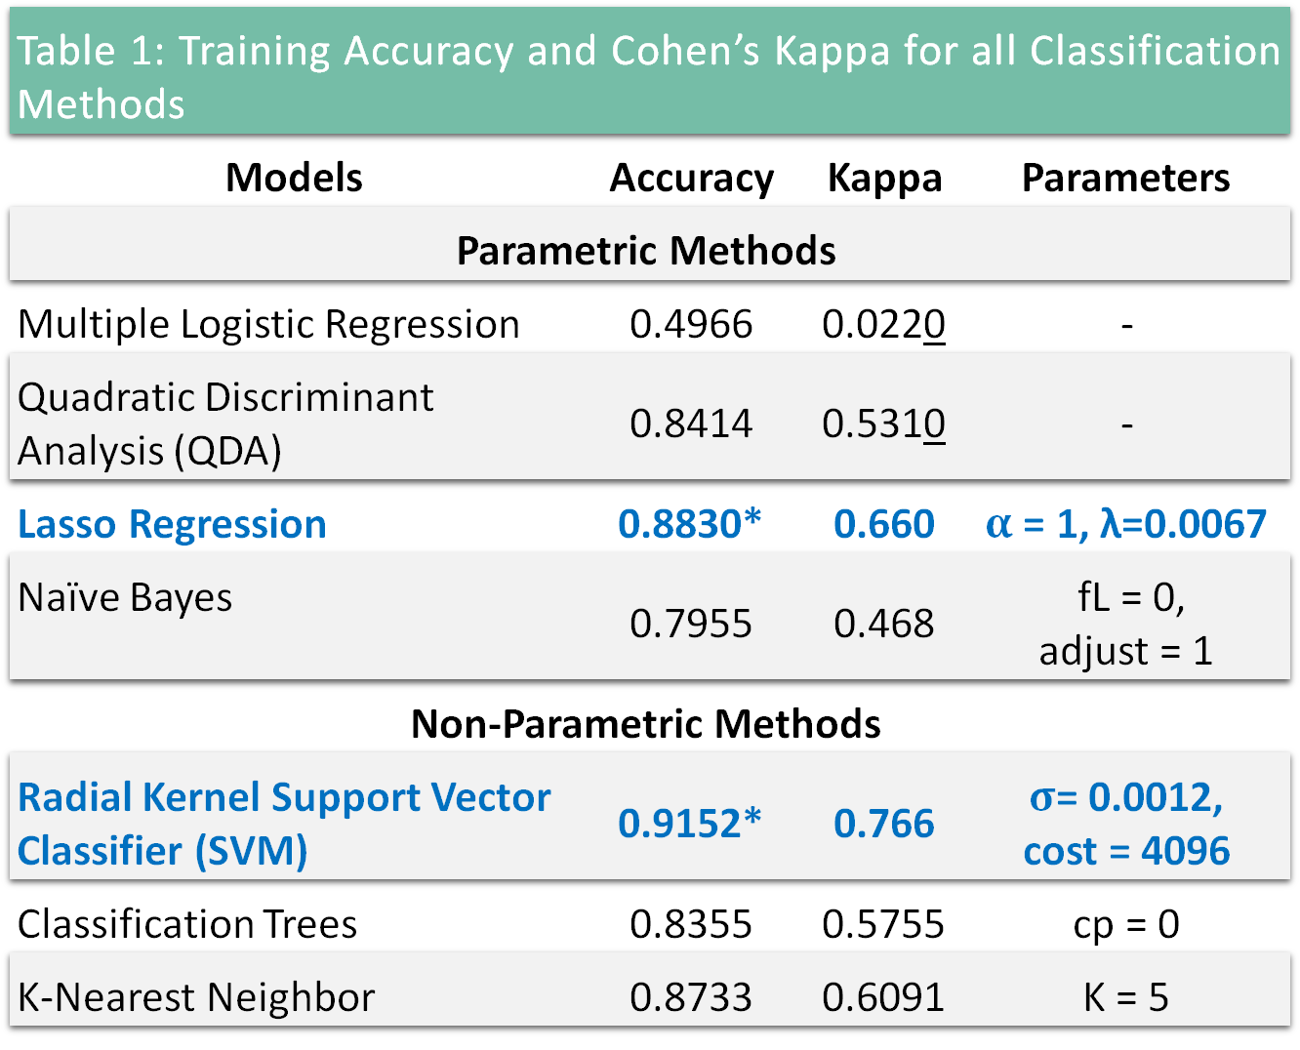
Results- Training accuracy
Table 1: Training Accuracy and Cohen’s Kappa for all Classification Methods
Models | Accuracy | Kappa | Parameters
Parametric Methods
Multiple Logistic Regression | 0.4966 | 0.0220 | -
Quadratic Discriminant Analysis (QDA) | 0.8414 | 0.5310 | -
Lasso Regression | 0.8830* | 0.660 | $α$ = 1, λ=0.0067
Naïve Bayes | 0.7955 | 0.468 | fL = 0, adjust = 1
Non-Parametric Methods
Radial Kernel Support Vector Classifier (SVM) | 0.9152* | 0.766 | $σ$= 0.0012, cost = 4096
Classification Trees | 0.8355 | 0.5755 | cp = 0
K-Nearest Neighbor | 0.8733 | 0.6091 | K = 5
Notes:
Now its time for the results. First looking at the training accuracy
For the parametric methods, the multiple logistic regression yielded the lowest training accuracy, whereas the Lasso regression yielded the highest training accuracy.
For non-parametric methods, the classification tree and the KNN with five nearest neighbors had similar training performance. However, the radial SVM with a cost of 4096 outperformed both non-parametric methods.
In fact, the radial SVM had the highest training accuracy among all classification methods applied.

Slide 11
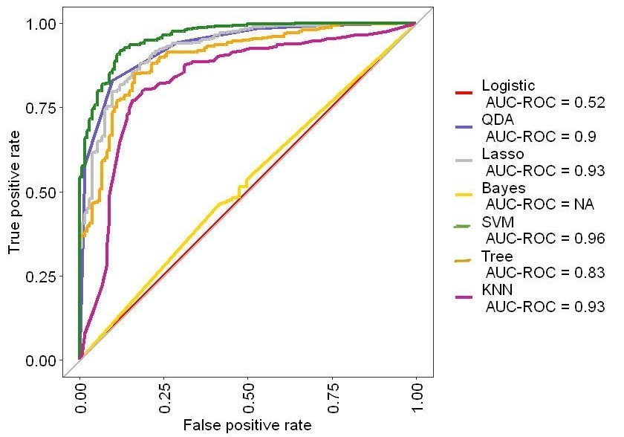
Results- Training roc-auc
Figure 1: AUC-ROC of all the models. Radial SVM appeared to have the best performance in terms of AUC-ROC
Best performance
Poor performance
Notes:
Now moving on to the training ROC-AUC evaluation.
For the parametric methods, multiple logistic regression had the lowest evaluation, resulted from a poor ROC-AUC performance.
QDA and Lasso regression performed similarly; however, Lasso had a slightly higher training performance.
For non-parametric classification methods, the classification tree performed the worst exhibited the poorest training performance whereas the radial SVM had the best training performance.

Slide 12
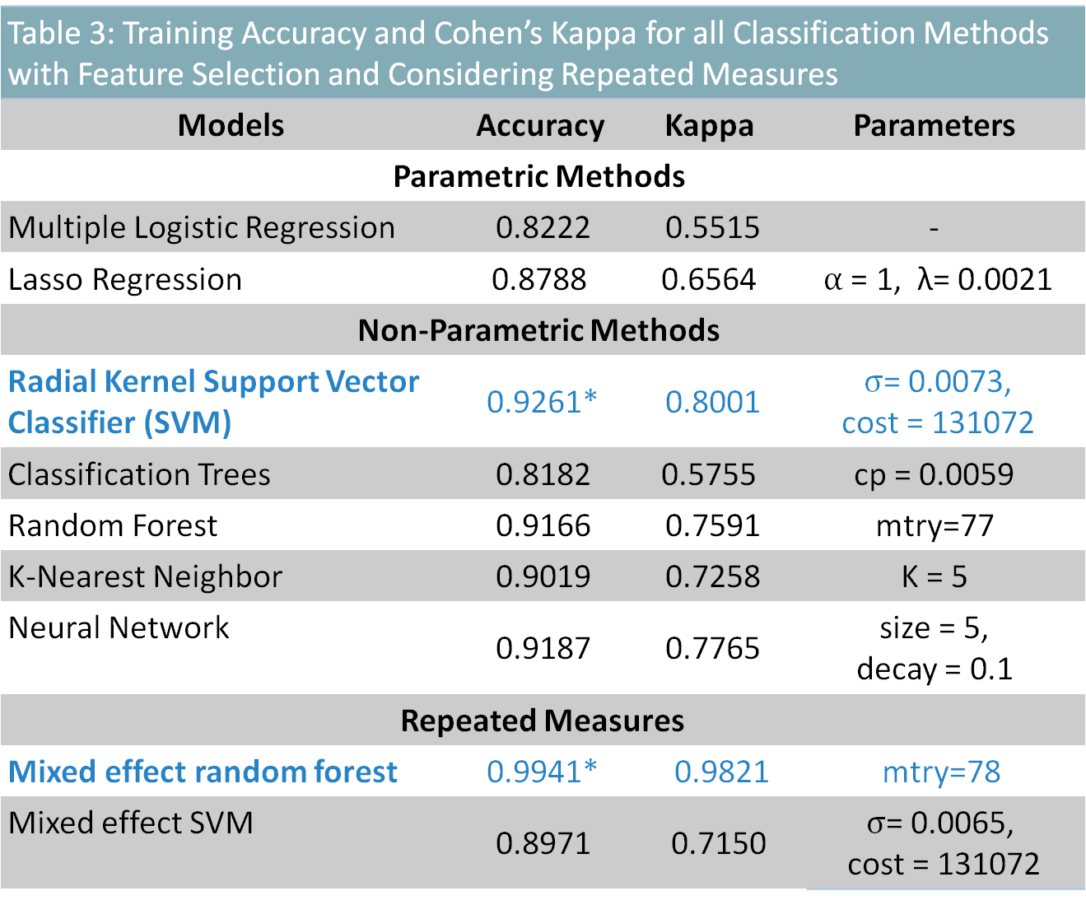
Results–Model improvement
Table 3: Training Accuracy and Cohen’s Kappa for all Classification Methods with Feature Selection and Considering Repeated Measures
Models | Accuracy | Kappa | Parameters | Parameters
Parametric Methods
Multiple Logistic Regression | 0.8222 | 0.5515 | - | -
Lasso Regression | 0.8788 | 0.6564 | $α$ = 1, λ= 0.0021 | alpha = 1, λ= 0.0021
Non-Parametric Methods
Radial Kernel Support Vector Classifier (SVM) | 0.9261* | 0.8001 | $σ$= 0.0073, cost = 131072 | s= 0.0073, cost = 131072
Classification Trees | 0.8182 | 0.5755 | cp = 0.0059 | cp = 0.0059
Random Forest | 0.9166 | 0.7591 | mtry=77 | mtry=77
K-Nearest Neighbor | 0.9019 | 0.7258 | K = 5 | K = 5
Neural Network | 0.9187 | 0.7765 | size = 5, decay = 0.1 | size = 5, decay = 0.1
Repeated Measures
Mixed effect random forest | 0.9941* | 0.9821 |  | mtry=78
Mixed effect SVM | 0.8971 | 0.7150 |  | $σ$= 0.0065, cost = 131072
Notes:
After feature selection with Boruta, 154 features were considered most important in the classification of PD.
Similar to the models that considered all features in the data, the multiple logistic regression had the poorest performance with a training accuracy and the radial SVM had the best training performance with a training accuracy.
When repeated measures were considered, the mixed-effect random forest had a higher training than the mixed-effect radial SVM.
However, random forests tend to overfit data, and the training accuracy is evidence of this.

Slide 13
Results – Test Set
Radial SVM Predictions for the Classification of Parkinson’s Disease on Test Set (n= 76)
 | n | (%)
Parkinson’s Disease | 50 | 65.8
Healthy Individual | 7 | 9.2
Inconclusive | 19 | 25.0
Notes:
We elected to implement a radial SVM, which yielded the best accuracy and ROC-AUC across non-parametric and parametric models across all statistical scenarios to predict our main outcome.
Of the 76 individuals in the test set, radial SVM predicted that 65.8% presented with PD and 9.2% were healthy.
25% of the individuals were predicted to have inconclusive results, indicating that these individuals were predicted to be both healthy and PD patients within the three repeated measures.

Slide 14
Discussion
We found the radial SVM to be the best machine learning method for classifying patients with PD and healthy individuals based on voice signals
We did not use
LDA: performs poorly in high-dimensional and imbalanced data
Polynomial SVM: performs better when the data are linearly separable, evidence of nonlinearity from non-parametric performing better than parametric models
Notes:
Similar to Hamza et al. we found the radial SVM to be the best machine learning method for classifying patients with PD and healthy individuals based on voice signals.
Although our training accuracy was higher, Hamza et al. noted higher accuracies have been reported for PD classification in the literature
These data did not suit LDA nor polynomial SVM and therefore were not used in the classification of PD.

Slide 15
Discussion
Limitations
p >>> n
Overfitting
Curse of dimensionality
collinearity
Radial SVM performs well in high-dimensional space
Still can be prone to overfitting, leading to poor generalization performance
Notes:
These results should be considered in light of some limitations.
The number of features was greater than the number of training dataset observations which can cause overfitting of the training set, curse of dimensionality that can lead to unstable and inaccurate models, and collinearity.
Although the radial SVM is known to perform well in high-dimensional spaces, it can still be prone to overfitting due to the flexibility of the model when the number of features is much larger than the number of observations, as is the case with these data, leading to poor generalization performance on new, unseen data.

Slide 16
Conclusion
Improve telemedicine
Improve technology
Future studies
Notes:
This technology can be used to improve early detection in the telemedicine space and improve technology for patients who may not have close access to a hospital for screening and treatment.
Future studies should consider collinearity of the features for better predictions.

Slide 17
Thank you
References
​​1. National Institute of Neurological Disorders and Stroke. Parkinson's Disease: Challenges, Progress, and Promise. National Institute of Health Web site. https://www.ninds.nih.gov/current-research/focus-disorders/focus-parkinsons-disease-research/parkinsons-disease-challenges-progress-and-promise. Updated 2023. Accessed April 8, 2023
​2. Hamza TH, Chen H, Hill-Burns EM, et al. Genome-wide gene-environment study identifies glutamate receptor gene GRIN2A as a Parkinson's disease modifier gene via interaction with coffee. PLoS Genet. 2011;7(8):e1002237. doi:10.1371/journal.pgen.1002237

Slide 18
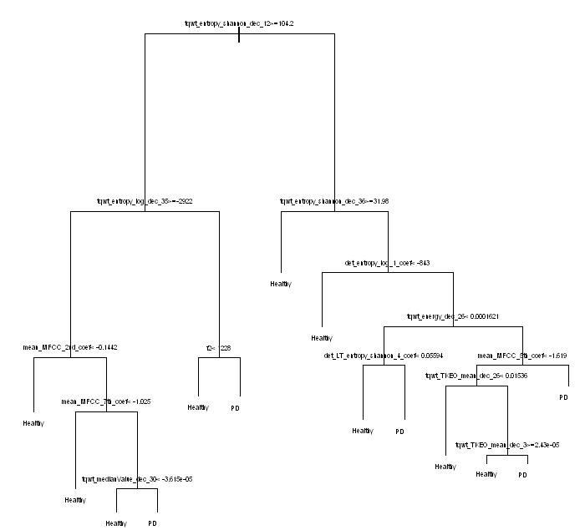
Classification tree
Notes:
The resolution is low but here we can see that the twqt feature set had the most importance for the prediction of PD in the classification tree.

Slide 19
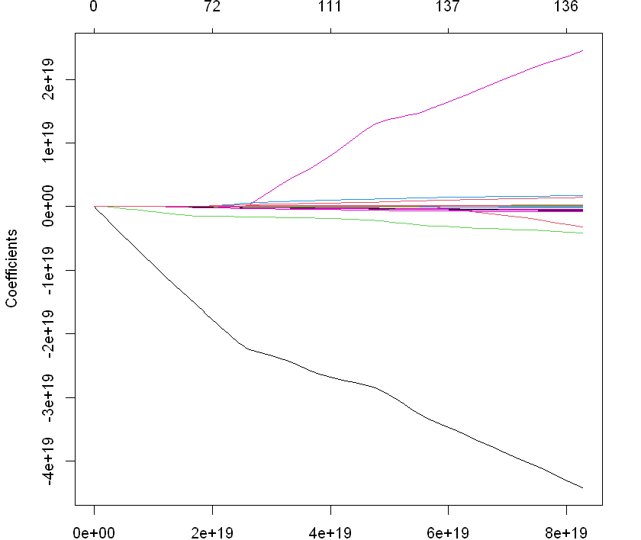
Lasso regularization
Notes:
Here we can see that most coefficients were shrunken to zero

Slide 20
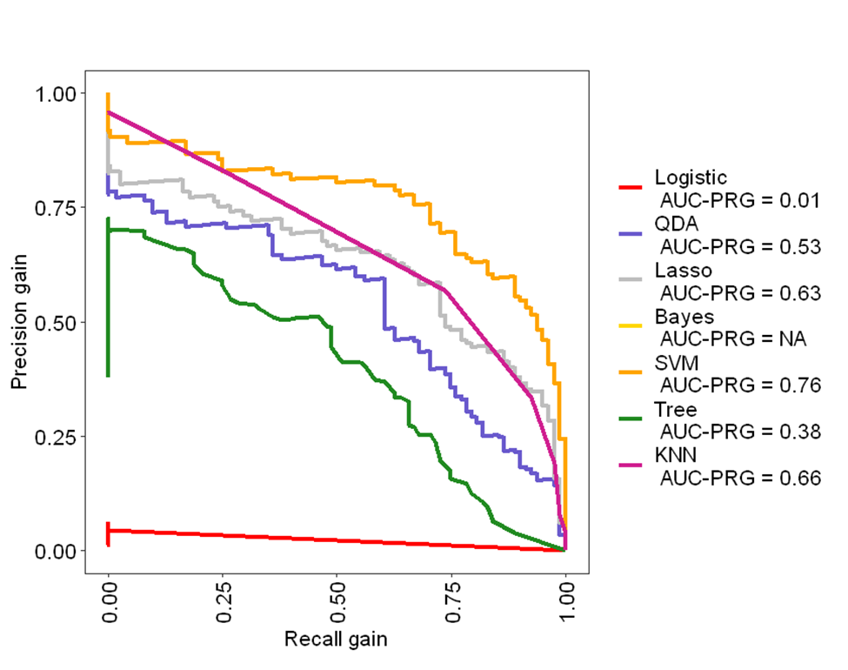
Pr-auc evaluation
SVM has the best performance because the curve is closer to 1 indicating a good precision-recall balance

Slide 21
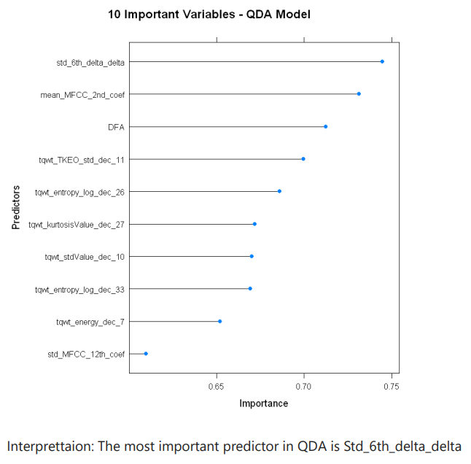
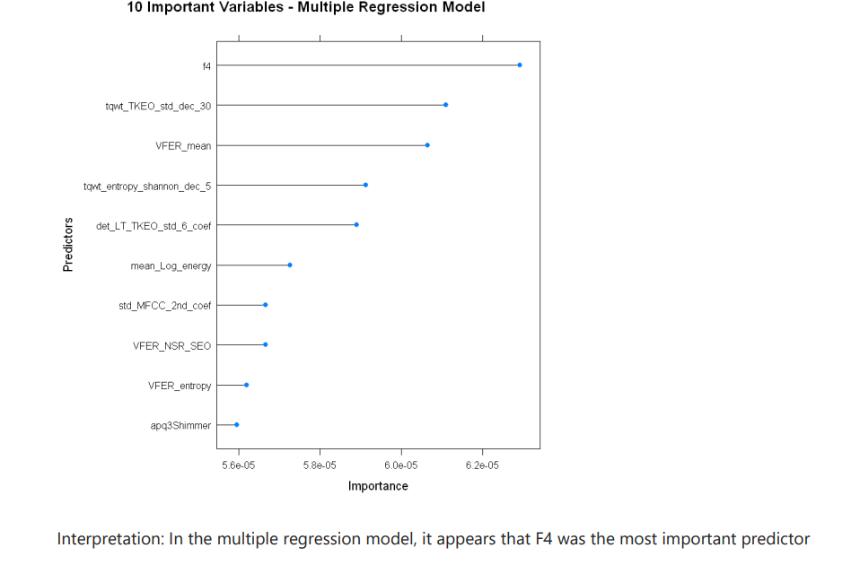
Feature importance
Notes:
In the lasso regression the most important feature was tqwt_meanValue_dec_5

