Slide 1

OQLA
Abdulmajeed Alrashoodi
Raseel Alhaqbani
Sultan Balbied

Slide 2

Do you remember captain Sami :)

Slide 3
TABLE OF CONTENTS
01
02
03
04
05
06
Introduction
The solution we provide
Our workflow
Data Overview
Data Modeling
Demo
07
conclusion

Slide 4
Introduction
Imagine you're in the middle of a home workout, feeling confident you're nailing every move. But did you know that incorrect exercise form can lead to injuries and hinder your progress? That's why maintaining the correct position during exercises is absolutely essential.
Stay safe with OQLA!

Slide 5
The solution we provide
Our solution provides a virtual personal coach using computer vision to analyse and evaluate exercise forms in real-time, providing immediate feedback on user movements' accuracy. The solution includes:
1
2
Real-time Form Detection: Using Mediapipe to identify key body landmarks and assess the correctness of squats, push-ups, and lunges.
Performance Dashboard: A summary of the user's workout performance, including correct repetitions, and overall form accuracy.

Slide 6
Our workflow
Gather images of correct exercise forms from reliable sources like Pinterest and Google.
Test the model using a live camera to ensure accuracy and reliability in detecting correct exercise forms.
Defining the problem
Landmark Detection
Deployment
Data collection
Testing
Clearly identify the need for accurate exercise provides in preventing injuries.
Use Mediapipe to automatically detect and label key landmarks on the body for each exercise position
Implement the model into a user-friendly interface using Streamlit, providing real-time feedback and a performance dashboard.

Slide 7


Data Overview
The dataset comprises images of individuals performing exercises like squats, push-ups, and planks. Each image is annotated with key landmarks that represent correct positions. The data was sourced from Pinterest and Google. The dataset includes:
Exercise Types: Squats, Push-Ups, lungs
Annotated Landmarks: Key points such as shoulders, elbows, hips, knees, and ankles.

Slide 8
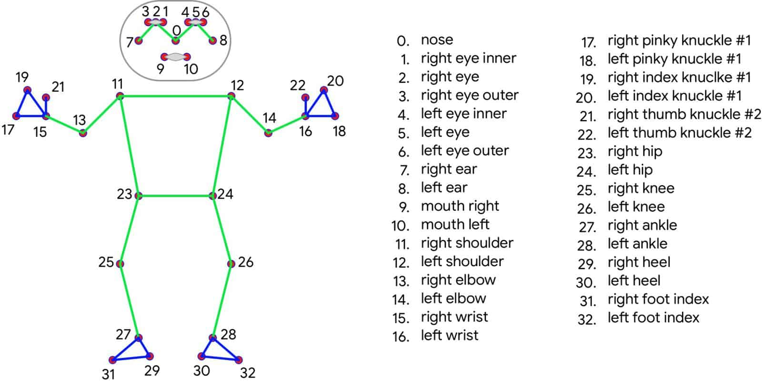

Data Modeling
Model Training: Use Mediapipe's pre-trained models to detect body landmarks to identify correct exercise forms.

Slide 9
conclusion
The AI personal coach (OQLA) utilized Mediapipe's cutting-edge computer vision technology to offer real-time user performance and feedback, improving training experiences and encouraging fitness enthusiasts to follow safer, more efficient workout regimens.

Slide 10
Thank you for listening!
DO YOU HAVE ANY QUESTIONS?
Abdulmajeed Alrashoodi
Raseel Alhaqbani
Sultan Balbied

