Slide 1



CYBERSECURITY THREAT PREDICTION IN IIoT USING GRAPH NEURAL NETWORK
SABARI S
SANKARI S

Slide 2

PROBLEM STATEMENT
Cyber attacks are increasing in smart industrial (IIoT) systems.
Traditional security systems cannot detect new or unknown attacks.
Existing systems often give many false alarms.
If one device is attacked, the threat can quickly spread to other connected devices.
Therefore, industries need a smart and predictive security system to detect threats early.

Slide 3

PROPOSED SOLUTION
Model the IIoT network as a graph where devices are nodes and their communications are edges.
Use a Graph Neural Network (GNN) to analyze relationships between connected devices.
Detect and classify cyber threats in real time based on abnormal communication patterns.

Slide 4
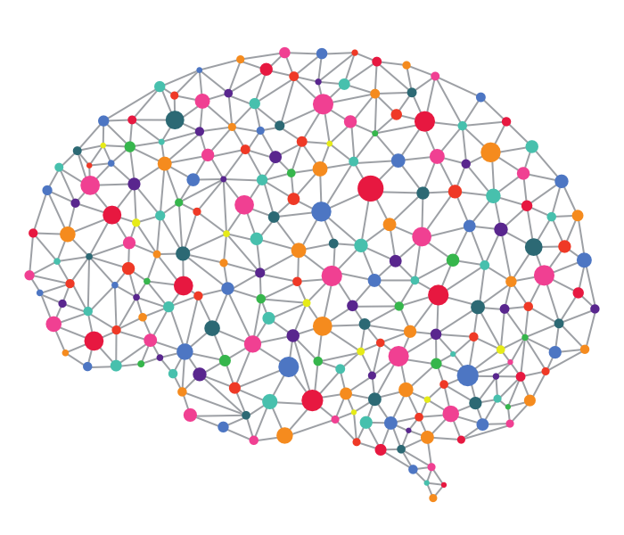
WHAT IS GRAPH NEURAL NETWORK ?
A Graph Neural Network (GNN) is an AI model that analyzes devices and their connections in a network.
WHAT ID DOES
It learns what "normal behavior“ of device looks like.
If something unusual happens → it raises an alert before it attack the connections of that Device.

Slide 5
THREAT PREDICTION PROCESS TIMELINE
Data Collection
Graph Creation
Gathering relevant information
Structuring data for analysis
GNN Training
Feature Extraction
Training the Graph Neural Network
Identifying key characteristics
Threat Prediction
Alert & Prevention
Identifying potential threats
Mitigating identified risks

Slide 6
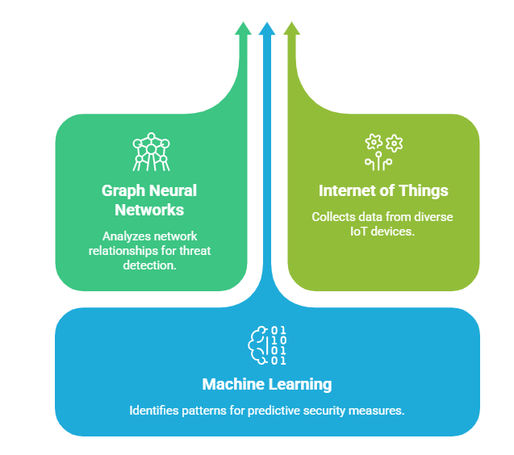
EXISTING SYSTEM
VS
PROPOSED GNN SYSTEM
INNOVATION CYBERSECURITY
FUSION
Cybersecurity in IIoT
Cannot Detect New Attacks
Detects Unknown Attacks
Analyzes Devices Individually
Analyzes Network Relationships
High False Alarm Rate
Lower False Positive Rate
Limited Threat Prediction
Predicts Threats
Existing System
Proposed GNN System

Slide 7

FEASIBILITY & VIABILITY
Can be implemented using existing IIoT network data and monitoring systems.
Uses widely available AI tools like Python, PyTorch, and TensorFlow.
Scalable to large industrial environments with many connected devices.
Supports real-time deployment in smart factories.
Cost-effective compared to production losses caused by cyber attacks.

Slide 8

TECHNOLOGIES AND TOOLS USED
Python – For building and running the model.
PyTorch / TensorFlow – To develop the Graph Neural Network (GNN).
NetworkX – To create and analyze network graphs.
IIoT Network Data – For training and testing the system.
Cloud / Edge Computing – For real-time threat detection.

Slide 9


