Slide 1
arXiv Math
Semantic search, RAG, trend analytics and advisor finder
BIU 8688697201 · Data Science · Final Project

Slide 2



The task
Semantic search + RAG (main feature)
Find papers by meaning, not keywords. Answer questions with citations to real sources.
“Where do I even
start my literature
review?”
Trend analytics (bonus)
Which topics are growing, who publishes the most.
Advisor finder (bonus)
A math student writes a topic in natural language
and gets back real papers, plus an answer
grounded in specific sources.
Most active and most cited researchers for a topic.

Slide 3
Dataset
arXiv metadata, Cornell University, mirrored on Kaggle
JSON fields: id, title, authors, categories, abstract, dates
Full dataset: 2.2 million papers, about 3.5 GB
Our subset: math.PR, math.ST, math.CO, math.OC, last 3 years
No full paper text in our index, only metadata and abstracts. Theorem finder is the one exception: it fetches the real LaTeX source live, per question.
57,155+
papers indexed, kept current
with live updates from arXiv

Slide 4
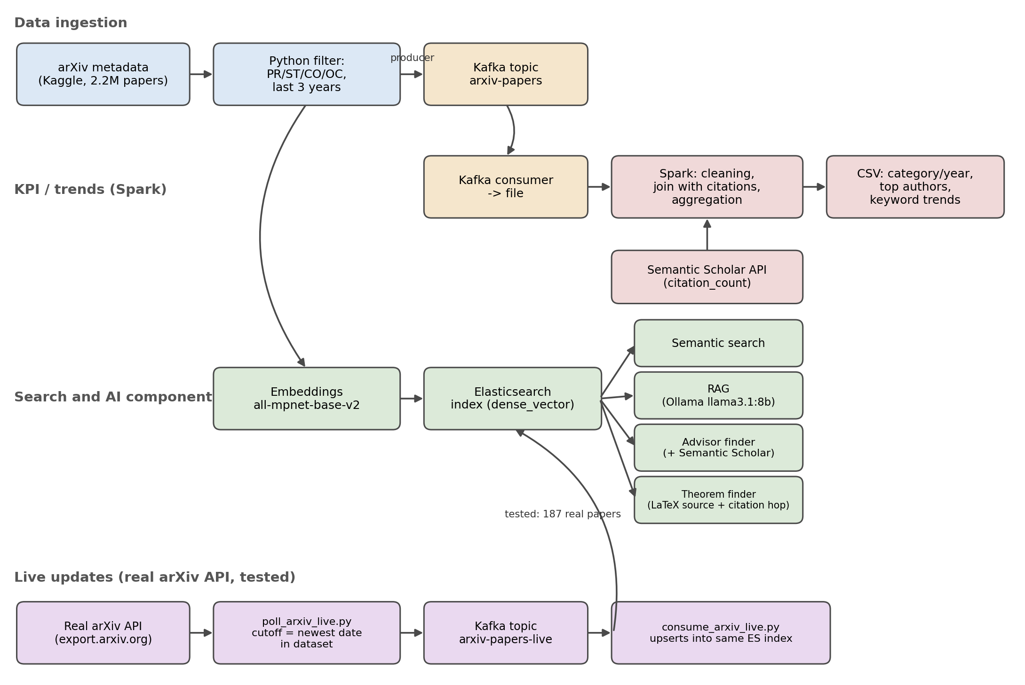
Architecture and data flow

Slide 5





Course technologies
Docker
Kafka
Spark
Elasticsearch
REST APIs
Elasticsearch and Kafka run as real containers (docker run), not simulated.
Producer/consumer ingestion, plus a separate live-update path.
local[*] mode, DataFrame + DAG, joins and aggregates the KPIs.
NoSQL document store. dense_vector + HNSW for fast kNN search.
Semantic Scholar, the real arXiv API, and Ollama's local API.

Slide 6
Deployment: Docker vs. native
Docker
Mac, native, outside Docker
Elasticsearch
Python scripts
:9200, index arxiv_math
filter, build_index, search, rag, ask.py
Kafka (KRaft)
Ollama
Spark
:9092, topic arxiv-papers
llama3.1:8b
local[*]
External APIs
arxiv.org (poll_arxiv_live.py) and Semantic Scholar (fetch_citations.py)

Slide 7
How it's built: script map
Ingestion
Spark and KPIs
Live updates
filter_math_subset.py
kafka_producer.py
kafka_consumer_to_file.py
fetch_citations.py
spark_kpis.py
poll_arxiv_live.py
consume_arxiv_live.py
Search and AI
compare_embedding_models.py
evaluate_embeddings_standart.py
build_index.py
search.py
rag_answer.py
find_advisor.py
find_theorem.py
ask.py

Slide 8
Choosing the embedding model
Tested on our own sample of 5,000 papers, 3 rounds
Started with a homemade heuristic, moved to standard MTEB / BEIR metrics
Self-supervised ground truth: a paper's title as the query, its own abstract as the correct answer
Model | dim | MRR | R@10 | nDCG@10 | V-measure | NMI
all-MiniLM-L6-v2 | 384 | 0.892 | 0.962 | 0.908 | 0.485 | 0.485
all-mpnet-base-v2 | 768 | 0.904 | 0.971 | 0.920 | 0.623 | 0.623
allenai-specter | 768 | 0.549 | 0.703 | 0.580 | 0.532 | 0.532
TF-IDF (baseline) | 21636 | 0.809 | 0.935 | 0.838 | 0.335 | 0.335
all-mpnet-base-v2 won on every metric at once, so it is used everywhere in the project.

Slide 9



Semantic search + RAG
Question
Retrieve top-k
Local LLM
Grounded answer
natural language
kNN over embeddings
Ollama, llama3.1:8b
cites real papers
Compared llama3.2 (3B) with llama3.1 (8B) on the same question: 8B gave a clearly deeper answer that used several sources together instead of copying one abstract.

Slide 10
Spark: the meaningful transformation step
local[*] mode: one machine, every CPU core as a worker
Data stored as a DataFrame, split into partitions
A DAG of steps (join, groupBy, explode) runs lazily, only when the CSV is written
Joined with real citation counts from Semantic Scholar
kpi_category_year.csv
papers per category, per year
kpi_top_authors.csv
most prolific authors
kpi_keyword_trends.csv
keyword trends vs. citation impact
99.8% of papers (57,031 of 57,155) were matched to real Semantic Scholar citation data.

Slide 11


Live updates: the real arXiv API
Real arXiv API
poll_arxiv_live.py
Kafka topic
consume_arxiv_live.py
export.arxiv.org
since our newest paper
arxiv-papers-live
upserts into same index
187
Found and fixed a real bug along the way: the first version double-indexed everything (374 entries instead of 187) because the consumer was missing a group_id. A one-line fix.
real new papers found and indexed, tested end to end
Now runs by itself every week, on a schedule set up with macOS launchd. Tested on a real Mac, no errors.

Slide 12

Bonus features
Advisor finder
Theorem finder
Finds the most active and most cited researchers for a topic through the Semantic Scholar API. Only shows an institutional affiliation, including Israeli institutions, when the data actually confirms it.
Finds theorem, lemma and proof blocks in the real LaTeX source, and checks whether a result is proved or just used in a paper. More on the next slide.

Slide 13
Theorem finder: proof or reference?
LaTeX source
Parse blocks
Citation hop
Flag correctly
pulled from arXiv
theorem, lemma, proof
follow to the source paper
used vs. proved
Example: “Where is Hoeffding's inequality proved?” The tool finds every paper that uses this bound, then follows one citation hop to the paper that actually proves it. A paper that only cites and uses the inequality gets flagged as used, not proved, and the search points to the real source instead.

Slide 14
Challenges and trade-offs
Kafka delivery semantics
The first live-update run indexed 374 entries instead of 187, because the consumer had no group_id and reprocessed the same messages twice. The fix was one line, but it was a real lesson in at-least-once delivery.
Model size vs. speed
llama3.2 (3B) answered fast but sometimes just paraphrased one abstract. llama3.1 (8B) is slower and needs more RAM, but pulls grounded answers from several papers at once. We chose quality over speed.
Scheduling on macOS
launchd runs the weekly update instead of cron, since it can catch up after the Mac wakes from sleep. Getting it registered took real debugging: a stale launchd registration kept an old file path until we forced a clean bootout and bootstrap.

Slide 15
Results and insights
Citation lag
Average citations per year drop toward 2026, simply because recent papers have not had time to collect citations yet.
99.8% matched
57,031 of 57,155 papers were matched to real Semantic Scholar citation data.
Re-checked on a CO and OC only subset: PR-heavy topics dropped out, OC and CO barely moved. 2026 is not a full year yet, but already close to 2025 totals.

Slide 16
Live demo
python3 ask.py : routes automatically
“What are recent approaches to concentration inequalities for random matrices?”
RAG
“Where is Hoeffding's inequality proved?”
Theorem finder
“Who works on convex optimization in Israel?”
Advisor finder
“What's the trend for random graphs?”
Trends
For the theorem finder question, we open the real paper on arxiv.org right after, to show the theorem is genuinely there.

Slide 17
Thank you
Questions?
github.com/SvZol/BigDataProject

