Slide 1
PREDICTION OF HEART STROKE USING MACHINE LEARNING ALGORITHMS
Guided by :
Ms.V.V.Bhavani
Presented by :
Y.Harshitha 20R01A6760
P.Ruthwik 20R01A6743
S.Vaishnavi 20R01A6748
E.Priyanka 20R01A6718

Slide 2
ABSTRACT
In recent times, Heart Stroke prediction is one of the most complicated tasks in medical field.
In the modern era, approximately one person dies per minute due to Heart Stroke.
As heart stroke prediction is a complex task, there is a need to automate the prediction process to avoid risks associated with it and alert the patient well in advance.
This project addresses the development of machine learning models to predict the likelihood of heart strokes based on a comprehensive set of health-related features.

Slide 3
INTRODUCTION
Heart strokes are a global health concern, and we need precise prediction methods to act promptly
The application of machine learning algorithms to predict heart strokes, leveraging comprehensive datasets and diverse algorithms.
We delve into data preprocessing, model development, and performance evaluation to aid in early risk identification.

Slide 4
PROBLEM STATEMENT
The aim of this project is to develop and evaluate machine learning algorithms that can predict the likelihood of heart strokes based on a diverse set of health-related features. The objective is to create accurate and interpretable models that healthcare professionals can use for early risk assessment and targeted intervention, ultimately reducing the incidence and impact of heart strokes."

Slide 5
EXISTING SYSTEM
Several studies have been conducted on heart stroke prediction in healthcare.
Khosla used a feature selection algorithm combined with Support Vector Machines (SVM) to conduct experiments on a dataset containing 4,988 examples, with 299 cases of stroke.
Miguel employed machine learning techniques to predict the functional outcome of stroke patients three months after the initial stroke. They worked with a dataset comprising 425 acute stroke patients.
Lim utilized deep learning to create a Stroke Risk Prediction (SRP) model using retinal images. Their approach achieved acceptable performance, but collecting retinal images was found to be time-consuming and expensive.

Slide 6
EXISTING SYSTEM
The above works revealed that stroke datasets tend to be limited in size, and they often suffer from data imbalance issues.
In an attempt to address the data imbalance issue, Liu et al. proposed a Deep Neural Network (DNN)-based model for stroke prediction. They worked with a larger dataset of 43,400 patient records, including 783 cases of stroke. However, even with this larger dataset, the problem of small data and data imbalance in stroke prediction remains challenging.

Slide 7
DISADVANTAGES
Researchers have used various methods to predict strokes, but they often face challenges like limited data and data imbalance.
The system has not been implemented for ‘’HYBRID DEEP TRANSFER LEARNING FOR STROKE RISK PREDICTION’’.
In an existing system, Generative Instances do not transfer using External Stroke Data.

Slide 8
PROPOSED SYSTEM
The proposed framework can create a better Stroke Risk Prediction (SRP) model. But to make it work well, we need to find the right settings for certain parameters.
Traditional methods like grid and random search aren't efficient for finding these parameters because the possibilities are vast.
We're using a method called Bayesian Optimization (BO), which helps us find the best parameters for the SRP model. BO uses a simple and flexible model called Gaussian process.
Introducing a novel Hybrid Deep Transfer Learning-based SRP framework that uses multiple sources of medical data.

Slide 9
PROPOSED SYSTEM
Demonstrating that the proposed framework outperforms existing models in various scenarios, can work efficiently when advanced network infrastructures like 5G/B5G are available.
The framework can be deployed in multiple hospitals to utilize their data without compromising patient privacy.
ADVANTAGES
The goal of the system is to model data samples that have been used to train a ML classifier for finding an exact and high accuracy.
The proposed system developed a network structure optimization in multiple sources using bayesian optimization with ml classifiers.

Slide 10
REQUIREMENTS
SYSTEM REQUIREMENTS
SOFTWARE REQUIREMENTS:
H/W System Configuration:-
Processor : Pentium –IV
RAM : 4 GB (min)
Hard Disk : 20 GB
Key Board : Standard Windows Keyboard
Mouse : 2 or 3 Button Mouse
Monitor : SVGA
Operating system : Windows 7 Ultimate.
Coding Language : Python.
Front-End : Python.
Back-End : Django-ORM
Designing : Html, css, javascript.
Data Base : MySQL (WAMP Server).

Slide 11
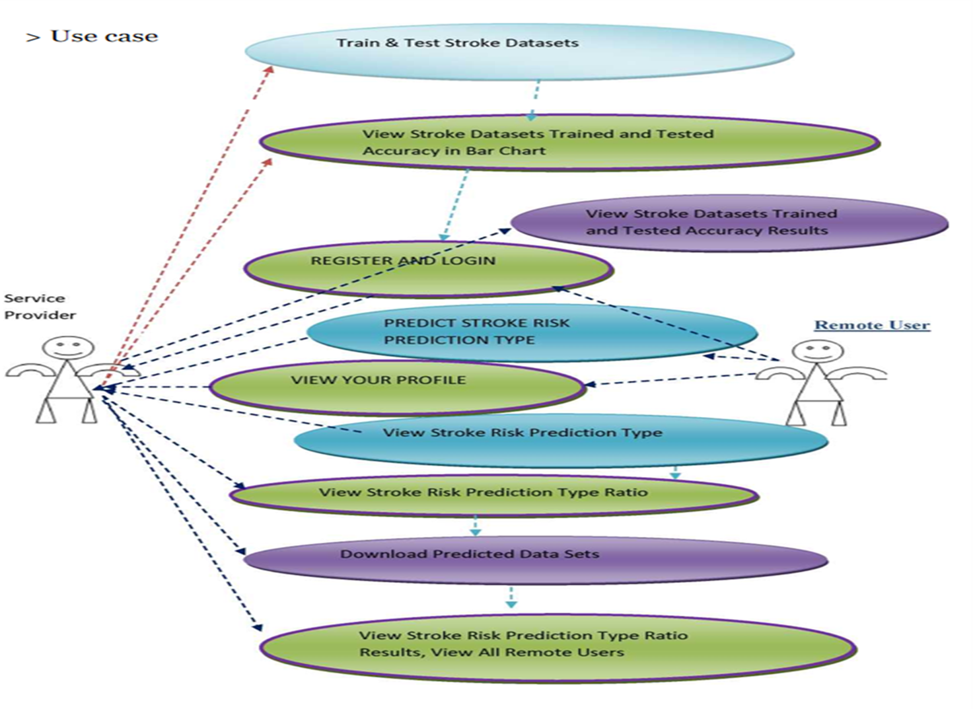
SYSTEM ARCHITECTURE

Slide 12
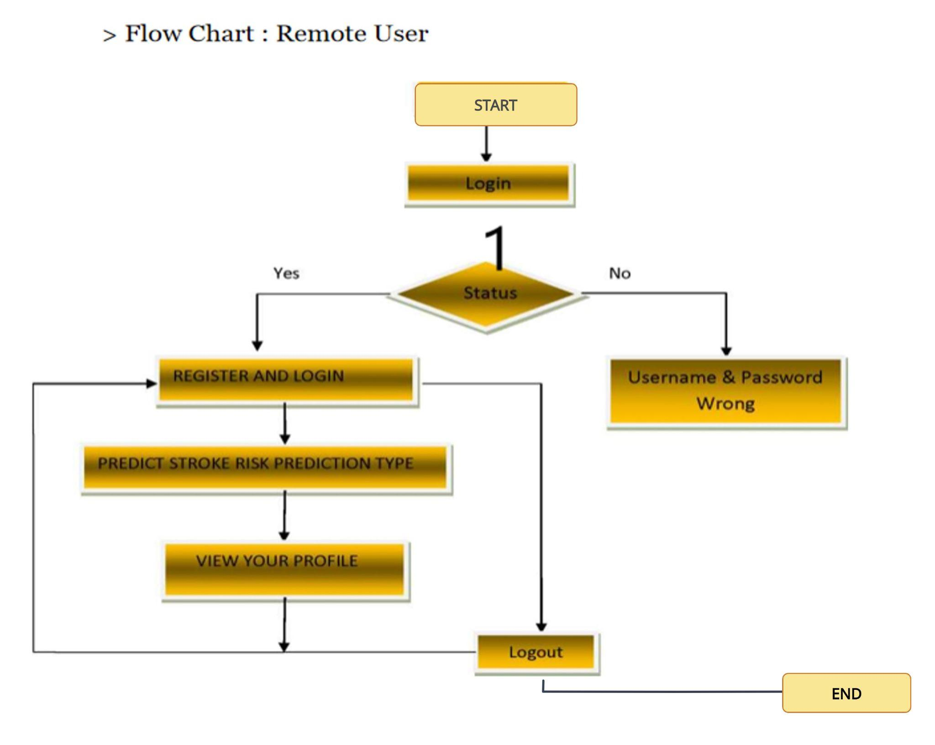
FLOWCHART- REMOTE USER

Slide 13
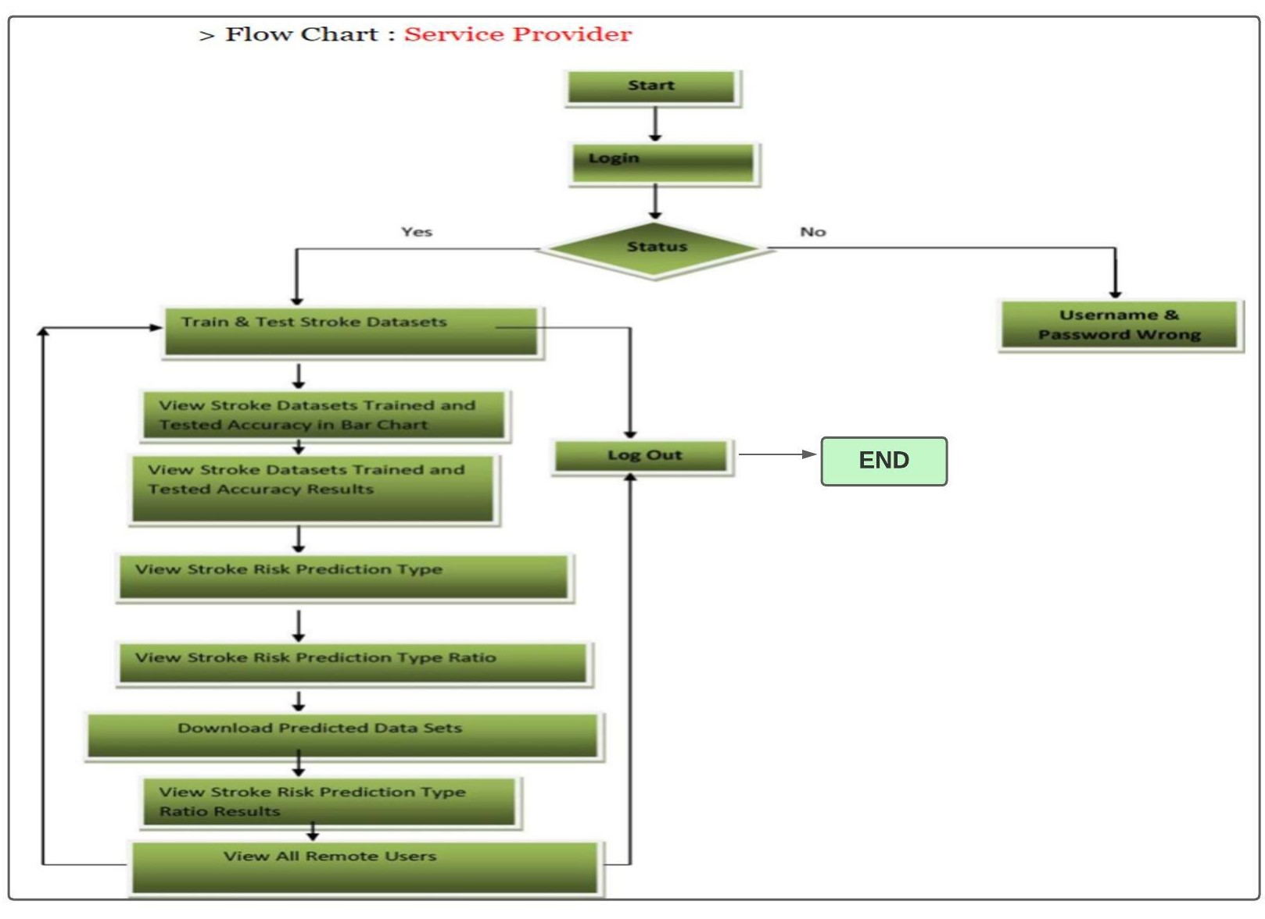
Flowchart : Service Provider

Slide 14
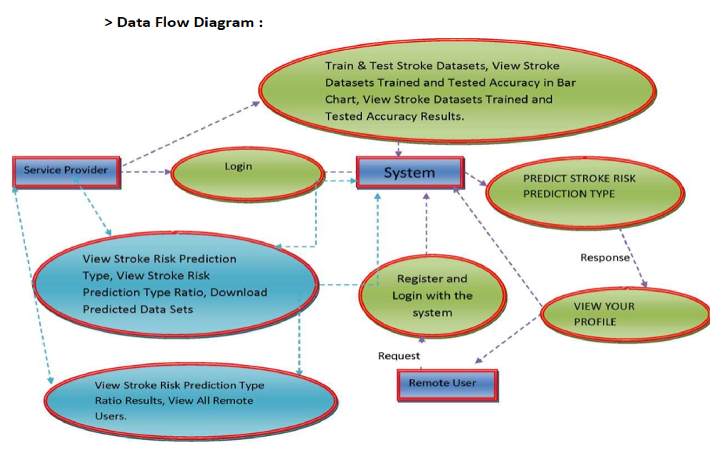
DATA FLOW DIAGRAM

Slide 15
MODELS
LOGISTIC REGRESSION
Logistic regression is one of the most popular Machine Learning algorithms, which comes under the Supervised Learning technique. It is used for solving the classification problems.It gives the values which lie between 0 and 1.
DECISION TREE
A decision tree algorithm is a machine learning technique that visually represents decisions and their possible consequences as a tree-like structure, making it useful for both classification and regression tasks. It works by dividing data into smaller subsets based on input features, creating a tree structure of decisions to predict outcomes.

Slide 16
MODELS
RANDOM FOREST
Random Forest is a machine learning algorithm that combines multiple decision trees to make more accurate predictions. It's versatile, handles complex data well, and is used for classification and regression tasks.
K-NEAREST NEIGHBOUR
K-Nearest Neighbors (KNN) is a simple machine learning algorithm used for classification and regression tasks. It makes predictions by finding the majority class or averaging nearby data points based on the k closest neighbors in the dataset.
SUPPORT VECTOR MACHINE
Support Vector Machine (SVM) is a powerful machine learning algorithm used for classification and regression tasks. It works by finding the best hyperplane that separates data into distinct classes.

Slide 17
PARAMETERS
1.Age
2.Hypertension
3.Heart disease
4.Ever married
5.Work type
6.Residence type
7.Avg glucose level
8.BMI
9.Smoking status
10.Stroke
11.Results

Slide 18
DATA PRE-PROCESSING
1.Getting the dataset
2.Importing libraries
3.Importing datasets
4.Finding Missing Data
5.Splitting dataset into training and test set
6.Feature scaling

Slide 19
ADVANTAGES
1.Early prediction of Heart stroke can be done.
2.Helps in taking preventive measures.
3.Cost of medication will be minimised.
4.High performance.
5.Reduce the time complexity of doctors.
6.Cost effective for patients.
APPLICATIONS
When a patient is predicted as positive for heart disease, then the medical data for the patient can be closely analysed by the doctors.
Future prediction for diagnosis.

Slide 20
RESULTS
The motivation of this project was to find the most efficient Machine Learning algorithm for detection of heart diseases. This study compares the accuracy score of different algorithms for predicting heart disease using UCI machine learning repository dataset. The accuracies obtained for different models are as follows :
Logistic Regression : 79% (approx.)
Decision Tree : 75.5% (approx.)
Random Forest : 99.17% (approx.)
K-Nearest Neighbor : 82% (approx.)
SVM : 78.6% (approx.)
This indicates that the Random Forest is the most efficient algorithm with accuracy score of 99.17 for prediction of heart disease.

Slide 21
CONCLUSION
In this project we proposed a method for heart disease prediction using machine learning techniques, these results showed a great accuracy standard for producing a better estimation result. By introducing new proposed Random forest classification, we find the problem of prediction rate without equipment and propose an approach to estimate the heart rate and condition. Sample results of heart rate are to be taken at different stages of the same subjects, we find the information from the above input via ML Techniques.

Slide 22
FUTURE ENHANCEMENT
Multi-Disease Prediction:
Extend the model to predict not only heart strokes but also other related cardiovascular diseases. This could involve collecting and integrating data on conditions like hypertension, diabetes, and more.
Automated Hyperparameter Tuning:
Investigate automated methods, such as Bayesian Optimization or genetic algorithms, for optimizing the hyperparameters of your machine learning models. This can lead to improved model performance.
Integration with Electronic Health Records (EHR):
If not already integrated, consider incorporating electronic health record data, which can provide a richer source of patient information and enable more accurate predictions.

Slide 23
REFERENCES
[1] Emelia J. Benjamin, Michael J. Blaha, and Stephanie E. Chiuve. Heart
disease and stroke statistics— 2017 update a report from the American
Heart Association. Circulation, 135(10):e146–e603, 2017.
[2] Silvia Koton, Andrea L. C. Schneider, Wayne D. Rosamond, Eyal Shahar,
Yingying Sang, Rebecca F. Gottesman, and Josef Coresh. Stroke incidence
and mortality trends in us communities, 1987 to 2011. JAMA, 312(3):259–
268, 2014.
[3] Emelia J Benjamin, Paul Muntner, and Márcio Sommer Bittencourt.
Heart disease and stroke statistics— 2019 update: a report from the
American Heart Association. Circulation, 139(10):e56–e528, 2019.
[4] Aditya Khosla, Yu Cao, Cliff Chiung-Yu Lin, Hsu-Kuang Chiu, Junling
Hu, and Honglak Lee. An integrated machine learning approach to stroke
prediction. In Proc. KDD, pages 183–192. ACM, 2010.

Slide 24
THANK YOU

