Slide 1
ISCHEMILYZER

Slide 2
Overview
A stroke, or "brain attack," happens when blood flow to the brain is cut off . Strokes are the second leading cause of death in the world, according to the American Stroke Association. Most strokes are caused by a blood clot, plaque buildup, or a combination of these two things and are known as ischemic strokes.
Around 87 percent of all strokes are ischemic strokes. The other type of stroke, known as a hemorrhagic stroke, happens when a blood vessel in or around the brain becomes weak and ruptures.

Slide 3
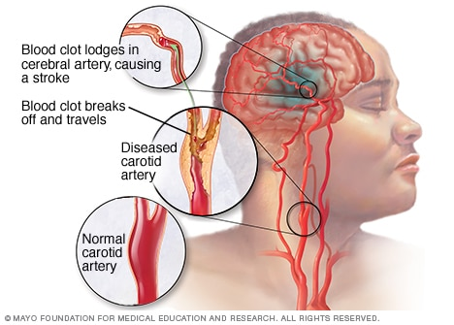
Ischemic stroke
When enough plaque collects in one spot, it can prevent blood from getting through to vital organs

Slide 4
Worldwide Statistics
According to the World Health Organization, 15 million people suffer stroke worldwide each year. Of these, 5 million die and another 5 million are permanently disabled.
High blood pressure contributes to more than 12.7 million strokes worldwide.
Europe averages approximately 650,000 stroke deaths each year.
In developed countries, the incidence of stroke is declining, largely due to efforts to lower blood pressure and reduce smoking. However, the overall rate of stroke remains high due to the aging of the population.

Slide 5
Symptoms
Trouble with speaking and understanding
Paralysis or numbness of the face, arm or leg
Trouble with seeing in one or both eyes
Headache
Trouble with walking

Slide 6
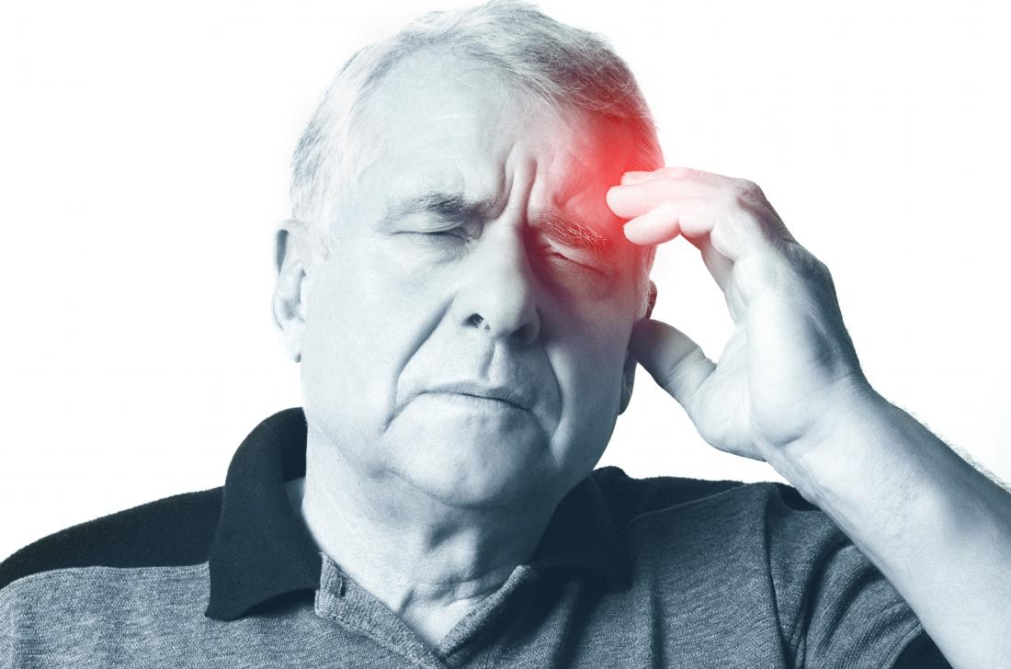
- Headache

Slide 7
Risk factors
Many factors can increase your stroke risk. Some factors can also increase your chances of having a heart attack. Potentially treatable stroke risk factors include:
Lifestyle risk factors
Being overweight or obese
Physical inactivity
Heavy or binge drinking
Use of illicit drugs such as cocaine and methamphetamines

Slide 8
Medical risk factors
Blood pressure readings higher than 120/80 millimeters of mercury (mm Hg)
Cigarette smoking or exposure to secondhand smoke
High cholesterol
Diabetes
Obstructive sleep apnea
Cardiovascular disease, including heart failure, heart defects, heart infection or abnormal heart rhythm
Personal or family history of stroke, heart attack or transient ischemic attack.

Slide 9
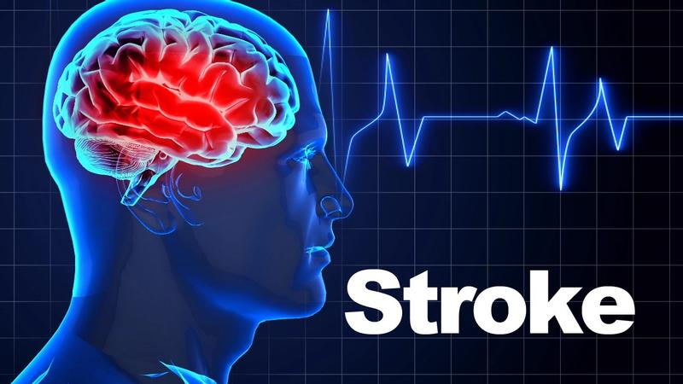
What if strokes can be predicted?

Slide 10
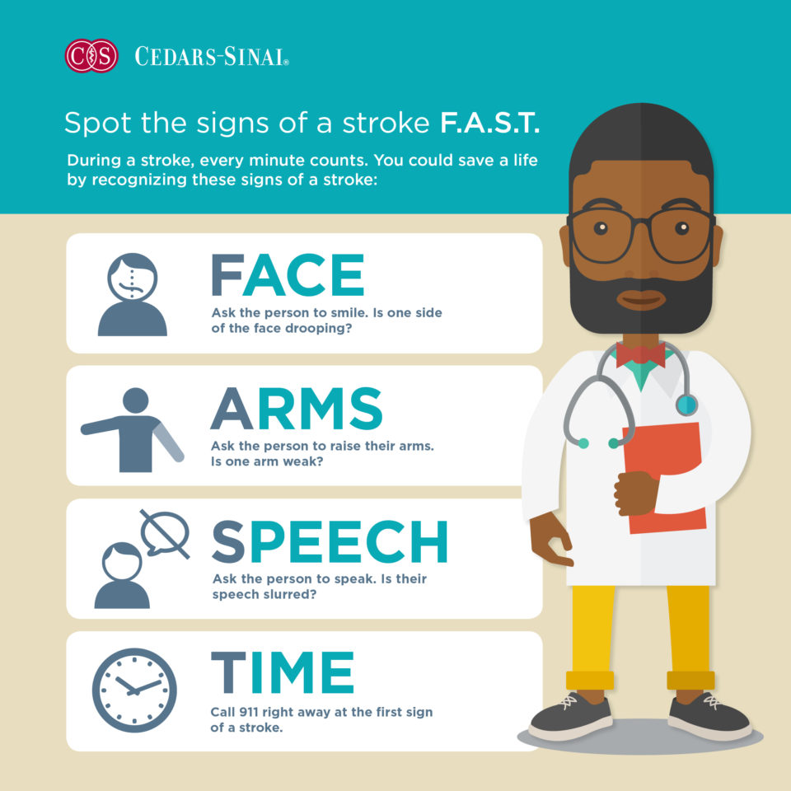

Slide 11
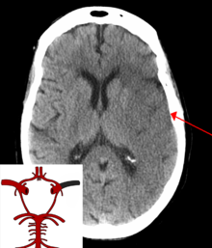
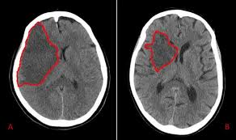
Our project is based on the prediction of paralysis.
We will create a dataset of CT scans images and provide to our machine platform so that it can be used to predict strokes.

Slide 12
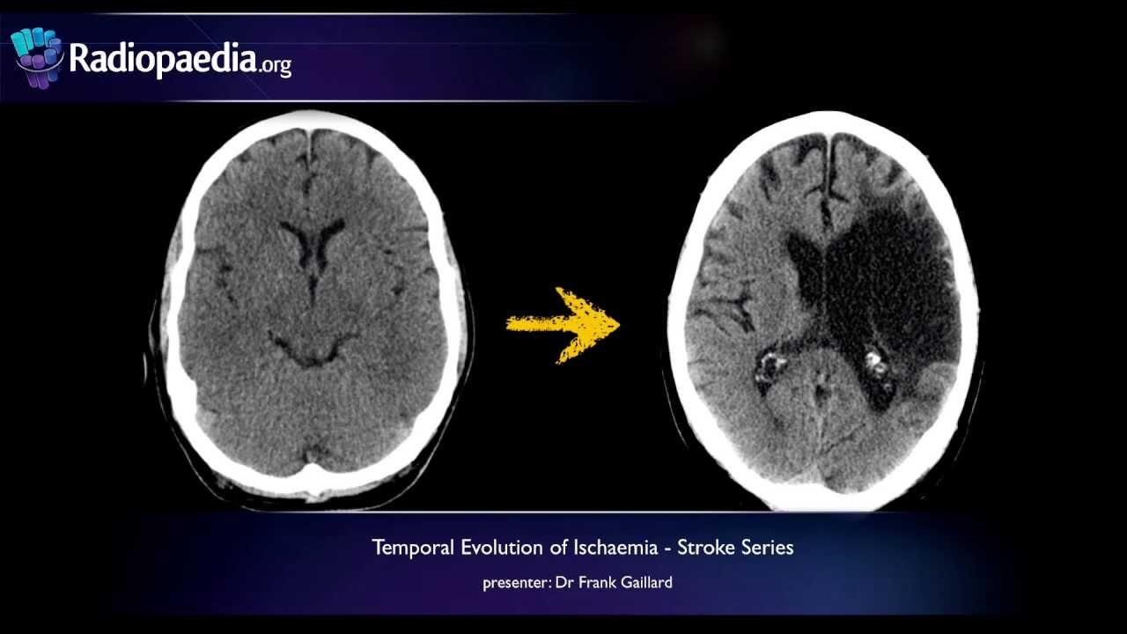

Slide 13
