Slide 1
M83:
Running VoigtFit Code

Slide 2

Importing packages

Slide 3
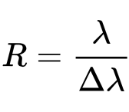
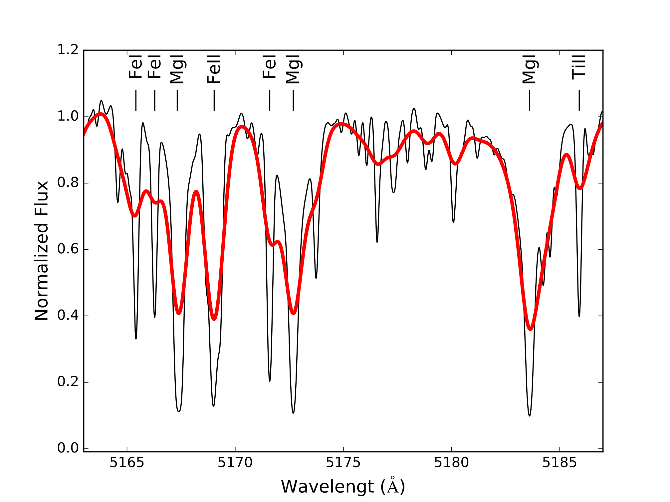

Resolving Power:
smallest difference in wavelengths that can be
distinguished at a wavelength of λ
R~ 30,000
R~ 7,000

Slide 4
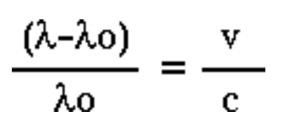
Velocity of a galaxy
An object in motion will have its radiation (light) shifted in wavelength.
$λ$ Measured/observed wavelength
$λ_{o}$ Original/rest wavelength
v speed of the object
c speed of light
Rest
Wavelength
Observed
Wavelength
$λ$ = 1144.5 A
$λ_{o}$ = 1144.0 A
c = 2.99e5 km/s
v = 131 km/s
1142
1144
Wavelength ($Å$)
1145
1142
1145
1144
Wavelength ($Å$)

Slide 5
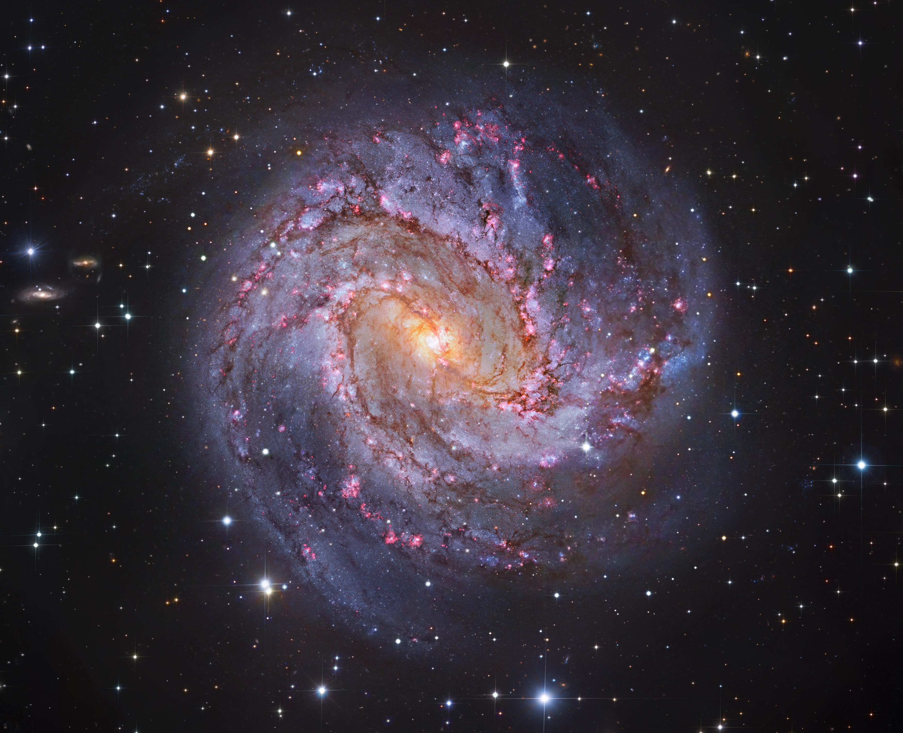
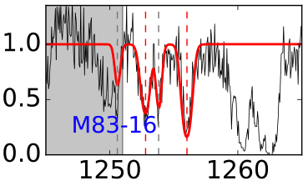
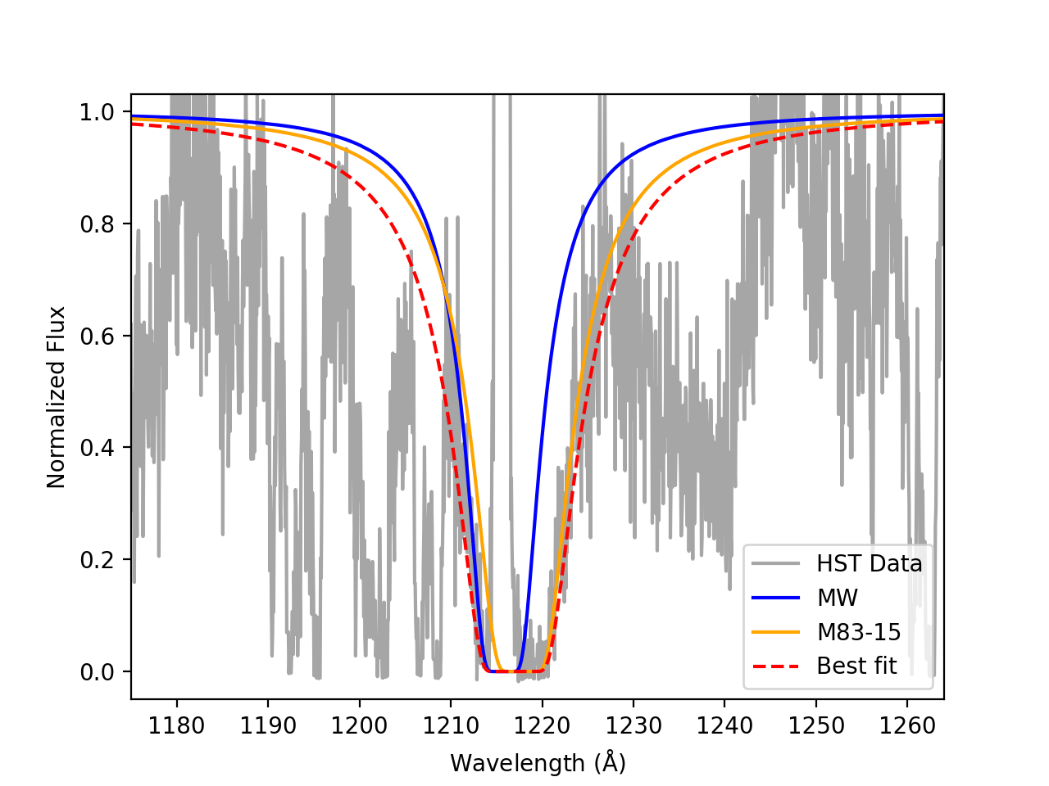
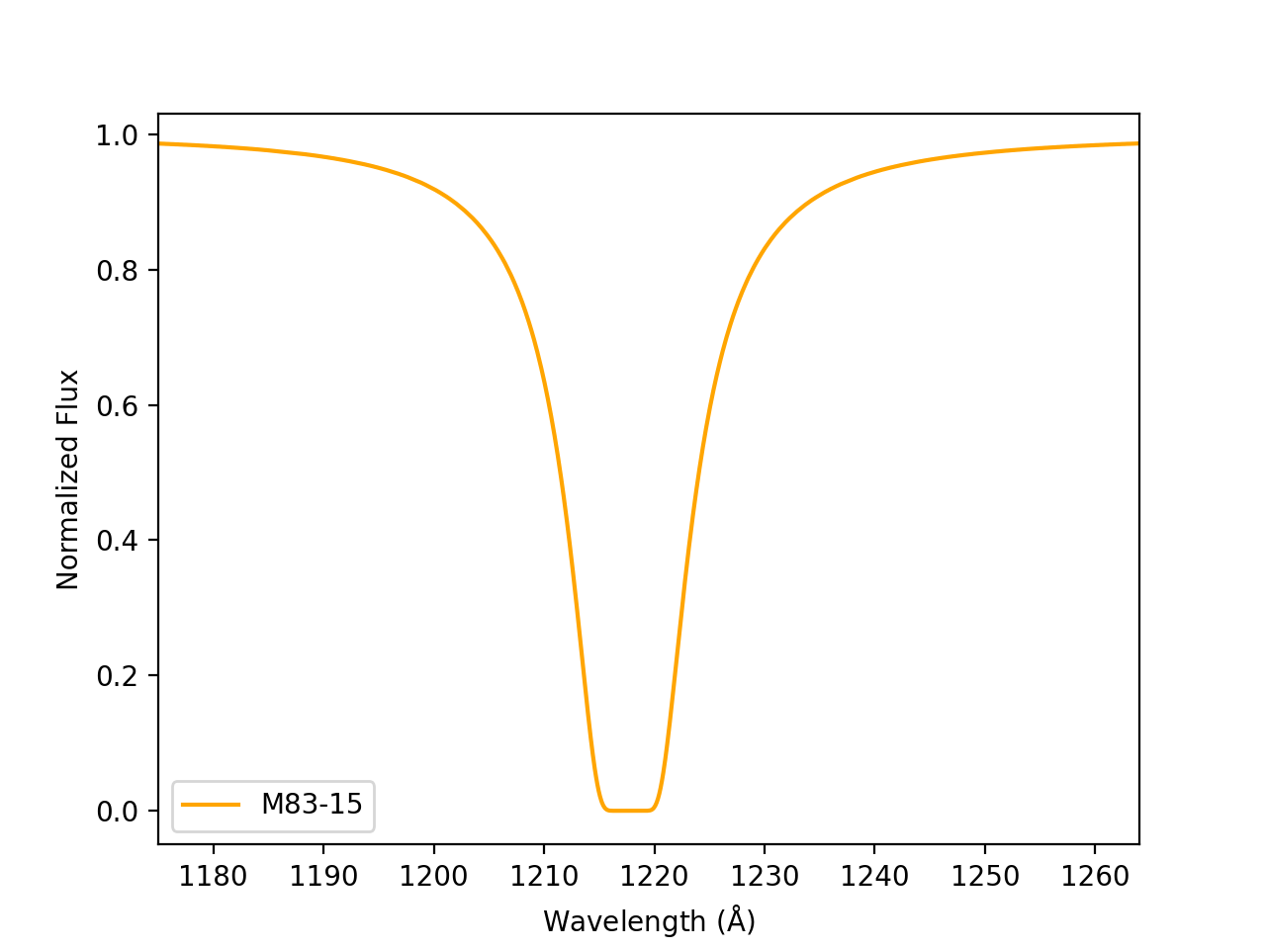
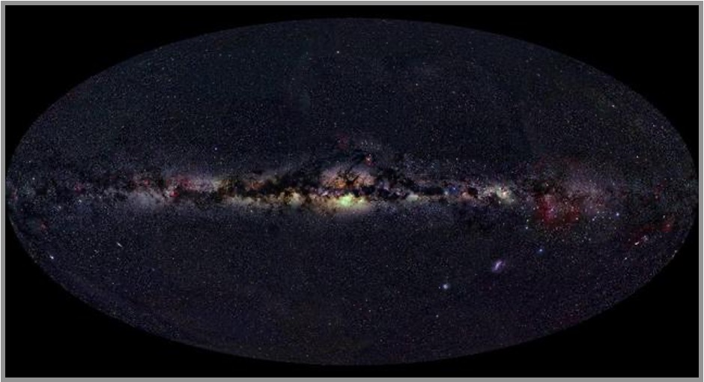
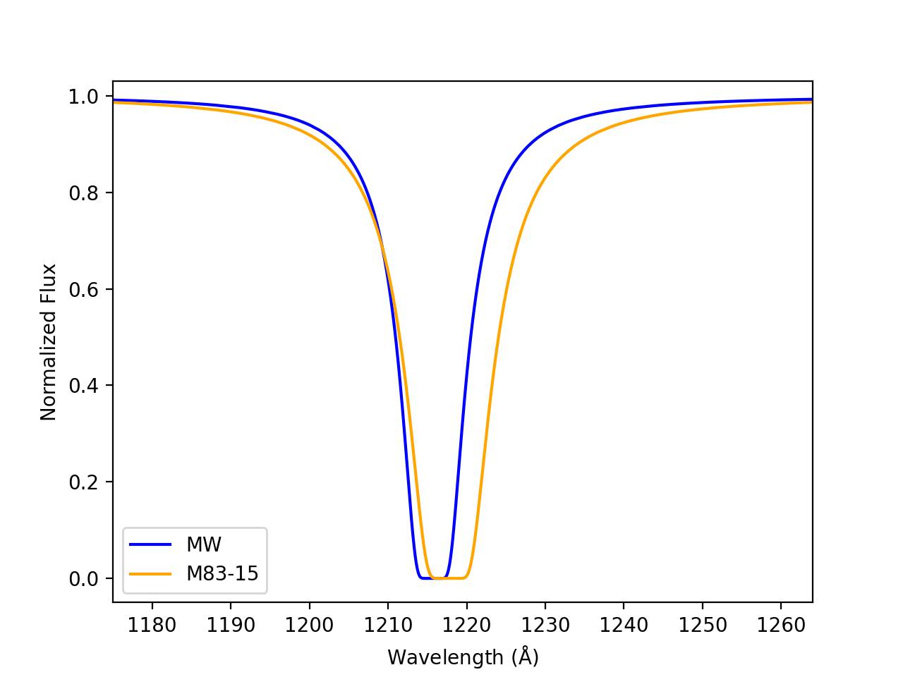
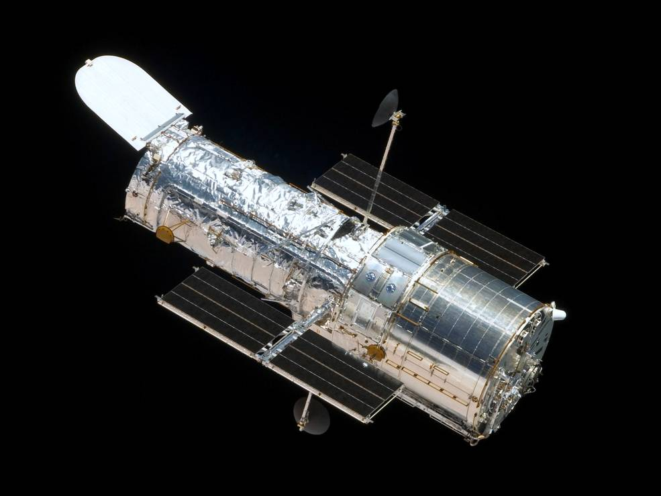
Multiple Components
SII 1250 $Å$
SII 1253 $Å$

