Slide 1
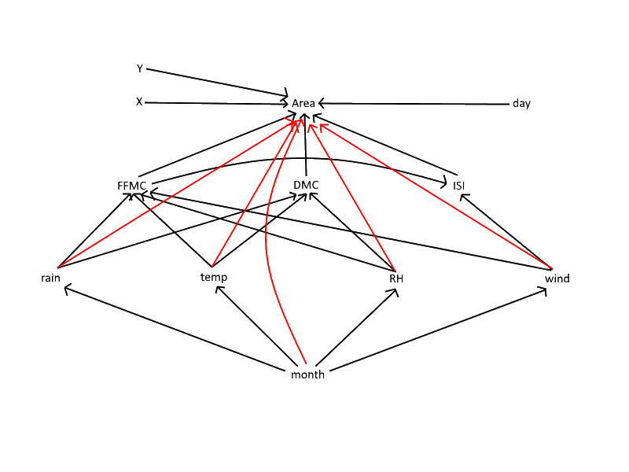
Forest fire network
Continuous and categorical data
517 measurements
Testing implies (in)dependencies
Cortez, P., & Morais, A. D. J. R. (2007). A data mining approach to predict forest fires using meteorological data.
Denise Klep, s4210646
Sven Den Hartog, s1003026
Jesse Zwamborn, s4314182
Notes:
Daily weather observations collected at 12:00 local standard time (LST) of:
• Ambient temperature (°C)
• Relative Humidity (RH) (%)
• Mean wind speed, at 10 m above surface (km/h)
• Rainfall, 24 hr total (mm)
FFMC depends on temp RH wind rain and previous FFMC
Initial Spread Index (Describes the potential rate at which a fire will spread )
Fine Fuel Moisture Code (top layer soil)
Duff Moisture Code (lower layer soil)

Slide 2
Forest fire network
Test
Denise Klep, s4210646
Sven Den Hartog, s1003026
Jesse Zwamborn, s4314182

