Slide 1
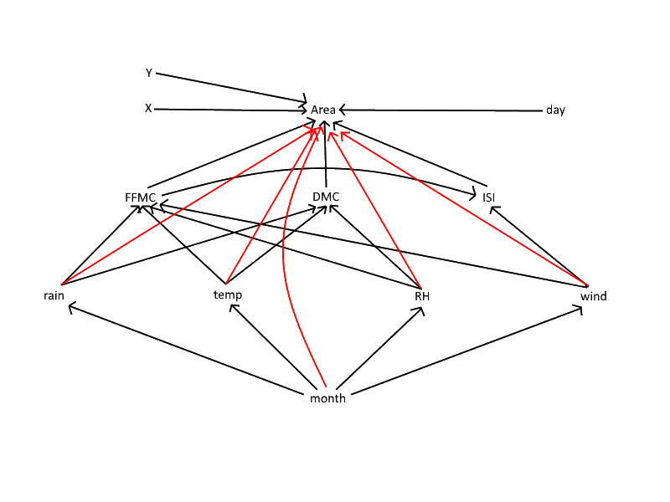
Forest fire area predictor
-text here
And here maybe
Or even down here, Australia-
style

Slide 2
Forest fire network
Stuff
Conclusions:
Two males fucking is pretty gay

