Slide 1
Perceptual distance in Norwegian retroflexion
Sverre Stausland Johnsen
Phon circle, MIT
Nov 2 2009

Slide 2
Norwegian retroflexes
In Urban East Norwegian (UEN), a laminal coronal series /t d n s/ contrasts with a retroflex series /T D N S/
/kɑt/ ‘cat’ - /kɑT/ ‘map’
/ɾɔːd/ ‘advice’ - /ɭɔːD/ ‘lord’
/tʉːn/ ‘yard’ - /tʉːN/ ‘gymnastics’
/mɑːs/ ‘nagging’ - /mɑːS/ ‘Mars’

Slide 3
Norwegian retroflexion
Retroflexes can also be derived across morpheme boundaries
When a morpheme ends in /-ɾ/, and the following morpheme begins with /t d n s/, the sequence surfaces as /T D N S/
/ʋɔːɾ-tæjn/ > /ʋɔː-Tæjn/ ‘spring sign’
/ʋɔːɾ-dɑːg/ > /ʋɔː-Dɑːg/ ‘spring day’
/ʋɔːɾ-nɑt/ > /ʋɔː-Nɑt/ ‘spring night’
/ʋɔːɾ-suːɽ/ > /ʋɔː-Suːɽ/ ‘spring sun’

Slide 4
Rate of retroflexion
Two experiments tested how often retroflexion is applied
The results revealed the following hierarchy:
d/n > sk > st > s
(> = ‘undergoes retroflexion significantly more often than’)
This means that /d/ is more likely to alternate with /D/ than /s/ is to alternate with /S/

Slide 5
Perceptual distance
Steriade (2001, 2009) proposes that the greater the perceptual distance between two forms x and y, the less likely x and y are to alternate
Could imply that /s/ alternates less with /S/ than /d/ with /D/ because the perceptual distance in /s/-/S/ is greater than in /d/-/D/
If so …

Slide 6
Perceptual distance hierarchy
Then the perceptual distance hierarchy should be the inverse of the retroflexion hierarchy
Retroflexion hierarchy:
d/n > sk > st > s
Hypothesized perceptual distance hierarchy:
s > st > sk > d/n (& t)
= The perceptual distance /s/-/S/ is greater than the perceptual distance /st/-/ST/, etc.

Slide 7

Perceptual experiment
12 UEN subjects in an AX discrimination task
Stimuli were two groups of /ɑCɑ/ words:
  C = /s st sk t d n/
  C = /S ST SK T D N/
Amplitude of the vowels was RMS equalized
Trial overlaid with babble noise (S/N ca. –7 dB)
/ɑsɑ/ - /ɑSɑ/
192 trials x 12 subjects = 2304 trials

Slide 8
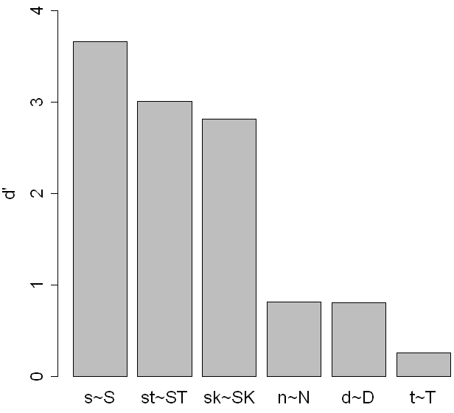
*
*
*
*

Slide 9
Perceptual hierarchy from the experiment:
s > sC > t/d/n
sC = st > sk ?
In the experiment /st/ and /sk/ were treated the same
Could be the result of the relatively clear distinction between the sibilants in /st/ - /ST/ and /sk/ - /SK/

Slide 10
In the experiment, the /s-S/ distinction trumps any other distinctions, so /st/ and /sk/ come out the same
If so, /st/ and /sk/ should be the same when only the sibilant is presented
Subjects were presented with only /ɑs/ and /ɑS/, excised from the original /ɑstɑ/-/ɑskɑ/ sets

Slide 11
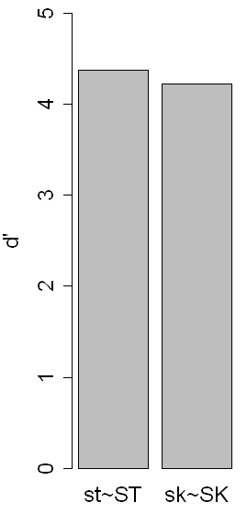
p = .98

Slide 12
If /st/ is different from /sk/, then the difference lies in the following consonant
Test whether the remaining /t-T/ is more distinct than /k-K/

Slide 13
If /c/ can be distinguished from /C/, it means that they have different phonetic qualities correlating with the quality of the preceding sibilant (/s/-/S/)
Speakers should be able to identify the preceding sibilant from the quality of the stop
The perceptual distance /c/-/C/ was therefore measured by how successfully subjects identified the preceding sibilant as /s/ or /S/

Slide 14
Presented as an identification task
No added noise
/Tɑ/ /tɑ/
96 trials x 12 subjects = 1152 trials

Slide 15
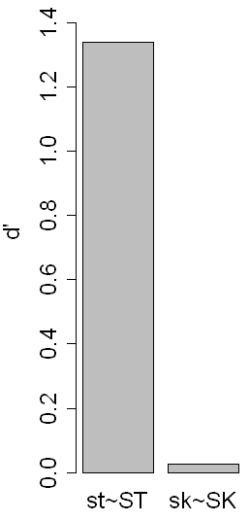
*
*

Slide 16
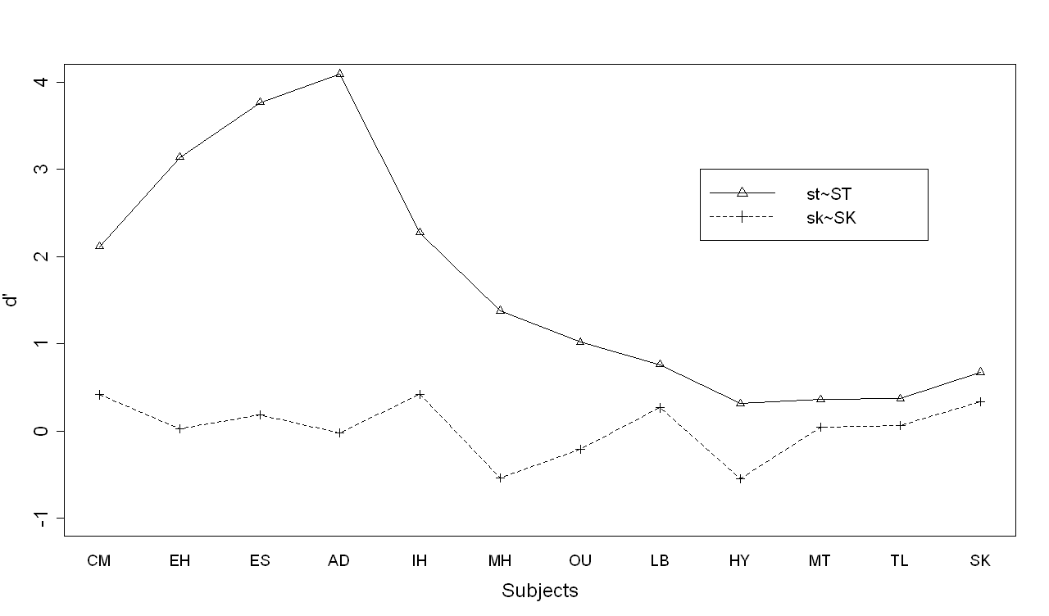

Slide 17
The hypothesized perceptual distance hierarchy is confirmed

Slide 18
The question
How can perceptual distance influence phonological production?

Slide 19
Speakers have a detail rich representation of words and categories (Goldinger 1998)
This representation is continuously updated
When perceiving a token, various factors might
  Make correct lexical access difficult or
  Prevent correct lexical access altogether
  Perceptual distance is such a factor

Slide 20
Marslen-Wilson et al. 1996
Result:
x-y pairs where a non-word y differed from a word x only in the initial segment. The greater the perceptual distance between x and y, the less y activated word x
Implication:
The greater the perceptual distance in x-y, the greater the chance that y is not identified as x
(with a different pronunciation)

Slide 21
Whenever UEN [Suːɽ] is accessed as a token of the word /suːɽ/, it is recognized as /suːɽ/ with a different pronunciation
But with the large perceptual distance between /suːɽ/ and /Suːɽ/, tokens like [Suːɽ] will on occasion not be recognized as the word /suːɽ/
For [Nɑt]-/nɑt/, where the perceptual distance is very small, this happens much less often

Slide 22
Words in /s-/ will be updated with [S]-tokens less often than words in /n-/ are updated with [N]-tokens
Over time, this can accumulate to significant differences (Wedel 2006)

Slide 23
Phonological productions are directly influenced by speakers’ own detailed representations (Goldinger 1998, Pierrehumbert 2002)
If these representations contain fewer [S]-tokens relative to /s/ than [N] to /n/, then speakers will replicate that distribution in production
In short, people say what they hear …

Slide 24
Summary
The rate of retroflexion of a coronal /c/ is inversely correlated with the perceptual distance between /c/ and the retroflex /C/
The greater the distance /c/-/C/, the more often a retroflexed [C]-token will not be identified with the /c/-word
As a direct result, speakers replicate this pattern in their own production

Slide 25
References
Goldinger, S. 1998. Echoes of echoes? An episodic theory of lexical access.
Marslen-Wilson, W., H. Moss & S. van Halen. 1996. Perceptual distance and competition in lexical access.
Pierrehumbert, J. 2002. Word-specific phonetics.
Steriade, D. 2001. Directional asymmetries in place assimilation.
Steriade, D. 2009. The phonology of perceptibility effects.
Wedel, A. 2006. Exemplar models, evolution, and language change.

