Slide 1
Perceptual distance & sound change
GSAS workshop on historical linguistics
Oct 16 2009

Slide 2
Norwegian retroflexes
In Urban East Norwegian (UEN), a laminal coronal series /t d n s/ contrasts with a retroflex series /ʈ ɖ ɳ ʂ/
/kɑt/ ‘cat’ - /kɑʈ/ ‘map’
/ɾɔːd/ ‘advice’ - /ɭɔːɖ/ ‘lord’
/tʉːn/ ‘yard’ - /tʉːɳ/ ‘gymnastics’
/mɑːs/ ‘nagging’ - /mɑːʂ/ ‘Mars’

Slide 3
Norwegian retroflexion
Retroflexes can also be derived across morpheme boundaries
When a morpheme ends in /-ɾ/, and the following morpheme begins with /t d n s/, the sequence surfaces as /ʈ ɖ ɳ ʂ/
/ʋɔːɾ-tæjn/ > /ʋɔː-ʈæjn/ ‘spring sign’
/ʋɔːɾ-dɑːg/ > /ʋɔː-ɖɑːg/ ‘spring day’
/ʋɔːɾ-nɑt/ > /ʋɔː-ɳɑt/ ‘spring night’
/ʋɔːɾ-suːɽ/ > /ʋɔː-ʂuːɽ/ ‘spring sun’

Slide 4
Obligatory retroflexion?
Retroflexion across morpheme boundaries is described as obligatory and beyond speakers’ active control (Eliasson 1986, Kristoffersen 2000, Torp 2007)
According to native intuition, however, retroflexion is optional for onsets in /s/, especially when followed by a vowel
/ʋɔːɾ-suːɽ/ > /ʋɔː-ʂuːɽ/ ~ /ʋɔː-suːɽ/ ‘spring sun’

Slide 5
Experiments
Two experiments were designed to test the retroflexion rate for onsets in /sV-/ and /sC-/
Ten UEN subjects
Experiment 1: Nonce word in /-ɾ/ + high-frequent monosyllables in /sV-/ and /st-/
Experiment 2: /sɔməɾ/ ‘summer’ + nonce monosyllables in /sV-/, /st-/ and /sk-/
In total 5800 compound tokens

Slide 6
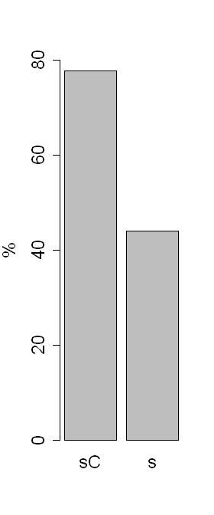
*
*
*

Slide 7
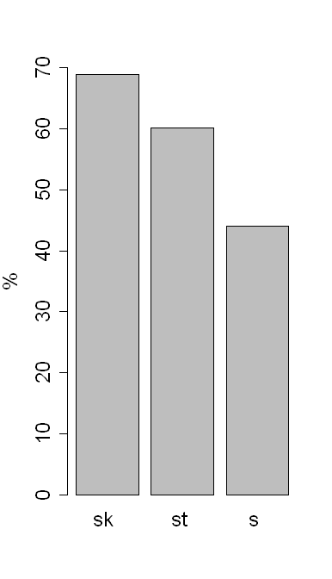
*
*
*
*

Slide 8
The experiments were not designed to test other retroflexes
But there were in total 745 fillers with onsets in /d-/ and /n-/
The mixed effects logistic regression shows that they undergo retroflexion significantly more often than /st-/ and /sk-/

Slide 9
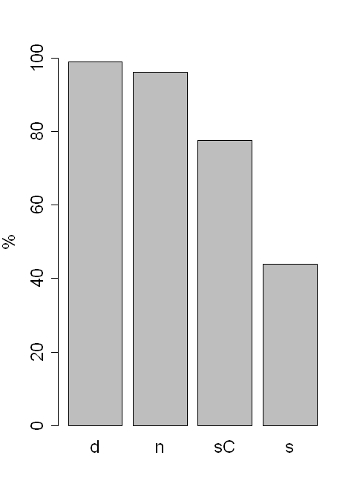
*
*
*
*
*
*

Slide 10
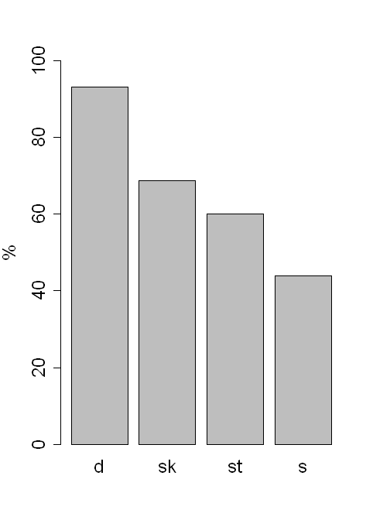
**
*
*
*
*

Slide 11
Retroflexion hierarchy
With respect to the likelihood of undergoing retroflexion, there is a descriptive hierarchy:
(t?)/d/n > sk > st > s

Slide 12
Perceptual distance
Steriade (2001, 2009) proposes that the greater the perceptual distance between x and y, the less likely x and y are to alternate
The reason why /st/ undergoes retroflexion less often than /sk/ could therefore be that the perceptual distance between /st/ and its retroflex counterpart ‘/ST/’ is greater than the perceptual distance between /sk/ and its retroflex counterpart ‘/SK/’

Slide 13
Perceptual distance
Hypothesis:
The hierarchy for perceptual distances between x and its retroflex counterpart X is the inverse of the retroflexion hierarchy
Retroflexion hierarchy:
(t?)/d/n > sk > st > s
Hypothesized perceptual distance hierarchy:
s > st > sk > t/d/n

Slide 14
Perceptual experiment
12 UEN subjects participated in an AX discrimination task
The stimuli were of the format /ɑCɑ/, where /C/ is a morpheme internal /s st sk t d n/ or the retroflex counterpart /S ST SK T D N/, as produced by a native UEN speaker
Where A=X, the two tokens were non-identical

Slide 15
Perceptual experiment
The vocalic portions of the stimuli were RMS equalized to an amplitude of 0.03 Pa
Each trial was overlaid with babble noise (69 dB, 0.056 Pa)
ISI = 2 sec
To participate in the experiment, the subjects needed to complete a noise-free training phase without errors
192 trials x 12 subjects = 2304 trials

Slide 16
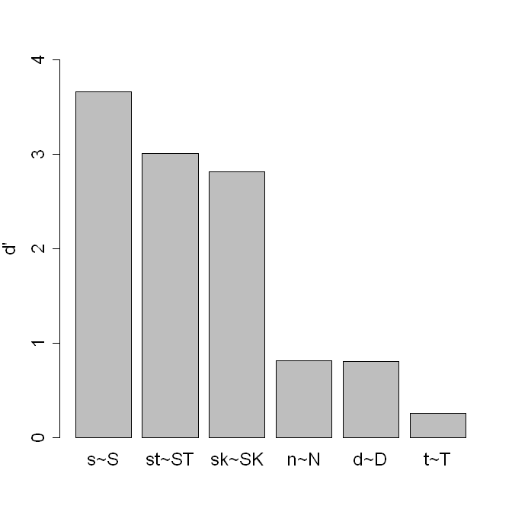
p = .14

Slide 17
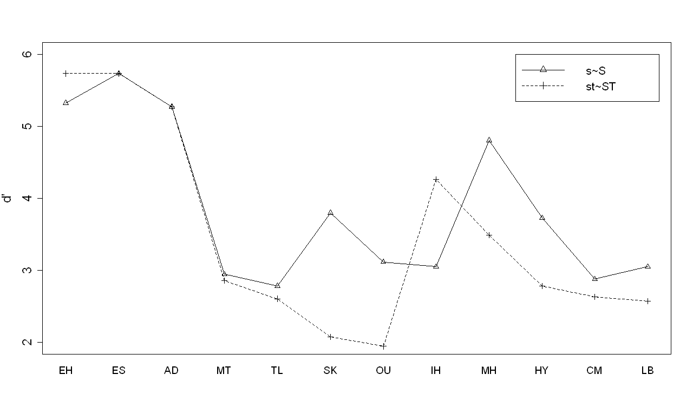

Slide 18
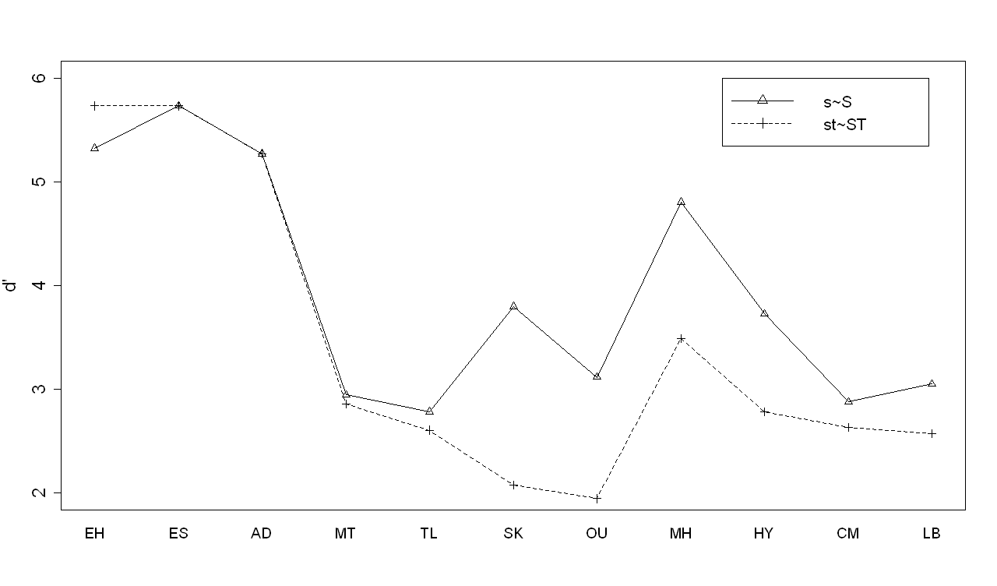

Slide 19
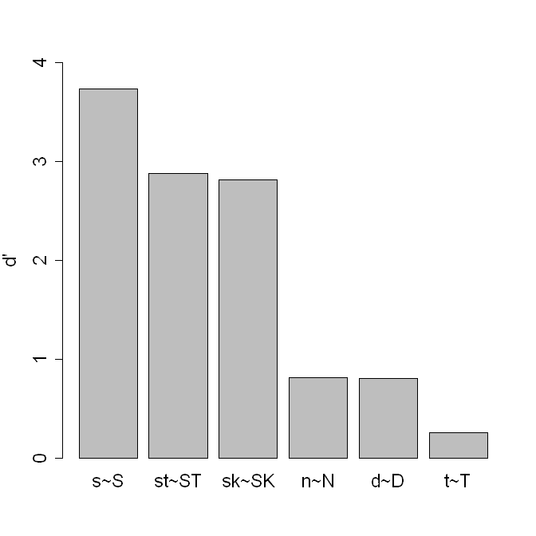
p = .027
*

Slide 20
p = .35
*
*
*

Slide 21
Discussion
The perceptual distance hierarchy:
s > sC > t/d/n
sC = st > sk?
The experiment failed to show that /st/ is significantly different from /sk/
Could be the result of the relatively clear distinction between the sibilants in /st/ - /ST/ and /sk/ - /SK/

Slide 22
Does not mean that the /st/ pair is not different from the /sk/ pair
In the experiment, the /s-S/ distinction trumps any other distinctions, so /st/ and /sk/ come out almost the same
To test this idea, the original stimuli /ɑstɑ-ɑSTɑ/, /ɑskɑ/-/ɑSKɑ/ were split

Slide 23
Perceptual experiment 2
Same setup as in the main experiment
The stimuli consist only of /ɑs/ and /ɑS/, excised from the original stimuli
48 trials x 12 subjects = 576 trials
Hypothesis: /s(t)/ and /s(k)/ will come out equally distinct

Slide 24
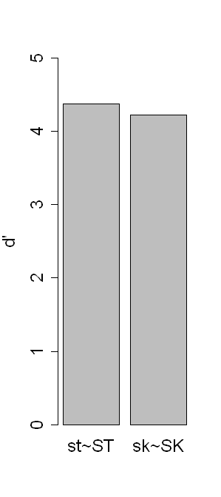
p = .98

Slide 25
Perceptual experiment 3
Subjects are presented with release burst plus the final /ɑ/, excised from the original /st/ /sk/ stimuli
No added noise
Identification task, where subjects are asked to identify the preceding absent sibilant as /s/ or /S/

Slide 26
Subjects will not be able to answer differently in line with the stimuli unless they perceive the stimuli as distinct
Two tests in one:
Perceptual distinction
Awareness of cooccurrence restrictions and/or coarticulation effects

Slide 27
Hypothesis:
Subjects are significantly better at distinguishing /t/ from /T/ than /k/ from /K/
As a result, they will be significantly better at guessing which sibilant preceded /t/ and /T/ than /k/ and /K/

Slide 28
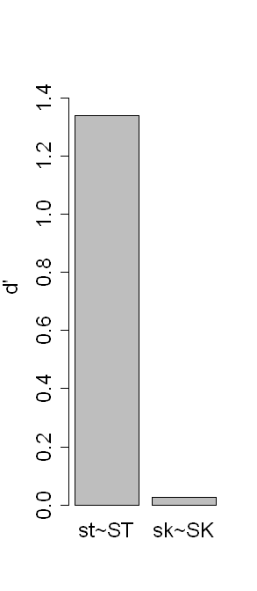
**

Slide 29
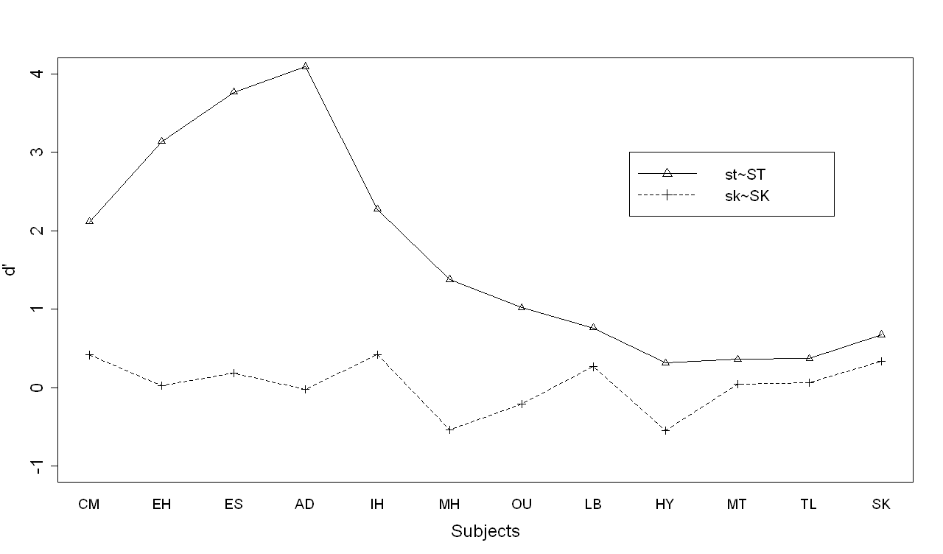

Slide 30
Perceptual distance hierarchy
The hypothesis is confirmed:
The perceptual distance hierarchy is the inverse of the retroflexion hierarchy:
Retroflexion hierarchy:
(t?)/d/n > sk > st > s
Perceptual distance hierarchy:
s > st > sk > t/d/n

Slide 31
Questions
How can perceptual distance influence how phonology operates?
Experiments have shown that:
Speakers’ perception of words has a direct influence on the speakers’ own production of those words
Various conditions might cause listeners to fail to recognize a word token as that word – or as a word at all

Slide 32
This means that:
Speakers are continuously updating their phonological representations
Some word tokens are left unidentified and do not contribute to the updating of those words

Slide 33
A proposal
In a base form A with a segment x₁ and a variant with segment x₂, the greater the perceptual distance between Ax₁ and Ax₂, the greater the risk of Ax₂ not being recognized as a token of word A.
For words with a great perceptual Ax₁-Ax₂ difference, A will more often fail to be updated with Ax₂ tokens

Slide 34
The phonological representation of A will on average contain fewer Ax₂ tokens than another word B where the x₁-x₂ difference is smaller
Since speakers’ representations directly influence their own productions, speakers will on average produce fewer Ax₂ tokens than Bx₂ tokens

Slide 35
An illustration
In UEN, the perceptual distance [suːɽ]-[ʂuːɽ] is great, whereas the distance in [nɑt]-[ɳɑt] is small
As a result, more tokens of [ʂuːɽ] will not be recognized as the word /suːɽ/ than would be the case for [ɳɑt] = /nɑt/
Therefore, we predict that speakers will produce fewer [ʂ]-tokens of /s/-words than [ɳ]-tokens of /n/-words
The initial experiments confirm this prediction

