Slide 1

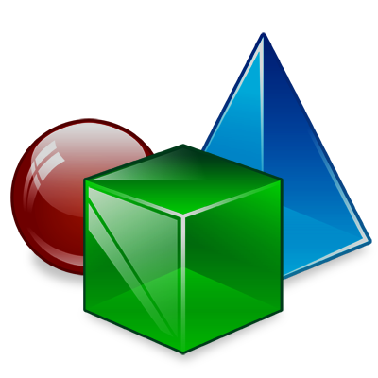



Object-Oriented Programming Team work
Team "Honeydew"
Object-Oriented

Slide 2
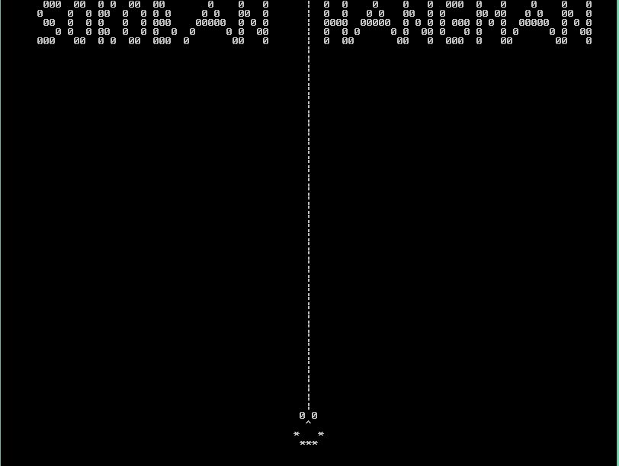
Sokoban & Hangman
You want to play, but don’t know what ?!?
Now you can choose.

Slide 3
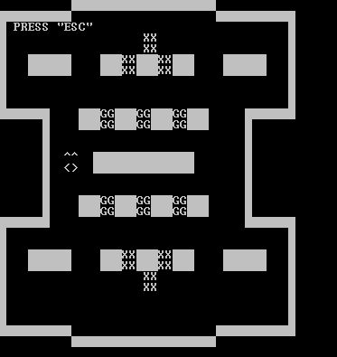
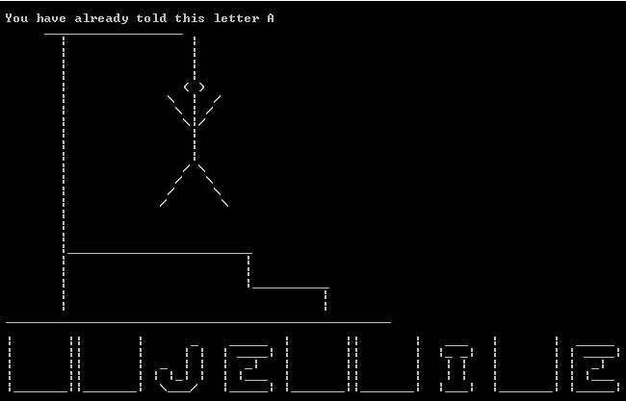
Sokoban || Hangman

Slide 4

How is created?
5 Interfaces
5 Helping classes
1 Main GameEngine class
Drawing is implemented with 2 Classes
and many hours of head banging

Slide 5
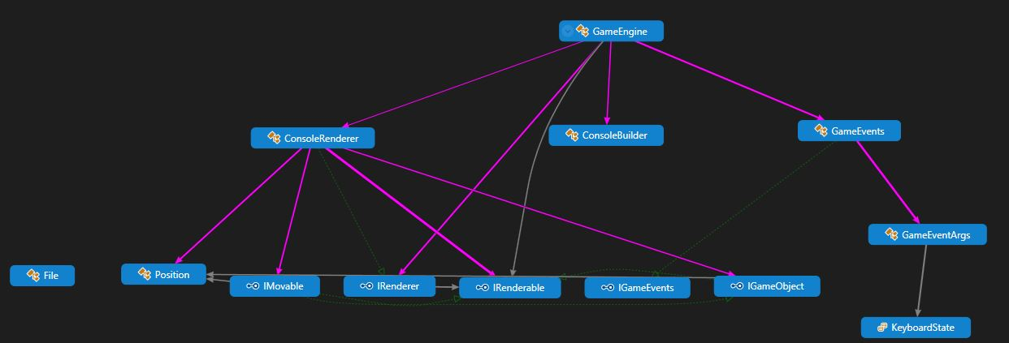
Diagrams of the used Classes
Our main classes have this Diagram

Slide 6
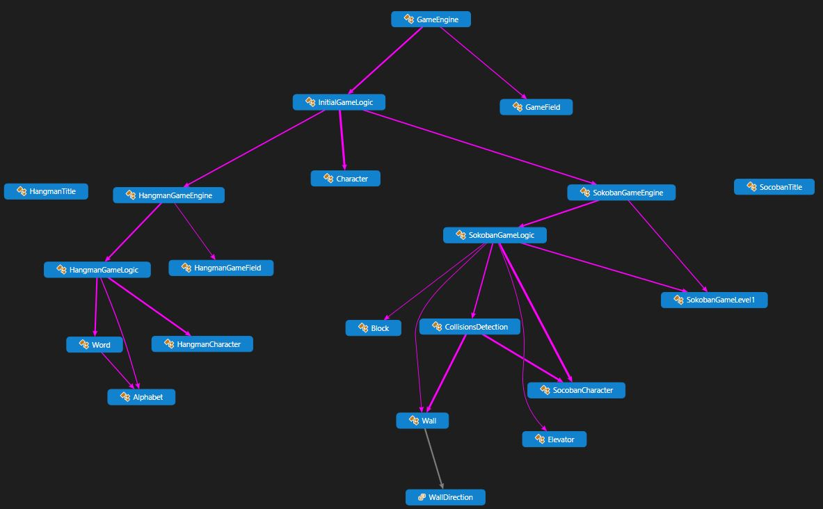
Diagrams of the used Classes(2)
Our Game classes are as follow

Slide 7
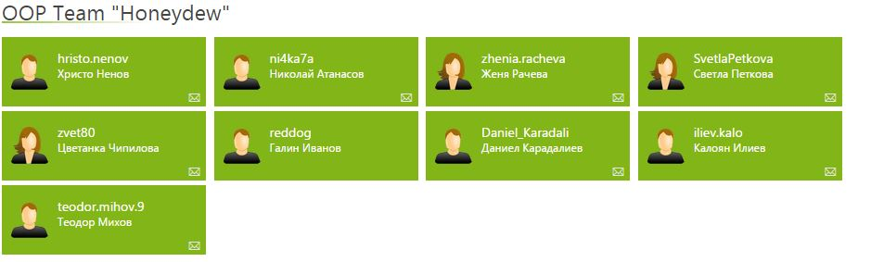
Who are we?
We are a little team of enthusiast , with plans to became a good developer in the near future.

