Slide 1

Spring Fundamentals
Spring Boot Introduction
SoftUni Team
Technical Trainers
Software University
https://softuni.bg

Slide 2
Table of Contents
What's Spring Boot?
Spring Data

Slide 3
Questions
sli.do #java-web

Slide 4

What is Spring Boot?

Slide 5





Spring Boot
Opinionated view of building production-ready Spring applications
Tomcat
pom.xml
Gradle
Spring Boot
Auto configuration

Slide 6
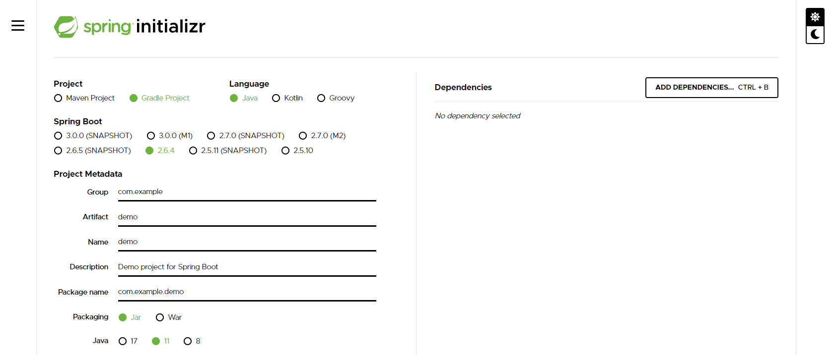
Creating Spring Boot Project
Just go to https://start.spring.io/

Slide 7
Spring Dev Tools
Additional set of tools that can make the application development faster and more enjoyable
In Maven:
In Gradle:
pom.xml
<dependency> <groupId>org.springframework.boot</groupId> <artifactId>spring-boot-devtools</artifactId> <scope>runtime</scope> </dependency>
build.gradle
dependencies {
compileOnly("org.springframework.boot:spring-boot-devtools")
}

Slide 8
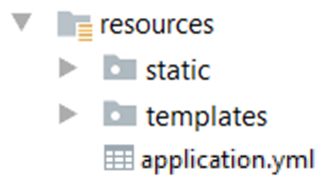
Spring Resources
HTML, CSS, JS
Thymeleaf templates
Yaml configuration

Slide 9

Spring Boot Main Components
Some main components:
Spring Boot Starters - combine a group of common or related dependencies into single dependency
Spring Boot Auto-Configuration - reduce the Spring Configuration
Spring Boot Actuator – provides EndPoints and Metrics
Spring Data – unify and ease the access to
different kinds of database systems

Slide 10
Spring Boot Starters
spring-boot-starter-web
spring-boot-starter-tomcat
spring-web
spring-data
…
tomcat-embed-core​
…
spring-webmvc
…
spring-jpa
…
spring-aop
spring-beans
spring-context
spring-core
…

Slide 11
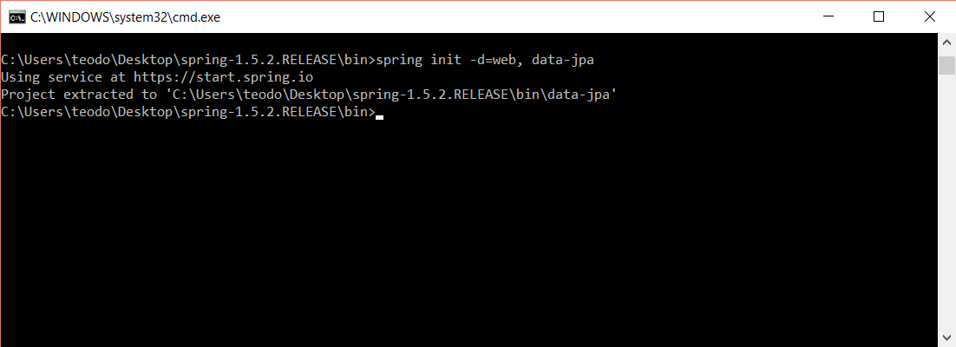
Spring Boot CLI
Command Line Interface - Spring Boot software to run and test Spring Boot applications

Slide 12
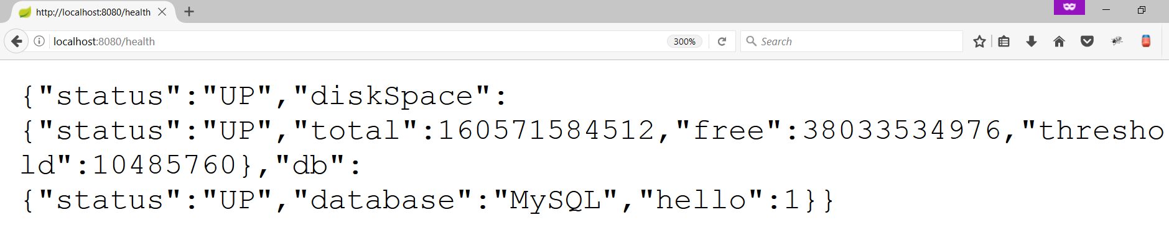
Spring Boot Actuator
Expose different types of information about the running application
build.gradle
dependencies {
compileOnly("org.springframework.boot:spring-boot-starter-actuator")
}

Slide 13
Inversion of Control
Spring provides Inversion of Control and Dependency Injection
UserServiceImpl.java
UserServiceImpl.java
//Traditional Way
public class UserServiceImpl implements UserService {
private UserRepository userRepository = new UserRepositoryImpl();
}
//Dependency Injection
@Service
public class UserServiceImpl implements UserService {
@Autowired
private UserRepository userRepository;
}

Slide 14
Spring IoC
Meta Data:
XML Config
Java Config
Automatic Beans:
@Component
@Service
@Repository
Explicit Beans
1. @Bean
Configuration
IoC
Fully Configured System

Slide 15
Beans
Object that is instantiated, assembled, and otherwise managed by a Spring IoC container
Dog.java
public class Dog implements Animal {
private String name;
public Dog() {}
//GETTERS AND SETTERS
}

Slide 16
Bean Declaration
MainApplication.java
@SpringBootApplication
public class MainApplication {
…
@Bean
public Animal getDog(){
return new Dog();
}
}
Bean Declaration

Slide 17
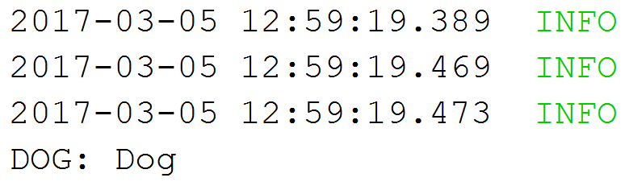
Get Bean from Application Context
MainApplication.java
@SpringBootApplication
public class MainApplication {
public static void main(String[] args) {
ApplicationContext context = SpringApplication.run(MainApplication.class, args);
Animal dog = context.getBean(Dog.class);
System.out.println("DOG: " + dog.getClass().getSimpleName());
}
}

Slide 18
Beans Scopes in Spring Framework
There are part of Beans scopes:
Singleton
Prototype
Request
Session

Slide 19
Singletone Scope
Container creates a single instance of that bean, and all requests for that bean name will return the same object, which is cached
This is default scope
@Bean
@Scope("singleton") <- Can be omitted
public Student student() {
return new Student();
}

Slide 20
Prototype Scope
Will return a different instance every time it is requested from the container
@Bean
@Scope("prototype")
public Student student() {
return new Student();
}

Slide 21
Bean Scope
The default one is Singleton. It is easy to change to Prototype
Mostly used as State-less
Mostly used as State-full
Singleton
Prototype
Request A
Request A
Animal 1
Request B
Animal
Request B
Animal 2
Request C
Request C
Animal 3

Slide 22
Bean Lifecycle
Instantiation
Set Properties
Set Name
Initialization
Pre Initialization
Set Application Context
Container Shutdown
Post Initialization
Bean is ready
Bean is destroyed

Slide 23
Bean Lifecycle Demo (1)
MainApplication.java
@SpringBootApplication
public class MainApplication {
public static void main(String[] args) {
ApplicationContext context = SpringApplication.run(MainApplication.class, args);
((AbstractApplicationContext)context).close();
}
@Bean(destroyMethod = "destroy", initMethod = "init")
public Animal getDog(){
return new Dog();
}
}

Slide 24

Bean Lifecycle Demo (2)
MainApplication.java
public class Dog implements Animal {
public Dog() {
System.out.println("Instantiation");
}
public void init(){
System.out.println("Initializing..");
}
public void destroy(){
System.out.println("Destroying..");
}
}

Slide 25
PostConstruct Annotation
Spring calls methods annotated with @PostConstruct only once, just after the initialization of bean
@Component
public class DbInit {
private final UserRepository userRepository;
public DbUnit(UserRepository userRepository)
{ this. userRepository = userRepository;}
@PostConstruct
private void postConstruct() {
User admin = new User("admin", "admin password");
User normalUser = new User("user", "user password");
userRepository.save(admin, normalUser);
}
}

Slide 26
PreDestroy Annotation
A method annotated with @PreDestroy runs only once, just before Spring removes our bean from the application context
@Component
public class UserRepository {
private DbConnection dbConnection;
@PreDestroy
public void preDestroy() {
dbConnection.close();
}
}

Slide 27
BeanNameAware Interface
BeanNameAware makes the object aware of the bean name defined in the container
public class MyBeanName implements BeanNameAware {
@Override
public void setBeanName(String beanName) {
System.out.println(beanName);
}
}
@Configuration
public class Config {
@Bean (name = "myCustomBeanName")
public MyBeanName getMyBeanName() {
return new MyBeanName();
}
}

Slide 28
BeanFactoryAware Interface
BeanFactoryAware is used to inject the BeanFactory object
With the setBeanFactory() method, we assign the BeanFactory reference from the IoC container to the beanFactory property
public class MyBeanFactory implements BeanFactoryAware {
private BeanFactory beanFactory;
@Override
public void setBeanFactory(BeanFactory beanFactory)throws BeansException {
this.beanFactory = beanFactory;}
public void getMyBeanName() {
MyBeanName myBeanName = beanFactory.getBean(MyBeanName.class);
System.out.println(beanFactory.isSingleton("myCustomBeanName"));
}
}

Slide 29
InitializingBean Interface
For bean implemented InitializingBean, it will run afterPropertiesSet() after all bean properties have been set
@Component
public class InitializingBeanExampleBean implements InitializingBean {
private static final Logger LOG
= Logger.getLogger(InitializingBeanExampleBean.class);
@Autowired
private Environment environment;
@Override
public void afterPropertiesSet() throws Exception {
LOG.info(Arrays.asList(environment.getDefaultProfiles()));
}
}

Slide 30
DisposableBean Interface
For bean implemented DisposableBean, it will run destroy() after Spring container is released the bean
@Component
public class Bean2 implements DisposableBean {
@Override
public void destroy() throws Exception {
System.out.println(
"Callback triggered - DisposableBean.");
}
}

Slide 31
Common Application Properties
Various properties can be specified inside your application.yaml file
Property contributions can come from additional jar files
You can define your own properties
Link to documentation

Slide 32
Application Properties Example
application.properties
spring.datasource.driverClassName=com.mysql.cj.jdbc.Driver
spring.datasource.url=jdbc:mysql://localhost:3306/thymeleaf_adv_lab_exam_db?createDatabaseIfNotExist=true
spring.datasource.username=root
spring.datasource.password=12345
spring.jpa.properties.hibernate.dialect = org.hibernate.dialect.MySQL8Dialect
spring.jpa.properties.hibernate.format_sql = TRUE
spring.jpa.hibernate.ddl-auto = update
spring.jpa.open-in-view=false
logging.level.org = WARN
logging.level.blog = WARN
logging.level.org.hibernate.SQL = DEBUG
logging.level.org.hibernate.type.descriptor = TRACE
server.port=8000

Slide 33
Application Yaml Example
application.yaml
spring:
datasource:
driverClassName: com.mysql.cj.jdbc.Driver
password: 12345
url: jdbc:mysql://localhost:3306/spring_data_lab_db?allowPublicKeyRetrieval=true&useSSL=false&createDatabaseIfNotExist=true
username: root
jpa:
database-platform: org.hibernate.dialect.MySQL8Dialect
hibernate:
ddl-auto: create-drop
open-in-view: false
properties:
hibernate:
format_sql: true

Slide 34

Spring Data

Slide 35
Overall Architecture
Repository
Service
Controller
Database
View
Entities
Models/ DTO
Back-End

Slide 36
Entities
Entity is a lightweight persistence domain object
Cat.java
@Entity
@Table(name = "cats")
public class Cat {
@Id
@GeneratedValue(strategy = GenerationType.IDENTITY)
private long id;
private String name;
//GETTERS AND SETTERS
}

Slide 37
Repositories
Persistence layer that works with entities
CatRepository.java
@Repository
public interface CatRepository extends JpaRepository<Cat, Long> {
}

Slide 38
Services
Business Layer - All the business logic is here.
CatService.java
@Service
public class CatServiceImpl implements CatService {
private final CatRepository catRepository;
@Autowired
public CatServiceImpl(CatRepository catRepository){
this.catRepository = catRepository;
}
@Override
public void buyCat(CatModel catModel) { //TODO Implement the method }
}

Slide 39

Summary
Spring Boot - Opinionated view of building production-ready Spring applications
Spring Data - Responsible for database related operations
…
…
…

Slide 40
Questions?
Notes:
40

Slide 41














SoftUni Diamond Partners

Slide 42

Educational Partners

Slide 43
Trainings @ Software University (SoftUni)
Software University – High-Quality Education, Profession and Job for Software Developers
softuni.bg, about.softuni.bg
Software University Foundation
softuni.foundation
Software University @ Facebook
facebook.com/SoftwareUniversity
Software University Forums
forum.softuni.bg
Notes:
43

Slide 44

License
This course (slides, examples, demos, exercises, homework, documents, videos and other assets) is copyrighted content
Unauthorized copy, reproduction or use is illegal
© SoftUni – https://about.softuni.bg/
© Software University – https://softuni.bg
Notes:
44

