Slide 1

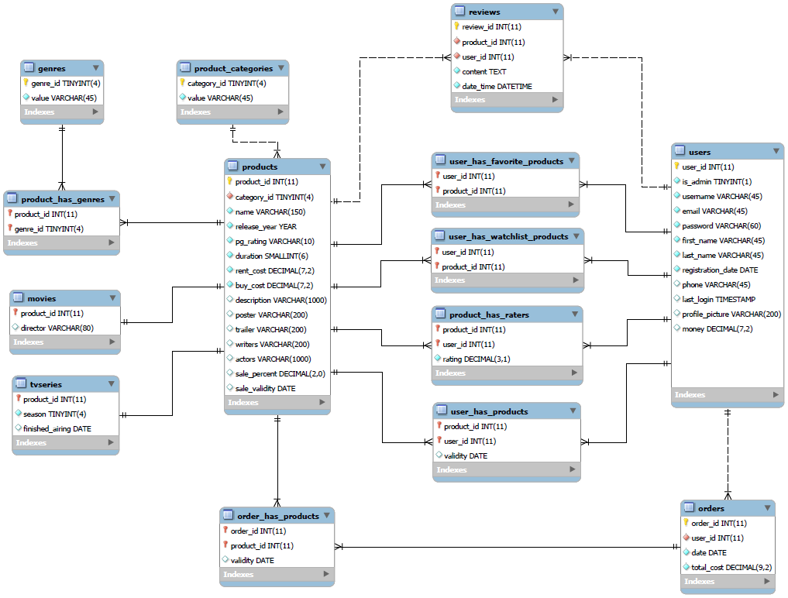
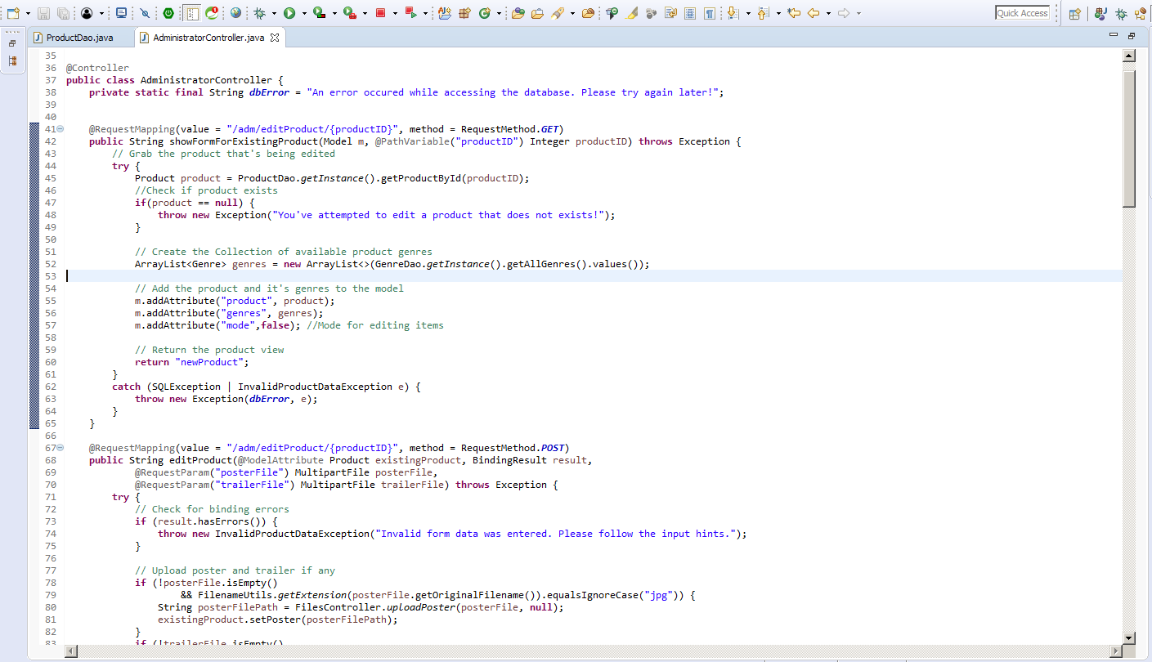
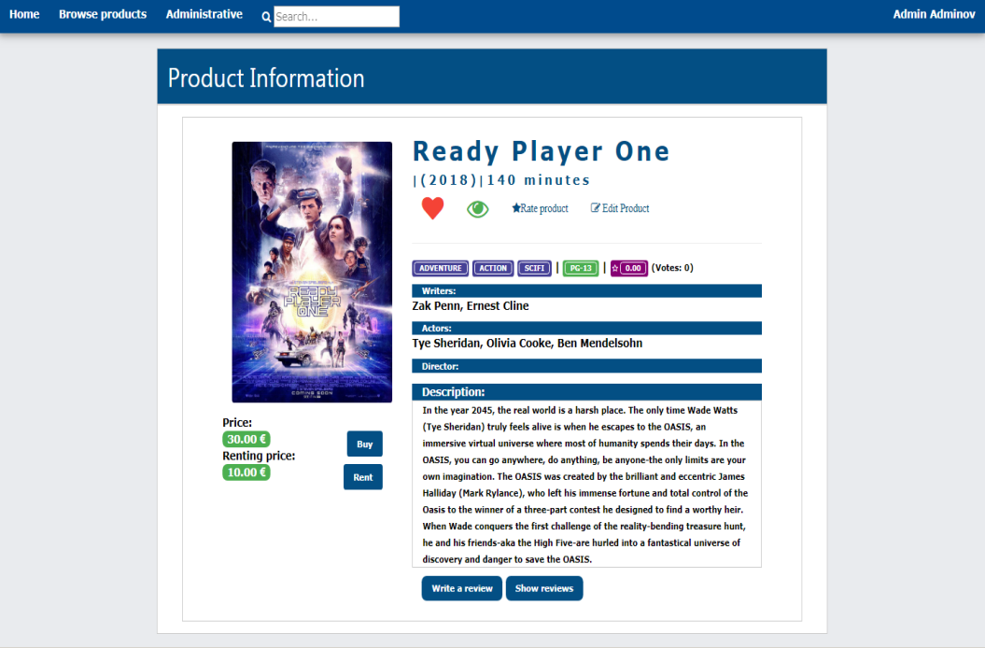
It talents training camp season 9
Group Java EE 1
Final project
filmoteka.bg
Developed By:
Mario Dimitrov
Svetoslav Gekov
гр. София, 07 май 2018 г.
1

Slide 2
Contents
About us
Project overview & functionality
Technology stack
Backend technologies
Frontend technologies
Database Entity Relationship Diagram
Class Diagram
Live Demonstration
гр. София, 07 май 2018 г.
2

Slide 3
1. About us
Svetoslav Gekov
Mario Dimitrov
Age: 25
Education: Land Surveyor Engineer
Current employment: Assistant Professor, Geodetic Faculty, UACEG, Sofia, Bulgaria
Age: 20
Education: Studying Computer Science - Software Engineering, Technical University, Sofia, Bulgaria
гр. София, 07 май 2018 г.
3

Slide 4

2. Project overview
A web project for accessing Movies and TV Series through an online platform.
Based on successful web platforms like:
Vudu, QuickFlix, PrimeVideo
гр. София, 07 май 2018 г.
4

Slide 5
2. Project functionality
Our project allows the user to do the following:
Register, login and edit a personal account;
Browse and search through the available products;
Add and remove products from his personal collections (favorites, watchlist and cart);
Buy the products in his cart;
View his orders history;
Rate and comment products;
Administrator specific:
Create and edit products;
Other:
Automatic email notifications for products nearing their expiration date;
Automatic deletion of expired products;
гр. София, 07 май 2018 г.
5

Slide 6






3.1. Backend technologies
What is backing us up?
Database:
MySQL Server
MySQL Workbench
Programming language & IDE:
Language – Java (JDK 8)
IDE – Eclipse Oxygen 3 For Java EE
Web Server:
Apache Tomcat 8.5
Java Frameworks:
Spring Boot
гр. София, 07 май 2018 г.
6

Slide 7





3.2. Frontend technologies
What is up in the front?
Views:
Java Server Pages (JSP)
HTML 5
Additional Code Using:
JavaScript (JS)
Java Standard Tag Library (JSTL)
Stylization:
Standard CSS
W3.CSS
гр. София, 07 май 2018 г.
7

Slide 8
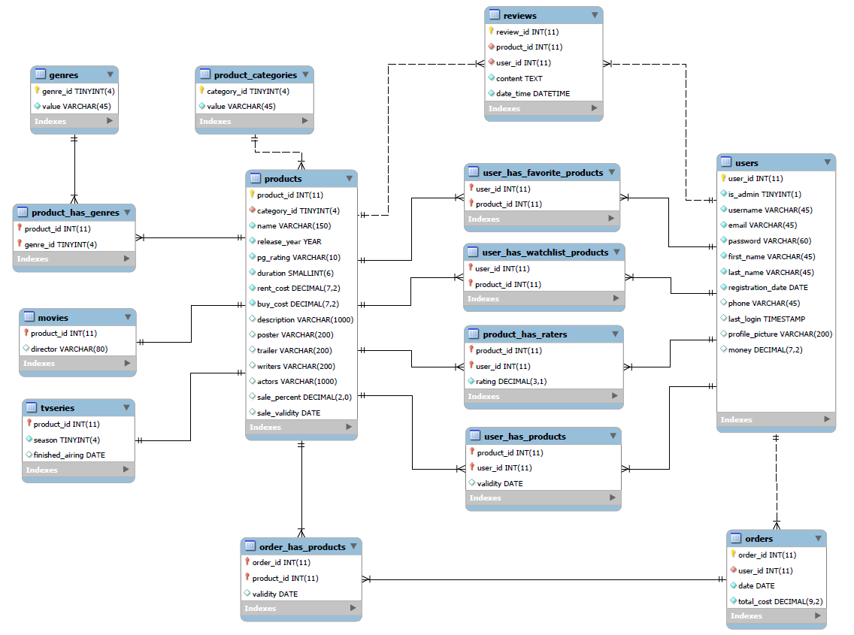
4. Database Entity Relationship Diagram
гр. София, 07 май 2018 г.
8

Slide 9
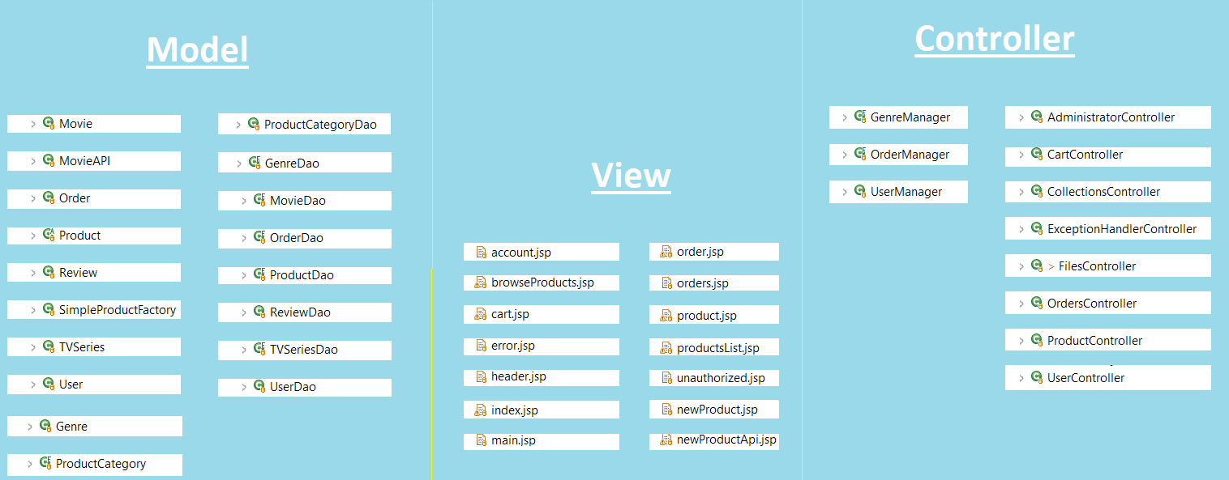
5. Class Diagram
гр. София, 07 май 2018 г.
9

Slide 10

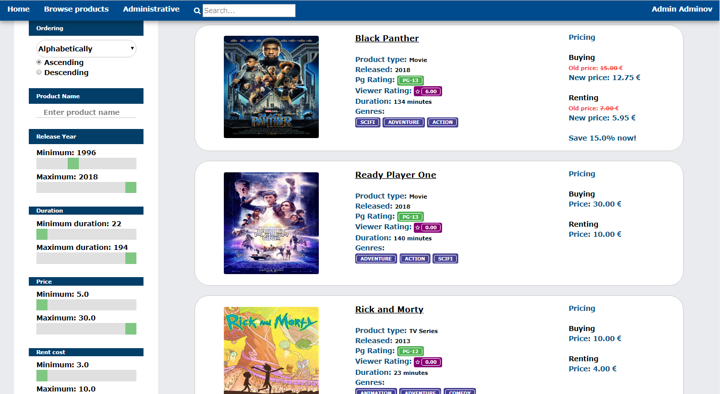
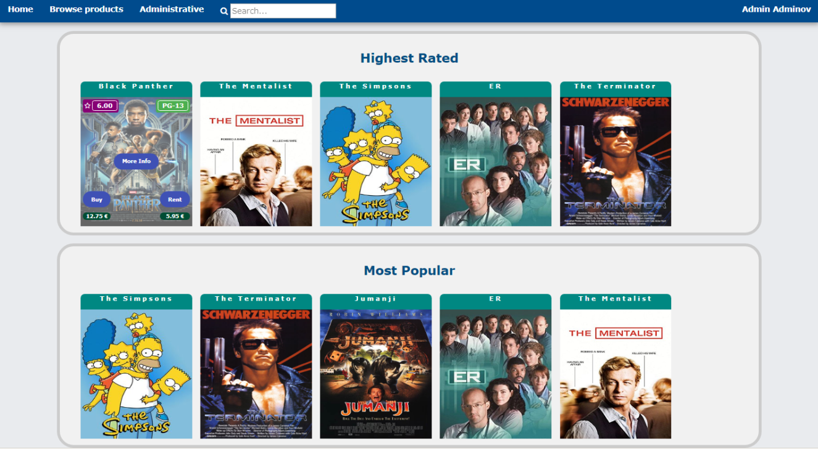
6. Live Demonstration
гр. София, 07 май 2018 г.
10

Slide 11
Thank you for your attention!
Filmoteka.BG
Developed By:
Mario Dimitrov
Svetoslav Gekov
гр. София, 07 май 2018 г.
11

