Slide 1
CARGOSERVICE
Un sistema AUTOMATIZZATO per la gestione INTELLIGENTE di una stiva

Slide 2
PREVIEW DELLA PRESENTAZIONE:
REQUISITI DEL COMMITTENTE
SPRINT 0
SPRINT 1
SPRINT 2
SPRINT 3
DEPLOYMENT

Slide 3
REQUISITI DEL COMMITTENTE
Obiettivi e vincoli richiesti dal committente
per lo sviluppo del sistema

Slide 4
A Maritime Cargo shipping company (from now on, simply company) intends to automate the operations of load of freight in the ship’s cargo hold (or simply hold).
To this end, the company plans to employ a Differential Drive Robot (from now, called cargorobot) for the loading of goods (named products) in the ship’s hold.
The products to be loaded must be placed in a container of predefined dimensions and registered, by specifying its weight, within a database, by using a proper service (productservice).
After the registration, the productservice returns a unique product identifier as a natural number PID, PID>0.
The hold is a rectangular, flat area with an Input/Output port (IOPort).

Slide 5
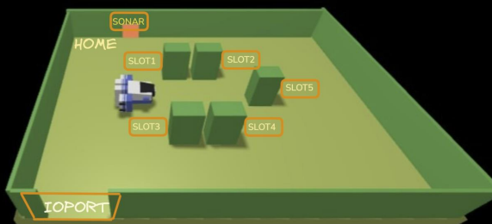
The area provides 4 slots for the product containers.
• The slots depict the hold storage areas, when they are occupied by product containes
• The slots5 area is permanentely occupied, while the other slots are initially empty
• The sensor put in front of the IOPort is a sonar used to detect the presence of a product container, when it measures a distance D, such that D < DFREE/2, during a reasonable time (e.g. 3 secs)

Slide 6
The company asks us to build a software systems (named cargoservice) that:
is able to receive the request to load on the cargo a product container already registered in the productservice.
The request is rejected when:
the product-weight is evaluated too high, since the ship can carry a maximum load of MaxLoad>0 kg.
the hold is already full, i.e. the 4 slots are already occupied.
If the request is accepted, the cargoservice associates a slot to the product PID and returns the name of the reserved slot. Afterwards, it waits that the product container is delivered to the ioport. In the meantime, other requests are not elaborated.

Slide 7
is able to detect (by means of the sonar sensor) the presence of the product container at the ioport
is able to ensure that the product container is placed by the cargorobot within its reserved slot. At the end of the work:
the cargorobot should returns to its HOME location.
the cargoservice can process another load-request
is able to show the current state of the hold, by means of a dynamically updated web-gui.
interrupts any activity and turns on a led if the sonar sensor measures a distance D > DFREE for at least 3 secs (perhaps a sonar failure).
The service continues its activities as soon as the sonar measures a distance D <= DFREE

Slide 8
SPRINT 0
FORMALIZZAZIONE DEI CONCETTI CHIAVE E
DEFINIZIONE DEL MODELLO ARCHITETTURALE DEL SISTEMA

Slide 9
FORMALIZZAZIONE DEI CONCETTI CHIAVE
NODI COMPUTAZIONALI | Tipo
cargoservice | Microservizio
Productservice | Microservizio
Sonarservice | Microservizio
Webgui | GUI
COMPONENTI FORNITI DAL COMMITTENTE:
Hardware: DDRobot, Sonar, Led, IOPort, Slot(1..5)
Microservizi: ProductService , basicrobot24
Wenv
COMPONENTI DA SVILUPPARE:
cargoservice, sonarservice, webgui

Slide 10
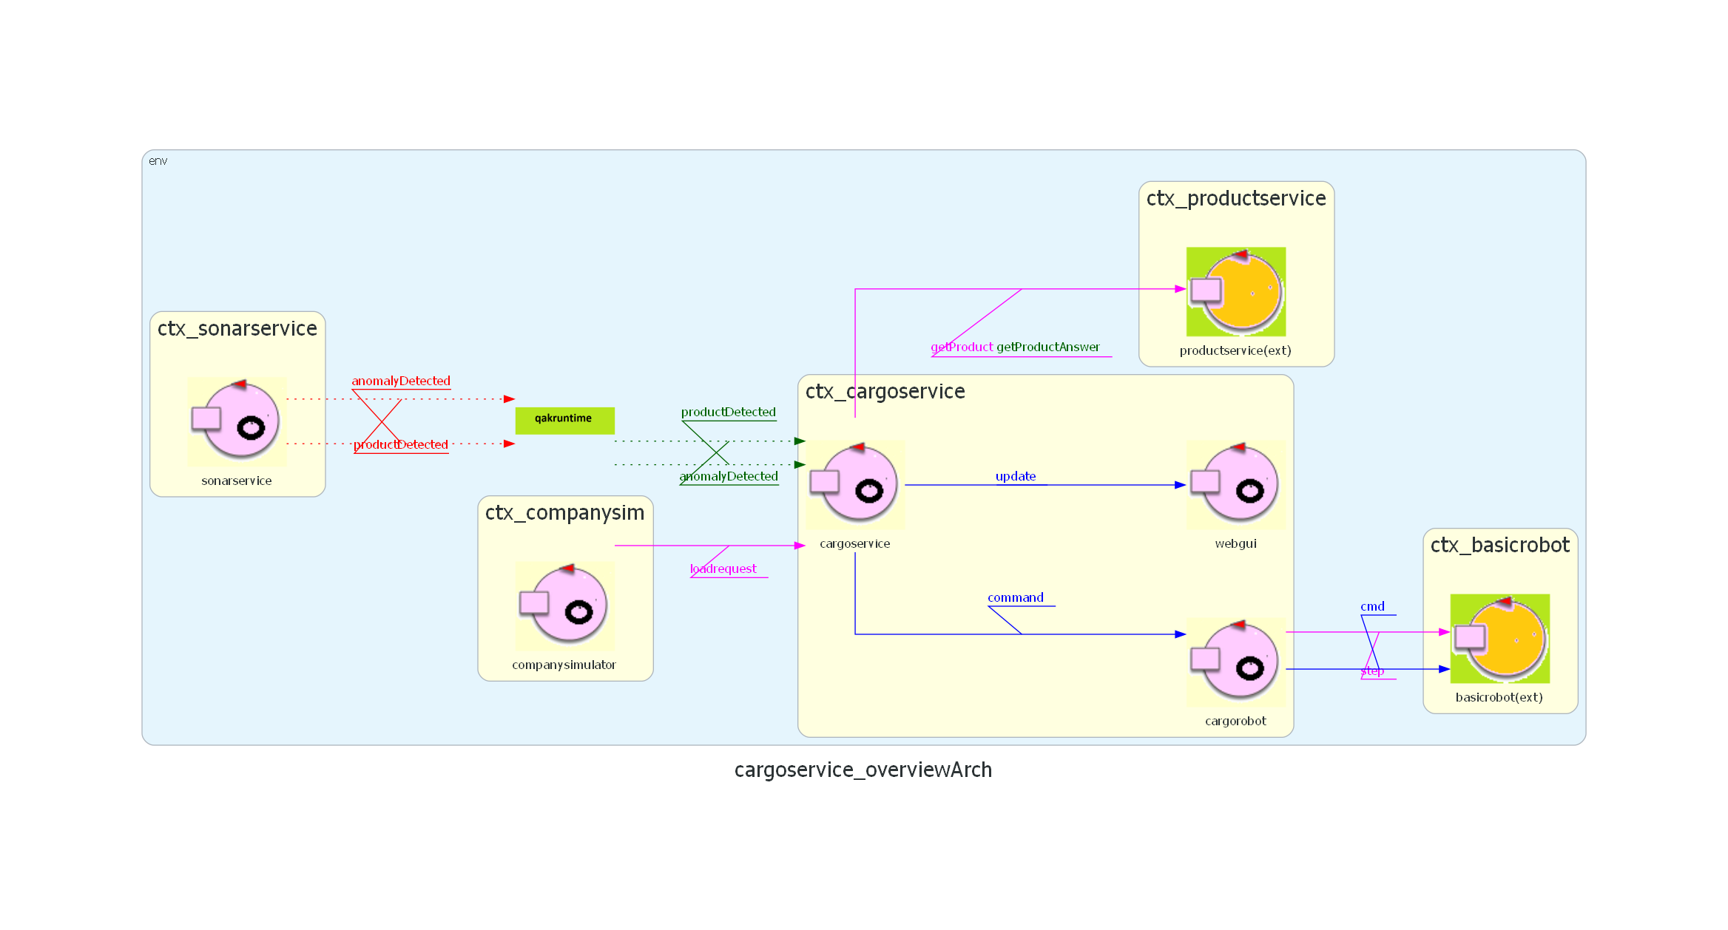
MODELLO DEI MESSAGGI:
microservizio principale: cargoservice
microservizio indipendente: sonarservice
microservizi esterni: product service, basicrobot

Slide 11
SPRINT 1
ANALISI, PROGETTAZIONE E REALIZZAZIONE DEL MICROSERVIZIO CARGOSERVICE

Slide 12
CARGOSERVICE
Analisi :

Slide 14
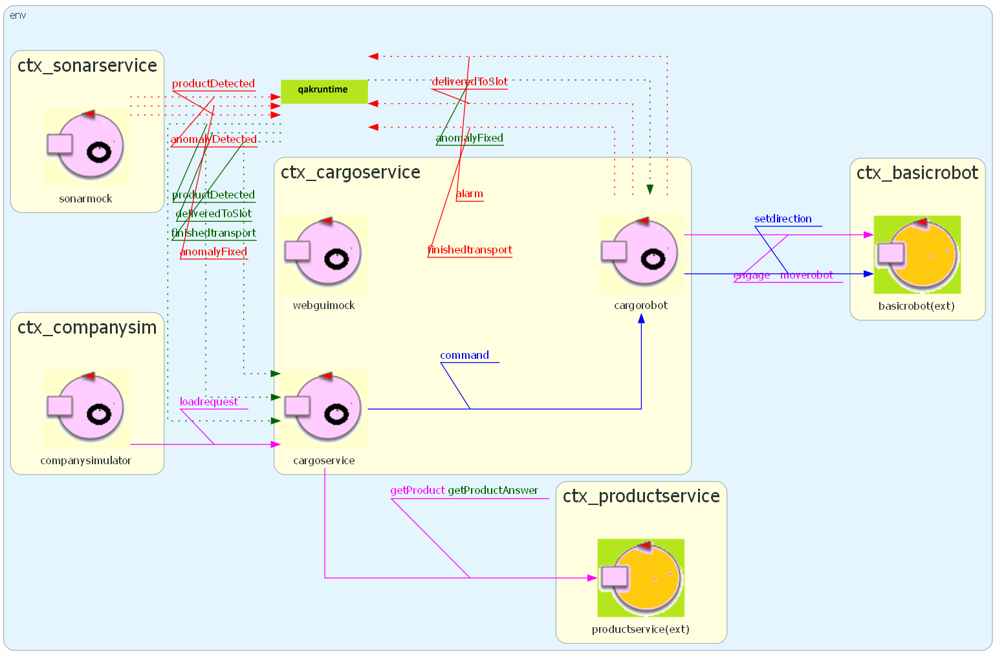
MODELLO DEL SISTEMA AL TERMINE DELLO SPRINT 1:

Slide 15
SPRINT 2
ANALISI, PROGETTAZIONE E REALIZZAZIONE DEL MICROSERVIZIO sonarservice

Slide 17
SPRINT 3
ANALISI, PROGETTAZIONE E REALIZZAZIONE DELla webgui

Slide 18
DEPLOYMENT

