Slide 1
Visuals Only

Slide 2
Definition
“Gentrification is a process whereby the urban working class and poor are expelled from their districts and replaced by more affluent residents. Its drivers are structural — the policies and planning frameworks of the local state, and the tendency of capital to close rent gaps. It is, as the geographer Neil Smith put it, a “global urban strategy”.[10] To live in a neighbourhood being gentrified is to experience rent rises, the destruction of community and ultimately displacement. Yet it is often something that is difficult to quantify and track.”The Greater Manchester Gentrification Index (Common Wealth)

Slide 3
Part 1 Univariate Visuals

Slide 4
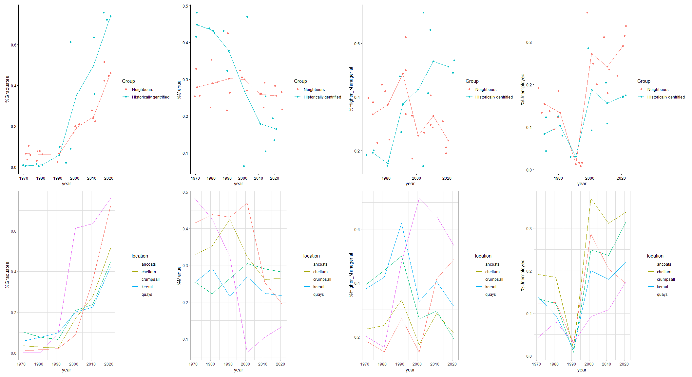
Labour Market Makeup and Gentrification

Slide 5
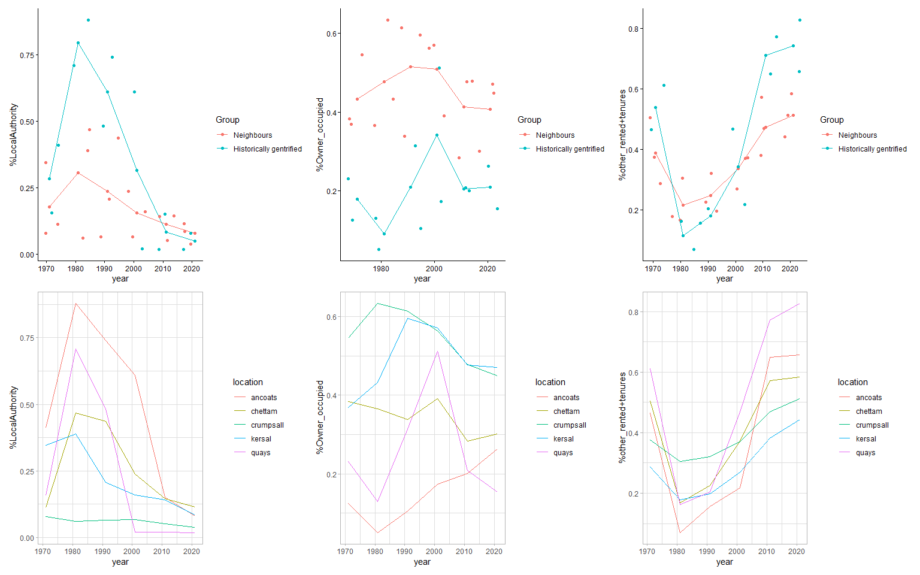
Housing Market Makeup and Gentrification

Slide 6
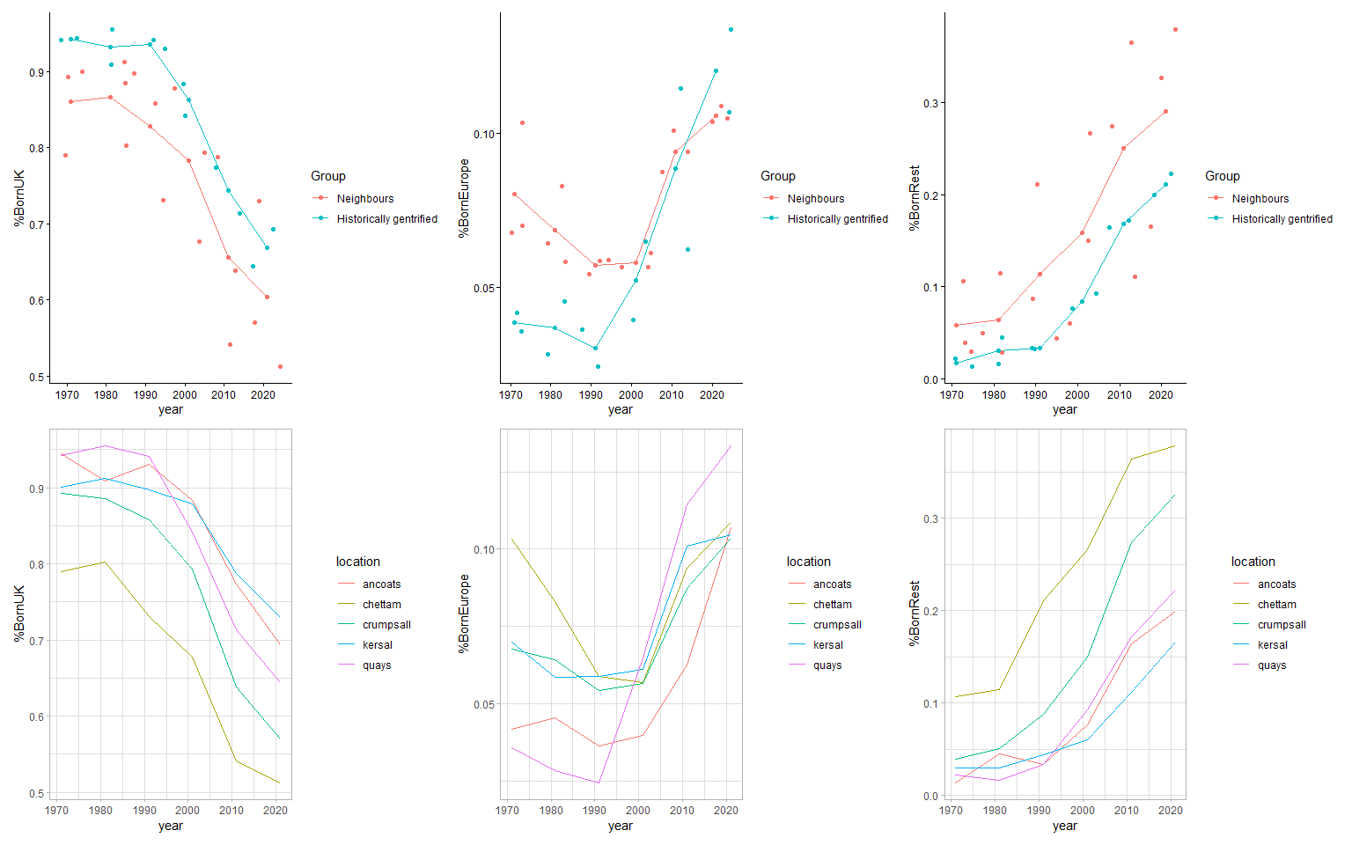
Country of Birth and Gentrification

Slide 7
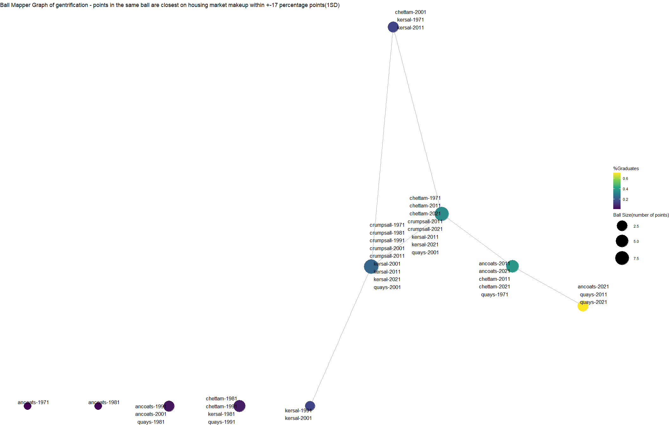
Part 2 Multivariate Visuals with Ball Mapper.Structural Path of neighborhoods overtime

Slide 8
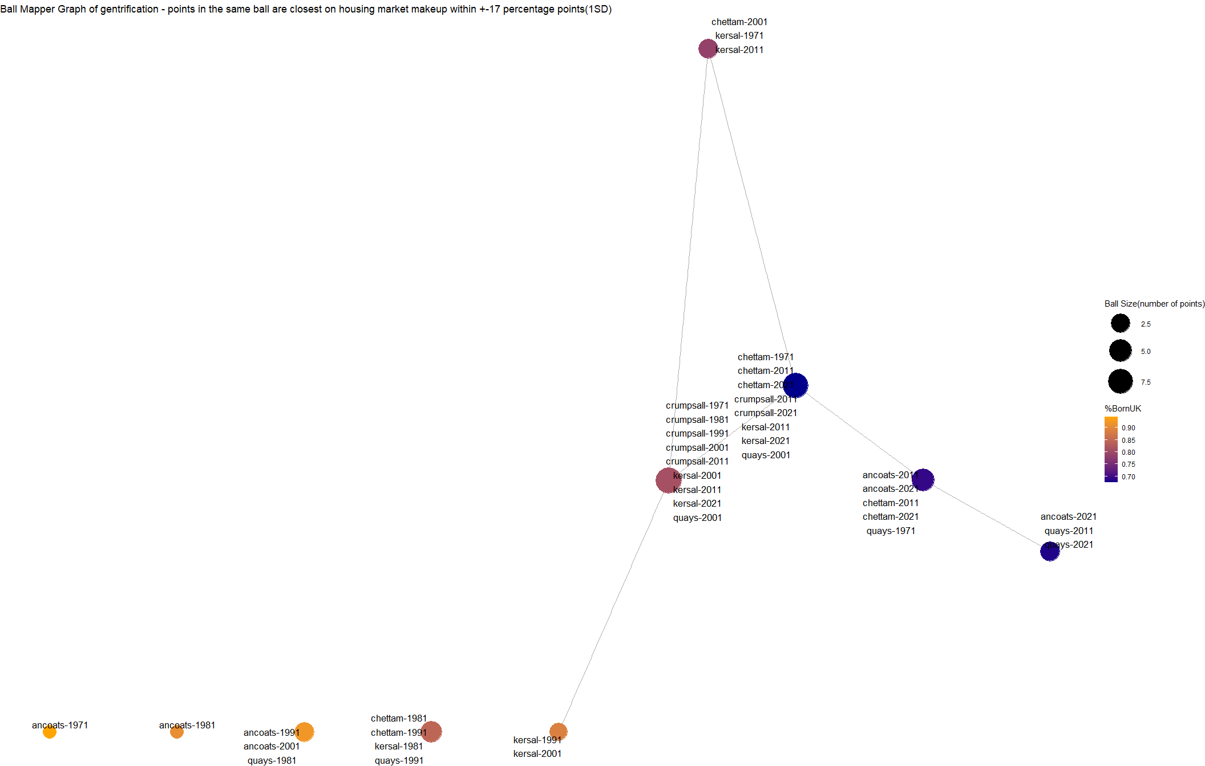

Slide 9
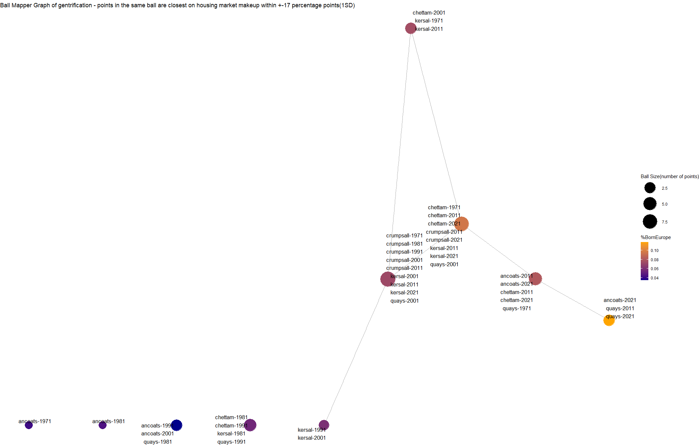

Slide 10
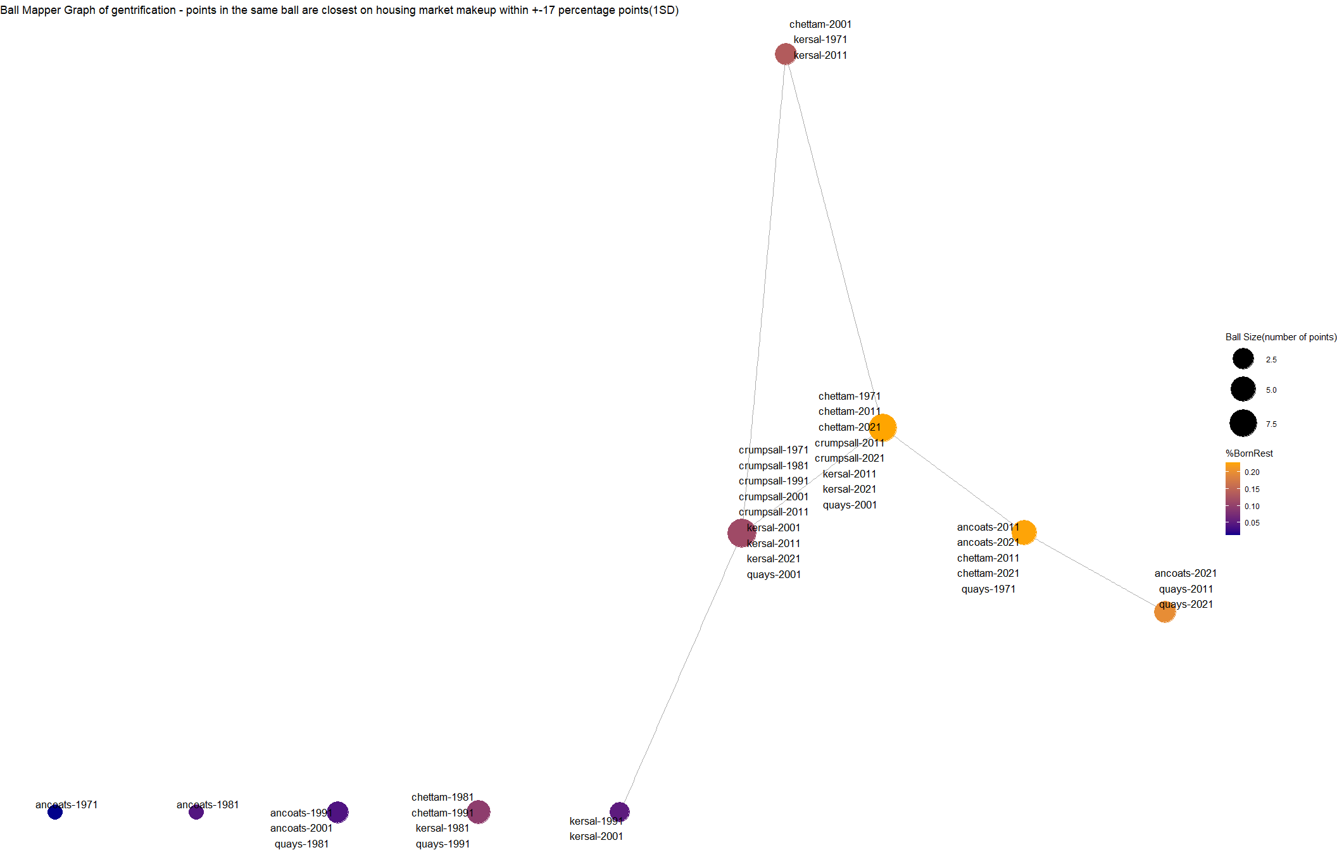

Slide 11
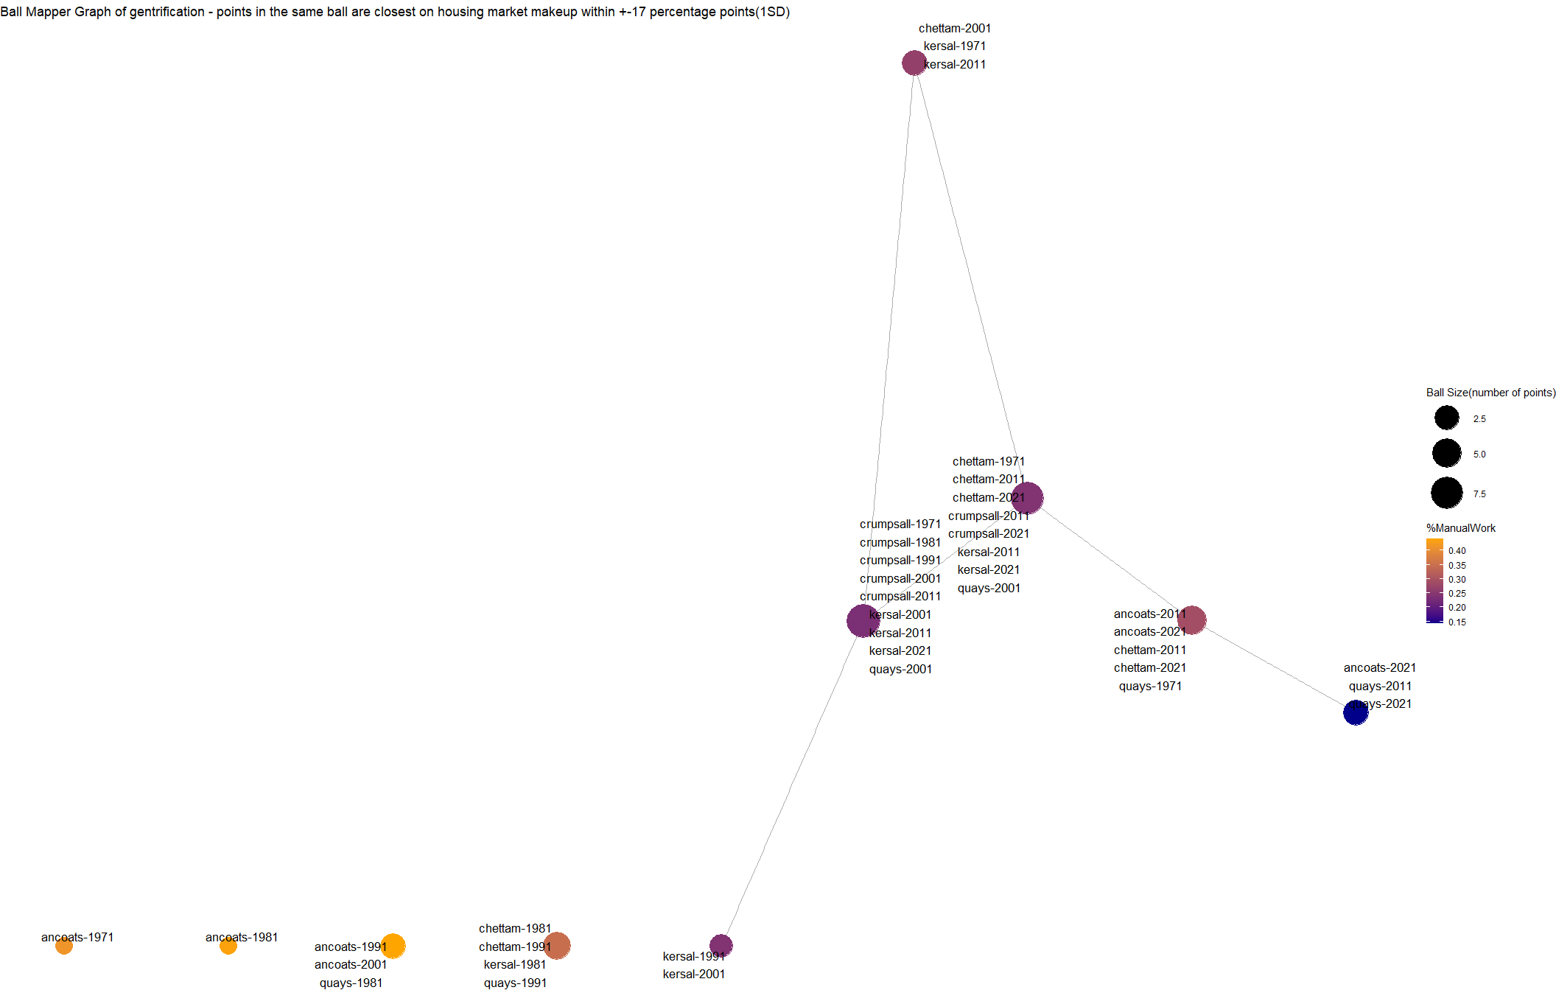

Slide 12
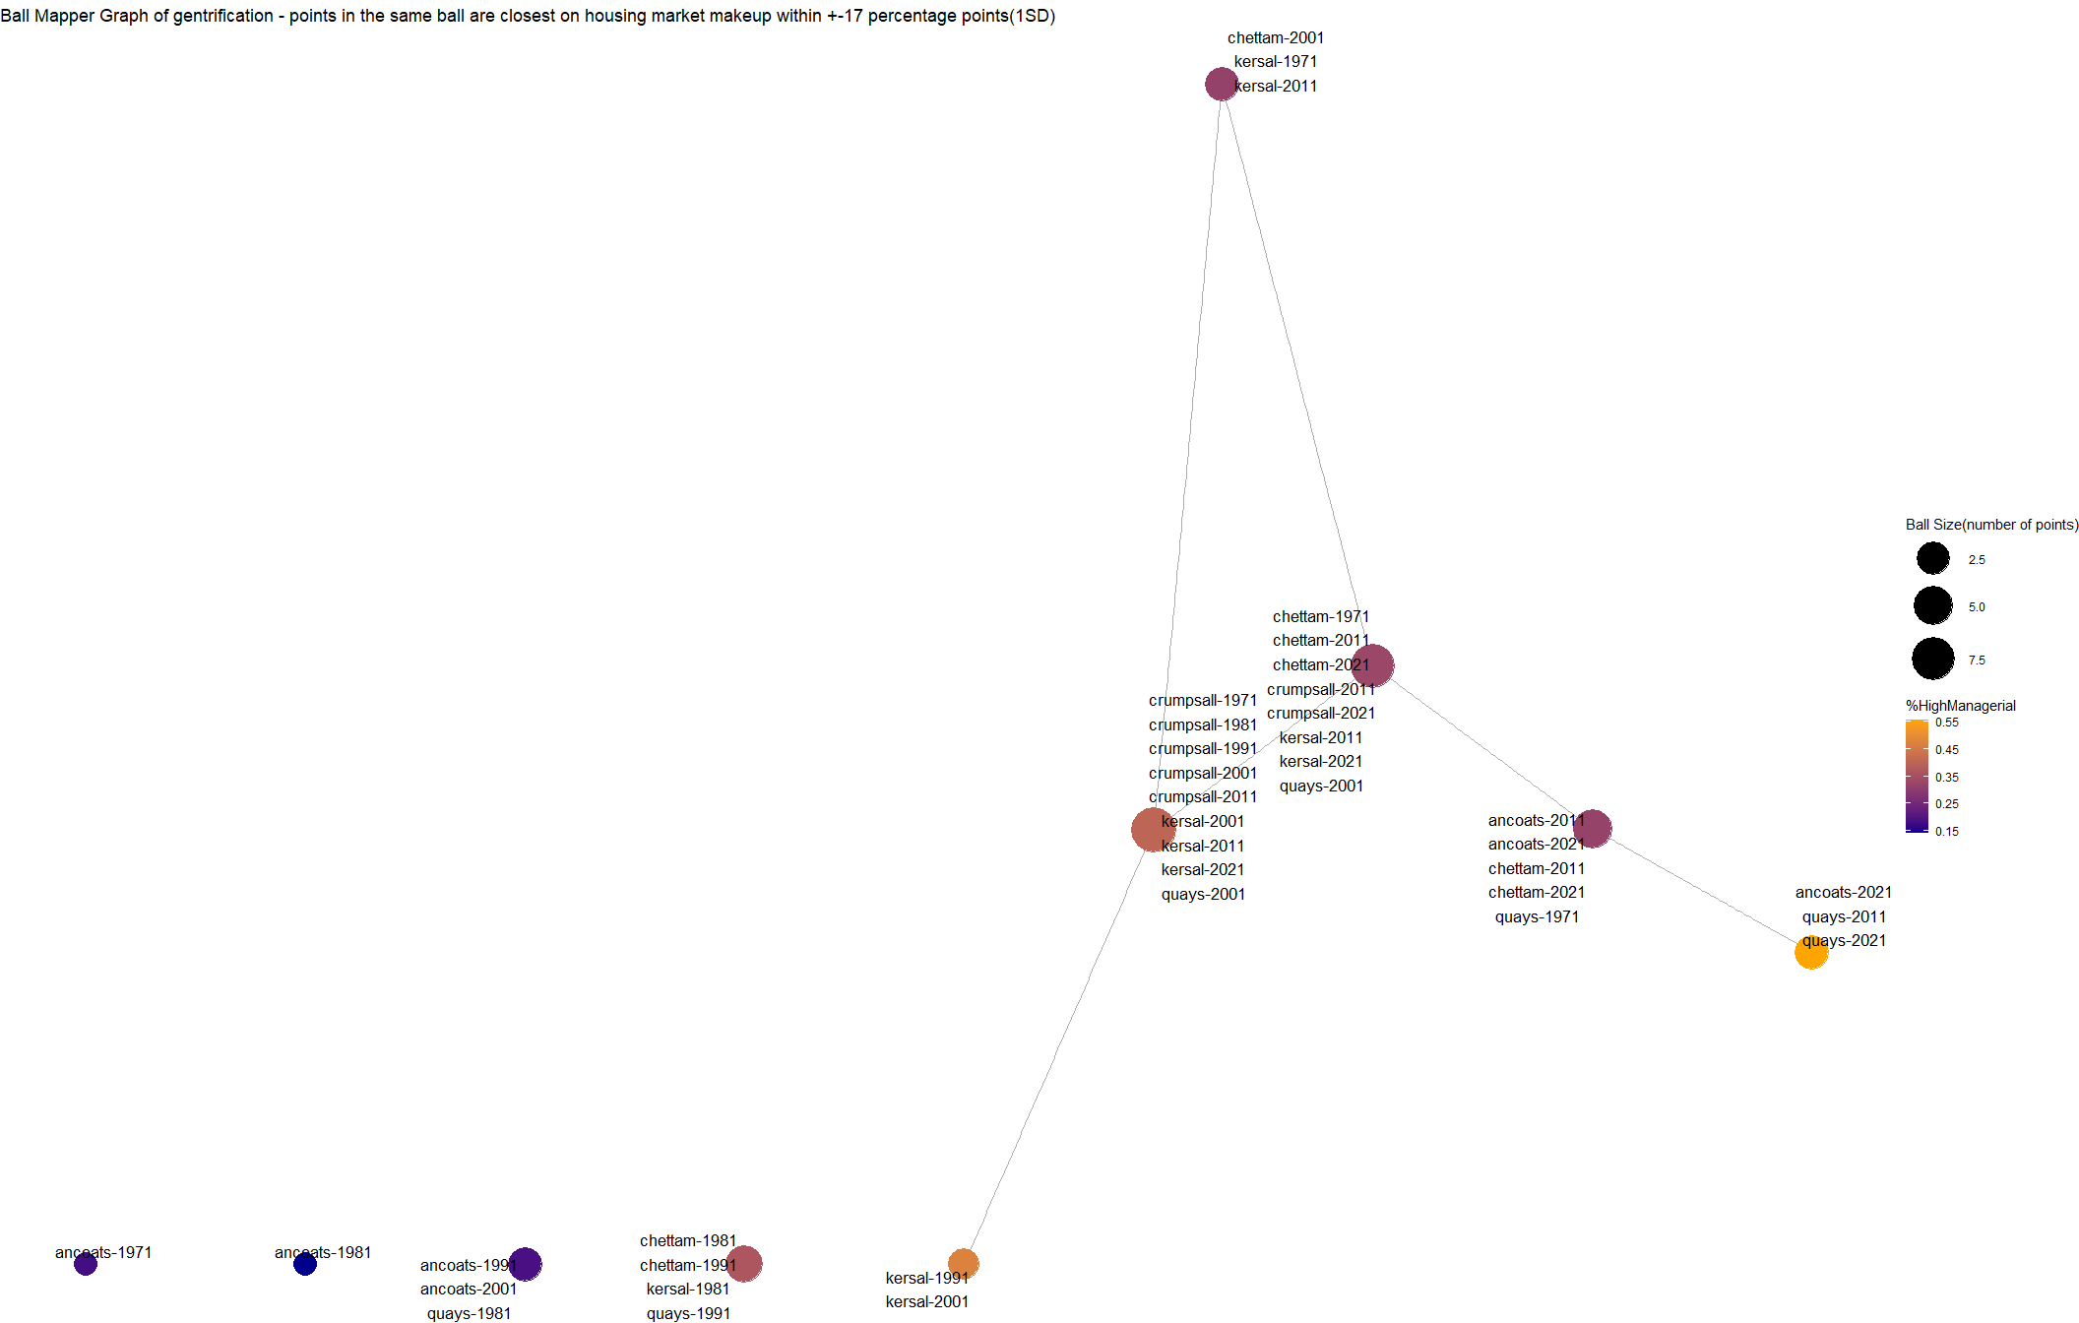

Slide 13
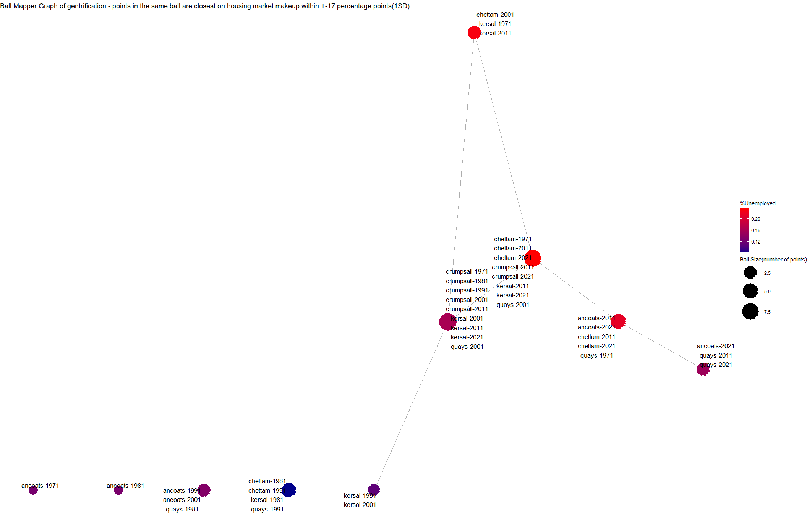

Slide 14
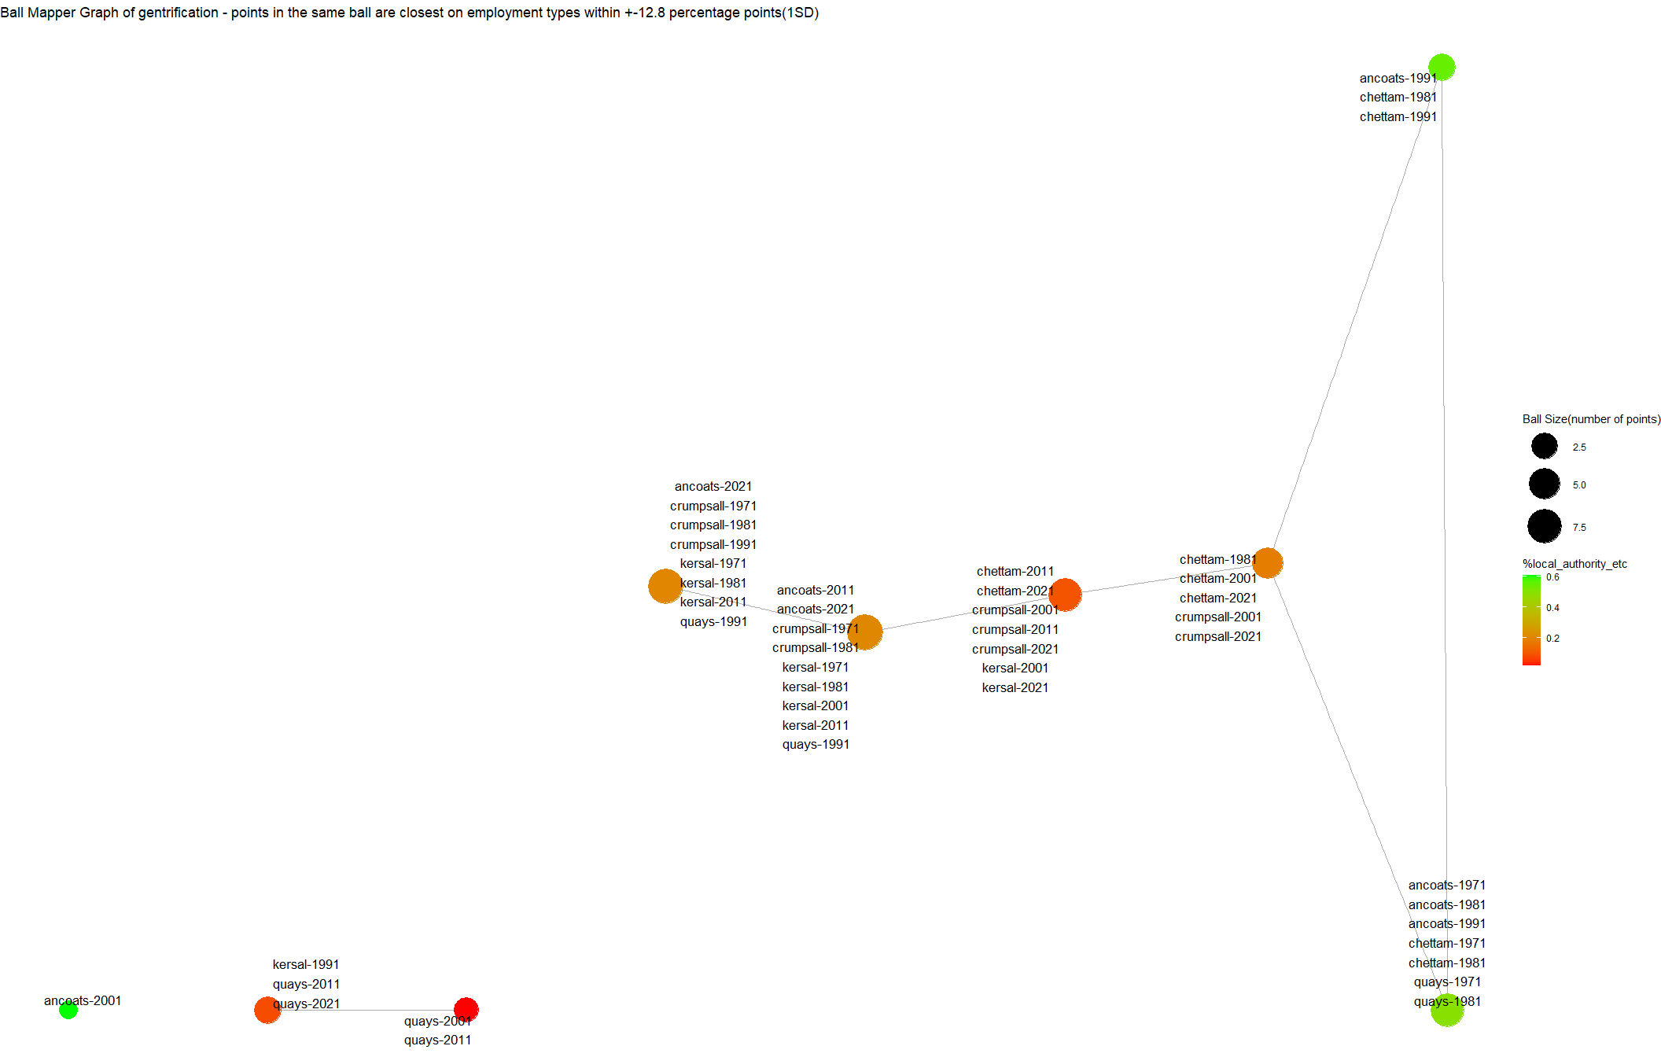

Slide 15
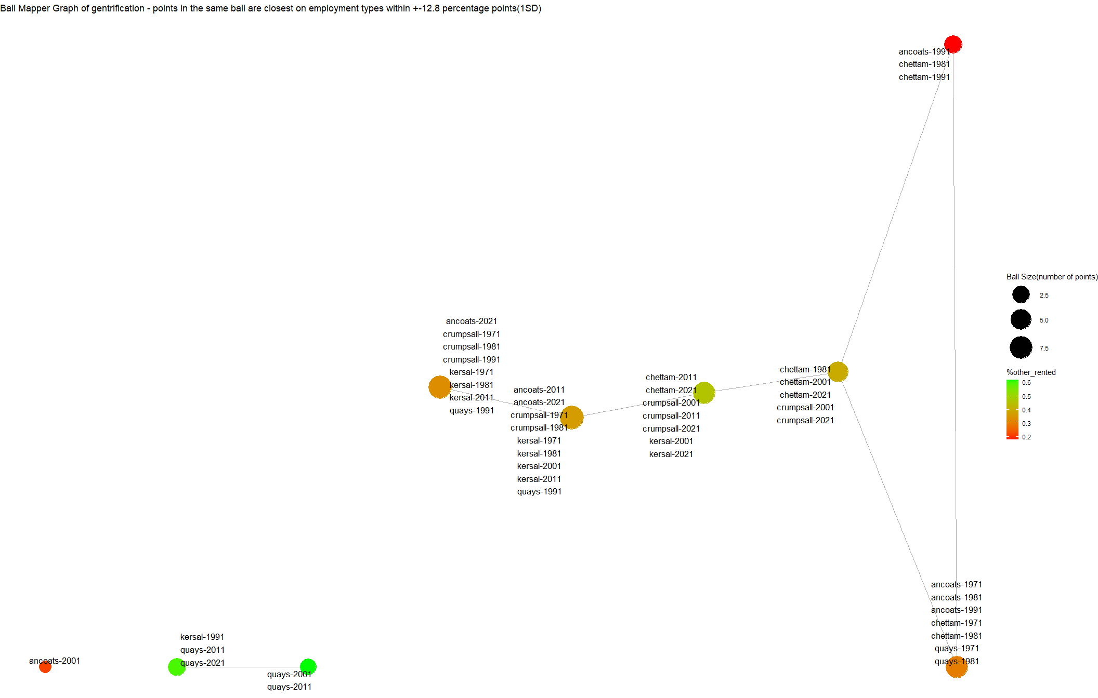

Slide 16
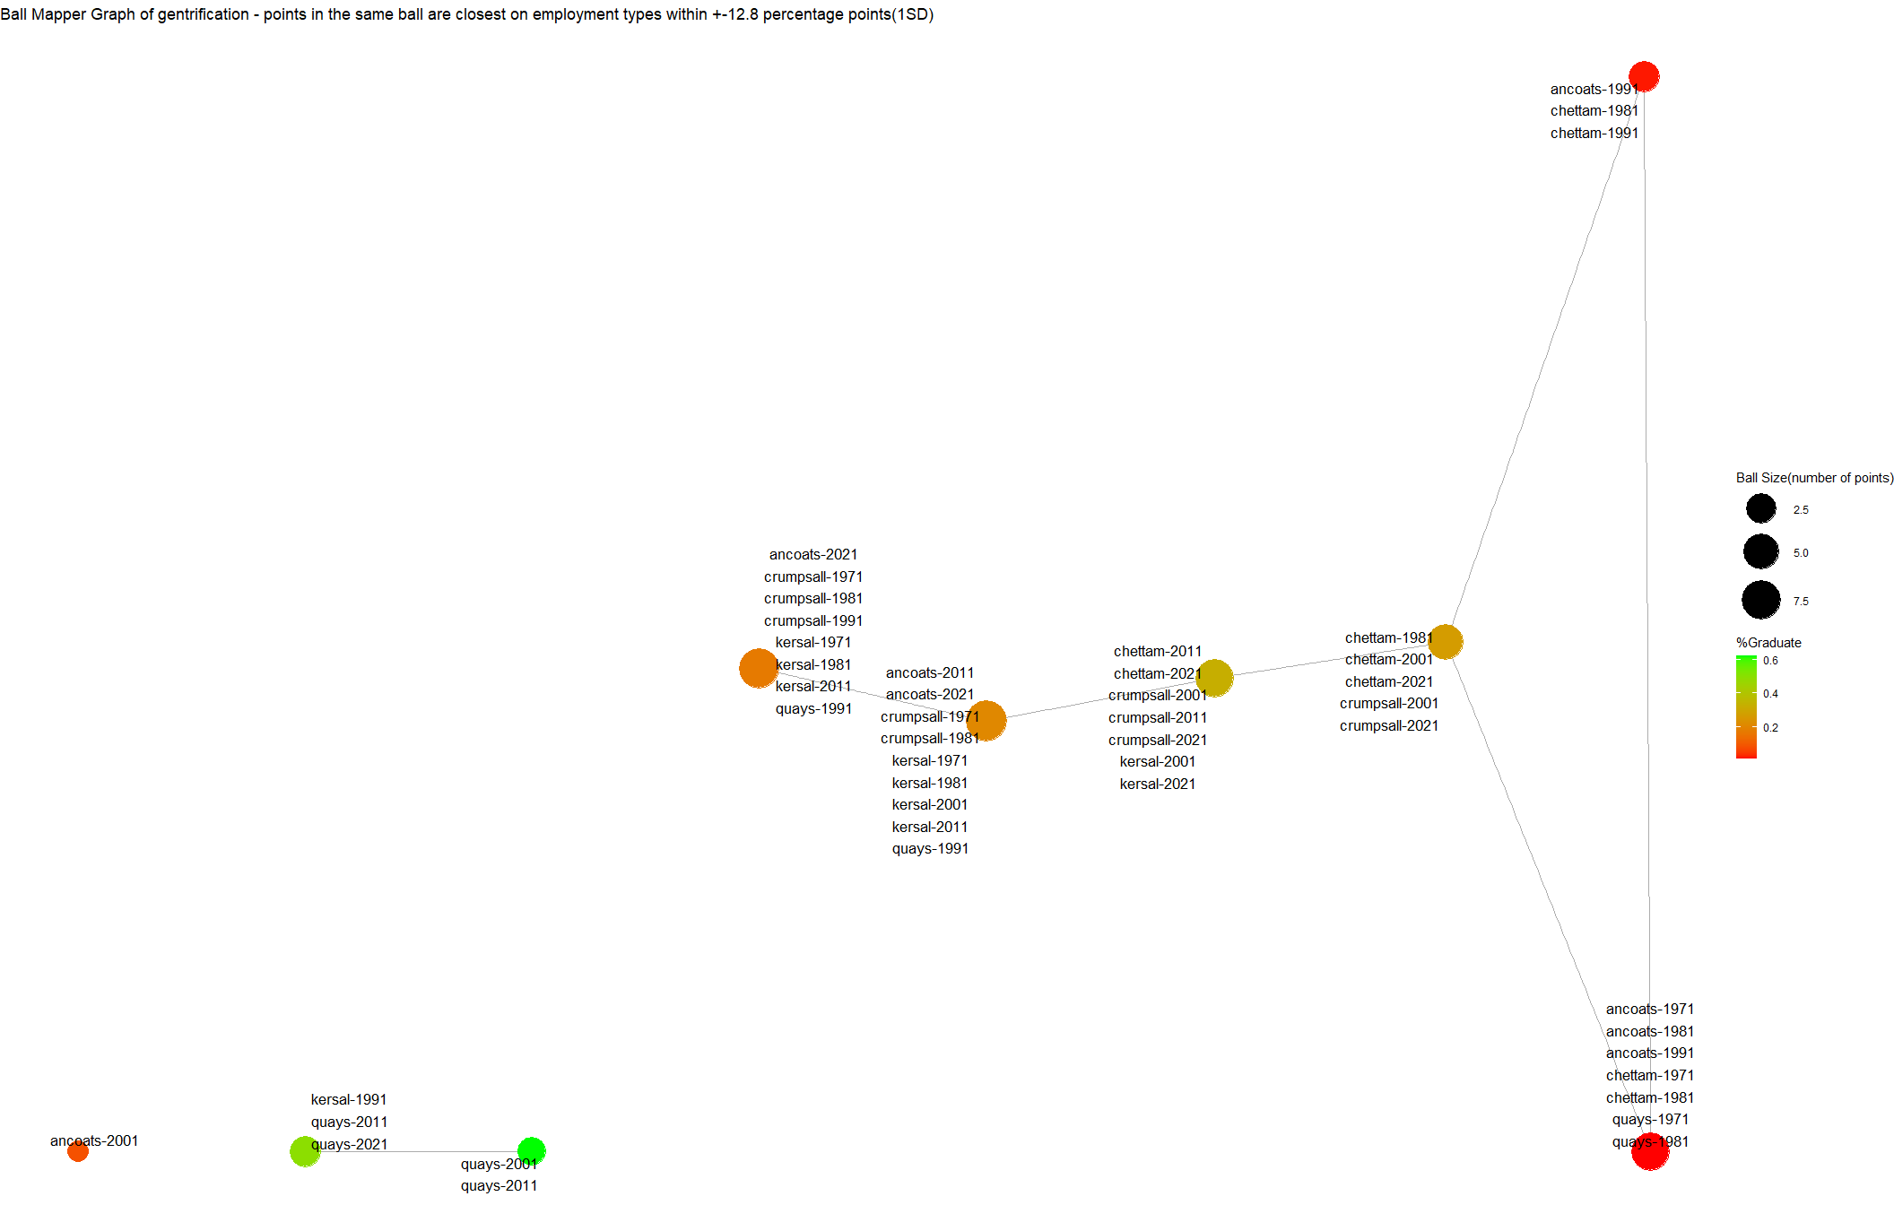

Slide 17
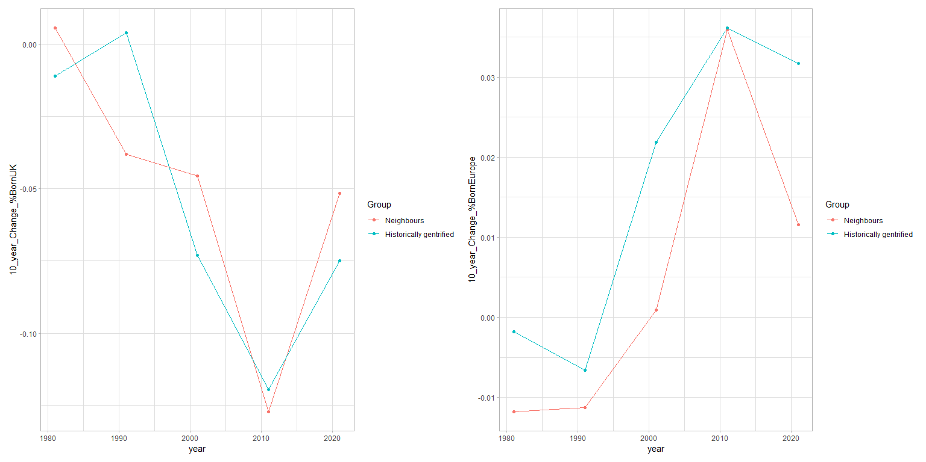
Part 3 What if? approximate counterfactuals with first differences

Slide 18
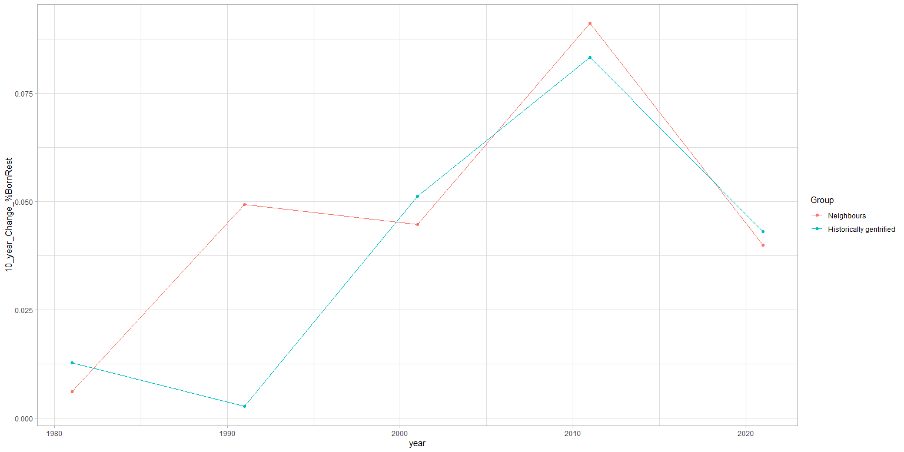

Slide 19
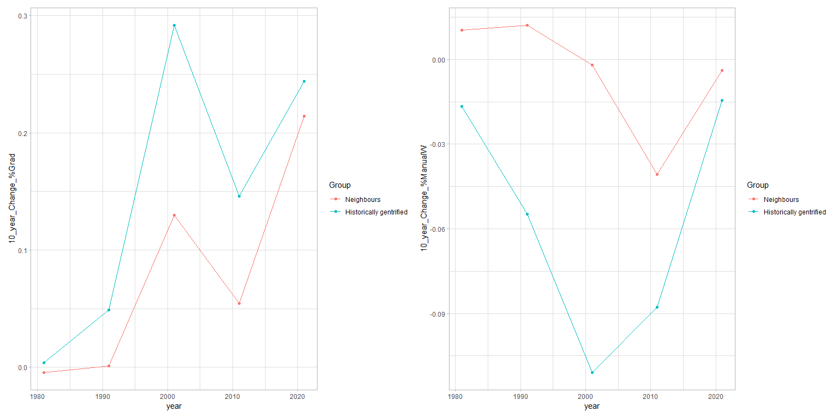

Slide 20
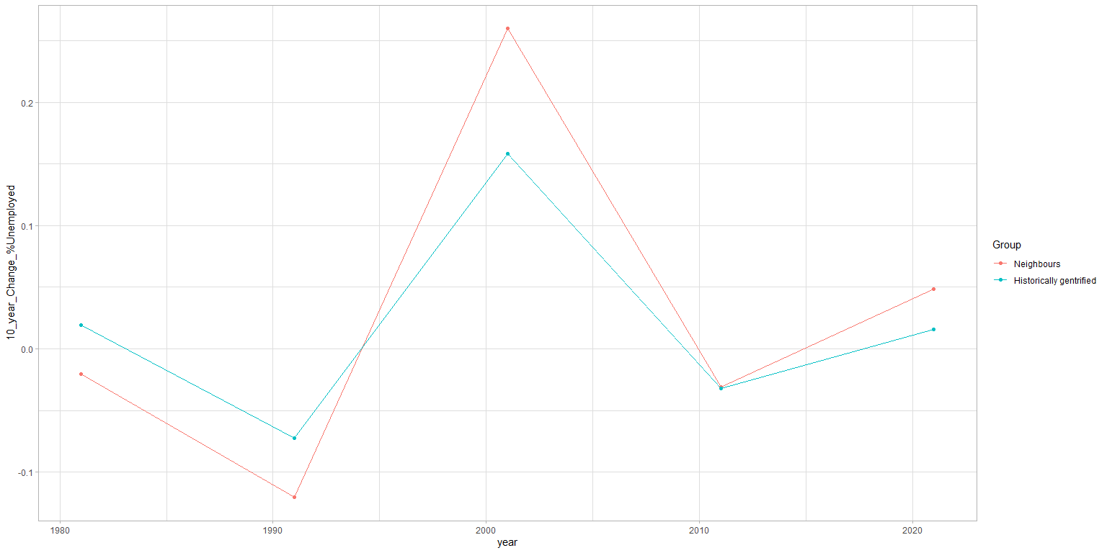

Slide 21
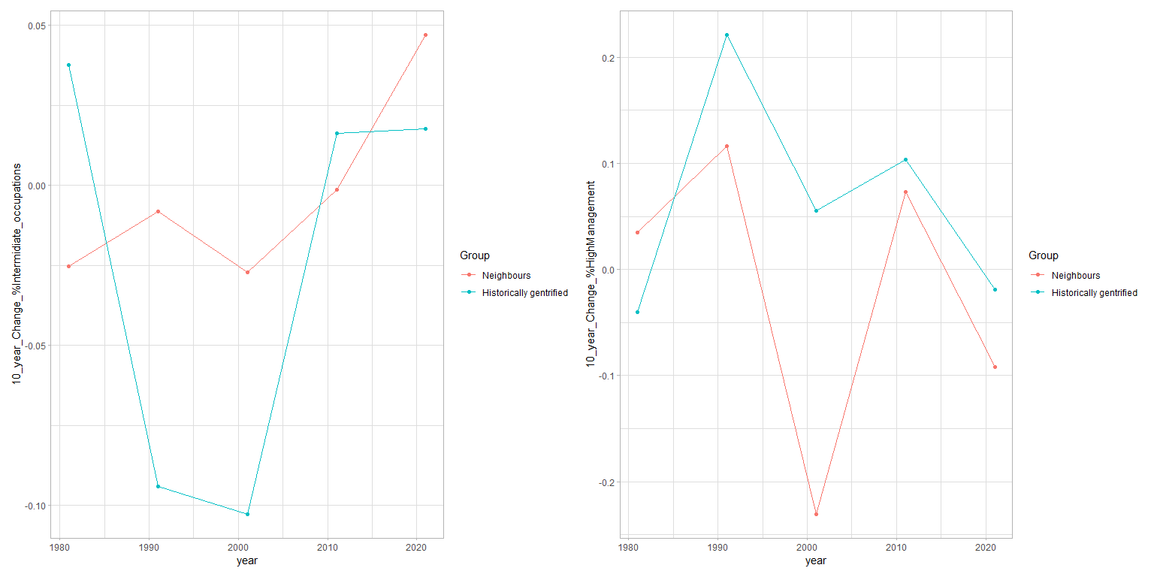

Slide 22
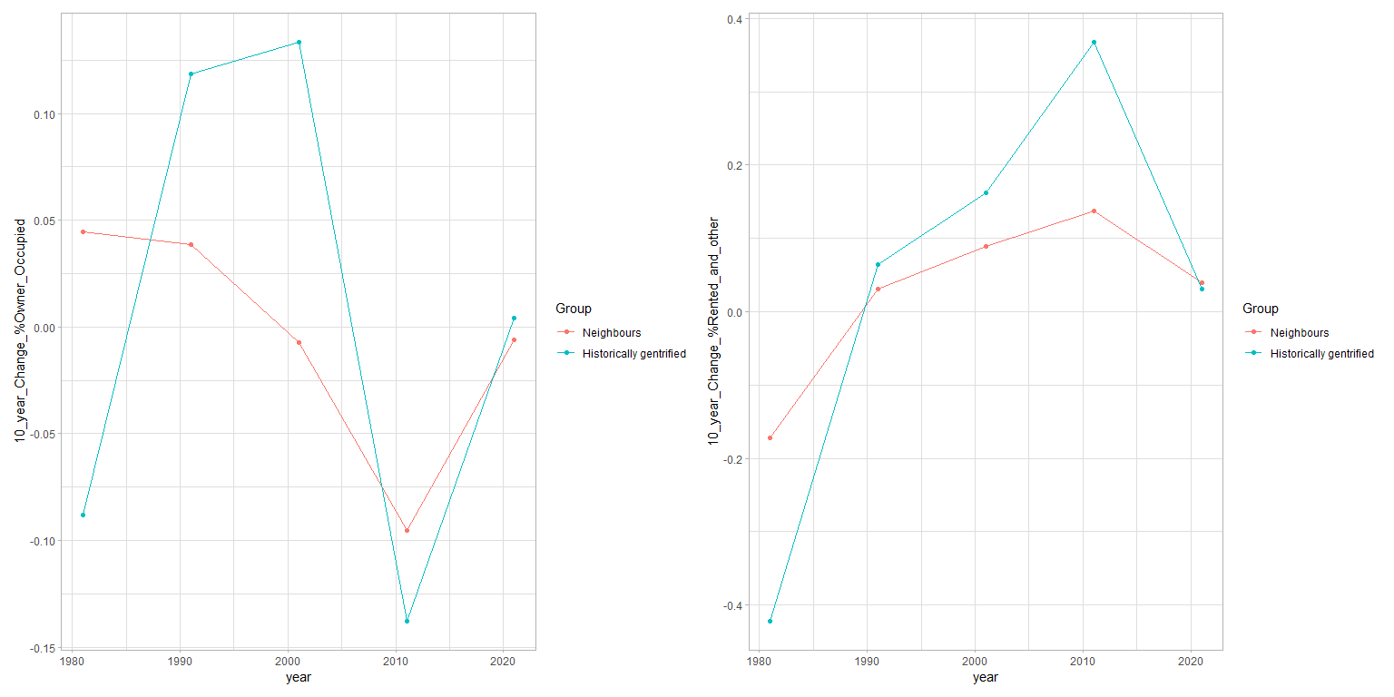

Slide 23


